Slide 1
How to Develop a Compliant Proposal
OST Bid & Proposal Academy Course
COPYRIGHT © 2024 WWW.OSTGLOBALSOLUTIONS.COM

Slide 2
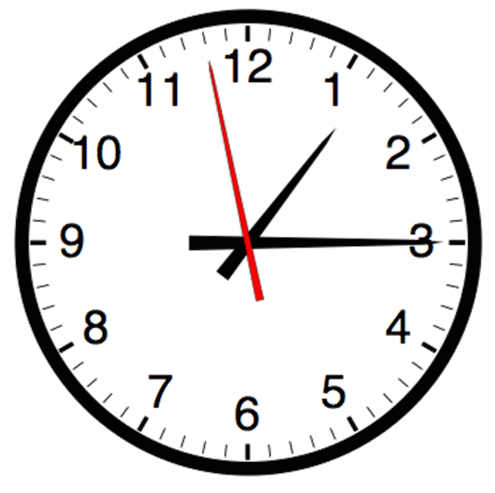
Agenda
09:00 – 10:30 AM Training
10:30 – 10:45 AM Break
10:45 AM – 12:00 PM Training
12:00 – 01:00 PM Lunch Break
01:00 PM – 02:45 PM Training
02:45 PM – 03:00 PM Break
03:00 PM – 04:00 PM Training
04:00 PM – 05:00 PM Flex
Please, give yourself the benefit of focus and limit email and use of cell phones to breaks

Slide 3
Learning Objectives
Understanding compliance Understanding how properly annotated outlines help reduce stress in proposals and get a higher score with evaluators Navigating different types of RFX structures like a professional Mastering the techniques for structuring proposal outlines correctly Setting up compliance matrixes Developing cross-reference matrixes Developing compliance checklists Allocating the page count correctly Developing effective resumes and past performance templates Setting up outlines for business and cost volumes | Creating useful annotations to guide the authors Incorporating proposal mock-up elements into the outline Incorporating section flow into the outline Reviewing and refining the outline Issuing assignments to the authors using an annotated outline Navigating through the pros and cons of working with storyboards and writers’ work packages Setting up the storyboards correctly for the writers to eliminate typical storyboard breakdowns Working with Q&A and Amendments Checking compliance at reviews Preparing a compliant proposal for submission

Slide 4

How to Maximize the Learning Process
How adults learn:
  Understand WHY things work a certain way
  Participate in exercises
  Ask questions
  Relate the material to your own experience
  Take notes
Bring up topics of interest to your job
Move around during exercises

Slide 5

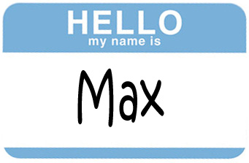
Introductions – Who is Who
Your Name, Position, Company
An interesting fact about your life
Experience with proposals
What are you looking to get out of this training?
Notes:
Start with me:

Slide 6
Module 1
How to Ensure Your Proposal Is Compliant

Slide 7

What is Compliance?
Compliance is:
  Submitting everything that the RFP requires
  Answering every requirement the way the government asked
If the proposal is non-compliant, it gets removed from consideration or gets a lower score.
Compliance goes deeper than merely catching every RFP requirement and writing a response to it - it must show responsiveness.
To be deemed compliant, your proposal response needs to be of substance.
  It cannot be “we will comply with” or “we will deliver” this and that, or merely mentioning a requirement and giving it some lip service.
  The proposal must respond to that requirement by answering at a minimum WHAT will be done, WHO will do it, and HOW it will be done, as well as WHEN and WHERE it will be done if applicable.
As a proposal professional, your proposals must be 100% compliant 100% of the time.

Slide 8
Three Types of Compliance
1. Instructional Compliance
Following the RFP Instructions to Offerors
2. Administrative Compliance
Filling Out the Required Forms and Submitting the Right Attachments and Documents.
3. Technical Compliance
Providing a Technical Solution That Meets All RFP Requirements – Otherwise Referred to as Responsiveness.

Slide 9
Compliance is Built In From the Start and is Checked Till Submission
Preparation and review of the annotated outline (Is the outline built correctly? Does it include everything needed? Are all the volumes and attachments built correctly?)
In-process reviews (Is there a “writer’s drift” and how should we adjust course? Are the writers responding completely to the requirements?)
Amendments and Q&As issuance, when changes need to be made.
Reviews:
  Pink Team (Check of outline compliance and compliance of the information that’s in the document by this point. Customer readiness level of the proposal is at 60%.)
  Red Team (Full content compliance check in addition to all the requirements being addressed. Customer readiness level of the proposal is at 90%.)
  Read-Aloud Review (did we address every requirement?)
  Gold Team (Is everything compliant in form and in substance? Customer readiness level is 99.99%)
Production (White Glove) (Did we assemble the package correctly? Did we include absolutely everything? Customer readiness level is 100%)
Final compliance check (Quadruple-check: are there all the pieces necessary for submission?)

Slide 10
Please, Complete an Assignment or Quiz for Module 1 Prior to Listening to the Next Module

Slide 11
Quiz
Which of the following is NOT a type of compliance necessary for a successful proposal?
  Instructional Compliance
  Technical Compliance
  Financial Compliance
  Administrative Compliance
True or False: A proposal that tells what you will do to show that your company will comply with the requirements is considered substantively compliant.
What is the importance of "responsiveness" in the context of technical compliance? From your observations, please, share an example of how you have seen a proposal demonstrate this characteristic or fail to do so.
Notes:
1. Correct Answer: C
2. Correct Answer: False
3. Attendees discuss or share a writeup of their observations. Responsiveness is ensuring that a proposal not only provides a response that states what you will do and that you have done it before – but also offers the details of how you will do it. It contains “substance” that satisfies the intent of the question the government asked.

Slide 12
Module 2
Overview of Outlines

Slide 13
Where Outlining Fits in the Proposal Process
OST Proposal Process:
Read RFP
Prepare for Kick-Off
Conduct Kick-Off
Develop Work Packages
Prepare Draft 1
Conduct Pink Team
Prepare Draft 2
Prepare Draft n
Conduct Red Team
Prepare Final Draft
Read Aloud
Print, Check, Deliver
Implement Post-Delivery Win Strategy
Update Lessons Learned
Annotated Outline
Assignments
Work Packages
Compliance Checklist
Style Guide
Background Materials
Briefing
Pink Team Recovery
Outline Frozen
Red Team Recovery
Decision to proceed
Award
Make Bid-No-Bid Decision
Brainstorm & Research
In-Process Review(s)
In-Process Review(s)
DTP, Edit
DTP, Edit
Conduct Gold Team
Collect Lessons Learned
Attend Debrief
Orals,
CR/DRs,
FPR
Integration Phase
Planning Phase
Writing Phase
Polishing Phase
Production
Phase
Post-Proposal
Phase

Slide 14

Outlining is the Foundation of Instructional Compliance
Proposal outlining is figuring out how to tell a compelling story within the confines of the instructional and administrative compliance.
Instead of one set of instructions, RFPs often come in multiple parts and documents with requirements sprinkled in multiple places.
You must figure out how to correlate these requirements to each other – “integrate” the proposal upfront.
It is about putting puzzle pieces together that become an integrated proposal development architecture.
  Some RFPs are highly prescriptive and outlining is straightforward and mechanical.
  Other RFPs make outlining more of an art with substantial decision making – it is not a mechanical process.
  Many RFPs are a mix of both the art and the craft.

Slide 15
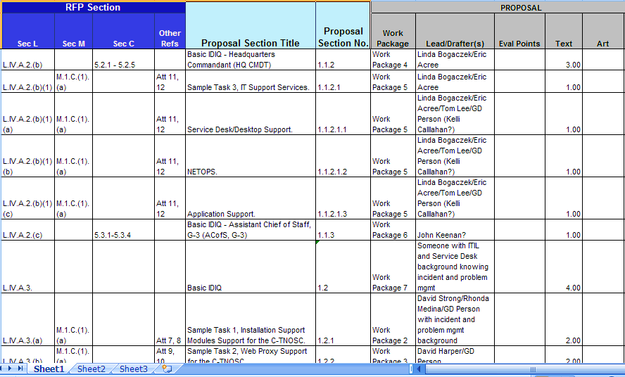
A Classical Outline Used to Organize Work and Track Compliance
Many proposal managers feel that this outline is sufficient to issue assignments to writers, but it is not the case

Slide 16
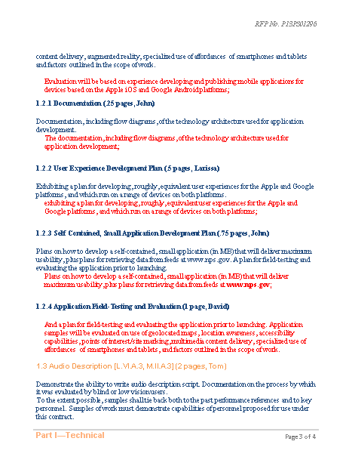
A Regular Outline with Requirements Included is a Step Up in Helpfulness
The outline with requirements, page counts, and assigned names pasted in is better than just a list of headings in a separate document
Set up in a proposal template or a blank MS Word document
Structures the proposal and serves as a “skeleton”
Provides the requirements allocated to that section to make life easier for the writer
Adds authors and page count allocations to provide additional guidance
Serves as a style sheet if developed inside the company’s proposal template
  Tip: Teach your writers to “Paste Special, Unformatted Text” into the templates to ensure clean Styles

Slide 17
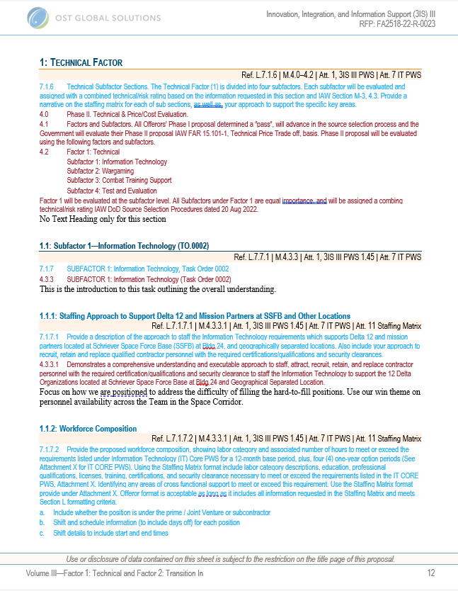
An Annotated Outline is More of a Creative Hybrid Product
While developing an annotated outline, a proposal manager truly digests and masters the RFP, removing most guesswork for the writers, creating:
  A topical outline
  RFP requirements shred/checklist
  A Cross-Reference (“Compliance”) roadmap laid out in a Word Document
  Assignments roadmap
  A proposal mockup
  Style sheet
  Storyboards with framework to think through the sections
  Conceptual framework for proposal content

Slide 18
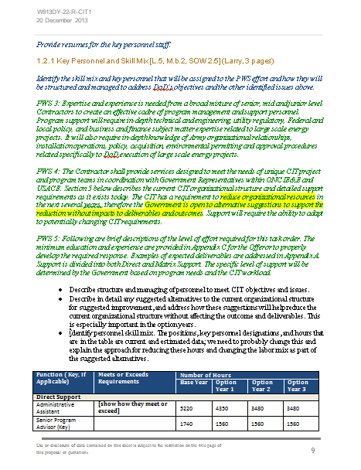
An Annotated Outline is Most Helpful to Writers
Offers a step up from the regular MS Word Outline with Requirements:
  Provides explicit instructions on how to address the requirements, with their interpretations
  Adds tables with instructions, graphics concepts, etc.
  Builds in cross-references
  May add win themes, section transitions, and already developed solution descriptions or boilerplate
  Tip: Be careful not to overwhelm inexperienced proposal writers that may have “too much” stuff in the outline – walk each person through the material, don’t trust them to figure it out on their own

Slide 19

Why Develop an Annotated Outline?
Annotated outlines help reduce stress in proposals and get a higher score with evaluators
“Integrates” the proposal upfront and reduces “writers’ drift” and compliance issues
Keeps all the requirements at a writer’s fingertips
Enables compliance tracking and reviews
Unclutters tracking of the completion status of proposal sections
Helps organize the content management process

Slide 20
An Annotated Outline is Best Paired with an Assignments/Cross Reference/Status Tracking Matrix
An MS Word annotated outline is not enough for a well-organized proposal effort – a punch list of actions for each section and visual completion status are vital to continuous situational awareness and progress tracking
Transfer your outline headings and compliance items into a table
Consider the following format for this living, constantly updated document:
Proposal Section No. | Proposal Section Title | Section L | Section M | PWS | Other | Page Limit | Author and Support | Actions to Get to “Blue” | Status
 |  |  |  |  |  |  |  |  | Not Started
 |  |  |  |  |  |  |  |  | In Progress
 |  |  |  |  |  |  |  |  | Good
 |  |  |  |  |  |  |  |  | Ready

Slide 21
Please, Complete an Assignment or Quiz for Module 2 Prior to Listening to the Next Module

Slide 22
Module 2 Quiz
What is a key benefit of using an annotated outline in the proposal development process?
  It facilitates a better understanding of the Request for Proposal (RFP), thereby minimizing the reliance on guesswork by writers.
  It is only used for formatting the final proposal document.
  It replaces the need for an initial proposal draft.
  It is used to determine the technical specifications of the product or service being proposed.
Which statement best describes the difference between a regular MS Word outline with requirements and a proper annotated outline?
  An annotated outline should not contain any win themes or graphics concepts.
  An annotated outline is less detailed and only includes the section titles.
  A regular outline with requirements does not include explicit instructions or interpretations for addressing the requirements.
  A regular outline with requirements is more comprehensive and includes win themes and boilerplate content.
What should be paired with an MS Word annotated outline to ensure a well-organized proposal effort?
  A detailed biography of each team member.
  A list of all potential competitors.
  The final draft of the proposal.
  An Assignments/Cross Reference/Status Tracking Matrix.
Notes:
Correct Answer: A
Correct Answer: C
Correct Answer: D

Slide 23
Module 3
Navigating RFPs, RFQs, and Other Solicitation Types

Slide 24
There Are Different Types of Government Solicitations
Request for proposal (RFP) for a requirements contract or an Indefinite Delivery Vehicle (IDV): traditional negotiated procurement of professional services, systems, and solutions where proposals are complex; usually includes several volumes that cover technical and management approach, past performance, and price. Price is almost always separate from technical response. These have many flavors in and of themselves, that come with different formats.
Request for quote (RFQ): a solicitation for a fixed-price, non-sealed bid contract. Often doesn’t ask for price separately from technical.
Task Order, Call Order, or Delivery Order RFPs: RFPs for a Task Order under an indefinite delivery multiple award contract that are page-limited and time-limited and are often structured similarly to one another on the same contract vehicle.
Invitation for bid (IFB): a request to submit the technical proposal, and if it is deemed acceptable, then submit a sealed, fixed-price bid. IFBs are mostly used in construction or in situations where the requirements are very clearly defined.
Request for Information, Sources Sought: Although these deliverables may not result in contract award, they require a compliant response that catches customer’s attention.

Slide 25
And More Solicitation Types
Broad Agency Announcements (BAA): R&D solicitations that describe a specific research area and request proposals from industry or academia to conduct research and development in that area.
Other Transaction Authority (OTA) or OT Solicitation: A flexible mechanism that allows specific government agencies, such as the DoD, NASA, and the Department of Homeland Security, to enter into transactions that are not contracts, grants, or cooperative agreements. Other OTA solicitation types include Request for White Papers (RWP), Request for Project Proposals (RPP), and Consortium Membership Request from a consortium between industry, academia, and non-profit members.
Commercial Solutions Openings (CSO): This relatively new type of solicitation is designed to acquire innovative commercial items, technologies, or services that directly fulfill requirements, close capability gaps, or provide potential technological advances. Used often to enter into OTAs.
Request for Solutions (RFS): Often used in government innovation units like the Defense Innovation Unit (DIU), an RFS solicits innovative solutions or prototypes to rapidly fulfill the most pressing needs of the government.
Small Business Innovation Research (SBIR) and Small Business Technology Transfer (STTR) Solicitations: These programs encourage domestic small businesses to engage in Federal Research/Research and Development (R/R&D) that has the potential for commercialization. Often referred to as government “Seed” capital.
Request for Expressions of Interest (RFEI): An RFEI is used when a procuring entity wants to gather market interest or capabilities from potential vendors, often prior to issuing a formal solicitation.

Slide 26
But Wait – There is More!
RFPs or RFQs for Single/Sole Source Justifications: Not a competitive solicitation, but a formal request for proposal to contract without a competitive process, usually due to unique capabilities or situations where only one provider can fulfill requirements.
Notice of Funding Opportunity (NOFO): This is a formal announcement by a government agency or a private foundation that funds are available for a specific program or project. NOFOs typically outline the scope of the funding program, eligibility requirements, the application process, and the criteria that will be used to evaluate submissions.
Program Announcements (PA): Used primarily by federal agencies such as the National Institutes of Health (NIH), PAs are formal statements about new or ongoing extramural activities or programs that are used to solicit applications for grant-supported research.
Funding Opportunity Announcement (FOA): A public document that announces the availability of federal funds for specific grant or cooperative agreement programs. This is the government's equivalent of a Request for Proposal (RFP) for grants and typically outlines the funding agency's expectations and requirements.
Cooperative Agreement Notice (CAN): Similar to a NOFO, a CAN is used when the government anticipates substantial involvement with the recipient during the performance of the activities funded by the award.
And more (think all the NASA-specific solicitation types, such as Announcement of Opportunity, etc.)
DON’T BE INTIMIDATED BY THE DIFFERENT SOLICITATION TYPES – THEY HAVE SIMILAR CHARACTERISTICS AND RECOGNIZABLE PARTS IMPORTANT TO OUTLINING. LEARN HOW TO FIND THOSE PARTS AND WORK WITH THEM.
NOTE THAT YOU NEED ALL THE RELEVANT DOCUMENTS AT HAND AS SOME SOLICITATIONS REFER TO DOCUMENTS NOT INCLUDED IN THE SOLICITATION BUT ARE IMPORTANT TO OUTLINING.

Slide 27
Check How the Solicitation is Set Up
Check How the RFP is Structured to Understand Where the Relevant Requirements Are Hiding
Alphabetical
  A-M with standard FAR meanings for the sections
  Other alphabetical specific to the agency (ex. GSA, VA…)
Non-alphabetical
  Numbered
  Organized into distinct sections in several separate documents, sometimes published elsewhere and not included with the solicitation
  Unnumbered (bulleted or not)
  Stream of consciousness (the most painful kind)
May even be in the HTML format in the body of the SAM announcement
May hide in Attachments or Appendices
May issue additional requirements in amendments and clarify in Question and Answer responses that are important to read to gain full understanding
May include templates and explanations for preparing the response on the agency’s website – do your research

Slide 28
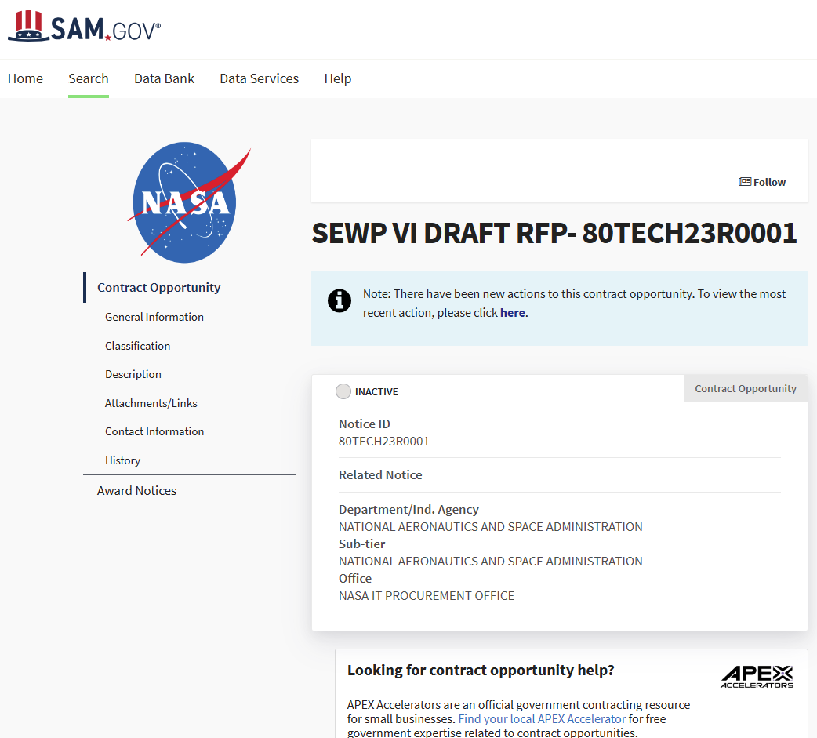
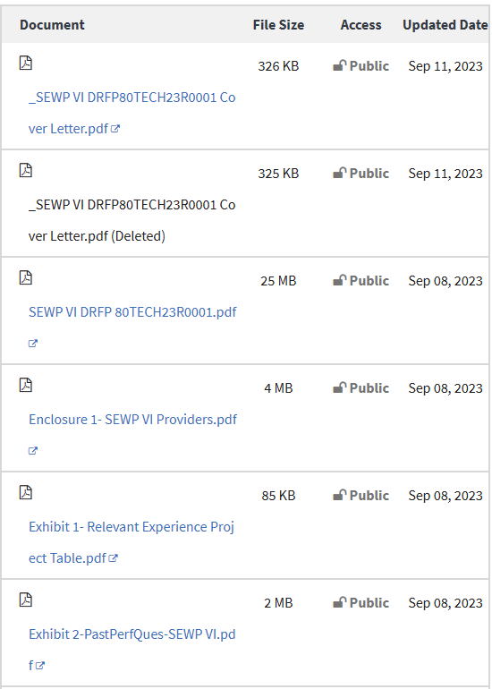
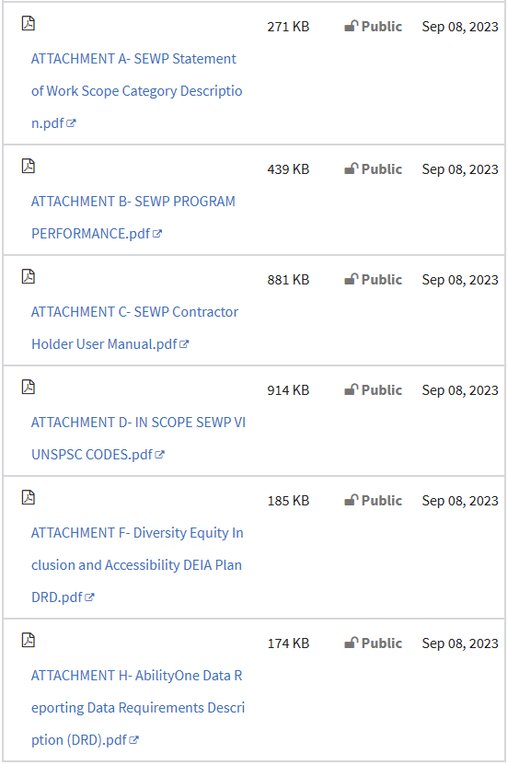
What a Solicitation Looks Like
https://sam.gov/opp/37298dea43964737b0c55d80081f5ed9/view

Slide 29

Do Not Read a Solicitation Like a Book, From Beginning to End
Reading an RFP cover-to-cover will take more time – instead, navigate to the most important parts first
Seek sections that have familiar functions:
  Instructions (A, L) – what you need to do and submit
  Evaluation Criteria (M) – how your proposal will be judged
  Statement of Work (C or J) – what work you will need to do once awarded
  Other: B (pricing), H (special contract requirements), etc. - additional information that could affect your proposal
Example: In a traditional FAR-dictated RFP, start reading with the order above first (A, L, M, C (J) or equivalents), and only then read the rest
Notes:
Different types of structures and how to navigate them successfully

Slide 30
Please, Complete an Assignment or Quiz for Module 3 Prior to Listening to the Next Module

Slide 31
Module 3 Exercise: Navigate a Classic Alphabetical RFP with Sections A-M
Walk through the RFP handout to identify each of the sections and information offered in them; Use Word file: Modules 3-13 Exercise - RFP
A – standard offer form (the form that becomes cover of the contract once countersigned by the government)
B – supplies or services and prices
C – descriptions/specifications/performance work statement (PWS)
D – packaging and marking
E – inspection and acceptance
F – deliveries or performance
G – contract administrative data
H – special contract requirements
I – contract clauses
J – attachments – a “flexible” section designation
K – representations, certifications, and other statements of offerors
L – instructions, conditions, and notices to offerors
M – evaluation criteria for award
Notes:
How to decide what sections are important for compliant outlining and what sections are part of a contractual document and therefore don’t require proposal mention

Slide 32
Module 4
Identifying RFX Requirements for Outlining

Slide 33
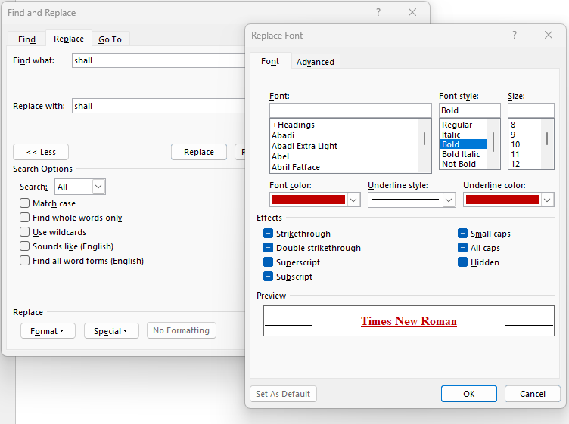
Find the Requirements Easily
Highlighting key requirement words may help draw your eye to the requirements and help highlight the difference between INFORMATION and REQUIREMENT
Look for Major
Requirement Words:
Shall
Will
Require
Change
Must
Should
Comply
Request
Submit
Remove
Include
Incorporate
Contain
Commit
Constraint
Guideline
Respond
Ensure
Not
ASAP
Notes:
Search and replace – highlight keywords (shall,

Slide 34
What Instructions Typically Include
Proposal Format and Organization:
  Structure: Clear guidance on organizing your proposal into distinct volumes or sections, such as technical, management, past performance, and price.
  Page Limits: Specific limitations on the length of each section and instructions on page formatting (margins, font type, font size).
  Tables and Figures: Directions on the inclusion of tables, figures, and appendices, and how they count towards page limits.
Content Requirements By Proposal Volume or Section – Examples of Typical Proposal Parts.
  Executive Summary: Instructions for preparing an executive summary that captures the essence of the proposal.
  Technical Approach: Detailed requirements for describing the technical solution, innovation, and compliance with the Statement of Work (SOW).
  Management Plan: Outline of the management structure, staffing plan, and quality assurance processes.
  Past Performance: Specifications for documenting relevant past projects and references.
  Cost Volume: What the customer wants in the cost/price volume.
Submission Details:
  Deadlines: Exact due dates and times for proposal submission, including any milestones for draft proposal submissions.
  Delivery Method: Instructions for electronic submission portals, email addresses, or physical mailing addresses for hard copies.
  Point of Contact: Designated agency representatives for submitting questions and clarifications, and deadline.

Slide 35
What Evaluation Criteria Typically Include
Each acquisition’s evaluation factors are unique and focus on aspects critical to that particular procurement.
All evaluation criteria and their importance must be clearly stated in the solicitation.
Evaluation Type:
  Lowest Price, Technically Acceptable (LPTA). Award will be made to the offeror whose price is lowest among all proposals that were deemed to be technically acceptable.
  Best Value/Tradeoff. The tradeoff method is used when it is in the Government’s best interest to consider award to other than lowest priced offeror, or to other than the offeror given the highest ratings for technical, management, past performance, or other non-cost/price factors. Under the tradeoff approach, the Government evaluates both cost/price and other performance factors.
Evaluation factors show key areas of importance in your proposal and are a tool to compare the proposals.
Price or cost is evaluated in all selections, with some exceptions for certain DoD, NASA, and Coast Guard contracts and multiple award contracts.
Quality is assessed via non-cost factors like past performance and technical excellence.
Past Performance is evaluated in acquisitions exceeding the simplified acquisition threshold.
A factor for assessing small business participation goals in subcontracting normally applicable to full and open contracts.
The solicitation must indicate relative importance: state if non-cost factors are more, less, or equally important as cost or price.

Slide 36
Various Scope Section Types
SOW – lists tasks and subtasks of the work scope (WHAT the contractor needs to do and sometimes the HOW – preferred methods or processes)
Performance Work Statement (PWS) – adds performance standards and metrics to the work scope; it’s up to bidder to propose the best way to meet those standards and metrics
Statement of Objectives (SOO) – lists the desired outcomes and goals but requires the bidders to create their own PWS or SOW with methods to achieve the objectives; signals need for innovations
Design Specifications – contains detailed engineering requirements that may list precise measurements, materials, and procedures
Level of Effort (LOE) – Effort-focused – specifies the amount of effort and nature of the work for R&D contracts; or lists Time & Materials – labor hours and materials required
Program Description, Project Description, Scope of Project, or Funding Opportunity Description – describes grant program and priorities, as well as impacts, research topics, or programmatic activities; lists details of available funding, budget restrictions, and cost-sharing or matching requirements

Slide 37
What Statement of Work (SOW) Typically Includes (1)
Introduction or Background:
  Describes the customer, purpose of the project and its significance.
  Provides context and sets the stage for the specific tasks.
  Serves as fodder for Introduction/Executive Summary.
Objectives:
  States the goals the project seeks to achieve.
  Provides a clear picture of the desired end state or outcomes.
  Serves as fodder for Intro sections and Exec Summary.
Scope of Work/Tasks and Subtasks:
  Outlines the breadth of work, including the tasks and subtasks to be performed.
  Details specific tasks, deliverables, and responsibilities.
  The part that’s used in outlining.
Performance Standards:
  Specifies the quality and performance metrics required.
  Provides standards for acceptable deliverables.
  Called out in the outline wherever pertinent.
Deliverables:
  Lists tangible items or services to be delivered, including reports, plans, documentation, and physical products.
  Details delivery schedules, format, and content.
  Called out in the outline wherever pertinent.
Place of Performance:
  Identifies where the work will be performed, which can be at the government's site, the contractor's facilities, or other locations.
  Taken into consideration in the approach.

Slide 38
What Statement of Work (SOW) Typically Includes (2)
Period of Performance:
  Specifies the start date, end date, and any key milestones.
  Includes deadlines for each phase of the project.
Reporting Requirements:
  Outlines the reporting structure, frequency, and content.
  Details any briefings or updates to be provided to the government.
  May be combined with deliverables.
Standards and Testing:
  Details any industry standards or testing protocols that apply to the work or deliverables.
  Describes inspection and acceptance criteria.
  Applicable only to certain types of work.
Government-Furnished Property/Information (GFP/GFI):
  Lists any property, facilities, or information provided by the government for use in the project.
  Describes the handling, use, and return of such items.
Security Requirements:
  Outlines any security clearances required and procedures for handling classified or sensitive information.
Travel and Personnel:
  Specifies requirements for travel or personnel qualifications necessary to complete the work.
Other Direct Costs:
  Identifies any other costs expected to be incurred, such as materials, communication expenses, or special equipment.

Slide 39
What Section H Typically Includes
Unique administrative, management, or legal stipulations that are not covered elsewhere in the standard contract clauses – often many of these items are already included in the scope of work.
Pertinent to Outlining a Proposal:
  Key Personnel – positions that are must-have and tough to replace that may need to be addressed in your technical/management approach and Resume section.
Pertinent to Formulating the Technical/Management Approach:
  Travel and Level of Effort – requirements for travel or level of effort that might impact your staffing, management, and pricing.
  Reporting Requirements and Security Requirements integrated into your management approach.
  Data Rights and Intellectual Property developed under the contract, influencing technical approach and collaboration strategies.
  Equipment and Property (GFE or facilities), impacting logistics and operations in the technical plan and pricing.
  Environmental and Safety standards a contractor must adhere to, which may affect the technical approach and project management plans.
  Subcontracting Restrictions or Requirements with guidance on the use of subcontractors, which must be considered in your management approach.
  Details the quality assurance measures that the contractor is expected to follow, informing the technical approach and quality management plan.

Slide 40
Additional Solicitation Items to Check
Is there any mention of any kind of documents or a resource library that presents additional knowledge about the project?
What does Section B say about the way you are supposed to present pricing and break it into Contract Line Item Numbers (CLIN), which may impact your management approach?
Always scan the attachments
  Do they offer a separate section called Contract Deliverable Requirements List (CDRL) to address where needed and include in the schedule?
  Are there forms or templates to fill out such as the past performance table(s), pricing table, resume/CV format, or certifications you are supposed to provide?
  Are there additional drawings, technical specifications, reports, or data relevant to the project?

Slide 41
Not Every “Shall” or Other Requirement is Needed for Outlining
Remember that the RFX for contracts (not grants) is mostly the contract for the future work – lots of requirements it contains are contractual specifications, terms, and conditions
Sections important to outlining:
  Everything that instructions dictate to include in the proposal
  Everything that will be evaluated
  The actual “tasks” section in the statement of work
  Specifications and standards
  Deliverables
The main goal is to address every bit of instructions and evaluation criteria
Solutions that address scope could be presented at a higher level if proposal is severely page-limited, without having to reference every item
Statement of Work sections that are only important to contract execution and would make proposal overly bureaucratic and take up valuable space
  Should be informing your approach but don’t need to appear in the text: Ex: Work hours, travel clearance, Common Access Cards, etc.
Notes:
How to decide what sections are important for compliant outlining and what sections are part of a contractual document and therefore don’t require proposal mention

Slide 42
Excellent Point from a LinkedIn Question About “Ignoring” Some Compliance Requirements
“You pose an interesting question. How many times have I been approached by a seasoned, senior executive asking if I've prepared a "compliance matrix" that's responsive to all the "shalls" in an RFP. It only takes 10 minutes with Word to parse a 200-page document for all the "shalls" to discover how futile that exercise can be in figuring out which parts are necessary in outlining.
The next step seems to involve judgment and experience to decide what the evaluators will care about and what they won't. And to make it even more subjective, throw in the Capture team's assessment of what the customer "really" wants and you end up concluding there are no tools, processes, or formulae that will deliver a winning proposal. Winning takes diligence, analysis, judgment, insight, many pairs of eyes, and perhaps a bit of luck.
I think the most likely truth is: most acquisition teams don't truly understand the process by which an RFP is turned into a proposal, and all the subtle and not-so-subtle cues proposal professionals read into RFPs can be misleading. Consequently, a formulaic approach to proposal development HAS to be tempered with judgment and customer intel.
So, yes: I ignore LOTs of "shalls" to leave space to address what we believe will be truly valued and defensibly scored.”
By Nils van den Beemt

Slide 43
Role of Section M, Evaluation Criteria
Although instructions tell you what to include in the proposal, what evaluators use to decide the winner is all-important
Make sure you clearly understand what is:
  Evaluated and counts to distinguish between winners and losers
  Not evaluated but must be included just to be compliant
This knowledge helps you make important decisions that drive:
  Page allocation
  Resource allocation
  Emphasis for persuasion purposes (win themes, visuals, use of bold font)
  The ultimate outline structure (subsections/elements that help evaluators score)
  Reviewer instructions that imitate government evaluation of your proposal

Slide 44
Please, Complete an Assignment or Quiz for Module 4 Prior to Listening to the Next Module

Slide 45
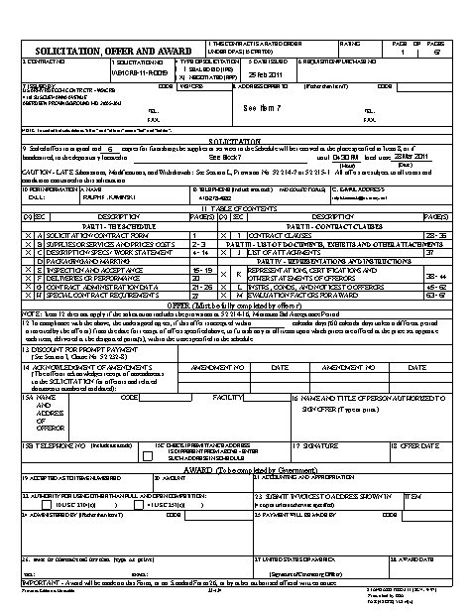
Module 4 Exercise: Identify Sections Pertinent to Outlining
Identify sections and information important to know when outlining the proposal
Identify sections that would not make it into the outline but are important to take into consideration as they inform your solution development
Identify sections and information that are important for contract execution but are not as relevant to outlining
Use the Word file: Modules 3-13 Exercise - RFP

Slide 46
Module 5
Set Up Your Proposal Template

Slide 47
Set Up Template and Styles Compliant with the RFP
Professionals set up their compliant templates from the outset, so that you can judge where you are lengthwise, and not forget about some small compliance item at submission time
Margins
Page size
Fonts for text, tables, graphics (and other sizing limitations)
Spacing between the lines and paragraphs (ex: One blank line)
Graphics and Tables captions: Make decision between Exhibit and Table/Figure
Markings on the proposal document (disclaimers, volume number, etc.)
Any restrictions (ex: no offeror’s name or logo on proposal document pages)
Color restrictions (ex: black font on white pages)
Page numbering (consecutive, by section, etc.)
Tabulation
What’s included or excluded from the page count
“Front matter”: Table of Contents, Table of Figures, Table of Tables, Acronyms, Cross-Reference Matrix, Signature, etc.
Other

Slide 48
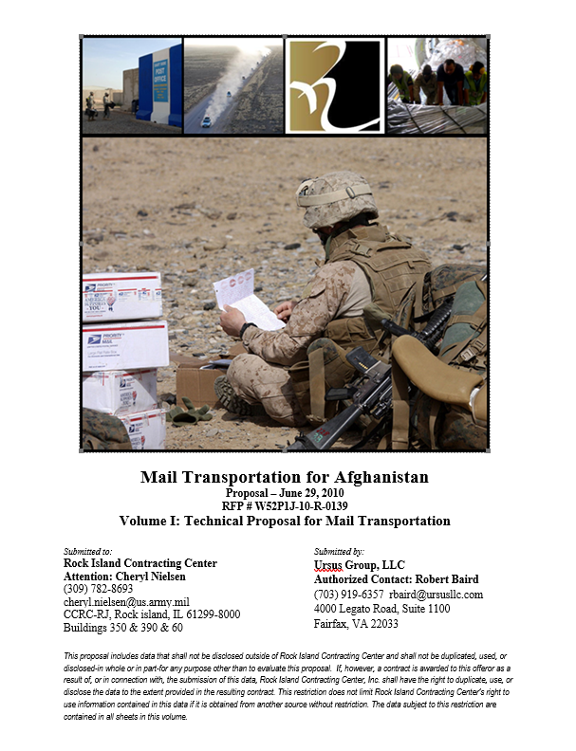
Set Up Cover and Title Page
Customer-centric image
Yours or Team’s Logo(s)
(Don’t use customer’s logo without permission)
Carefully review what must be included in the title/cover requirements, and set up the page (even if the image will be generated later)
In electronic submissions cover and title page are the usually same
In hard copy submissions, cover and title page are not always synonymous Cover goes outside the binder in hard copy submissions
  Title page goes inside the binder
  May include less information on the binder cover than title page in hard copy submissions to make it more visually attractive, as long as the title page is inside the binder
Solicitation Title (usually found at the top of the SOW)
Proposal due date (and possibly time)
Solicitation number
Volume number and title
Submitted by (company name, address, and contact name, title, and info)
Submitted to (agency, address, and contact name, title, and info)
Legal disclaimer
Other possible items: CAGE code, UEI, GSA schedule, IDIQs, small business/socioeconomic type, signature, original/copy, etc.

Slide 49
Table of Contents and Other References
Insert a section break after the cover (Layout -> Breaks -> Section Breaks -> Next Page)
Consult the solicitation – does the page count allow for inserting the table of contents, does it require specific tables, or does it specify the format and level of detail for the Table of Contents? How should the page numbering appear?
Insert a Table of Contents (References -> Table of Contents) or other reference tables (Table of Figures, Table of Tables)
Does the RFP distinguish between Figures and Tables or can you reference Exhibits (Tables and Figures together)?
Follow with the section break
See if a Glossary of Acronyms is required and add a placeholder, follow with another section break
In the Footer, adjust page number format to lower case roman numerals for the front matter and set Different First Page to ensure there is no page number on the cover sheet. Ensure the page numbers aggregate correctly.

Slide 50
Please, Complete an Assignment or Quiz for Module 5 Prior to Listening to the Next Module

Slide 51

Module 5 Exercise: Set Up Your Title Sheet and Proposal Template
Set up a compliant proposal template
Start with the cover/title sheet using the provided Word file: Module 5 Exercise – Proposal Cover and Modules 3-13 Exercise - RFP
Locate RFP customer and title that usually appears in the statement of work (also in the SAM or another opportunity listing)
Add RFP number, customer, due date, volume number, and other required information
Ensure all the compliance elements required by the RFP are present

Slide 52
Module 6
Structuring Proposal Outlines

Slide 53
Annotated Outline Development Process
Just like anything in proposals, outlining is an iterative process
Don’t stop at a top-level outline and leave figuring out the details to authors
Some of this information can be added right away, and other after brainstorming
Be ready to rearrange and tweak as your thinking matures
Proposal Manager
Creates the
Requirements-Based Outline first
The first cut takes place before brainstorming, and the second step after
Rearrange bullets within sections and streamline while minding compliance
Add your interpretation of requirements
Start with L
Add templates for tables
(Instructions)
Add must-have figure placeholders
Add in M (Evaluation
Criteria)
Add applicable win themes
Submit for in-process reviews, improve, and freeze the compliance part after Pink Team
Add C or J
Add other points of discussion if known
(Statement of Work)
Add cross
-
references between sections
Add H, CDRLs, etc.
and volumes
Add introductions and transitions

Slide 54
Focus on Telling the Story While Remaining Compliant
Outlining is more of an art than a craft
The more the RFP is open to interpretation, the more decision-making is involved
Picture the best way to present information so that it is easy to evaluate:
  It follows the instructions and the levels of importance given to each evaluation factor
  It works in SOW task information logically where it fits in the order that instructions and evaluation criteria require you to reference it, not necessarily the order in the SOW
  Section headings and inline headings are labeled with solicitation references – the evaluator doesn’t have to guess or hunt and peck to find where requirements are addressed
  The outline considers the story: it presents information from general (big picture) to specific (details), and introduces information logically so that an evaluator doesn’t have to jump around to understand the story
  It is not repetitive
  It is not over-numbered, over-partitioned, and overly bureaucratic, wasting space on items that don’t matter during the evaluation

Slide 55
Color Code Requirements As You Outline (and Include a Legend)
Requirements Journey in the Outline
Blue: Proposal Instructions (L)
Red: Evaluation Criteria (M)
Green: Statement of Work (C, J)
Purple: Performance Metrics
Brown: Deliverables
Black: Proposal Manager’s comments and instructions
Yellow highlights over the requirements are there to point out the important parts
1. Pasted into the Word document so that the writer could digest all of them together and respond.
2. Upon addressing each one thoroughly, moved into comments that attach to that section’s heading. Moving into comments helps retain requirements for compliance checks but allow for accurate page count estimation.
3. Delete after the last compliance check (around the Red Team).

Slide 56
Read Each Requirements Phrase Carefully to Understand the Intent
Note that there are several key phrases and ways to combine them to outline the section.
Each requirement may contain several key phrases – dissect each sentence carefully to catch every requirement that may appear hidden until you read closely.
Example from the practice RFP:
  L.3.1.4 The offeror shall propose their ability to provide an adequate amount of personnel with the appropriate labor mix to fulfill the requirements set forth in the SOW.
Dissect it into requirements phrases:
  L.3.1.4 The offeror shall propose their ability to provide an adequate amount of personnel with the appropriate labor mix to fulfill the requirements set forth in the SOW.
Ability to provide an adequate amount of personnel
Is this about showing them how many people should be in each labor category (presented in a table with the labor mix below)? Or is it about making sure one has proper recruiting or candidates for each slot?
Appropriate labor mix
What is the best format to present this information? Is it required anywhere else in the proposal so we could build on that format?
Fulfill the requirements set forth in the SOW
How do we ensure that we pick the right areas of the SOW or how do we allocate the whole SOW if it’s about everyone bid on the project?

Slide 57
Look for Correlated Other Requirements: Section M
M.4 Rating System, Evaluation Criteria, Standards, and Factors
M.4.1.1.1 Excellent – Proposal demonstrates a thorough understanding of requirements and an approach that exceeds the minimum performance requirements in a way significantly beneficial to the government. The offeror’s proposal demonstrates a thorough understanding of the requirements and how these requirements will be executed. The technical approach is clearly and completely described and represents a feasible approach for meeting the ManTech and Technology Transition (T2) requirements. The offeror’s proposal provides evidence of significant knowledge and expertise in ManTech and T2 support services.
M.5.2 Technical Approach
M.5.2.1 The Government will evaluate the offeror’s proposed technical approach which the offeror demonstrates ability to provide manpower support services to the Government as detailed in the SOW. Each evaluator will make an independent evaluation and assign an adjectival rating to each of the factors, based upon an integrated assessment of the individual elements. The factor rating shall be supported by narrative comments citing significant strengths, strengths, weaknesses, significant weaknesses, deficiencies, and other special considerations made by the evaluation board members
M.5.2.2 Adjectival Rating/Definition – Technical Approach
M.5.2.2.1 Excellent (E) Proposal significantly exceeds the Government’s requirements. Numerous strengths are identified which will significantly benefit the Government. No deficiencies or weaknesses are identified. The proposal represents a low risk.
M.5.2.3.1 Significant Strength: An aspect of a proposal that, when judged against a stated evaluation criteria, appreciably enhances the merit of the proposal or significantly increases the probability of successful performance of the contract.
M.4.1.2.1 Low Risk (LR) Offeror’s proposal provides essentially no doubt that the Offeror will successfully perform the required effort.

Slide 58
Adding Section M Insights
Ability to provide an adequate amount of personnel
  Understanding: What is tough about making sure one has proper recruiting or candidates for each slot? What are the critical factors in the ability to provide manpower support services to the Government as detailed in the SOW?
  Approach: ensure we show how we exceed the minimum performance requirements and significant benefits to the government
  Proof: Evidence of significant knowledge and expertise in ManTech and Technology Transition (T2) requirements (we are low risk)
Labor mix
Fulfill the requirements set forth in the SOW

Slide 59
Adding SOW Insights
Ability to provide an adequate amount of personnel to fulfill the requirements set forth in the SOW
  Understanding: What is tough about making sure one has proper recruiting or candidates for each slot? What are the critical factors in the ability to provide manpower support services to the Government as detailed in the SOW?
    Objectives (SOW 1.0): Show how your staffing objectives are in line with facilitating the RDECOM’s execution of the Army ManTech Program.
    Background Information (Section 2.0): Describe the current state of affairs versus the goals of the ManTech Program, including technology transition and technical processes – ghost the incumbent.
  Approach: ensure we show how we exceed the minimum performance requirements and significant benefits to the government
    Scope of Work (Section 3.0): Address how proper staffing will help address the tasks listed in the SOW:
    ManTech Program Support (3.1): Joint service integration (3.1.1), program execution (3.1.2), and various support tasks mentioned like the Defense Manufacturing Conference (3.1.1.2).
    Technology Transition Program Support (3.2): Support of T2 functions, including coordination, briefing materials, and interactions with Army Legal Council related to CRADAs and PLAs (3.2.1).
    Technical Process Support (3.2.3): Facilitation of HQ planning, coordination, and management of TFT/SID activities (3.2.3.1) and support of business process and policy development (3.2.3.3).
  Proof: Evidence of significant knowledge and expertise in ManTech and Technology Transition (T2) requirements (we are low risk)
Labor mix
  Estimated Work Requirements (Section 3.3): Include projections for manpower including the roles and hours estimated for the performance of the contract. Show you can meet and exceed these estimated work requirements with qualified personnel.
  Security Requirements (Section 6.0): Show that all personnel has the right security clearance levels.
Note that SOW is not here as full text; but you normally would include it; sometimes you may want to include full text in comments

Slide 60
Please, Complete an Assignment or Quiz for Module 6 Prior to Listening to the Next Module

Slide 61
Module 6 Exercise: Decide on How to Structure the Proposal Outline
Build the skeleton outline first (volumes, sections, subsections, etc…).
  Follow the instructions first.
  Then map the evaluation criteria and SOW.
  Then, decide how you will map other instructions into your outline:
    Performance Requirements
    Deliverables
    Format for staffing matrix
Debrief on how you decided to structure your outline and why.
Create a blank Word document and get the requirements from the Word file: Modules 3-13 Exercise - RFP

Slide 62
Module 7
Properly Titling and Numbering Proposal Sections

Slide 63
Proposal Level Section Flow
If the solicitation permits, go from general to specific, and from an overview to greater detail
1.0 - Overall Top Level Summary or Introduction/Overview Section
Example: Technical Solution or Management Approach Intro
1.1 – First Topic
1.1.1 - Detail*
FLOW
1.1.2 - Detail
1.2 – Second Topic
1.2.1 - Detail
1.2.2 - Detail
1.2.3 - Detail
Evaluator that doesn't have expertise in the field (usually the Contracting Officer)
Evaluator with some expertise (usually the COR/COTR, Program Manager, other evaluators that are not as familiar with the program)
Subject Matter Expert Reader (SETA contractors, etc.)

Slide 64
Naming and Numbering Your Sections
Emulate your customer’s section naming and numbering conventions as much as possible
Mimic your customer’s order, numbering system, and naming conventions
Make your proposal easy to evaluate
Follow the RFP order (no matter how logical or illogical)
Incorporate customer’s section names into yours, with adjustments for brevity
Always explicitly explain how you are deviating from the solicitation order, if you select to do so for highly compelling reasons
RFP:
L.2.5 Show capability of providing analysts who have fluency in the PWS target languages.
Proposal:
1.5 Capability of Providing Analysts with Fluency in the PWS Target Languages

Slide 65
Numbering Can Be a Bit Tricky
Yes, you can assign your own numbers to the outline, and track compliance to the solicitation numbering in brackets in each section’s heading
Don’t get carried away with numbering and over-number sections
  Too many headings detract from the story and eat up page count
Try not to go down deeper than four levels unless the solicitation leaves you no choice
  Use bold inline headings to drill down further than four levels
If there are multiple volumes with a narrative, consider starting numbering with volume numbers to give your proposal sections unique numbers – make sure it doesn’t contradict the RFP
Subdivide sections only when there are more parts than one
Volume 1 – 1.0
  Section 1.1
  Section 1.2
    Section 1.2.1
    Section 1.2.2
      Section 1.2.2.1
      Section 1.2.2.2
Volume 2 – 2.0
  Section 2.1
  Section 2.2
    Section 2.2.1
    Section 2.2.2
      Section 2.2.2.1
      Section 2.2.2.2
Volume 3 – 3.0
  Section 3.1
  Section 3.2
    Section 3.2.1
    Section 3.2.2

Slide 66
Add Compliance References to Your Sections’ Headings
Add L, M, Statement of Work
Consider adding other requirements (CDRLs, H, etc.)
May add WBS References
May track compliance at major section levels, or at subsection levels
If tracking at subsection levels, only add unique compliance items such as the Statement of Work and CDRLs
1.0 Management Approach [L.2.1, M.2.1.3, C.2.5, CDRLs A001, A002]

Slide 67
Please, Complete an Assignment or Quiz for Module 7 Prior to Listening to the Next Module

Slide 68
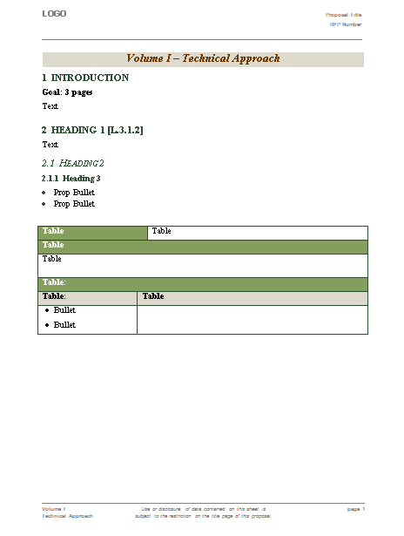
Module 7 Exercise: Transfer Your Outline to the Proposal Template and Add RFP Requirements
Use Paste Special, Unformatted Text
Assign the right heading levels to the outline using styles or format painter
Start inserting RFP text (instructions, evaluation, SOW) into the Technical Approach section
Use RFP reference information in section headings so that the evaluators can cross-reference your proposal with the RFP
  2.1.2 Personnel Recruitment Plan [SOW 3.1.2]
Add authors’ names (fictional) and page count allocations in a different color to the headings as if you were assigning the sections to writers
Build the entire outline before you begin annotations
Use the Word file: Module 7 Exercise - Proposal Template and the Modules 3-13 Exercise - RFP

Slide 69
Module 8
Understanding the Evaluation Criteria

Slide 70
Importance of Evaluation Criteria
Evaluation Criteria are the standards used to evaluate proposals.
Define what the customer values the most, guiding your areas of differentiation and strengths.
Must be clearly defined in the RFP.
Tell you what will be scored and how.
Shows you what information doesn’t contribute to evaluation scores and may get less ‘real estate’ or be extraneous.
May include additional instructions on what to include in the proposal.
Helps determine where to best allocate page count, time, and resources in the proposal process.

Slide 71
What Happens Behind the Closed Doors
Evaluators get “just-in-time training” on the evaluation process
Proposals may or may not be split into sections or volumes assigned by specialty; cost is nearly always separately evaluated per FAR
Scan the pile of proposals. An average evaluator spends 20 seconds on a page of text, 40 seconds on a graphic
Throw out the non-responsive proposals and document the decision – to cut down the evaluation process
Read the remainder of proposals more closely
Document findings in a scorecard, a form, or a freeform memo
Scrutinize the proposal; talk to other evaluators to make sure it makes sense
Decide to conduct discussions; make determination of a competitive range
Conduct pre-award debriefings, ask questions, request clarifications, discuss, ask for final offers
Recommend the decision to the SSA (if CO is not the SSA)
SSA Signs the Award Justification Memo and other activities including notifying the bidders
Evaluators keep their fingers crossed to make sure there is no protest within 10 days of award or 5 days of debrief(s)

Slide 72

What Evaluation Approach Will Your Agency Use?
Understanding the evaluation approach will help you determine the best proposal planning strategy
Best Value is the greatest overall benefit in response to the requirement, even if higher price
Best Value/Tradeoff or Lowest Price Technically Acceptable is not a black-and-white distinction
Best value is actually a continuum with “lowest price technically acceptable” process on one end and Tradeoff process on the other end
Best value is obtained through one or more source selection approaches: LPTA, Performance Price Tradeoff, or Full Tradeoff
Evaluation criteria defines which process will be used
  Always seek to influence the evaluation criteria during capture
  Read the section M (evaluation criteria) carefully during the proposal
Best value/tradeoff means that you could win as the high technical, high price; but don’t go over the budget ceiling

Slide 73
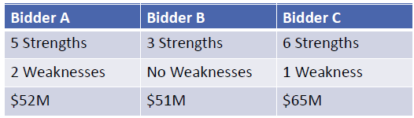
Understand the Best Value Continuum in Proposal Evaluation
FAR Parts 13-14
FAR Parts 8 and 12
LPTA where the customer reads all the proposals and it is possible to influence the perception of what’s technically acceptable; cost factors significantly more important
Full trade-off analysis between the cost and non-cost factors; non-cost factors are more important than price
Simplified and sealed bids
Best Value Continuum
LPTA where the customer only reads the lowest-priced proposal; cost factors are most important
Performance/Price Trade-off (PPT) – once the proposal is deemed technically acceptable, the customer decides between price and performance; cost and non-cost factors are equally as important

Slide 74
Typical Evaluation Factors
The more experience the evaluator has, the less important is the price factor; Technical approach, past performance, and price are the most used factors
M
Five “mandatory” evaluation factors:
  Price or cost to the Government
  Quality (can be evaluated under other factors as a proxy)
  Past performance (can be waived but is increasingly more important)
  Small disadvantaged business participation (don’t apply to SBs)
  Small business subcontracting (don’t apply to SBs)
Minimal evaluation factors:
  Acceptability of the offer (where the offeror accepts the terms, proposes adequate small disadvantaged business participation, and is eligible for the award)
  Risk
  Price (or cost+fee)
  OCI
Evaluation factors are often cut-and-pasted from old solicitations

Slide 75
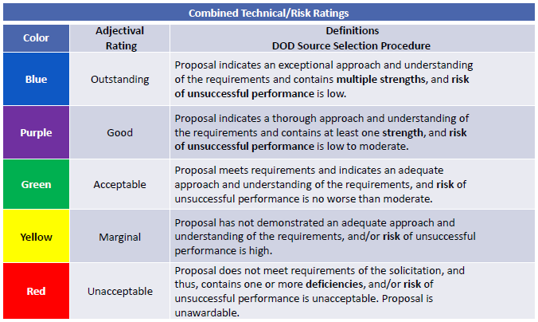
Gather Enough Strengths and Reduce Risk

Slide 76
Create a Scoring Tree to Understand the Weighting of the Evaluation Criteria
Understanding the relative importance of evaluation criteria helps allocate page count and resources
Evaluation factors:
(1) Mission Support
      Factor 1 – Technical Approach
      Factor 2 – Management
      Factor 3 – Quality Control
(2) Past Performance
(3) Price
The Mission Support factor is more important than the Past Performance factor and more important than the Price Factor
The Past Performance Factor and Price Factor are equal in importance
Under Mission Support, Factor 1 - Technical Approach, and Factor 2 - Management are of equal importance, and each of these Factors is more important than Factor 3 - Quality Control
50 pages total

Slide 77
Page Allocation – Results and Exercise
Proposal
50 pages
Check the weighting criteria
Develop a scoring tree
Adjust for reasonableness
3 references, 2 pages each
Mission Support
25 pages
Price
Past Performance
25 pages
Not in this volume’s page count
7 pages
Factor 1
Tech Approach
10 pages
Factor 2
Management
10 pages
Factor 3 Quality Control
5 pages
28 pages

Slide 78
Evaluators are Trained to Follow the RFP
Evaluation is based on the proposal alone, and NOT:
  Knowledge of your capabilities by the Government missing from your proposal
  Relationships
  Great things you have done in the past
Even if evaluators love you, you may still lose a proposal because:
  Source selection process has many checks and balances
  Process is transparent in its documentation
  Government is afraid of protests and associated “discovery”
If it is not in the RFP, even if you were told it was important, use caution when responding
If it is not in the RFP, it cannot be evaluated; the impact is purely emotional
Protest ambiguity prior to proposal submission

Slide 79
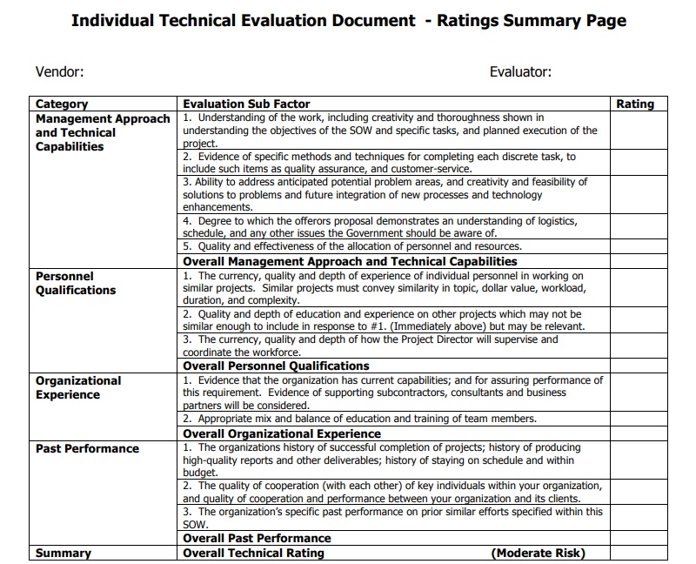
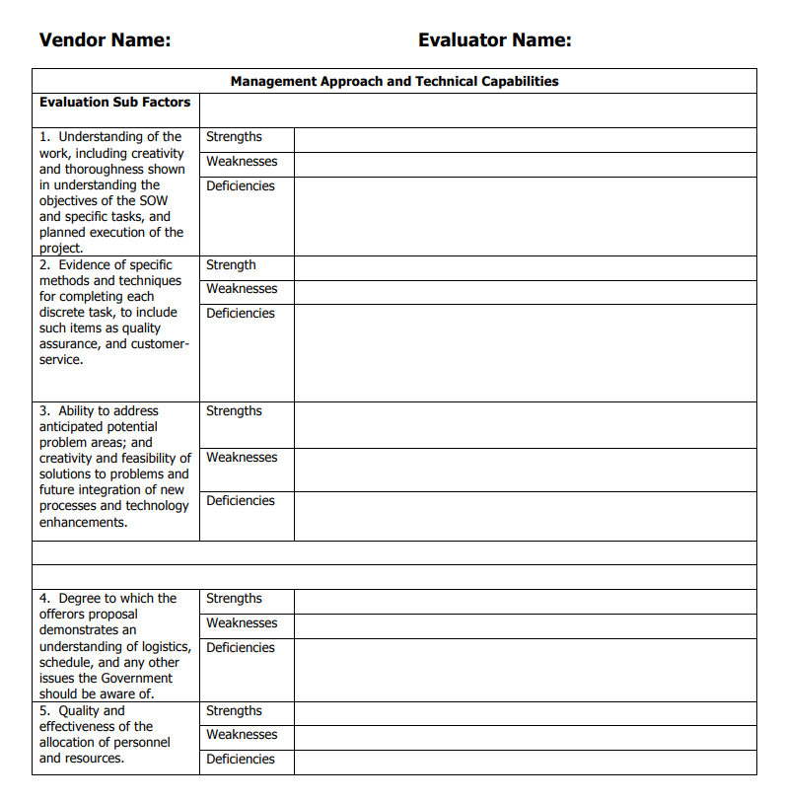
Example of Evaluator’s Scorecard

Slide 80
Please, Complete an Assignment or Quiz for Module 8 Prior to Listening to the Next Module

Slide 81
Module 8 Exercise: Create a Scoring Tree and Assign Page Counts
Create a scoring tree
Assign page counts for our practice proposal (write page count allocations in brackets in the headings of the outline you are creating)
Use section M.3.1.2 from the Word file: Modules 3-13 Exercise - RFP
M.3.1.2 The evaluation factors include (1) Technical, (2) Past Performance, (3) Cost/Price. Technical is more important than past performance which are both significantly more important than Cost/Price. Within the Technical proposal, the organization, management, and technical approach is equal in importance to the ability to provide knowledgeable personnel, and is somewhat more important than the ability to provide an adequate amount of personnel. The Government is willing to pay more if increases in, for example, technical merit of the proposal so warrants. The Cost/Price Factor may become more significant in contributing to the source selection decision if proposals are comparable.

Slide 82
Module 9
Ensuring Compliance Throughout the Proposal Development Process

Slide 83

Various Matrixes: Proposal Manager’s and Evaluator’s Helpers
Cross-Reference Matrix
Compliance Matrixes:
  By RFP Section
  By RFP Section with requirements language
Compliance Checklist

Slide 84
Cross-Reference Matrix
Prop. Section # | Section Title | L | M | C | Other | Page
1.2 | Engineering Approach | L.2.2 | M.1.a | C.3.5 | H.12 | 12
1.2.1 | Command and Control System | L.2.2 | M.1.a | C.3.5.1 | Attachment 1 | 14
Used in page-limited proposals
Sometimes required by the customer
Tracks how compliance gets addressed in proposal sections
Shows how RFP requirements “intersect”
Usually is the basis for the outline
When compliance is tracked in section headings, a Table of Contents can serve as a cross-reference matrix

Slide 85
Compliance Matrix
Section L | Proposal Section Number | Section Title | Page
L.2.2 | 1.2 | Engineering Approach | 12
L.2.2 | 1.2.1 | Command and Control System | 14
… … …
Section C | Proposal Section Number | Section Title | Page
C.3.5 | 1.2 | Engineering Approach | 12
C.3.5.1 | 1.2.1 | Command and Control System | 14
Is easier for evaluators to track compliance as it goes in the order of the RFP
Goes on for pages and is not suited for page-limited proposals
Usually is provided for instructions, evaluation criteria, and statement of work

Slide 86
Another Variation of a Compliance Matrix
Requirement Reference | Requirement Language | Proposal Section Number and Title | Proposal Page
L.3.a.1 | Offeror shall discuss the technical approach where it pertains to mail delivery. | 2.1 Technical Approach | Page 5
L.3.a.1 | Offeror's proposal shall also include the approach to security. | 2.1.1.2 Security | Page 7
Very convenient for an evaluator
May backfire if you have not been 100% thorough with compliance
  Often compliance matrixes are there to create an impression of thoroughness even if you had to fudge it in some areas

Slide 87
Compliance Checklist
Used for reviews to check compliance
Also used to shred the RFP to ensure incorporation of every requirement
 | RFP – Statement of Work |  |  | YES | NO | Outline Section No.
4.0 GENERAL | 4.1 Contractor Transition | 4.1.1 | The Contractor shall conduct phase-in procedures beginning 60 calendar days prior to the performance date specified in Section F of the contract. |  |  | 2.4.1
 |  |  | The Contractor shall submit a phase-in plan for evaluation with its proposal. |  |  | 2.4.1
 |  |  | The phase-in requires coordination with the incumbent Contractors. |  |  | 2.4.1
 |  | 4.1.2 | At least 60 calendar days prior to contract completion, the Contracting Officer (KO) and Contracting Officers Representative (COR) will notify the Contractor of all outstanding requirements that shall be completed prior to contract termination. |  |  | 2.4.1
 |  |  | The Contractor shall provide personnel with a level of knowledge, skills, abilities, and aptitude in services to support the deliverables of this contract. |  |  | 2.4.1
 |  |  | Contractor employees working under this contract shall be able to fluently speak, read, and write English. |  |  | 2.4.1

Slide 88
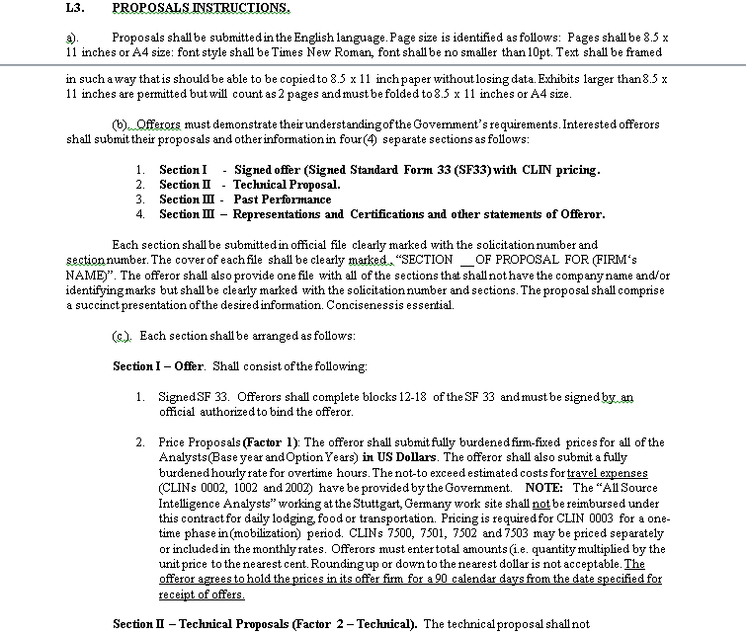
Numbering Compliance Items
[L3.(c).Sec I.1]
Track compliance to instructions, evaluation criteria, statement of work, and any other pertinent sections and attachments
In select cases, may also track your sections to WBS

Slide 89
Please, Complete an Assignment or Quiz for Module 9 Prior to Listening to the Next Module

Slide 90
Module 9 Exercise: Create the Initial Outline and Cross-Reference Matrix
This type of outline helps keep a succinct view of the structure, assignments, page allocations, compliance, and status
Transfer your logic to the Word or Excel/Smartsheets-based outline to figure out the numbering and compliance
Fill out section titles, page count allocations, and RFP section references
Proposal Section No. | Proposal Section Title | Section L | Section M | PWS | Other | Page Limit | Author and Support | Actions to Get to Blue | Status
 |  |  |  |  |  |  |  |  | Not Started
 |  |  |  |  |  |  |  |  | In Progress
 |  |  |  |  |  |  |  |  | Good
 |  |  |  |  |  |  |  |  | Ready

Slide 91
Module 10
Transforming the Topical Proposal Outline into an Annotated Outline

Slide 92
Annotated Outline Development
Be prepared to rearrange and tweak as your thinking matures
The next step in outlining is the hardest part
Don’t stop at a top-level outline and leave figuring out the details to authors
Some of this information can be added right away, and other after brainstorming
Proposal Manager
Creates the
Requirements-Based Outline first
The first cut takes place before brainstorming, and the second step after
Rearrange bullets within sections and streamline while minding compliance
Add your interpretation of requirements
Start with L
Add templates for tables
(Instructions)
Add must-have figure placeholders
Add in M (Evaluation
Criteria)
Add applicable win themes
Submit for in-process reviews, improve, and freeze the compliance part after Pink Team
Add C or J
Add other points of discussion if known
(Statement of Work)
Add cross
-
references between sections
Add H, CDRLs, etc.
and volumes
Add introductions and transitions

Slide 93
Incorporate and Infuse Section Flow
Design the proper paragraph flow for greater persuasion, to make your sections compelling by design; Use 8Ws to guide the paragraph flow
Higher level summary sections - X or X.X outline levels
Why: Customer problem, challenge, or key risk factor behind the requirement
Lower level sections for X.X.X levels and further down
What: What do we propose to do in response to the requirement?
Only if you have room: Why
Who: Who exactly is going to do this part of work, by name and title?
What, Who, and How
How: Step-by-step approach with benefits to the customer and risk mitigation
Only if you have room: When, Where and Wow
When: In what sequence we are going to do it per schedule, or when have we done it before?
Where: Indicate the location or facility, or say where we have done it before successfully
Wow: Powerful section conclusion

Slide 94
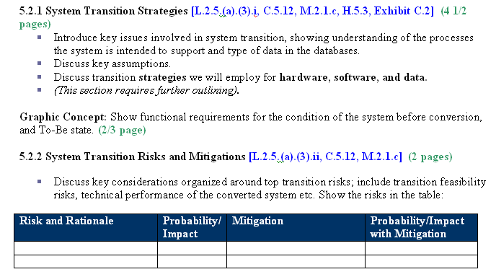
Example of Outline Annotations

Slide 95
Please, Complete an Assignment or Quiz for Module 10 Prior to Listening to the Next Module

Slide 96

Module 10 Exercise: Create Useful Annotations to Guide the Authors
Pick out all the key phrases that constitute direct requirements from the RFP
Highlight what information is the evaluator looking for?
Ask questions that will stimulate the writers
Add tables and raw graphic concepts
Add focus box placeholders and other mockup elements

Slide 97
Module 11
Developing Past Performance Template

Slide 98
Building a Past Performance Template
When developing past performance solution in advance of the RFP, use the same contracting office’s typical structure for past performance template
Present your past performance in a table
  It usually this allows for a smaller font so you can fit more information if page-limited
  At the very least, organize all the customer information in the table, with the rest as a narrative
Tailor this table exactly to what the RFP requires
If the RFP requires agency name, contract dollar amount, contract type, period of performance, Contracting Officer's name, contact information (phone, email, fax), this is exactly what the table cells should include
The next part is project summary and relevancy

Slide 99
Another Template Example
This template is more explicit in showing relevancy; and explains how and why you should describe the problems

Slide 100

Filling Out the Template
There are a few rules while filling out the template
Embed instructions to the writers to ensure consistency
Display your advantages:
  Explicit relevance above all
  Organize in accordance with the RFP requirements
  If a project is only relevant to a couple of RFP areas, don’t list all RFP areas and show "not relevant"
  Reuse this RFP’s terminology
  State explicitly why it is relevant or good: "Our experience on this project is highly relevant to this RFP because..."
Remind the writers to refer to the SOW/PWS for the past performance project

Slide 101

How to Make Your Past Performance Sizzle
Here is how you go for the gold in the past performance area and outdo your competition
Showcase:
  Technical, program management skills
  Unique capabilities, facilities, products
  Resourcefulness
  Improvements that resolved problems
Use direct quotes from award fee letters, awards, commendations, and customer emails
Include such graphics as Award Fee Improvement Curve (Award fee % over time)

Slide 102
Please, Complete an Assignment or Quiz for Module 11 Prior to Listening to the Next Module

Slide 103
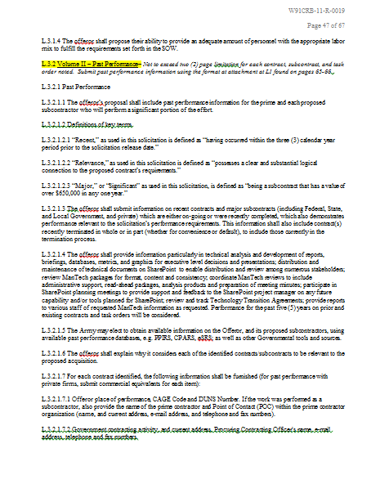
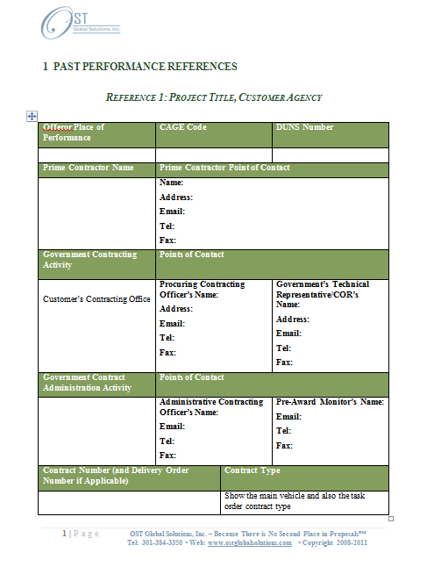
Module 11 Exercise – Develop Past Performance Template
This exercise is a tad challenging but will help you understand compliance in past performance templates
Build a Past Performance Template using the instructions in the Modules 3-13 Exercise - RFP
Use the table format in MS Word or draw by hand
Do not miss any requirements

Slide 104
Module 12
Developing Resume Templates

Slide 105
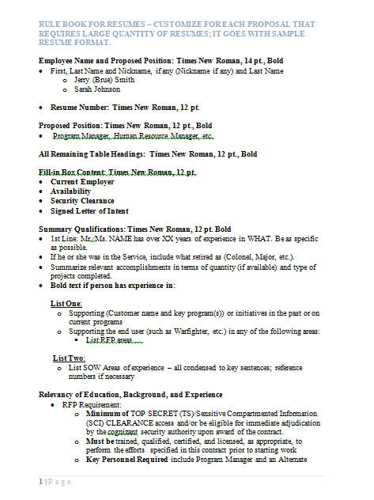
Important Resume Tips
Resumes require a level of consistency and standardization to send a message that you are trustworthy
Use requirements language in the resume – same terms as the RFP
In the Summary paragraph, highlight the areas most important to “sell” in each position
The summary paragraph is personal (Mr. Johnson has experience in…), but exclude all personal names and pronouns from the rest of text
Professional experience starts with the most recent job, with duties and quantified technical/management/cost reduction accomplishments, tied to the requirements
Tie everything to the exact position requirements and statement of work by calling those out for ease of evaluation

Slide 106
Resume Template Example

Slide 107
Resume Template with Detailed Instructions
Detailed instructions help make your resumes more consistent

Slide 108
Please, Complete an Assignment or Quiz for Module 12 Prior to Listening to the Next Module

Slide 109
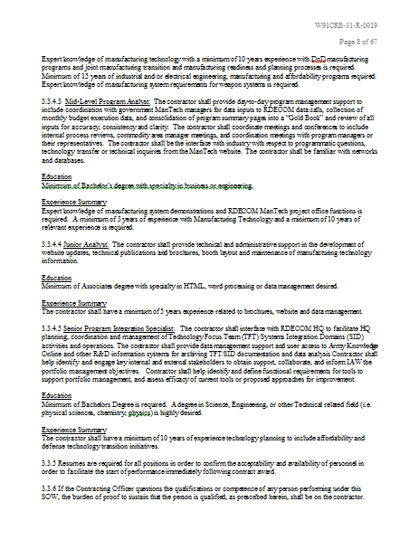
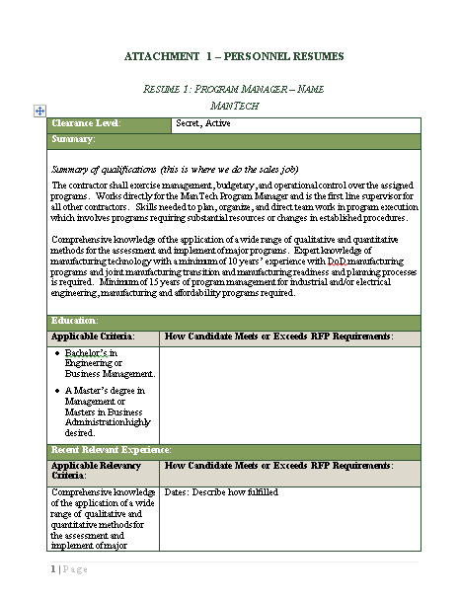
Module 12 Exercise: Design Resume Template for Your Practice Section
Design resume template for your practice section
How would you tailor the summary section?
Show compliance with all the key requirements
Don’t forget to show SOW references
Reference Word file: Module 12 - Resumes template example and Modules 3-13 Exercise - RFP

Slide 110
Module 13
Developing Cost Proposal Templates

Slide 111

Don’t Skip the Cost Proposal Outline
Often if you don’t drive the cost proposal outline development, the cost team may leave it to the end
Cutting and pasting may take you out of compliance
Ensure that you drive the process and track the cost proposal development the same as the rest of the proposal
Make sure you coordinate closely with the cost team on table set up

Slide 112
Please, Complete an Assignment or Quiz for Module 13 Prior to Listening to the Next Module

Slide 113
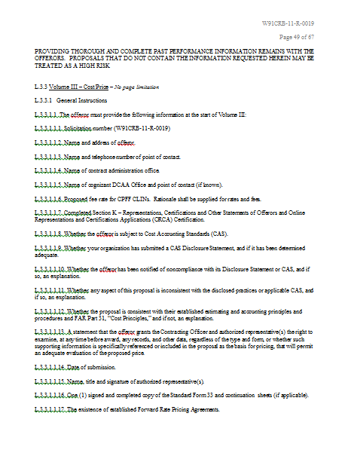
Module 13 Exercise: Set Up an Outline for the Cost/Price Volume
Go over the requirements
  Are there any requirements you find confusing?
How would you go about building a Cost/Price Volume?
Jot down a rough draft of an outline, noting where you may need guidance from your finance team

Slide 114
Module 14
Creating Proposal Storyboards and Work Packages

Slide 115
Split Annotated Outline Into Assignments
“Cut” the annotated outline into sections to allow easier document configuration control and navigation
Resave the document with a section number and author’s name in the file name
Delete the front matter and portions of the outline that don’t apply to that author
Conduct Pink Team on the multiple sections, but combine the sections into one document in time for the Red Team
This creates precise “work packages” for the authors
1.1_Executive Summary_Jenn_C
1.2_Technical Intro_and_1.2.2-1.2.4_Design_and_Construction_John_M
1.2.5_Design_Reviews_Ranita_H
2.0_Management_Intro_and_2.1-2.2_Organization_Quality_Assurance_Tariq_S

Slide 116
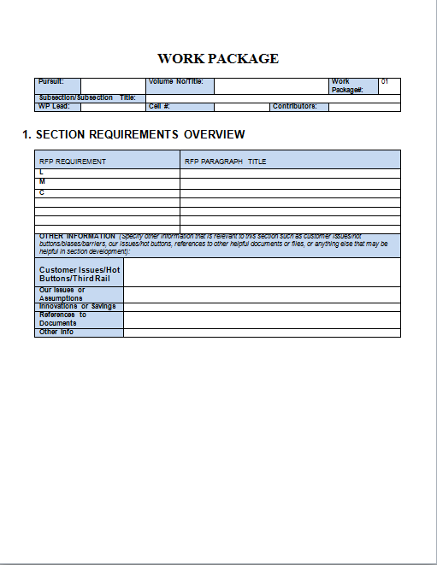
When to Use Standard Work Packages/Storyboards instead of an Annotated Outline
When the effort is large and complex, with hundreds or thousands of pages
When you don’t have enough time to create an annotated outline
When someone on the executive team loves storyboards and feels that it’s a requirement for a winning proposal

Slide 117
Traditional Storyboards Pitfalls
Most RFPs are too straight-forward and short for storyboards
Storyboards are difficult to format and work with, and they are inefficient in that you work in a separate document and then have to transfer information into the proposal
Storyboards are difficult to move information into and out of – making transition to the first draft onerous
Storyboards scare authors who are not used to the format
Storyboards put too much time and effort into documents that are typically abandoned by the authors after the Pink Team
Storyboards don’t provide good instructions and guidance on how to develop the material and what to do with that material after
  Storyboards require “win themes,” without pointing where they fit in the draft
Storyboards don’t address everything that should go into a section – an annotated outline will provide more specific instructions
Storyboards are not flexible as the information you need to collect varies

Slide 118
Standard Work Packages: Part 1
WORK PACKAGE
1. SECTION REQUIREMENTS OVERVIEW
Pursuit: |  | Volume No/Title: |  |  | Work Package#: | 01
Subsection/Subsection Title:
WP Lead: |  | Cell #: |  | Contributors:
See Module 14 – Work Package Example
RFP REQUIREMENT |  | RFP PARAGRAPH TITLE
L
M
C
OTHER INFORMATION (Specify other information that is relevant to this section such as customer issues/hot buttons/biases/barriers, our issues/hot buttons, references to other helpful documents or files, or anything else that may be helpful in section development):
Customer Issues/Hot Buttons/Third Rail
Our Issues or Assumptions
Innovations or Savings
References to Documents
Other Info

Slide 119
Standard Work Packages – Part 2

Slide 120
Standard Work Packages – Part 3

Slide 121
Standard Work Packages – Part 3 cont.

Slide 122
Standard Work Packages – Part 4

Slide 123
Please, Complete an Assignment or Quiz for Module 14 Prior to Listening to the Next Module

Slide 124

Module 14 Quiz
When is it appropriate to use storyboards (or storyboard-like standard work packages) in the proposal process?
  When the proposal effort is small and straightforward.
  When the proposal is large and complex, potentially spanning hundreds or thousands of pages.
  Only when the proposal is under ten pages.
  Whenever the proposal requires less detailed instructions.
True or False: Work packages created from the sections of the annotated outline allow authors to focus, find their sections faster, and keep easier configuration control.
Describe the impact of not having enough time to create an annotated outline on the proposal development process and the potential benefits of opting for work packages in this scenario.
Notes:
Correct Answer: B
Correct Answer: True

Slide 125
Module 15
Work With Q&A and Amendments

Slide 126
How to Work with Q&A
General rule is: if changes introduced in the Q&A are not incorporated in the conformed RFP, technically the unchanged RFP prevails
  However, many Contracting Officers have not updated the RFP
  Always ask the question if the RFP will be updated to be sure you are compliant, and check with the Government if it forgot to add the intended change to the RFP or issue a formal Amendment
Some Q&As take hours to get through
Fast navigation techniques:
  Scan through the answers instead of reading in order (Question – Answer) – often the answer is the same and speeds up the reading
  Use Search function to find relevant changes first – e.g. “font” or “past performance”
  Use AI to analyze the document
Check who may have asked a certain question and why (even though questions must be anonymized)– it may provide insight into a number of competitors, their level of preparation, and identity
Ask a follow up question if the Government misunderstood or willfully provided a vague or a non-answer to your question (even if it is past the deadline, clarifications are allowed)

Slide 127
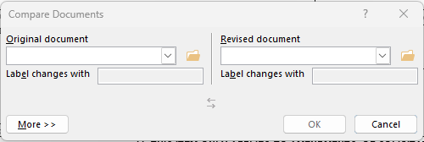
Work with an Amendment
Check the Amendment for changes right away:
  Some summarize the changes upfront
  Others may provide the redlines
  Least helpful ones provide an updated “conformed” solicitation or no solicitation and just the Q&A and Amendment that references the Q&A
If no summary or redlines are provided, create your own document comparison
  Export the solicitation from PDF into Word format, if needed
  Review -> Compare (Compare Two Versions of a Document – Legal Blackline)
After opening a redlined new document, which may be slow, uncheck Formatting redlines for ease of navigation and visibility into changes (go to Review -> Show Markup -> Formatting
Assess/summarize what changes need to be made to the proposal
Update the outline and compliance matrix
Communicate your findings to the proposal team and see if they saw something you may have missed
Browse to the previous RFP
Browse to the amended RFP

Slide 128
Please, Complete an Assignment or Quiz for Module 15 Prior to Listening to the Next Module

Slide 129
Module 15 Quiz
What should you do if you notice that changes mentioned in the Q&A are not reflected in the updated RFP?
  Assume the Q&A is correct and ignore the unmodified RFP.
  Incorporate the changes Q&A introduced and ask if the RFP will be conformed to incorporate the changes via a formal Amendment.
  Incorporate the changes Q&A introduced and wait for other competitors to ask for clarification.
  Proceed with the original RFP as is, without considering the Q&A, until and if an Amendment is issued.
If the government provides a vague or non-answer to a question, what is the suggested course of action?
  Accept the vague answer and proceed without further action or changes.
  Use the broader team and AI to read into the Government’s intent and interpret the answer.
  Ask a follow-up question for clarification, even if the original Q&A deadline has passed and a new one was not set.
  Try to guess the government's intention and proceed accordingly.
If an amendment does not provide a summary of changes or redlines, what is a recommended next step?
  Guess the changes based on the most recent Q&A and highlight each one manually.
  Ignore the amendment if it does not have a summary.
  Ask for another amendment that includes the summary of changes or redlines.
  Create your own document comparison to identify changes.
Notes:
Correct Answer: B
Correct Answer: C
Correct Answer: D

Slide 130
Module 16
Checking Compliance During Reviews

Slide 131
Checking for Instructional Compliance (1)
Double-check – is the company qualified to bid in the business size standard, business type, and NAICS codes, past performance, key personnel, possession of certain certifications, and other RFP requirements that limit the types of bidders that could bid.
Start with looking at the proposal table of contents. Check if all the sections that are supposed to be there, are there per the proposal instructions (Section L) – same order, titling, numbering, etc. Did the authors introduce sections that are extraneous and are not supposed to be in the outline? The proposal may need restructuring at an outline level.
Review evaluation criteria (Section M), and make sure that you can match evaluation factors to proposal sections where they apply. Specifically, identify Section M information that contains instructions or requirements not previously mentioned in proposal instructions (Section L) and check if those are included in the outline and/or are clearly referenced content.
Check if Section C (SOW/Performance Work Statement (PWS)) requirements are added and mapped back to the RFP where they logically should occur.
Review all other RFP sections for information that must be included.
Check compliance with the formatting requirements such as page count, margins, font size/family, shrunken graphics, information required on the title page, front matter, appendixes/placeholders, text in header/footer, proposal due date if there was an extension, etc.

Slide 132
Checking for Instructional Compliance (2)
Do word searches in the proposal and each section to ensure you didn’t miss the compliance words.
Pay attention to “buried” requirements. The government sometimes require a supporting piece of evidence and point to a subdocument that you must fill out, such as a past performance questionnaire, or a Transition Plan, or a Program Management Plan, or an Attachment providing additional detail. That document may not be listed in RFP instructions that often have a table with a list of all the documents to submit, or as a separate item in the submission requirements summary.
Flag obscure attachment requests that don’t make sense so our brains tend to dismiss them. For example, “include this attachment in PDF and Word formats” – and it’s signed teaming agreements.
Put the requirement in the text comment bubble to show what’s missing and what’s supposed to be addressed.
Indicate in your comments if there are redundancies and unnecessary duplication of information.

Slide 133
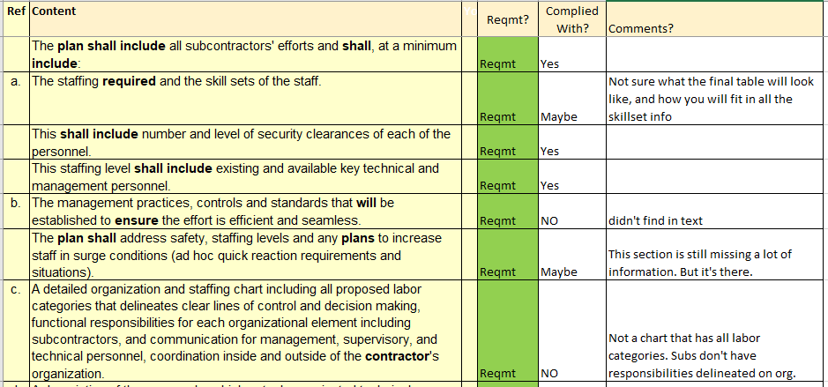
Reviewer Feedback and Compliance Check: Pink
At Pink Team, the compliance is somewhat relative because some information may be still missing: Yes, No, Maybe, So-So

Slide 134
Evaluating Technical Compliance is the Toughest
Dive deeper into the proposal content to judge technical compliance at a level of “responsiveness” to ensure the proposal doesn’t simply regurgitate the RFP
For example, if per the instructions, the big three narrative elements for management and operations are:
  Understanding of the Requirements
  Approach/Methodologies
  Demonstrated Capability
Your first test is – did the section include all three? Then, move in deeper.
  In the Understanding of the Requirement discussion, did the proposal highlight customer knowledge, focus on customer’s pain points and weaknesses, and convincingly articulate their vision for their mission?
  In the Approach/Methodologies, did the section answer everything that’s required in the RFP instructions (Section L) in enough detail?
Walk through the RFP requirements in the SOW/PWS and check if the technical solution meets all SOW/PWS elements and it goes beyond WHAT will be done. Review the proposal and ensure it answered the other “W” questions? Why, Who, How, When, Where, and Wow?
In the HOW, did the section specifically discuss what processes and tools will be used, and any innovative processes or technologies that benefit the customer?
Did the proposal use the RFP language? If not, and the narrative is unconvincing, it is probably not responsive.
Where it comes to Demonstrated Capability, did the proposal show how the company successfully applied their approach on similar past projects? To what good results? Is the success quantifiable in hard statistics? Are customer satisfaction ratings or Excellent CPARS touted? Are customer kudos cited? Are there other quantified statistics, or is that discussion missing?

Slide 135
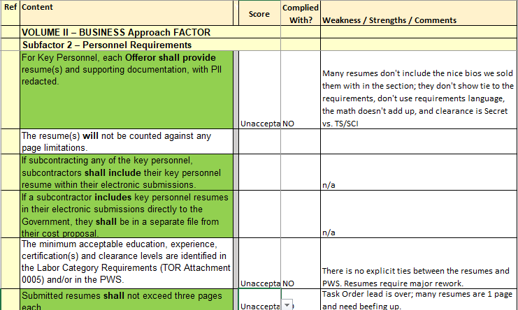
Reviewer Feedback and Compliance Check: Red
At Red Team, the compliance is absolute: Yes or No

Slide 136
Check for Administrative Compliance
Administrative Compliance Check may happen before the Gold team or at Production/White Glove and Final Compliance Check.
Are all the forms and attachments/appendices included, with original/copy signatures?
Is everything filled out correctly?
Review Representations and Certifications (Section K) requirements and fill-ins or substituted SAM compliance statement if allowed.
Were all the amendments that were issued referenced in the proposal? Are they all acknowledged in the way that the RFP requires (via signed copies, SF 1449 form, and/or text response)?
Check the requirements for Cover or Transmittal Letter and ensure it contains the right information and is signed.
Check all Section J Attachments and ensure that all required forms such as DD-254 are completed/signed.
Make sure the files are the right type and size and are named per the RFP instructions, and open.
Make sure original is there and copies are numbered correctly on proposal cover pages in a physical submission.
Manually count to double-check that page counts aggregate correctly.

Slide 137
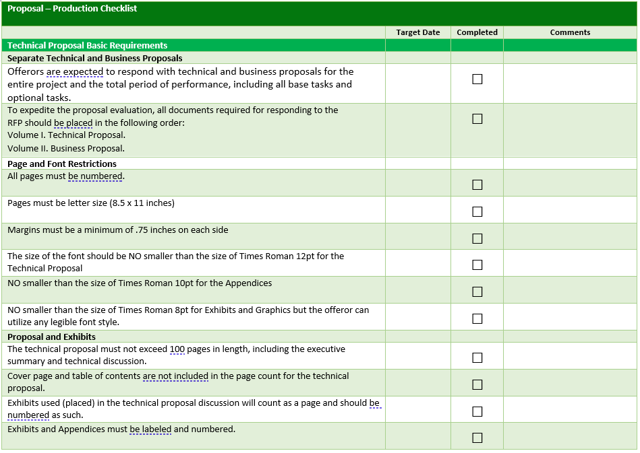
Final Compliance Check
Always run a compliance check prior to proposal submission
Create a submission checklist ahead of time to prevent missing an item that was required
Run a punch list until the end to ensure you took care of all proposal-related action items
“Quadruple-check” to check again after you feel that it is completely unnecessary and you feel stupid for checking
See Word file: Module 16 - Proposal_Production Checklist Example

Slide 138
Please, Complete an Assignment or Quiz for Module 16 Prior to Listening to the Next Module

Slide 139
Module 16 Quiz
Fill in the Blank:
  Checking for ________ compliance often involves ensuring that the proposal does not simply repeat RFP language but provides a substantive response.
  During the final compliance check, it is important to create a ________ checklist to ensure nothing is missed before submission.
True or False? Administrative compliance checks should only be conducted during the Pink Team review phase.
What is the result of not addressing 'buried' requirements in a proposal?
  The proposal may be seen as more innovative.
  The proposal may be disqualified for non-compliance.
  The proposal will likely receive extra points for brevity.
  The proposal will automatically pass to the final round of evaluations.
What is the purpose of the "quadruple-check" mentioned in the Final Compliance Check?
Notes:
1. a) [Technical]
b) [Submission]
False.
Correct Answer: B
Check again after you feel it is unnecessary and you feel stupid for checking.

Slide 140
Recap
?
What are the three types of proposal compliance?
What is the order of developing a proposal outline?
What is the difference between compliance matrix, cross-reference matrix, and compliance checklist?
What are the pros and cons of annotated outlines versus standardized work packages or storyboards?
What is your biggest takeaway from this class?

Slide 141



Contact Us!
7361 Calhoun Place, Suite 560
Rockville, MD 20855
Phone: 301-384-3350
service@ostglobalsolutions.com
Improving Our Country Through Better Proposals!™
www.ostglobalsolutions.com
Copyright © 2024 OST Global Solutions, Inc. All rights reserved. This material may not be reproduced, distributed, transmitted, or used for any commercial purpose without the express written permission of OST Global Solutions, Inc.

