Slide 1
Proposal Graphics
Conceptualization & design
(Including Ai)

Slide 2

Agenda
09:00 – 10:30 – Training
10:30 – 10:45 – Break
10:45 – 12:00 – Training
12:00 – 13:00 – Lunch
13:00 – 15:00 – Training
15:00 – 15:15 – Break
15:15 – 17:00 – Training
Please, give yourself the benefit of focus and limit the use
of cell phones and email to breaks.

Slide 3
Learning Objectives
Upon completing this course, you will have learned…
How to choose the right type of visual to represent your information
How to plan space for graphics and visuals in the proposal document
Allocate resources for graphic conceptualization, creation, and rendering
Conceptualize graphics and customer-centric representations of your solution
Use basic design principles to create attractive graphics
Find and use graphic templates and stock art
Develop powerful action captions to increase persuasiveness
Create large, graphic-intensive proposal elements such as covers and spines
Edit graphics to ensure a professional finish
Export graphics for final production

Slide 4

How to Maximize the Learning Process
How adults learn:
Understand WHY things work a certain way
Participate in exercises
Ask questions
Relate material to your experience
Take notes
Bring up topics of interest specific to your job
Move around during exercises

Slide 5
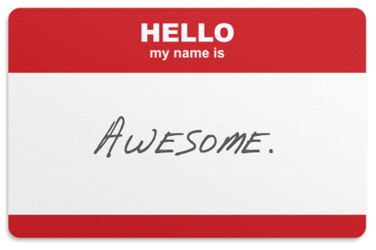
Introductions
Who’s Who?
1. Your name and position
2. An interesting fact about your life or career
3. What are you looking to get out of this training?

Slide 6
Setting the stage for proposal graphics
Module 1

Slide 7

Design Matters
VISUALS PREVAIL OVER TEXT
Rex is a kid-friendly dog. Come closer and pet him.

Slide 8
Design Matters
The impact of text is lower no matter what the font size is
Text
This is a closed plane curve, every point of which is equidistant from a fixed point within a curve.
Visual

Slide 9

Can you imagine modern sales and marketing without visuals?
…Yet, we try to win multimillion-dollar proposals (mega-sales) without visuals
Notes:
Mention the ridicule the graphics got from the recent scandal/leak

Slide 10
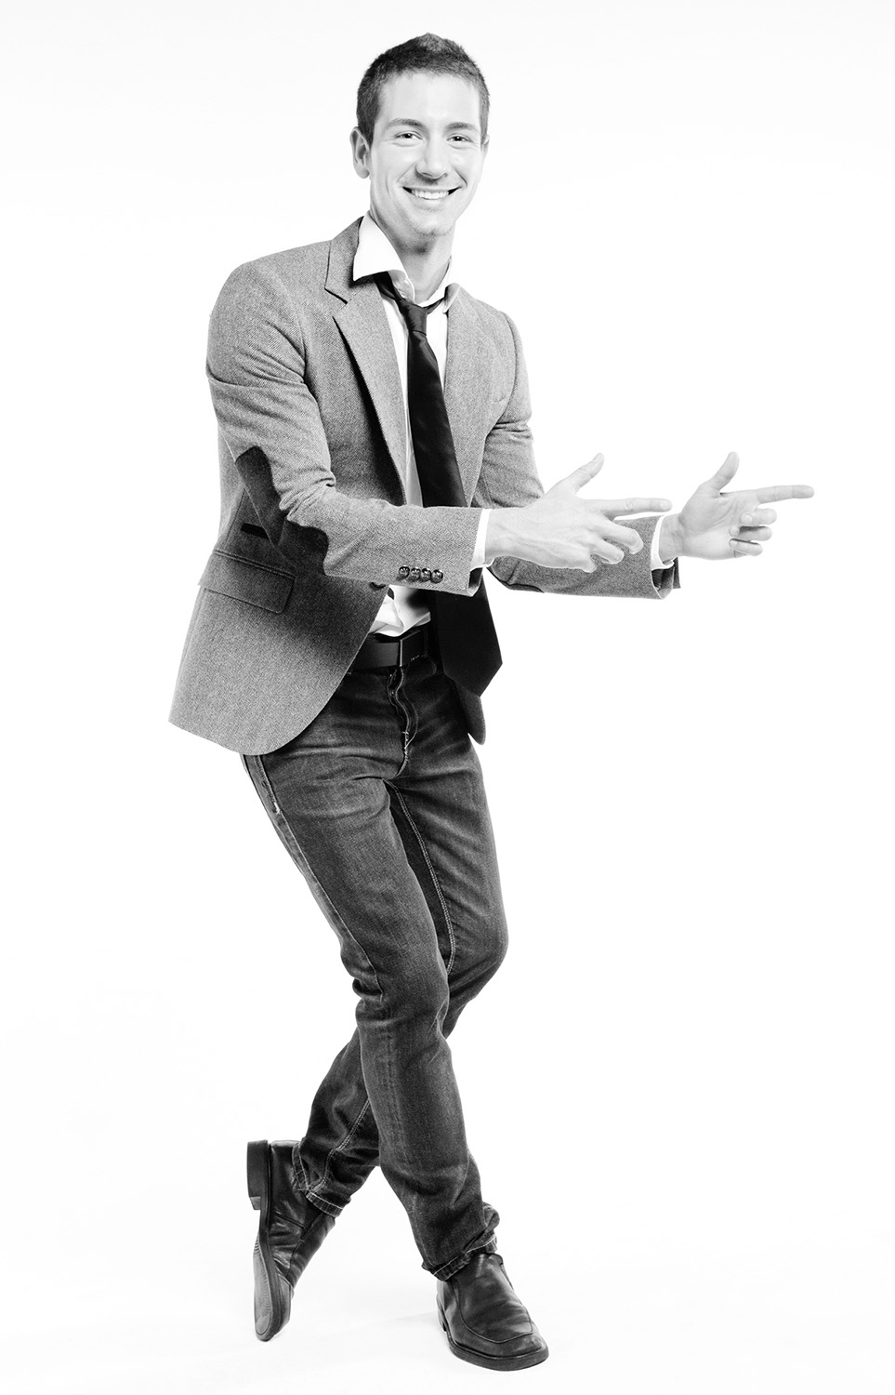
Successful Proposal Graphic Designer
What are they made of?
Has high degree of artistic ability (talent)
Stays current with design trends
Advanced skills with industry-standard design software tools
Has working knowledge of proposal production processes and specifics:
  RFP formatting requirements
  Page count restrictions and impact on graphic sizing
  Accelerated production timeline and deadlines
Dives into the actual proposal content; speaks up proactively, and impacts solution in positive ways
Conceptualizes graphics based on vague and complex information
Able to spell, cut-and-paste properly, and
use spell-check religiously!
Responsible, fast, has a great work ethic
Is fast, accurate, and has sharp attention to detail!
Is thick-skinned, collaborates, works well with others
Requires little or no sleep

Slide 11
Graphic Artists Start During Capture
1. Customer Engagement
6. Solution Development
2. Intelligence Gathering
GRAPHICS
Create color palette for
proposal template
  Based on customer’s brand
  Based on company’s marketing
Help SMEs brainstorm concepts for proposal graphics (usually whiteboard drawings)
5. Teaming
3. Win Strategy
4. Competitive Analysis
Capture Process

Slide 12
… and Continue Throughout the Proposal Process
Read RFP
Prepare for Kick-Off
Kick-Off
Develop Work Packages
Prepare Draft 1
Conduct Pink Team
Prepare Draft 2
Prepare Draft n
Conduct Red Team
Prepare Final Draft
Read-Out-Loud
Print, Check, Deliver
Implement Post-Delivery Win Strategy
Update Lessons Learned
Annotated Outline
Assignments
Work Packages
Compliance Checklist
Style Guide
Background Materials
Briefing
Pink Team Recovery
Outline Frozen
Red Team Recovery
Decision to proceed
Award
Make Bid-No-Bid Decision
Brainstorm & Research
In-Process Review(s)
DTP, Edit
Collect Lessons Learned
Attend Debrief
In-Process Review(s)
DTP, Edit
Conduct Gold Team
Orals
Integration Phase
Planning Phase
Writing Phase
Polishing Phase
Production
Phase
Post-Proposal
Phase
Archive graphics for future use

Slide 13
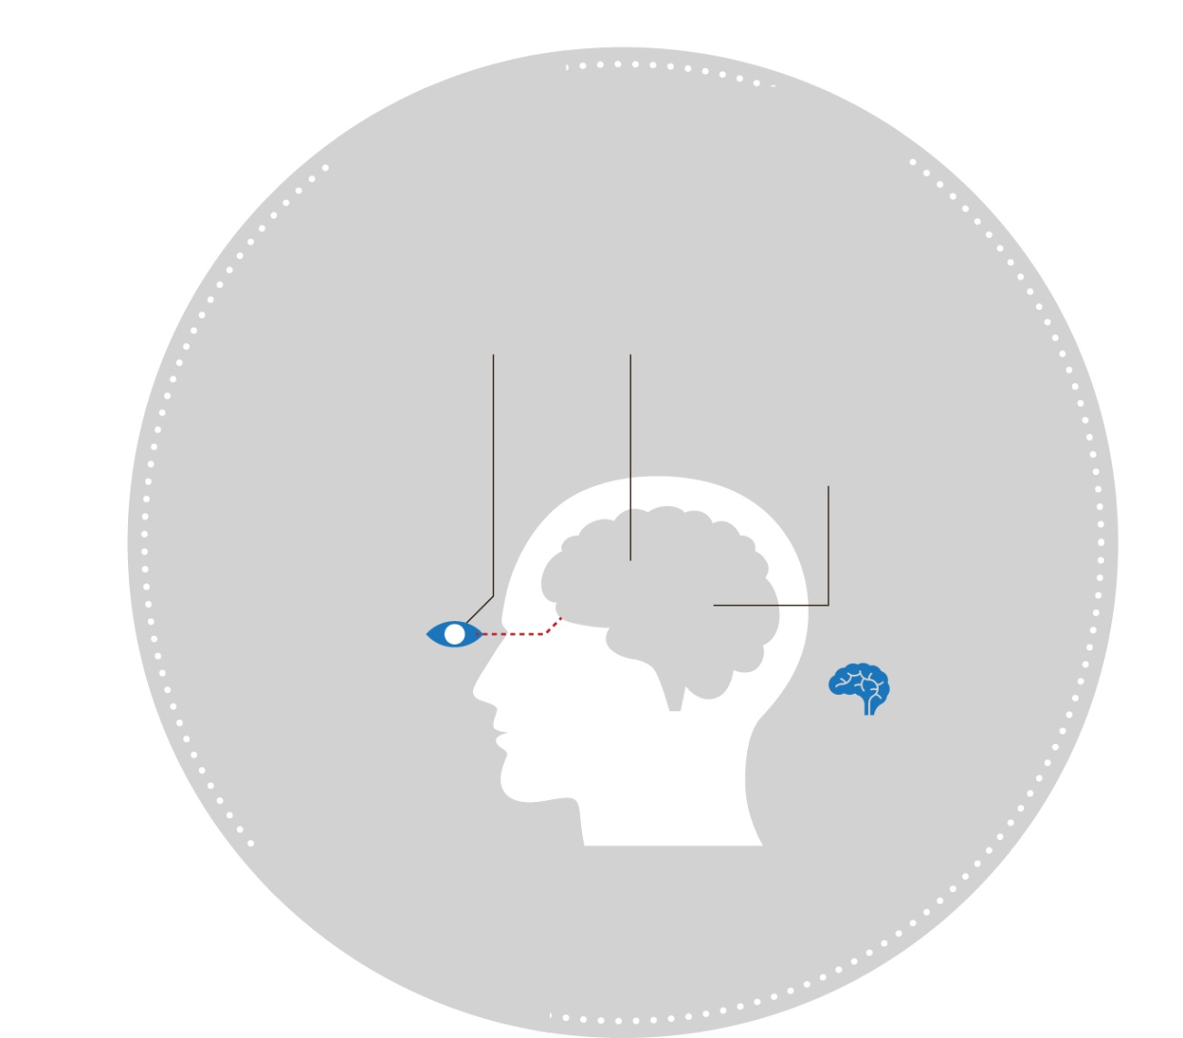
Graphic Designer’s Contribution to Proposal
directly impact proposal persuasion and win probability
HUMANS ARE
VISUAL
CREATURES
Significant competitive advantage
Level of professionalism
Increased perception of value
More prominent win themes
An easier proposal to skim-read
Faster to review and comprehend proposal, showing respect for evaluators’ time
Proposal evaluators are human.
90%
of information transmitted
to the brain is visual
10 MILLION
BITS PER SECOND
The rate in which the human retina transmits data to the brain or the speed of an Ethernet connection
1/2
% of brain dedicated
to visual function
Approximately
65% of people are
visual learners
Our brain processes
visual information
60,000 times faster
than text
Remember…
Most people only remember
20% of what they read

Slide 14
Module 1 Quiz
The slide titled "Design Matters" demonstrates the importance of visuals using the image of a dog. What is the primary message this slide conveys?
  Aggressive dogs are not dangerous
  Text descriptions prevail over the visuals
  Text can be misleading if it doesn’t match the visuals
  Visuals prevail over text because they speak to the “old brain”
Fill the blank: Trying to win multimillion-dollar proposals with limited or plain graphics is like trying to imagine modern sales and marketing without ___________.
Most people remember 80% of what they read.
  True
  False
Notes:
Correct answers:
The slide titled "Design Matters" demonstrates the importance of visuals using the image of a dog. What is the primary message this slide conveys?
Correct Answer: d) Visuals prevail over text because they speak to the "old brain."
Explanation: The slide titled "Design Matters" emphasizes that visuals have a stronger impact than text. The image of the dog serves as an example, illustrating how visuals can convey messages more effectively than words. This idea is supported by the concept that visuals connect with the "old brain" (the part of the brain that processes information quickly and emotionally), which is why visuals tend to have a more immediate and powerful effect compared to text.
Fill in the blank: Trying to win multimillion-dollar proposals with limited or plain graphics is like trying to imagine modern sales and marketing without ___________.
Correct Answer: Visuals
Explanation: The course material highlights the crucial role that visuals play in both modern sales and marketing, as well as in proposal development. Just as modern sales and marketing rely heavily on visuals to attract and engage customers, winning multimillion-dollar proposals requires effective and compelling graphics. The comparison underscores the importance of visuals in making a strong and persuasive case in proposals.
Most people remember 80% of what they read.
Correct Answer: b) False
Explanation: The statement is false because most people only remember 20% of what they read. The human brain processes visual information much more efficiently, which is why visuals are emphasized in proposals. The material explicitly states that 90% of the information transmitted to the brain is visual, and the brain processes visual information 60,000 times faster than text, making visuals a more effective way to communicate and retain information.

Slide 15
Proposal graphics definition
Module 2

Slide 16

      SO,
      What are proposal
      graphics anyway?

Slide 17

Proposal Graphics Are a Form of Information Design
Making complex ideas easy to grasp for an evaluator
Information Design is…
Information design focuses on:
  Accurate representation of specific subject matter
  WHAT ARE YOU TRYING TO SAY?
  Unique needs of the customer receiving that subject matter
  WHAT ARE THEY SEEKING TO KNOW?
DEFINING
PLANNING
SHAPING
Message to the customers, persuading them
to award you the contract

Slide 18
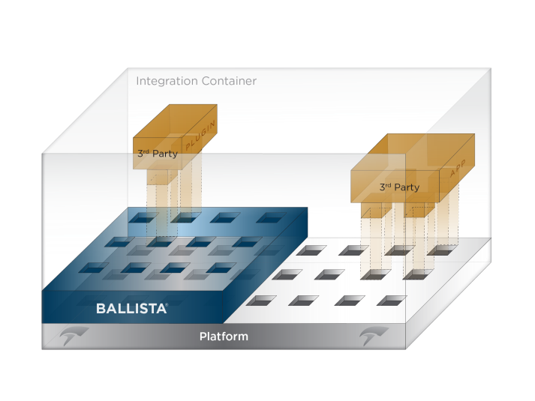
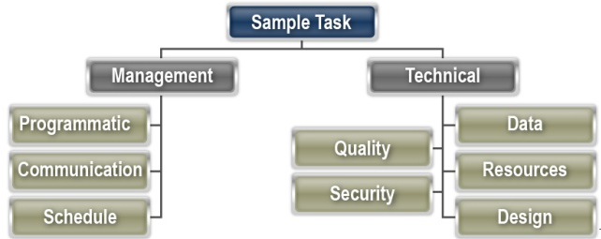
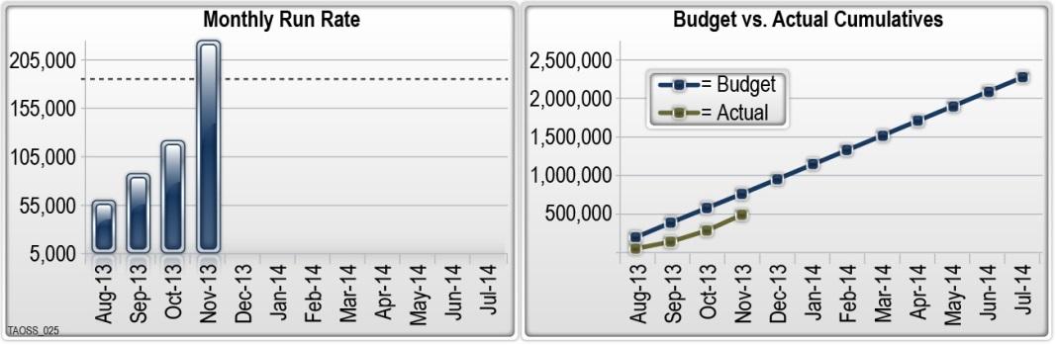
Types of Proposal Visuals
Proposal visuals break up the monotony of text and convey data more efficiently
  Covers, spines, medial labels and other packaging design
  Timelines, timetables, schedules, and calendars
  Charts and graphs (org charts, processes)
  Diagrams and schematics (network architecture, interfaces)
  Technical illustrations
  3-D models and computer simulations
  Exhibitions and environments (OV1, CONOPS)
  Screenshots
  Icons, symbols, and logos
  Maps
  Tables
  Callout and focus boxes

Slide 19
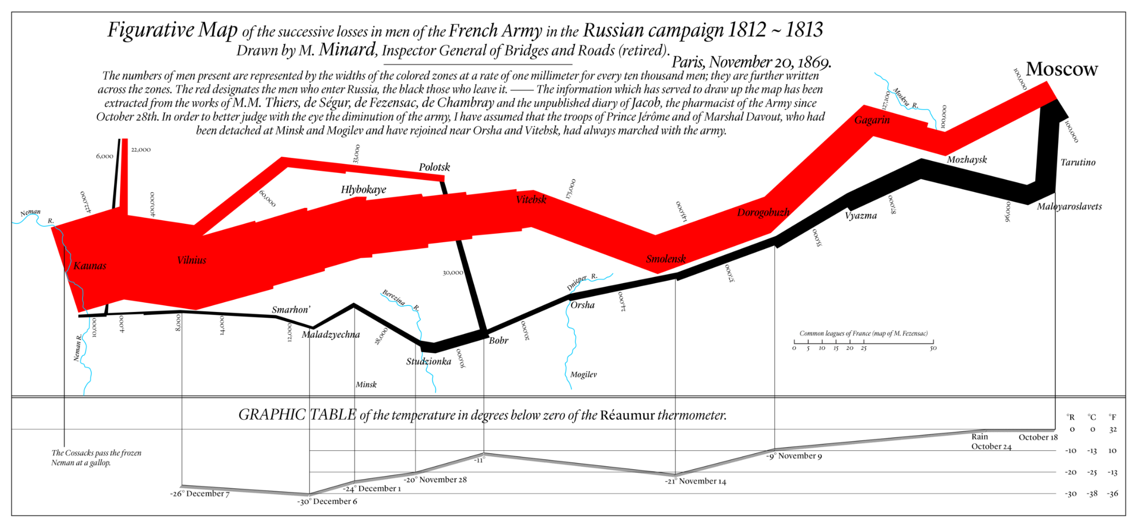
IMPORTANT RULE: Reviewer should understand within 10-seconds or less what the graphic is conveying
Map of Napoleon’s March (by Charles Minard)

Slide 20
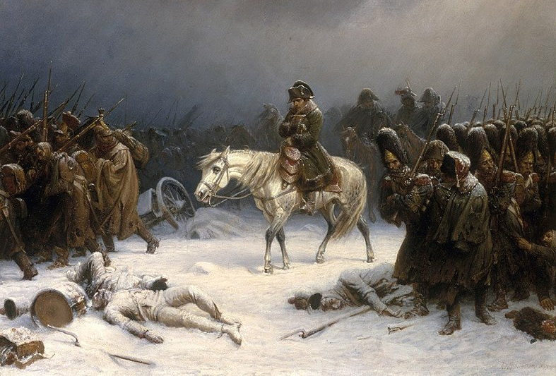
What the Graphic Conveyed

Slide 21
Module 2 Quiz
Information design is all about the visually attractive representation of data.
  True
  False
What are the three main aspects of information design?
  Defining, Planning, Shaping
  Analyzing, Writing, Drawing
  Researching, Prototyping, Implementing
  Brainstorming, Creating, Reviewing
According to the “Important Rule“ for graphics, how many seconds (or less) should it take for a reviewer to understand what a graphic is conveying?
Notes:
Correct answers with explanations:
Information design is all about the visually attractive representation of data.
Correct Answer: b) False
Explanation: Information design is not solely about making data visually attractive; it is primarily about making complex ideas easy to grasp. While visual appeal is important, the main goal of information design is to convey information effectively and ensure that the audience understands the message being presented. The focus should be on accurately representing the subject matter in a way that meets the needs of the customer and helps persuade them, not just on aesthetics.
What are the three main aspects of information design?
Correct Answer: a) Defining, Planning, Shaping
Explanation: The key aspects of information design include defining the message you want to communicate, planning how to represent this information visually, and shaping the final design to ensure it is clear and effective. These steps are crucial to ensure that the visual elements serve their purpose in a proposal, making the information accessible and persuasive to the evaluators.
According to the “Important Rule“ for graphics, how many seconds (or less) should it take for a reviewer to understand what a graphic is conveying?
Correct Answer: 10 seconds (or less)
Explanation: The “Important Rule” in the course material states that a reviewer should be able to understand what a graphic is conveying within 10 seconds or less. This guideline underscores the importance of clarity and simplicity in proposal graphics. The idea is that evaluators often have limited time, so graphics need to communicate their message quickly and efficiently to be effective.

Slide 22
Visual principles
Module 3

Slide 23

Visual Principles
Structure & Legibility
For proposal design purposes, most visual principles fall into two overlapping categories:
STRUCTURE
Page layout (grid structure)
Visual hierarchy
Proportion and balance (visuals vs. text)
LEGIBILITY
Color
Contrast
Typography (font types and sizes)

Slide 24
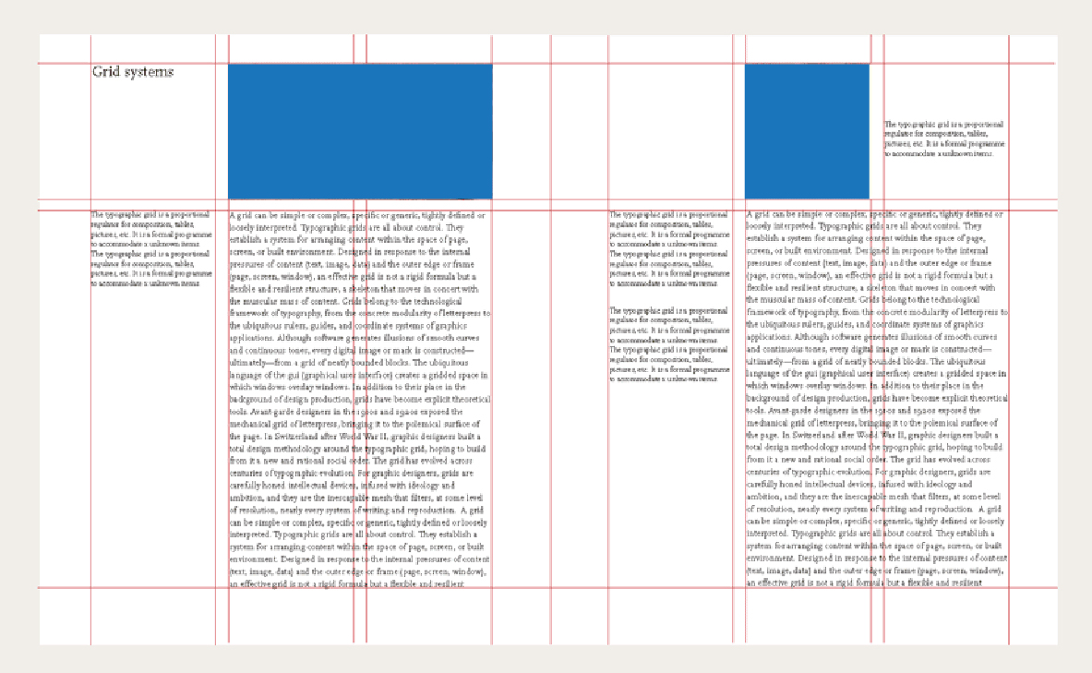
Visual Principles
Structure
Page Layout
Using Grid Systems
Use grids to organize content and clearly present messages
Grids create clarity through organization, movement, and grouping

Slide 25
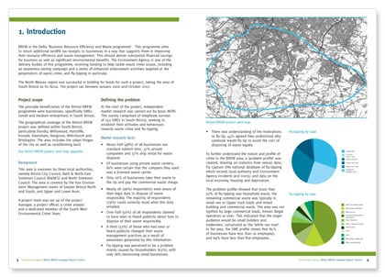
Visual Principles
Structure
Visual Hierarchy
Ordering of images, headers, and text to help reviewers quickly understand their relative importance
Lets reviewers skim content and decide what’s relevant to their evaluation process without having to read every word

Slide 26
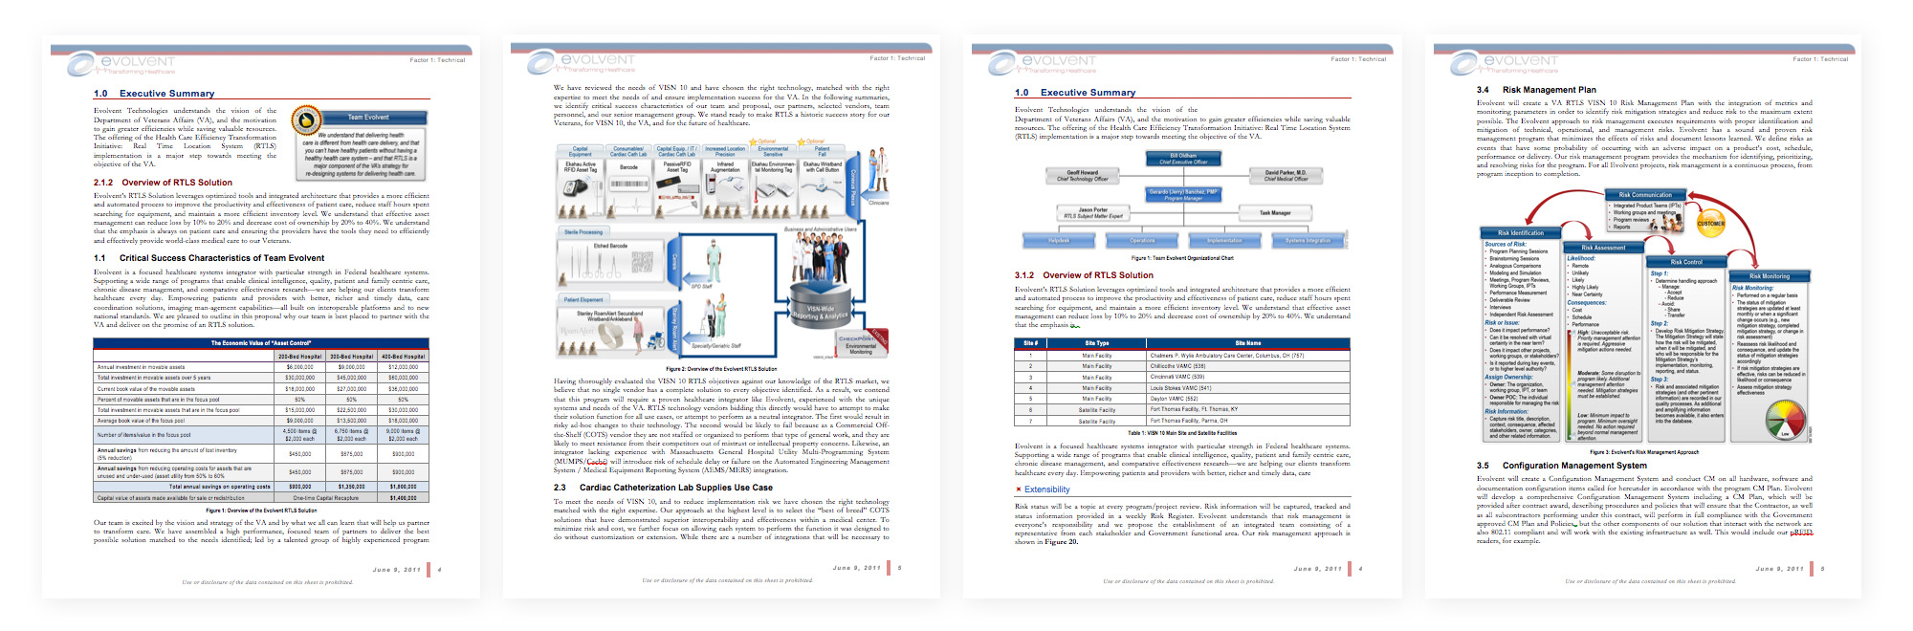
Visual Principles
Structure
Proportion and Balance
Proposals should have one graphic or visual element on every page (or every other page, at a minimum)
Graphics must follow traditional logic (left to right; top to bottom; clockwise)

Slide 27
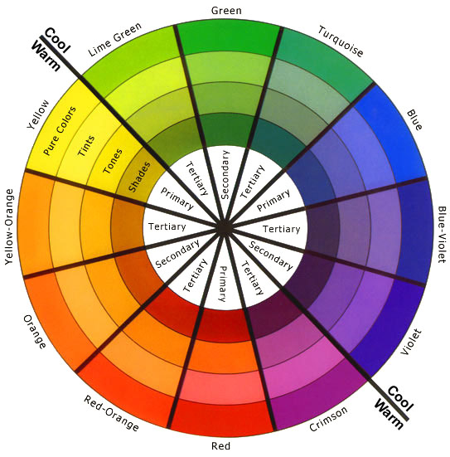
Visual Principles
Legibility
Color
Choose the color mode appropriate for your needs (RGB, CMYK, Spot)
RGB: Use for anything viewed on a screen (web graphics, presentations), and any time you’re working in MS Office (proposals)
CMYK: Use when preparing material to be printed by a commercial offset printer (brochures, marketing collateral, exhibits)
Spot: Use when preparing material to be printed commercial offset using ≤3 colors, or if required to use a precise color for a brand
ROY G BIV

Slide 28
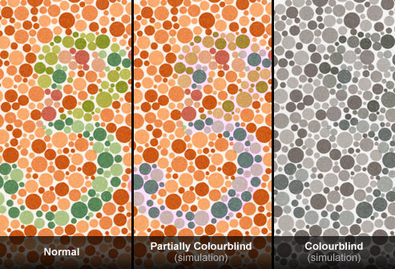
Visual Principles
Legibility
Color
Account for reviewers with visual deficiencies, aging eyes, and color blindness (Section 508)
Account for black-and-white copying
Consider cultural difference in color meaning, for example:
Red in Western Culture: Energy; excitement; action; danger; passion; warning to stop; anger
Red in South Africa: Color of mourning
RESOURCE: Websites like vischeck.com enable you to upload images to determine how they may appear to the visually impaired.

Slide 29
Visual Principles
C.R.A.P. DESIGN
Contrast
repetition
Contrast
Repetition
Alignment
Proximity
QUICK TIP: Do a contrast check by turning your monitor to grayscale or printing to a black-and-white printer. If graphic elements and text appear to blend together, adjust the colors to create more contrast. Many evaluators will not print proposals in color.
Use a different design elements to help things stand out: size, shape, color, direction
Reuse the same layout patterns and “building blocks” throughout the proposal for predictability and trust
Align
Use Align tool, grids, the Rule of Thirds, left-aligned or justified text, and same-sized boxes to line up everything
Move elements that belong together closer to each other, and those that are separate further apart, for pages to look more organized
proximity
alignment

Slide 30
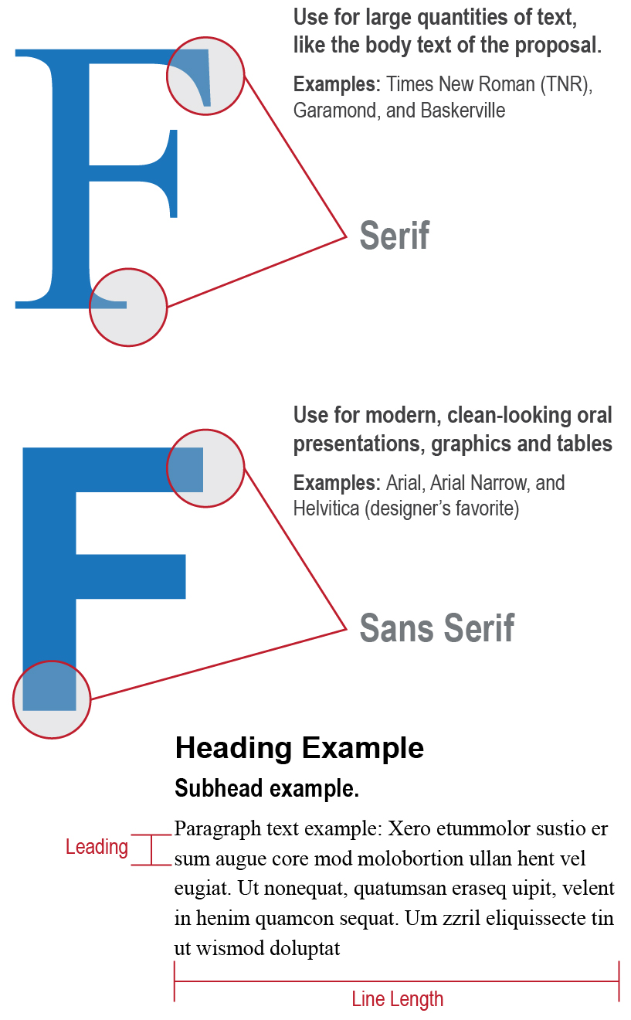
Visual Principles
Legibility
Typography
Type of font and font size are typically defined in an RFP (usually Section L) for text, graphics, and tables
Never go smaller than 8 pt Arial Narrow font in graphics even if not prohibited by the RFP
Attentiveness to legibility and readability will help evaluator access your message clearly
Consider things like serif vs. sans-serif fonts, column width and line length, and leading – which all affect readability

Slide 31
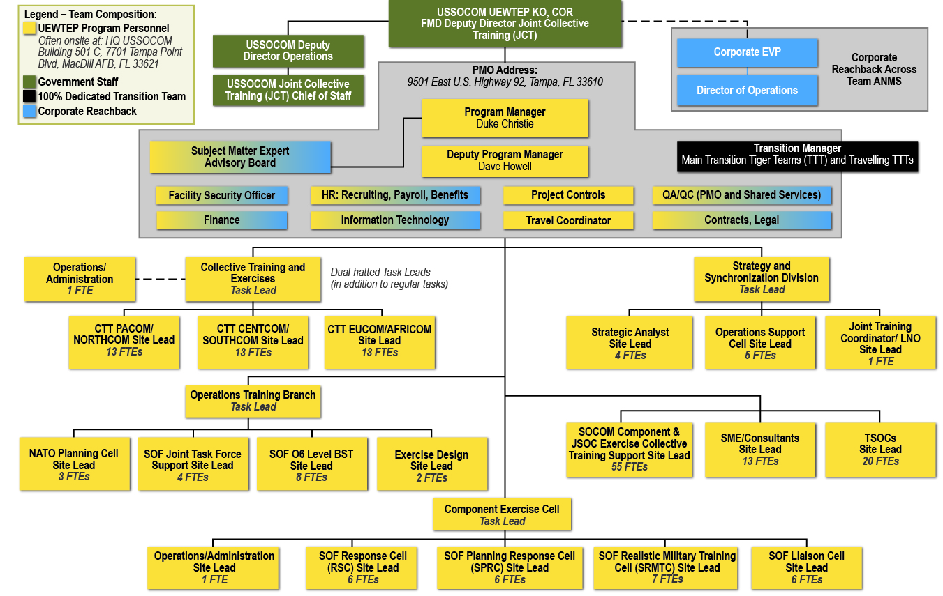
Module 3 Exercise: Critique This Graphic

Slide 33
Design process
Module 4

Slide 34
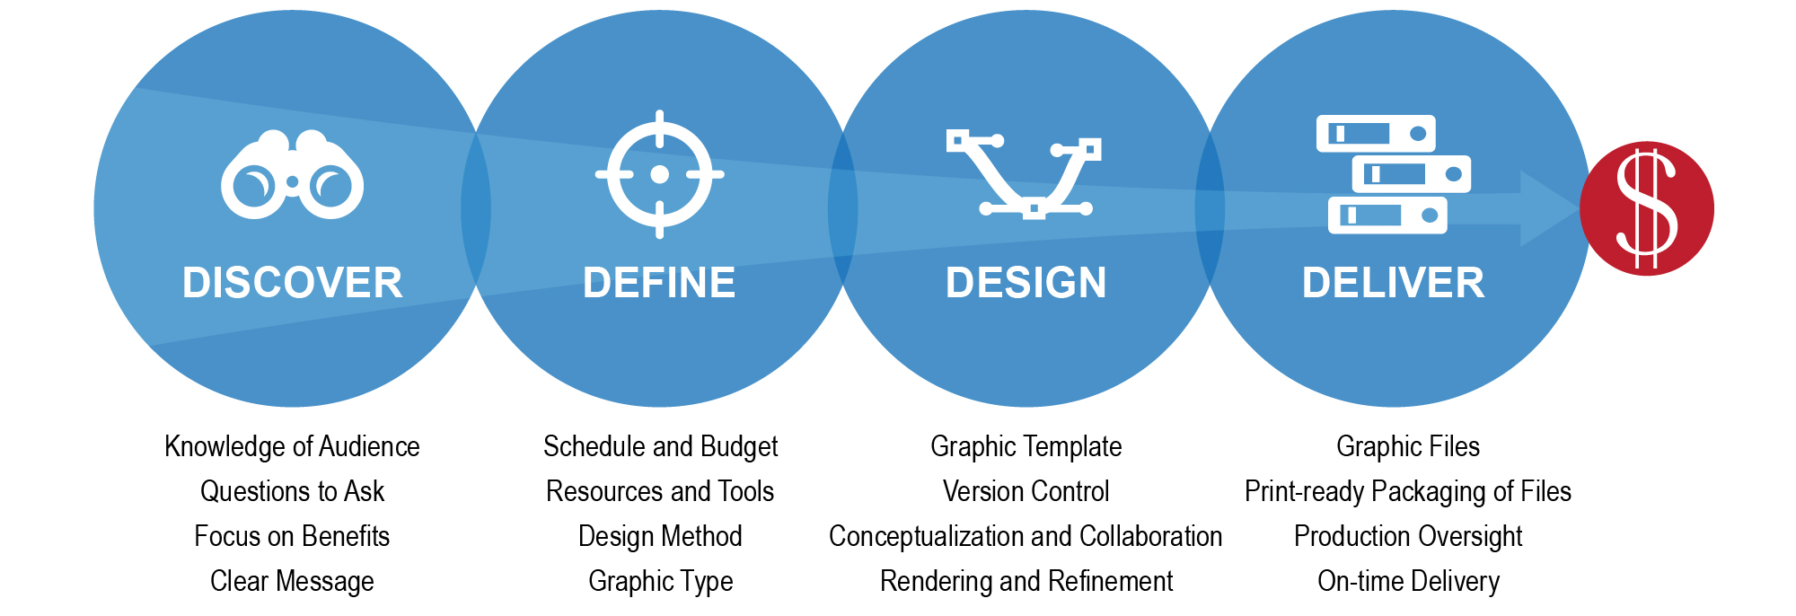
Design Process
Discover. Define. Design. Deliver.
There are many process models for developing visuals, but they all share common steps:

Slide 35


Slide 36
Discover
RESEARCH & CAPTURE:
Effective proposal graphics are driven by research and capture intelligence.
Research during the capture process provides insight into customer’s
hot buttons, needs,
and expectations.
Know Your Audience
PAIN:
Where are they now?
GOAL:
Where do they need to be?
ACTION:
How can you help them get there?
Focus on the high-level, key
message your audience needs
to know. Keep it simple.

Slide 37
      REMEMBER!
Notes:
Preface: the images that follow are not intended to offend anyone; the power and memorability of graphics is probably best illustrated by the images below. We could have used Kim John Il or Joseph Stalin, but weren’t sure if 100% of all the people in the class would recognize these self-centered dictators instead of Hitler.

Slide 38

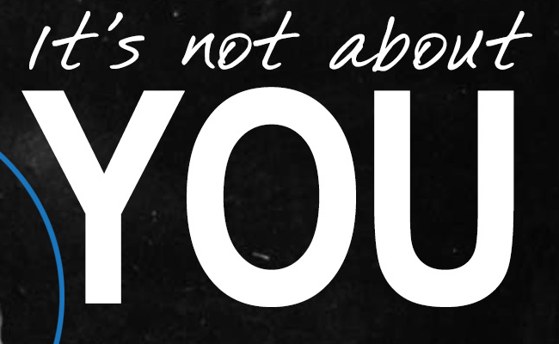


Slide 39
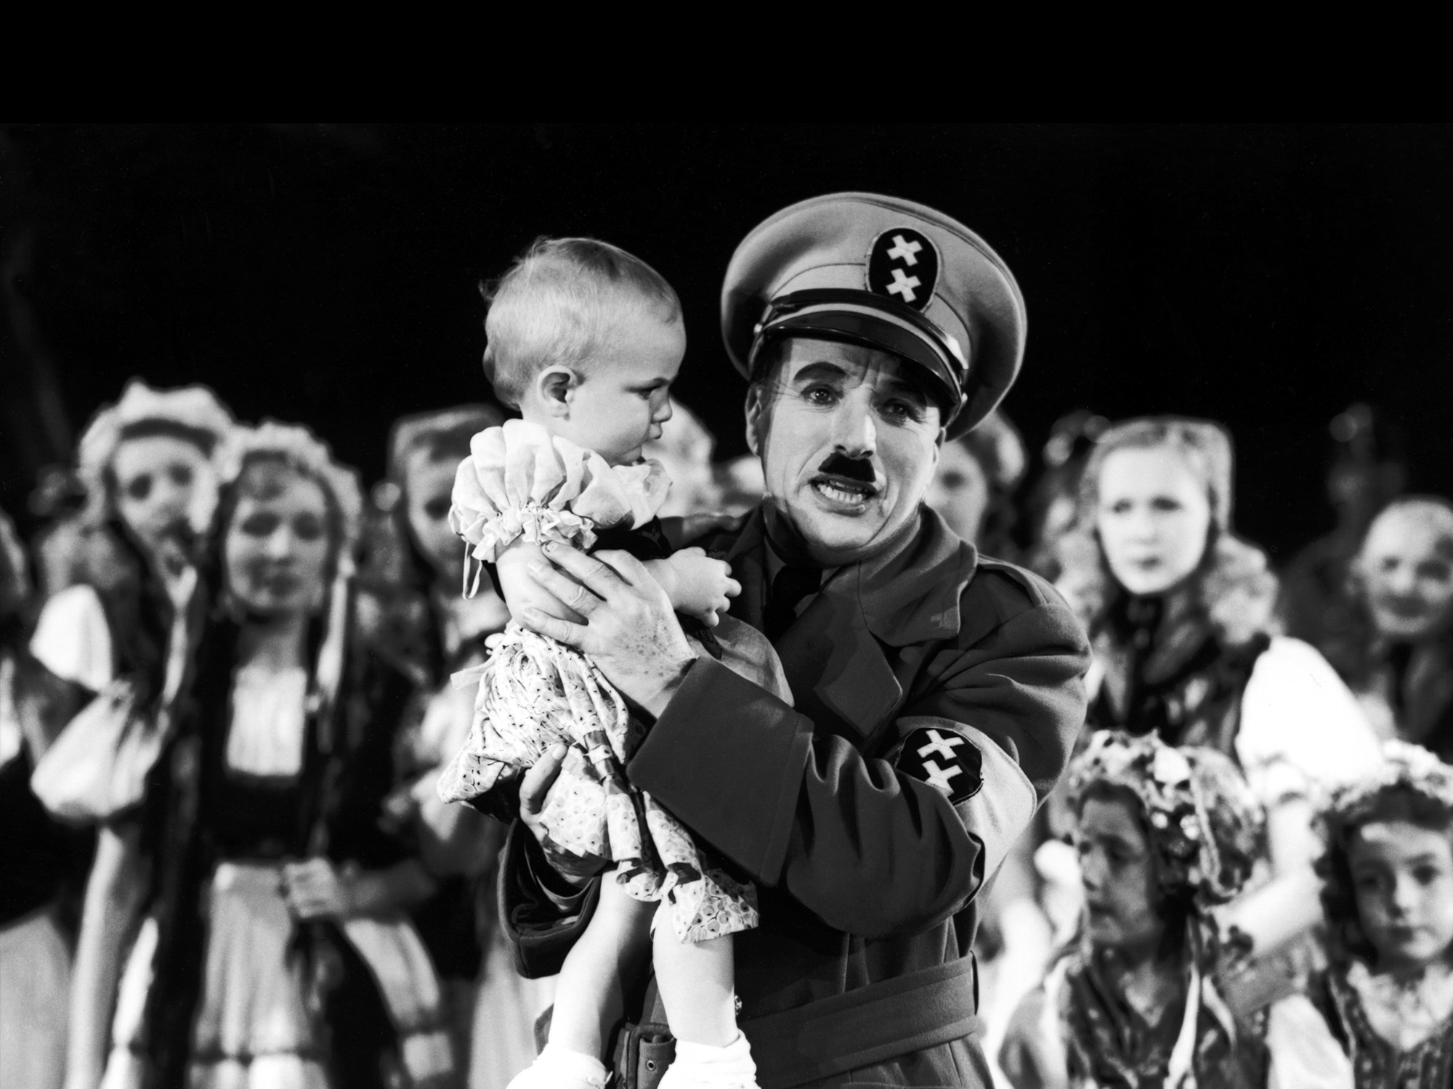
YOUR AUDIENCE
Notes:
It’s Charlie Chaplin

Slide 40

Discover
It is often easier to articulate a verbal idea of what you are trying to depict. Think of it as the seed. Articulating it speeds up the conceptual process.
What’s the Point?
Develop a vague concept to start
a creative germination process.
Ask questions such as:
What are you trying to represent?
What do you want the reviewers to learn or feel when they see this graphic?
Coming up with great graphics isn’t only for a designer – authors can make a designer’s job easier by developing great concepts.

Slide 41
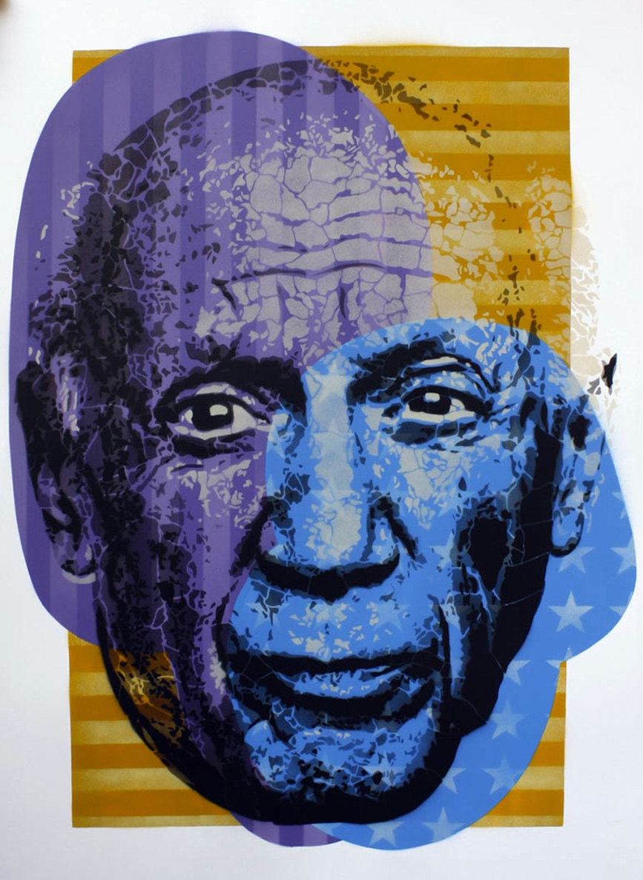
Discover
“Good artists copy, great artists steal.” – Pablo Picasso
Inspiration
Look for ways other companies, publications and the market associates your subject matter visually.
  Do not simply regurgitate what has been said and done elsewhere, but study the best ways to visualize the subject that resonates with your customer.
Pay attention to established visuals that are commonly understood to represent products and processes in the market.

Slide 42

Discover
REMEMBER!
The goal of any proposal graphic is to communicate
a specific message to the reviewer in a way that is clear, accessible, and
easy to understand.
Action caption To Clarify the Point
Writing action captions may feel like composing haiku. Instead, answer four questions:
What are you trying to depict?
What does it do?
What does it do for the customer and
why do they care?
What does it do better, faster, cheaper,
or less risky than the competition?
Figure 1.1-3. Assigning Task Order Work. Team ACME’s approach to assigning work results
in proactive management that minimizes disruption of operations, delivers a quality workforce, brings high accountability and transparency, and fully enables the support for the DTRA.
Notes:
Choose student to provide representative solution example.

Slide 43

MODULE 4 EXERCISE
DEVELOP YOUR ACTION CAPTION FOR A GRAPHIC.
FILE: Module 4 Graphics Conceptualization Exercise.docx
Notes:
We will give students a graphic concept for the class.

Slide 44
Define your graphics and concepts
Module 5

Slide 45


Slide 46
Define
Scheduling and Budget
Assume 1 graphic per page
(or at least every other)
Deduct title page, ToC, resumes, past performance
For graphic development, assume an average of (includes revisions):
Simple graphics = 1-2 hours
(basic org chart, short process)
Complex graphics = 4-6 hours or more
(CONOPS, systems architecture)
Assume an average of 20 hours for customer-centric covers/backs/spines (includes design, revisions and set up of volumes and copies); may change with AI and mostly electronic submissions
Communicate with proposal team to define scheduling and manage expectations
Example:
20 pages of text
Assumptions:
5 tables
15 graphics
- 12 simple
(12 x 2 = 24 hours)
- 3 complex
(3 x 6 = 18 hours)
- Several Options for Cover (assume electronic delivery) (20 hours)
Total: 62 hours

Slide 47

Define
Resources and Tools
Define and procure the resources and tools needed to develop effective proposal graphics that communicate your message effectively.
Resources include:
People (professional resources such as in-house staff, consultants, and freelancers)
Online (stock photography sites, template sites, and government media portals)
Tools include:
Software (Adobe Creative Suite, MS Office, etc.) and AI

Slide 48
Define
Staffing Resources
In-house Staff
In-house graphic designers, or other position that can occasionally fill design needs.
Graphic Design Company
Professional establishment with defined methodologies, tools, processes, QA procedures, management and accountability. More than a 1-man shop. Example: OST.
Graphic Design Freelancer
One individual that claims to have the skills you need. Be sure you review their past work, obtain references, and have a Plan B and C if things don’t work out.
When defining staffing resources for proposal graphic development, consider the cost/value. Is this the absolute best use of your budget dollars and of this person’s time?
For Example: A professional design consultant at $110-$125/hour is a better use of B&P funds than a $150/hour Proposal Manager doing graphics in addition to management activity. It also distracts them from their focus.

Slide 49
Define
Online Resources and Tools examples
Resource | Best Use | Considerations
Previous Proposal Graphics | Gain inspiration and reuse liberally | Often people forget left-over language from old proposals, don’t customize enough, or fail to adjust the palette
Google Images google.com | Ideas and inspiration Sophisticated search engine helps search vague concepts with decent results | Most material here is copyright protected and may not be re-used
GetMyGraphics Getmygraphics.com | Ideas and inspiration Editable PPT graphics, created with proposals in mind | Can’t control image export size or resolution (possible compliance issue). Workaround: Purchase PPTools Image Exporter plugin
Slide Shop Slideshop.com | Ideas and inspiration Editable PPT graphics and templates | Can’t control image export size or resolution (possible compliance issue). Workaround: Purchase PPTools Image Exporter plugin
Graphic River Graphicriver.net | Icons, templates, and other graphics elements | Can purchase, use, and re-use in proposals and presentations multiple times
Stock Image Sites: istock.com; fotolia.com; dreamstime.com; shutterstock.com; sxc.hu | Inspiration when using search terms like infographic or diagram Photos for covers and other graphic elements Icons (usually available in sets) | Most require membership to buy credits Costs vary ($5 to $300+ per image)
Play by the rules. Understand the restrictions for graphics and stock images before you purchase them.

Slide 50
Define
Online Resources and Tools – Government-Specific
USA.gov (usa.gov/Topics/Graphics.shtml)
DefenseLINK (defenselink.mil/multimedia)
DefenseImagery (defenseimagery.mil)
U.S. Army (army.mil/media)
U.S. Air Force (af.mil/photos)
U.S. Navy (navy.mil/viewGallery.asp)
U.S. Marines (marines.mil/Photos.aspx)
U.S. Coast Guard (uscg.mil/top/downloads)
U.S. National Guard (nationalguard.mil/resources/photo_gallery)
NASA (nasa.gov/multimedia/imagegallery)
NOAA (photolib.noaa.gov)
DOS (state.gov/r/pa/ei/pix/at_work)
Note: Some photos are in the public domain or U.S. government works and may
be used without permission or fee, but also may be protected; always check.
Most government agencies have photos under a media or photos tab.

Slide 51




Define
Adobe Creative Cloud
Subscription-based software allowing access to download and install all of Adobe’s latest versions of software applications.
Subscriptions cost $20 to $50 per month.
Tools - Software
Adobe Creative Suite
Photoshop, Illustrator, InDesign, Acrobat
Microsoft Office Suite
Word, Excel, PowerPoint, Outlook
Internet Browsers
Internet Explorer, Safari, Firefox

Slide 52
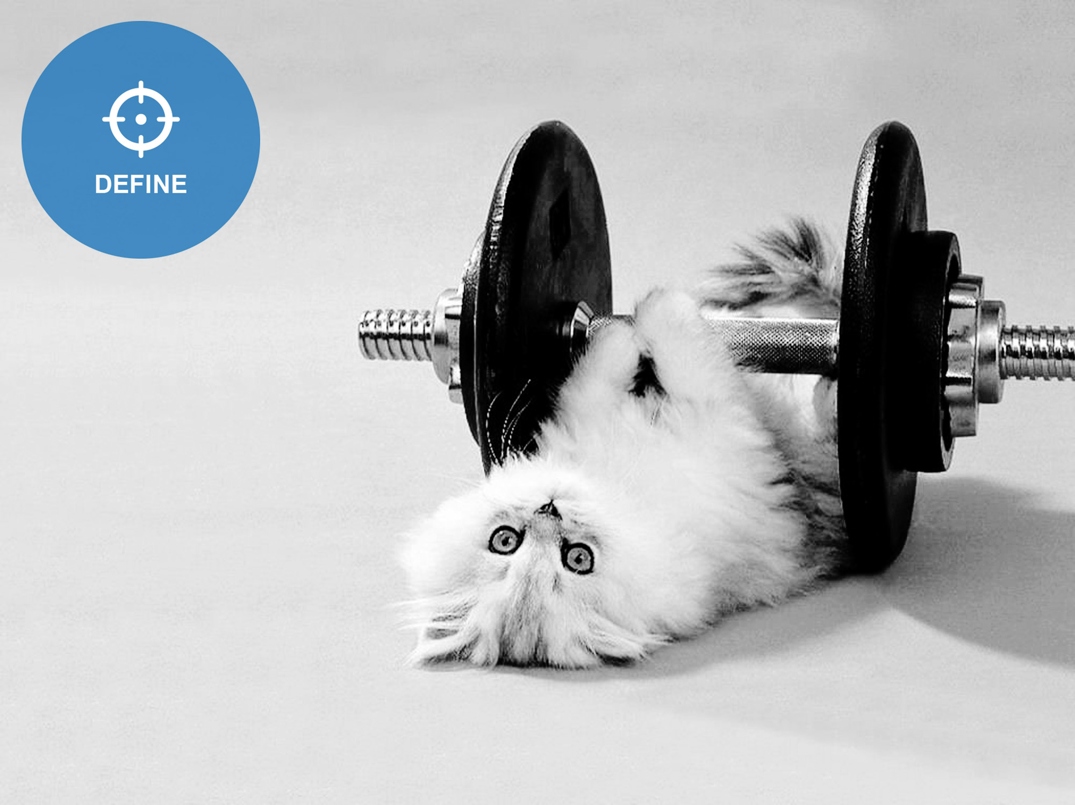
MODULE 5 EXERCISE:
DEVELOP PROPOSAL ACTION PLAN & ESTIMATE.
FILES: Module 5 Example RFP Formatting Reqs.docx
Module 5 Proposal Graphics Plan and Budget.docx
Notes:
Provide students with a form to fill out to aid them in this process. The form will be provided in hard and soft copy, so they can use it as a take-away resource as well.

Slide 53
Define: Using AI for graphics
Module 6

Slide 54




Define
AI Image Generators
OpenAI DALL·E for an easy-to-use AI image generator
Midjourney bot on Discord for the best AI image results of cinematic quality
Stable Diffusion for customization and control of your AI images
Adobe Firefly for integrating AI-generated images into photos
Generative AI by Getty for usable, commercially safe images
Leonardo.ai for creative and contextually relevant images
Google Gemini for visually compelling art
Topaz Gigapixel AI (paid) or Upscayl.org (free) for granulated image remastering
And more…

Slide 55

Prompting Makes All the Difference
Midjourney:
  /imagine Prompt Photo of a capture manager brainstorming in front of a proposal wall
  Notice the AI bias: capture manager is a white male; the look of a proposal wall and office environment is bland
  Photo looks ho-hum
Art: Midjourney

Slide 56

Modifying the Prompt for Better Output
Midjourney
  /imagine Prompt a photo of a red-headed female capture manager brainstorming in front of a proposal wall with post-its, with wide-angle camera and cinematic lighting; use this reference [file address]
  The image is less gender-biased, and becomes more artistic and impactful, showing deep thought
Art: Midjourney

Slide 57

Getting to What You Want to Convey
Midjourney
  /imagine Prompt a photo of a red-headed female capture manager brainstorming in front of a proposal wall with post-its, with wide angle camera and cinematic lighting, window in the back, with crepuscular ray, her face in focus with deep thought; use this reference [file address].
  Creative professionals with knowledge of photography and art have a clear edge over the untrained people without the knowledge and the “eye.”
  Now AI prompts are sold and traded.
  It is not about the initial product, it’s about finessing that product repeatedly with meticulous adjustments.
Art: Midjourney

Slide 58
AI Art Prompt Structure
AI Art Prompt Structure
  Graphic content or subject, description of action, and setting [describe in detail the actions that the subject is doing (e.g., presenting, working on the computer, or reviewing), how they're doing these actions (e.g., thoughtfully, joyfully, seriously, or boldly)]
  Art form, style (e.g. vector, icon, raster, photo, etc.), (you could use artist references although beware of copyright issues)
  Additional settings, such as lighting, colors, and framing – use photography vocabulary and skills
  The mood of the image (e.g., optimistic, business-like, nostalgic, exciting, etc.)
  Exceptions and exclusions
Separate elements in the prompt with commas
Don’t overload your prompts and optimize for a specific AI:
  Midjourney likes 60-word prompts
  Stable Diffusion likes prompts below 380 characters
Use AI LLVMs to help generate art prompts
Use artistic and photo terminology
Vivid details and concrete language produce more predictable results, but experiment with abstract concepts as a wild card

Slide 59
AI Art Prompt Strategies
AI Resources
  CLIP Interrogator takes an image and gives you a text prompt based on its content; reverse-engineer images as a basis for more detailed prompts for text-to-image AI.
  Runway enables image-to-image design instead of text to image – provide an image and change it.
  neural.love is an image outpainting tool to logically expand an image with additional details to the right size.
  Leap AI helps generate professional headshots out of photos and automate workflows.
AI prompts can be text-to-image or image-to-image: provide an image as inspiration and further tune it with text or model controls
Upload any image to an AI outpainting model, and it will expand it beyond the limits of the frame, creating a larger image from a smaller detail.
Get AI prompt ideas from other artists: Discord channels, Lexica, neural.love public library, etc. to understand how each AI interprets prompts: ex: Midjourney uses [xxx] icon --style raw to create a vector image of an icon. See Midjourney tutorial.
Some models let you adjust advanced generation settings such as increasing or decreasing the number of steps to control how processed the final image should be (more steps usually equal more details).
Edit parts of images using a text prompt in Photoshop or Canva.
Leverage AI to generate better text prompts.
Improve image resolution and reduce noise using AI tools.
Search for text-to-flowchart AI tools or develop concepts with AI.

Slide 60

AI Ethics and Copyright
Check AI work carefully including errors such as counting fingers, checking ears, and fixing other distortions
Don’t put proprietary text in AI that will use it for training data
Copyright implications of using AI is an evolving field – check permissions for each tool
  Ex: Midjourney can be used royalty-free for commercial purposes only by paying members; companies with over $1 million in revenue can use images commercially only with corporate membership
  Personal free users must give attribution to Midjourney
  Prompts are free to use for everyone
Ensure you correct for biases in AI-generated content and images: stereotyped, racist, agist, and other offensive content
Art: Midjourney

Slide 61

MODULE 6 EXERCISE
WALK THROUGH CREATING A MIDJOURNEY PROMPT
Notes:
We will give students a graphic concept for the class.

Slide 62
Define: design methods and graphics planning
Module 7

Slide 63

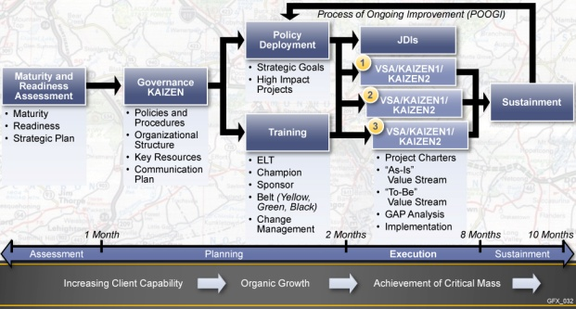
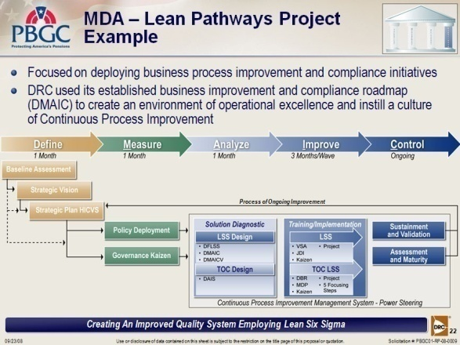
Define
Tools – Software Considerations
Written Format (Word)
Oral Format (PPT)
Software Used:
Illustrator (primary), Photoshop (imported raster elements)
Image Export Specs:
200dpi, RGB, JPEG or PNG format
Software Used:
PowerPoint (for simple graphics such as org charts and basic flows), Illustrator/ Photoshop and InDesign (for complex graphics)
Image Export Specs:
200dpi, RGB, JPEG or PNG format, Baseline Optimized
When choosing which software to
use for graphics, consider basic written (Word) and oral (PowerPoint) format differences.
Consider your business needs as well: is reusable library of graphics and ability to make changes without reaching out to a graphic designer more important than professional design advantages?
PRACTICE RESIZING GRAPHICS:
SEE FILE: Module 7 Graphic Templates PPT.pptx
6.5”
10”
X”
7.5”
X is >/= 8.75” (.25” is left for the exhibit tag text.)
This example illustrates: 8.5x11” page layout with 1” margins
(Dimensions will change if the margins are changed or if the graphic is for a foldout-8.7x15” or one column graphic-3.125”)

Slide 64

Define
Right Brain/Left Brain
Many graphic designers don’t think in terms of methods; inspiration and vision come naturally to them.
For others, thinking visually
and conceptualization is an overwhelming mystery.
Breaking design down into categories and types takes the mystery out of conceptualization.
Design Methods
Understand which types of imagery
and layout will relay your message
most effectively
Literal
Visual Metaphor
Data-Driven
Synthesis
(Four types of design methods are based on and inspired by the book Do-It-Yourself Billion Dollar Graphics: 3 Fast and Easy Steps to Turn Your Text and Ideas Into Persuasive Graphics [Hardcover, 2nd Edition], by Mike Parkinson, PepperLip, Inc., Copyright 2006-2010, www.BillionDollarGraphics.com; referenced and used with the author’s permission)

Slide 65
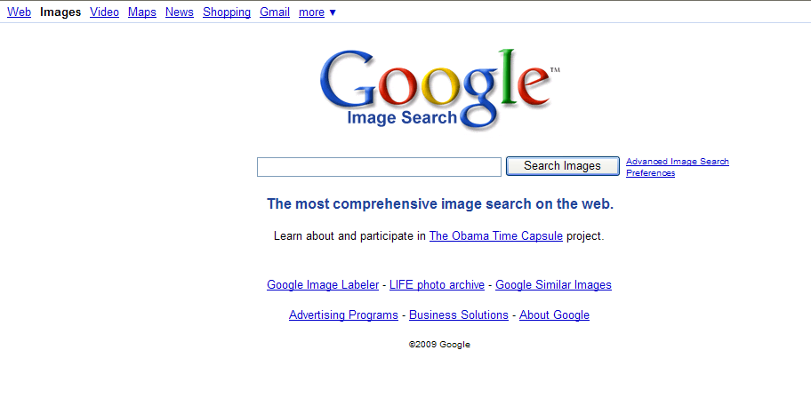
Define
Examples
Literal Design Method
Screenshot of a tool or database
Picture of a person or team – portrait or an action shot
Picture of an object (i.e. a product or product in action)
Collage of photos
Image of a document or its part
3-D models and computer simulations
Technical illustration, slice or segment
Zooming into a detail or cross-section
Illustration, no interpretation, no “connecting the dots,” it is what it is.
Desired Impact of Your Message:
“I have seen it, it does exist”
“They really did build this ahead of time, to prepare well!”
“Ah, that’s what it looks like…”
“It looks impressive (or technically sound, or having the characteristics I need)”
“I like (trust) this product (or person)”

Slide 66

Define
Examples
Visual Metaphor Design Method
An image conveying something unfamiliar, underappreciated, or complex, is LIKE something familiar, valuable, or easily understood. Makes un-relatable relatable, etches a memorable mental picture.
Desired Impact of Your Message:
“I get it now!”
“Oh, wow, it is really important!”
“I didn’t realize it before!”
“It is extremely beneficial for us and it is a great investment!”
“It makes total sense!”
Symbol or icon
Direct substitution (i.e. traffic lights to show status)
Indirect substitution (i.e. graphic structure designed to convey a specific message: puzzle pieces, scale, pipeline, gears, funnel, magnifying glass, spiral, building blocks, bricks, pillars, legos, stairs, ladder, peg, assembly line, highway, DNA, bridge, chain links, etc.)
Multi-level comparison or analogy: when an image compares a complex function or object to what you are portraying, and relates on multiple levels
Opportunity Pipeline

Slide 67
Define
Examples
Data-Driven Design Method
Schedules, timelines, timetables, and calendars
Tables
Dashboard with metrics, cockpit gauges
Matrixes (risk, trade-off decisions, responsibilities, staffing, L/T/X/Y-shape)
Charts (i.e. line, bar, column, stacked column, pie, area, segment, swim lane, spider, box plot, bubble, scatter)
Checklists
Nomographs (visual calculators)
Quantitative or qualitative data presented in a way that forms a clear picture and tells a logical story with facts and proof. May pack an emotional punch in a non-emotional wrapper.
Desired Impact of Your Message:
“I now understand how this information relates to each other.”
“They have thought it through.”
“It all adds up and makes sense.”
“It is a logical plan.”
“It is a thorough analysis.”
“It looks like all our requirements are met or exceeded.”
“They have considered all the technical details, so the execution risk is lower.”
“The numbers and facts tell the story!”

Slide 68
Define
Examples
Synthesis Design Method
Complex designs such as drawings and schematics
Interfaces (both physical and digital)
As-Is/To-Be
Processes (flowchart, step-by-step, waterfall, decision logic)
Diagrams (organization, tree, Venn, mind map, cause-and-effect, interrelationships)
Maps with data
3-D stackable (wedding cake, pyramid, coin stack, cut-out wedge, connected cubes)
Components of a system, method, or phases (pyramid, Venn, circles and loops, quadrants, arrows, hexagon/honeycomb
Architectures:
  Network
  Technical or Management CONOPS, Overviews, Infographics
  Environments such as stakeholder interaction or communications
The graphic connects the dots – brings together disparate parts fitting them in a clear picture; or breaks down the methodology and approach into clear how-to pieces.
Desired Impact of Your Message:
“They have a logical plan with clear benefits for us!”
“They have thought through this solution.”
“We can trust them because they know HOW to do the job!”
“I didn’t realize that there is an actual method to do this – and they are experts!”
“This is truly complex, but they have accounted for all the details and risks!”
“It is a thorough, sound approach we can rely on.”

Slide 69
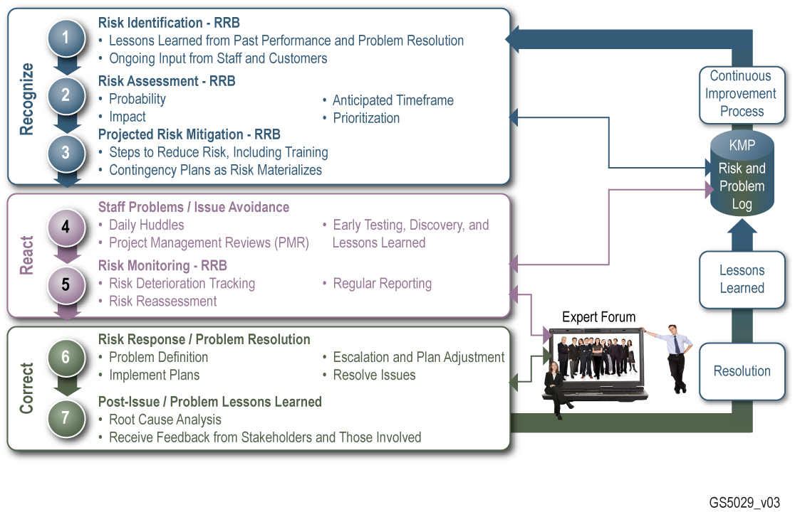
Example of a Synthesis Method

Slide 70
MODULE 7 EXERCISE:
DEVELOP A GRAPHIC CONCEPT.
FILE: Module 4 Graphics Conceptualization Exercise.docx
Notes:
Provide students with a form to fill out to aid them in this process. The form will be provided in hard and soft copy, so they can use it as a take-away resource as well.

Slide 71
DESIGN: CREATING THE TEMPLATE AND DESIGNING YOUR GRAPHIC
Module 8

Slide 72


Slide 73
Design
A PROPOSAL
GRAPHICS TEMPLATE
Proposal Graphics Template
RFP formatting requirements
Font size and type
Color or black-and-white
Margins (determines width
of graphics)
Volume names/titles
Media (hard copy, electronic via CD or online submission)
Color palette
Box and arrow styles
Icons and other repeated graphic elements
Graphic samples
All data that helps maintain consistency
Develop and use a proposal graphic template consistently throughout all graphics in the proposal.
BE CONSISTENT! A reviewer assumes a change in style = a change in meaning. Consistency sends a subliminal message: You can trust me!
BE COMPLIANT! Be familiar with RFP formatting requirements (typically Section L) regarding font type and size, margins, page limits, evaluation criteria, etc.
Overlooking these details can cause your proposal to be disqualified for non-compliance before it’s ever even considered.
Notes:
Show example of an RFP section

Slide 74
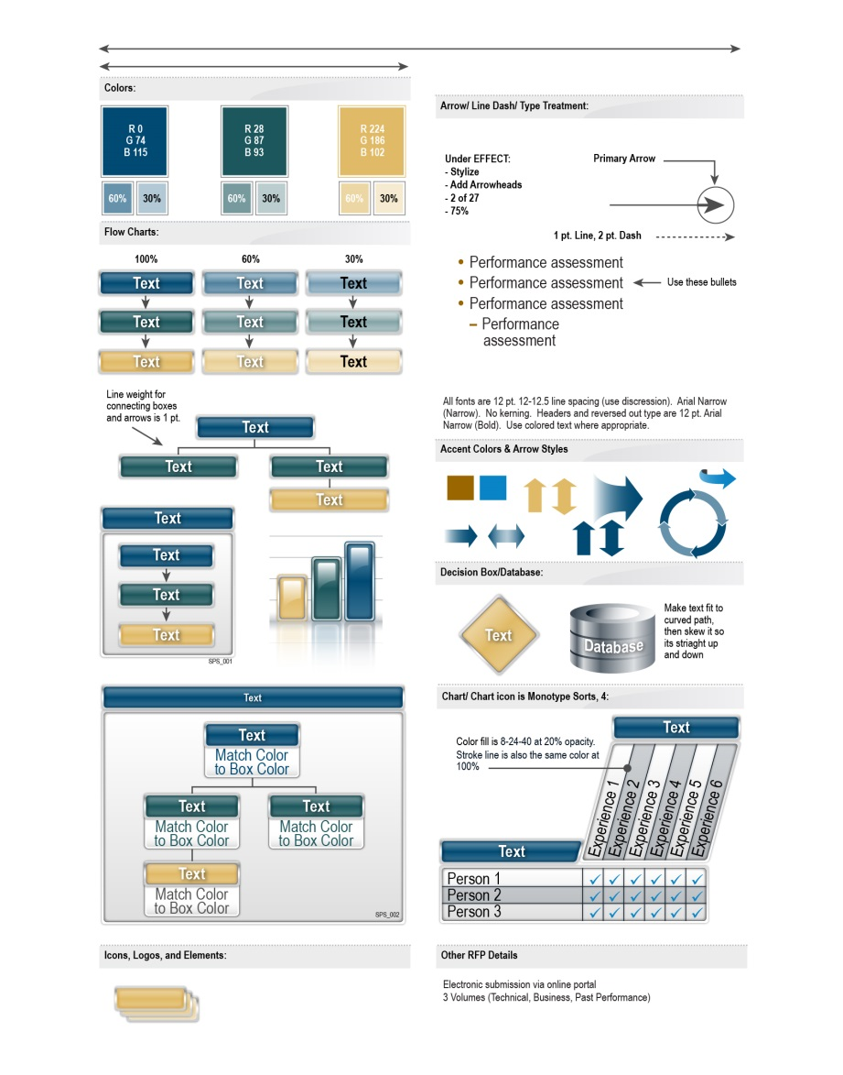
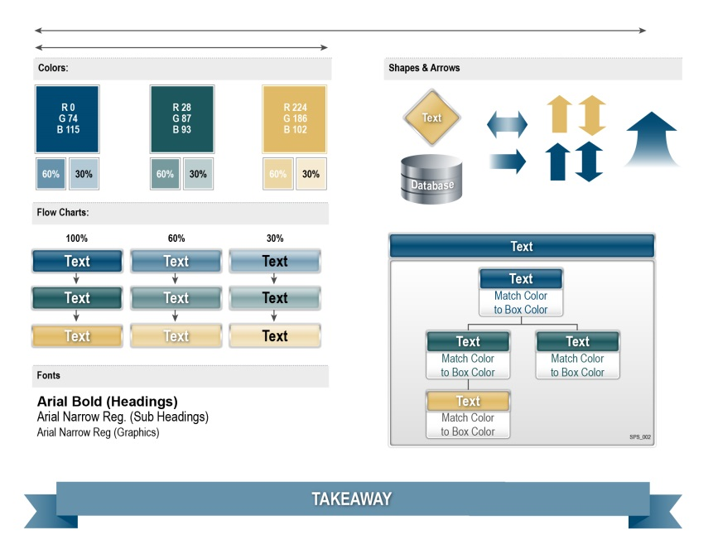
Design
Proposal Graphics Template
Example: Written Proposal Template
Templates enable you to build a visual language, which makes your message professional and effective.
Example: Orals Proposal Template

Slide 75
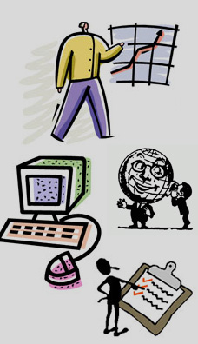







Design
What NOT to do…
Icons and Symbols
When purchasing stock art, consider things such as vector/raster and continuity of style between the pieces you buy to ensure consistency throughout your proposal.
Global Icons
Global Icons
Raster Icons
Vector Icons
Raster Icons
Vector Icons
Icons make almost any graphic more interesting.

Slide 76
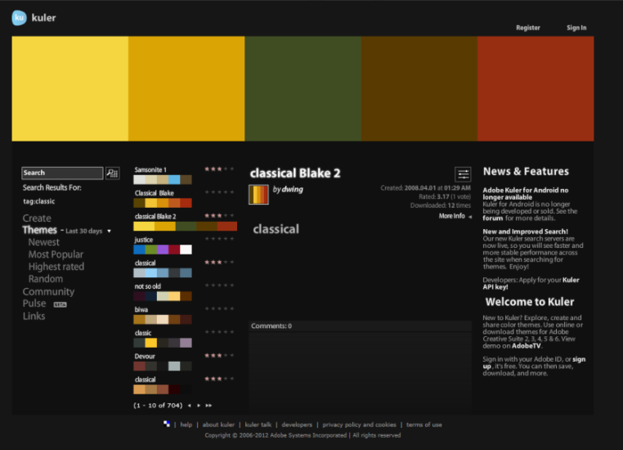
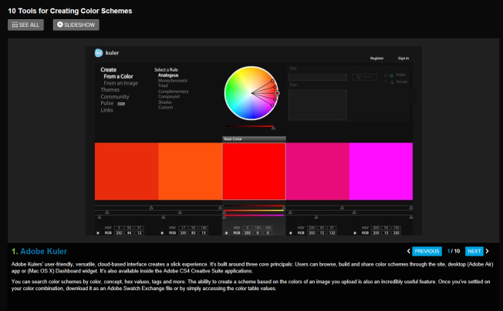
Design
Choosing a color palette
Three Methods:
Based on the customer’s brand/logo colors
Based on your brand/logo colors
Get it from your graphic designer if they have already made the selection
Online Color Palette Resources:
Search for Color Palette generator from file
Canva
Adobe

Slide 77
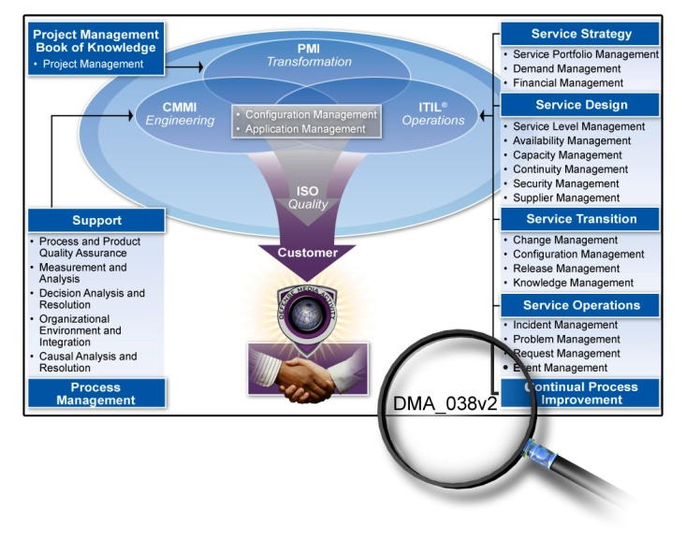
Design
Example: Graphic log number within graphic.
Tracking and Version Control
Use a graphics log (like the sample below) to keep track of each graphic number, version, author, title, software developed in, version, status, and section where it belongs.
Log # | Date In | Author | Working Title/Description | Dev. In | Version # | Status | Section
001 | 2/5 | Jeanne L. | Features and Benefits | AI | 2 | Done | 1.0
002 | 2/5 | Claudia A. | Demonstration | PSD | 5 | Done | 1.1
003 | 2/5 | Koshar | Quality Assurance Process | AI | 3 | Review | 2.0
004 | 2/6 | Jeanne L. | Summary of Features and Benefits | AI | 12 | Working | 2.0
005
006

Slide 78
Design
Managing Graphic Files
Typical file folder structure for proposal graphics:
To Artist (files from authors)
From Artist (files submitted by artist to authors)
Cover and Tabs (covers, spines, tabs)
Logos (company, teammate, and customer logos)
Source Art (editable files, password-protected)
Archives (editable files of previous versions)
CDs (labels and covers)

Slide 79
Design
Typical lifecycle of designing a proposal graphic
Sketch
Collaborate
Render
Refine
Sketch the graphic concept.
This phase is best accomplished with pencil and paper, or on a white board, although some prefer to use applications like PowerPoint or Visio.
Collaborate with Author/SME.
Have the author and/or SME(s) review the graphic concept sketch and provide their feedback. Because it is a sketch, it is easy and fast to modify at this point.
Render using design software.
Render the concept/sketch version of the graphic, based on template, and deliver proper size, color mode, resolution and format to author to review.
Make revisions as required.
Make changes to the graphic as required by author/SMEs and/or color team reviews. Don’t take things personal: this is the nature of our business.

Slide 80

MODULE 8 EXERCISE:
CREATE TEMPLATE AND DESIGN THE GRAPHIC.
FILES: Module 8 Graphics Template PPT.pptx
Module 8 Graphics Template Illustrator.pdf
Notes:
Tools: Template (provided)
Help students develop a graphic template, conceptualize, sketch, and render a graphic.
**Divide into groups – divide groups into designers and authors/SMEs. Teams use action caption exercise to sketch and refine concepts and ideas, render graphic, review, and finalize.

Slide 81
DELIVER: Producing and DELIVERING THE PROPOSAL
Module 9

Slide 82


Slide 83
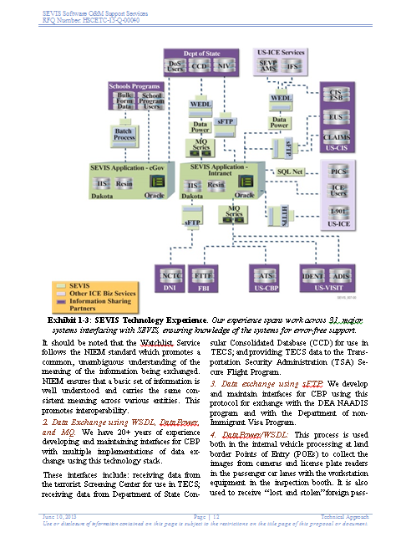
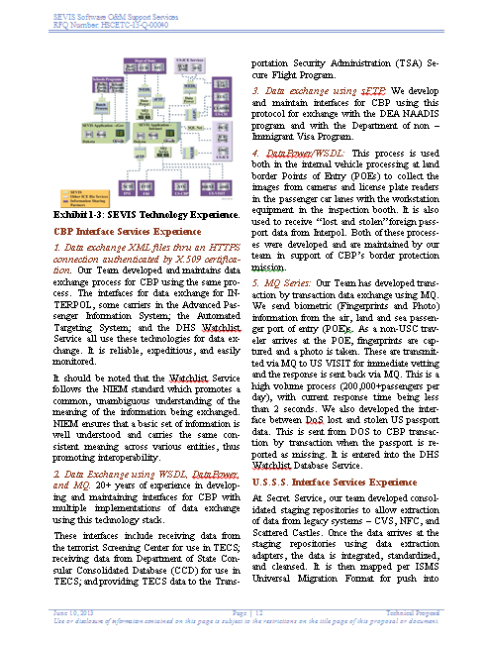
Deliver
By resizing the final image, you are automatically resizing the text, potentially making it noncompliant with the RFP
formatting instructions on minimum font size.
Insertion Into Proposal
Prepare proposal document and other packaging for final production and submission to the government.
Inserting graphics into Word is typically done by the Desktop Publisher (DTP).
Graphic Designer’s role is to provide the final, easy-to-insert graphic to DTP that doesn’t require additional sizing, cropping, or other formatting.
Compliant and readable, with an action caption.
Non-compliant, unreadable, impossible to understand.

Slide 84
Deliver
Proposal Packaging
Cover and Spine Sizes
Find out what binder size is needed for the cover(s) and spine(s)
Separate volumes may have different page counts—different sized covers and spines may be needed. Use the following table to determine cover and spine dimensions:
Normal Binders | 20lb Paper Count | 28lb Paper Count (Approx.) | Covers (Front & Back): All have 11” Height | Spines: All have 11” Height
.5” (half inch) | 90 | 81 | 9.5625” (9 & 9/16”) | 0.5625” (9/16”)
1” | 190 | 171 | 9.625” (9 & 5/8”) | 1.25” (1 & 1/4”)
1.5” | 265 | 238 | 10” | 1.8125” (1 & 13/16”)
2” | 400 | 360 | 10.625” (10 & 5/8”) | 2.4375” (2 & 7/16”)
3” | 600 | 540 | 11.0625” (11 & 1/16”) | 2.875” (2 & 7/8”)
4” (D Ring) | 900 | 810 | 11.125” (11 & 5/8”) | 3.875” (3 & 7/8”)

Slide 85
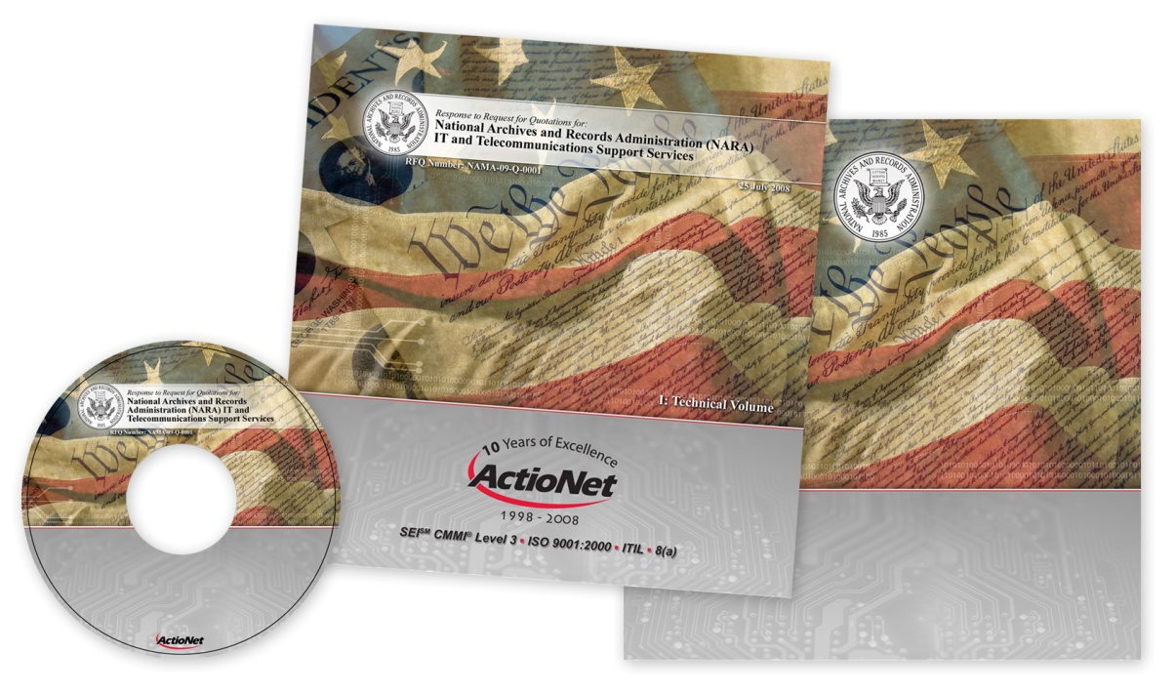
Deliver
Proposal Packaging
Use RFP to determine what text goes on the cover and spine, and/or ask a proposal manager
Find out how many copies of each volume/binder are needed
and define how “copy” text will be displayed, for example:
Original, Copy 1, Copy 2…
Original, Copy 1 of X, Copy 2 of X…
Is the disclaimer required on the actual
binder cover?
Is “Submitted to” and “Submitted by”
required on cover?
Should teammates’ logos go on the
cover or just prime’s?

Slide 86
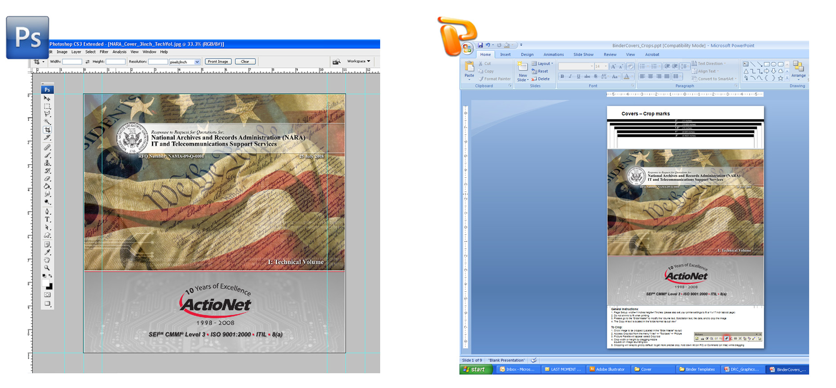
Deliver
Proposal Packaging
Import JPGs from Photoshop to PowerPoint (200dpi/RGB at 11” tall by X” wide)
Leave text that changes soft in PowerPoint (i.e. volume and copy text)

Slide 87
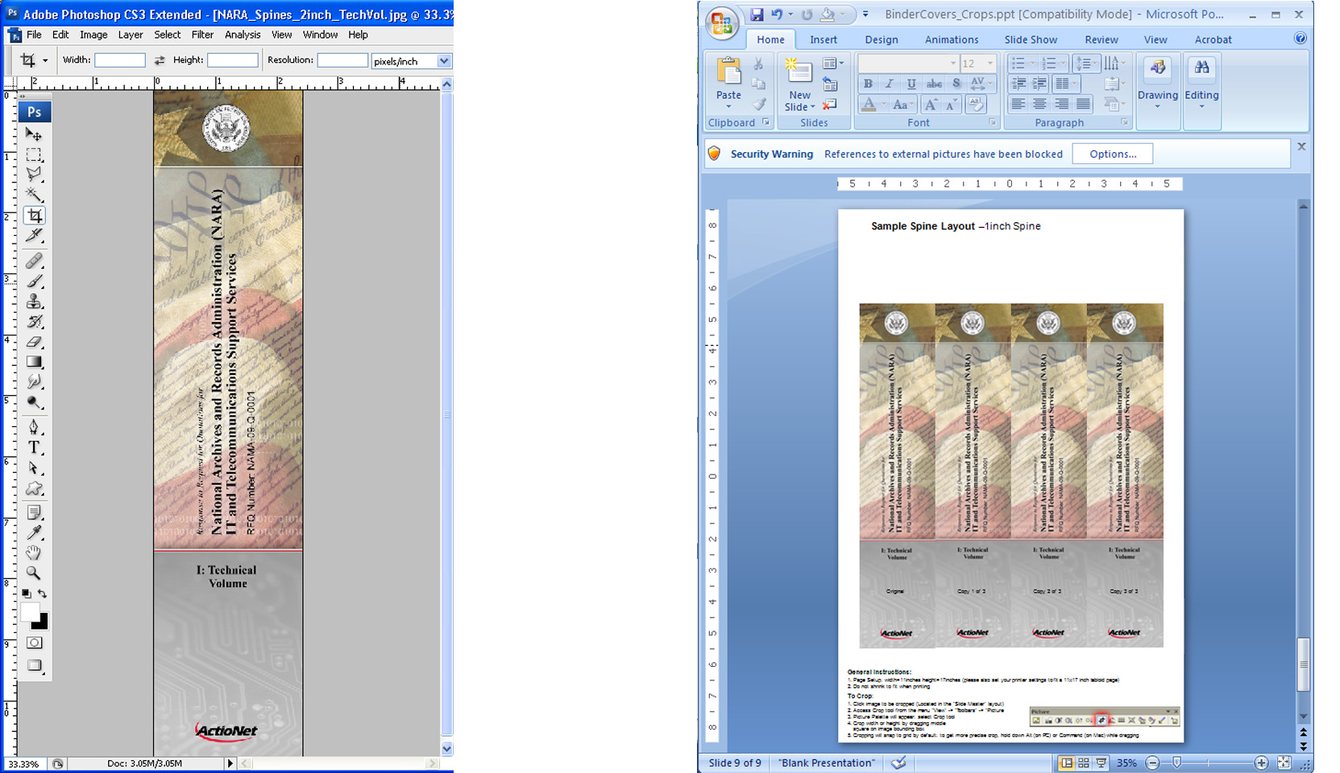
Deliver
Proposal Packaging
Sample of spines – Photoshop to PowerPoint

Slide 88
Deliver
Proposal Packaging
Import JPGs from Photoshop to PowerPoint (200dpi/RGB at 11” tall by X” wide)
Leave text that changes soft in PowerPoint (i.e. volume and copy text)

Slide 89

MODULE 9 EXERCISE:
DISCUSS THE PLANNING PROCESS FOR PROPOSAL PRODUCTION – ARE THERE ANY CHANGES YOU WILL MAKE?
Notes:
Tools: proposal cover background artwork; cover/spine template (PPT)
Use existing RFP, cover artwork and templates, have students prepare covers and spines for final production.

Slide 90

Recap
What did you learn?
Name some visual principles.
What are the four steps of the graphics development process?
Name four design methods and some of the graphic examples?
What is your biggest take-away from this class?

Slide 91


Thank you.
Please contact us if you have questions
Olessia Smotrova
CSO
c: 240.246.5305
o: 301.384.3350
e: osmotrova@ostglobalsolutions.com
http://ostglobalsolutions.com
David Huff
CEO
c: 513.316.0993
o: 301.384.3350
e: dhuff@ostglobalsolutions.com

