Slide 1
Desktop Publishing for Proposal Professionals
OST Bid & Proposal Academy Course
Copyright © 2012-2024
www.ostglobalsolutions.com

Slide 2
Agenda
09:00 – 10:30 AM Training
10:30 – 10:45 AM Break
10:45 AM – 12:00 PM Training
12:00 – 01:00 PM Lunch Break
01:00 PM – 02:45 PM Training
02:45 PM – 03:00 PM Break
03:00 PM – 04:00 PM Training
04:00 PM – 05:00 PM Flex
Please, give yourself the benefit of focus and limit email and use of cell phones to breaks

Slide 3
Introduction and Learning Objectives
Upon completing this course, you will have learned and be able to practice:
Understanding desktop publisher’s role and key attributes Locating all the key desktop publishing commands and functions in the Microsoft Word Ribbon Using the Ribbon, the Quick Access Toolbar, and keyboard shortcuts to save time on formatting and navigation Choosing a color palette Designing organized document templates and style sets Working with Microsoft Word’s automated tools to create reference tables | Importing raw content from multiple sources into a single file Implementing document design Inserting and captioning graphics Formatting text into tables, and captioning tables Completing a production run Conducting white glove reviews, aka book checks Testing soft-copy collateral Packing and labeling hard copies for shipment or hand-delivery Preparing receipts Completing electronic submissions using Adobe Acrobat

Slide 4
How to Maximize the Learning Process
How adults learn:
Understand WHY things work a certain way
Participate in exercises
Ask questions
Relate the material to your own experience
Take notes
Bring up topics of interest to your job
Move around during exercises

Slide 5
Introductions – Who is Who
Your Name and Position
An interesting fact about your life or career
Your level of experience: Beginner, intermediate, high-level?
What are you looking to get out of this training?
Notes:
The purpose of this slide is to get the conversation going:
Either have each person introduce themselves with interesting facts (don’t let them say they don’t have them).
In smaller classes: have each person sitting next to another confer for 3-5 minutes, and have people introduce each other to the team.

Slide 6
Module 1
Introduction and Setting Up Your Template

Slide 7
Characteristics of a Great Desktop Publisher
Great desktop publishers have the patience of Job, are fast, and have great stamina
Attention to detail, including editing glitches
An eye for aesthetics
Remaining cool-headed under pressure
Understanding of composition and design
Computer-savvy
Rather than panicking in the face of a mysterious formatting problem, ability to:
Remain curious and interested
Think the way the computer thinks about rendering a document
Technical mastery of Microsoft Word and Adobe Acrobat Pro
Ability to fix graphics issues in a pinch when a graphic artist is not available
Understanding of the RFP and proposal constraints
Important requirement: Have the latest versions of software and reliable hardware
Notes:
The Microsoft Office programs are the standard in desktop publishing for government proposals.
Even if you know Adobe Creative Suites software like InDesign and Photoshop, you can still do a lot in Word or PowerPoint to build a visually compelling proposal. Therefore, for those who are trained in graphic design using those programs, this class will show you comparable techniques in Office.

Slide 8
Getting Familiar with the Tools
Layout: Page size, margin size, one or two columns
Header and Footer (Insert-> Header, Footer)
Theme Colors (Design-> Colors)
MS Word has ribbons that contain tools grouped by function. Ribbons appear and disappear as needed.
Styles
Heading numbering
Tables
Graphics
Focus boxes
Always read the solicitation for formatting instructions!

Slide 9
Important Desktop Publishing Word Tools
2
3
3. Show/Hide tool to show nonprinting characters, so that you could see and manipulate spaces between words, paragraph breaks, page breaks, section breaks, tabs, anchors, etc.
1
1. Format Painter to quickly copy formatting from one part of the document to apply to the other.
Select the text whose format you want to copy.
Click the Format Painter button in the Clipboard group of the Home tab
After you click the Format Painter, your cursor will change to include a paintbrush icon. Then click and drag to select the text you want to format. The selected formatting will be applied to this new section.
Double-click on the Format Painter to apply the formatting to multiple areas. Press the 'ESC' key or click the Format Painter button again to turn it off once you're done.
2. Clear All Formatting to remove formatting options that had been applied to the selected text so the text matches the default Normal Style of the document.

Slide 10
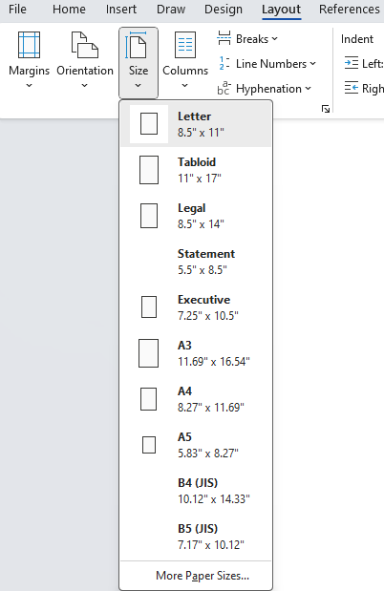
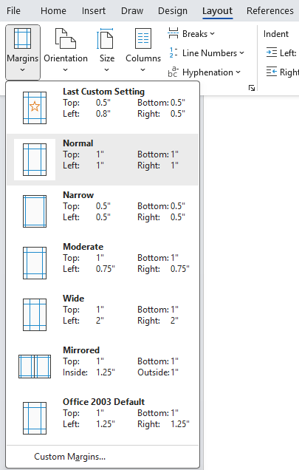
Page Size and Margin Size
Always check the RFP instructions for page size and margin requirements
Page size:
Usually 8.5” x 11”
Sometimes Tabloid 11” x 17” foldout is allowed
Check: does it count as 1 or 2 pages?
Orientation: Portrait for text, Landscape for Tabloid foldouts
Legal (11 x 14) is rarely allowed; it’s a portrait foldout
Margins
Usually 1” margins top, bottom, and left/right
Sometimes a combination of 1” (top/bottom) and 0.75” (left/right) or 0.75” all around

Slide 11
Deciding on Proposal Layout
1 column
2 columns
¾ columns (primarily commercial)
Every layout type has its advantages and disadvantages, and impacts readability and impression from your proposal
Notes:
The ¾ column style is becoming popular, but they do use a lot of space. Column 1 is still the norm but with left justification.

Slide 12
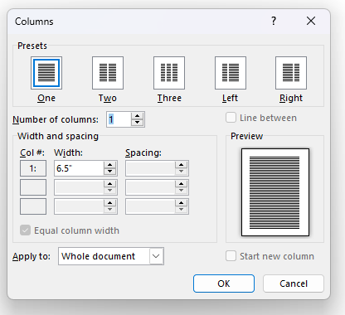
One or Two Columns
One Column
Document is easier to edit and format, especially if using simultaneous editing in such platforms as SharePoint
Tables and graphics are easier to insert and balance with text (when there is too little text and too many visuals, two-column layout looks terrible)
There is no need to balance out the columns at section ends
You can use “invisible” tables for multi-column lists to save space
Two-Column
Looks sharp
Can be easier to read if proposal is text-heavy
Will save about 10% of space in tight page-count proposals
Allows to cheat by reducing spacing between columns (the “gutter”) and separating columns with a “Line between” and minimal white space
Must use multiple columns with landscape formats, although RFPs often prohibit text on tabloid size paper counting as 1 page

Slide 13
Most Readable Formats
Research results by Christine Menna, University of Pittsburgh at Jonestown, 2011
Readers are most willing to read the ¾ page format with pictures and focus boxes in the margins – few can do that on Government proposals that are predominantly page-limited
Double-column text and single-column are no different in reader willingness, readability, and comprehension, as long as there are pictures
Color + Graphics = Readability
All important information should be presented at least 3 times for greater comprehension (your win themes should appear a few times in different forms)
Notes:
It is always best to read the RFP and know what your company prefers.

Slide 14
Please, Complete an Assignment or Quiz for Module 1 Prior to the Next Module

Slide 15
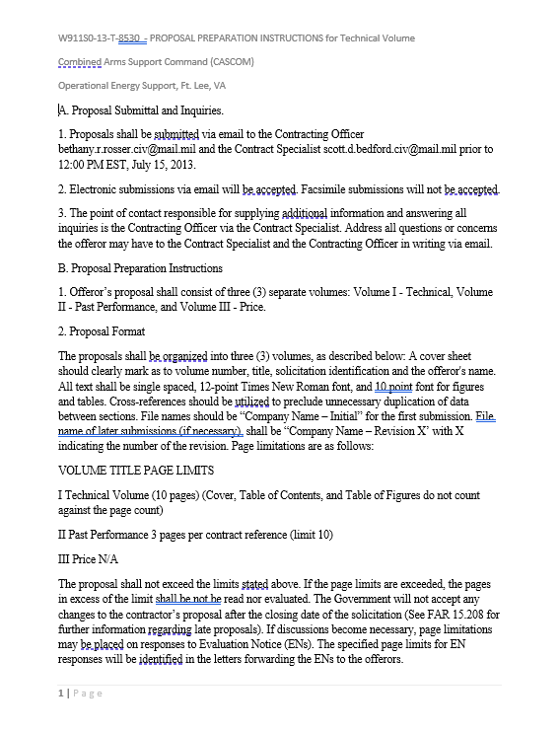
Module 1 Exercise: Assessing the Level of Effort
This is a learn-by-doing course
Open the practice content documents and get ready to complete tasks as we go through the class
List what you see broken in the document: assess the level of effort
Use the following files:
Proposal: Module 1 Volume I - Technical Proposal for Formatting.docx
RFP: Module 1 Proposal Preparation Instructions.docx
Notes:
Exercise Document: Volume I – Technical Proposal for Formatting.docx. This is the primary working document throughout the class. So, participants should keep it readily available for the day.
Hint: To easily switch back and forth between windows on your compute, hold Alt and Tab. Then choose the window you need to use.

Slide 16
Module 2
Theme Colors

Slide 17
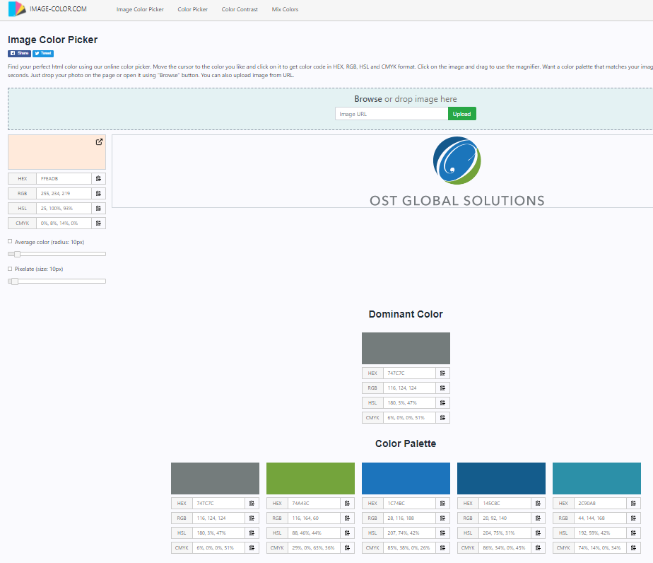
Creating a Color Palette From an Existing Graphic
Choose a source graphic – your logo or your customer’s logo, for example
Note: Check with your graphic artist or corporate marketing department to make sure there is not already an existing palette
Search for “image color picker”
Upload your source graphic
Copy down the RGB or hex codes – these are the numbers you will use to set your palette in Word
Notes:
May want to find your company color values to keep track of them and use as highlights/themes. Be sure to name it if you create your own color theme.

Slide 18
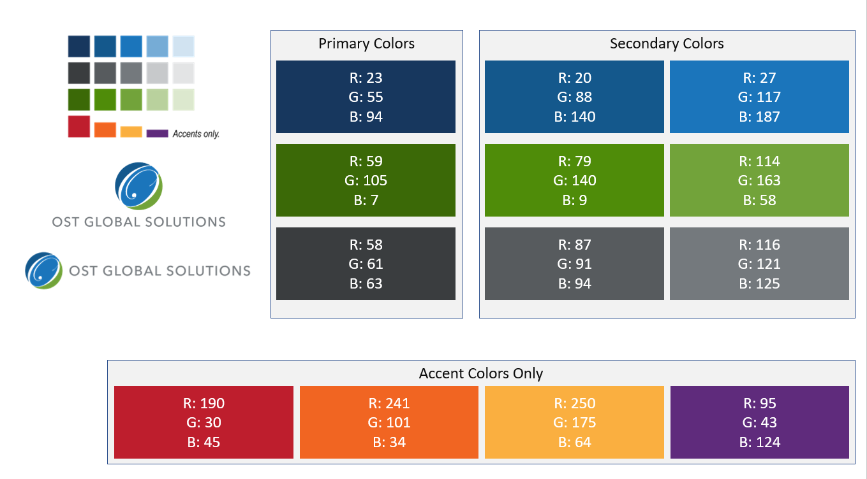
Example of a Color Palette
See Module 2 Color Palette Example.pptx for OST’s example of a color palette for corporate guidance

Slide 19
Please, Complete an Assignment or Quiz for Module 2 Prior to the Next Module

Slide 20
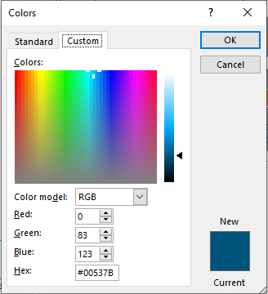
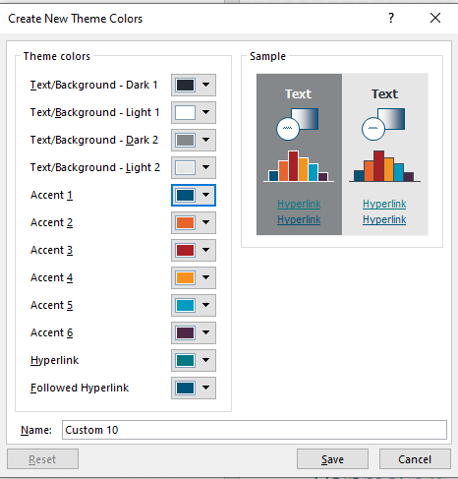
Module 2 Exercise: Set Up Template Theme Colors
Practice Tasks:
Open and save a blank document
Set up theme colors using your company’s or OST’s RGB or Hex colors
Program at least four accent colors

Slide 21
Module 3
Fonts and Styles

Slide 22
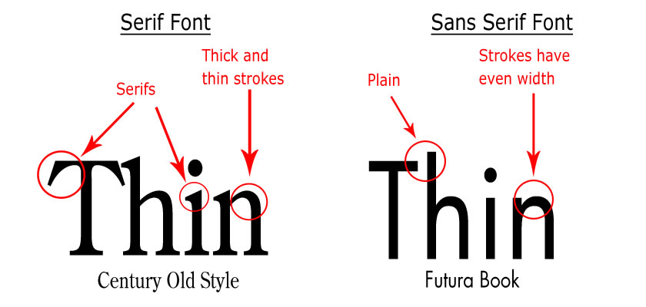
Font Basics
To help evaluators not skip the important sections, you must visually structure the document so that the main ideas catch the readers’ attention
Typography:
If you have a choice, use Sans Serif font for graphics and headings (Arial, Calibri, Arial Narrow for space purposes)
If the RFP says all text shall be 12 Times New Roman, then you cannot use Sans Serif in headings
You can use font size larger than 12 for headings
Serif fonts are easier to read in continuous text (Times New Roman) than Sans Serif fonts (Arial, Calibri, etc.)
ALL CAPS IN TEXT REDUCE READING SPEED BY 13-20%
Continuous italics type significantly reduces reading speed
Underlining looks dated
Readers pay attention to contrast among typographic elements such as bold, light, bold italics
Notes:
Hints:
Serif fonts are considered better to use for large documents.
All caps are also easier to read; consider using all caps (or small caps) for headings, at least.
Avoid italicizing unless you’re trying to call attention to something, because it slows readers down.
Avoid underlining; it looks dated. Call attention with bolding instead.
Most evaluators don’t want a lot of fonts. Use only a few complimentary fonts.

Slide 23
Text and Paragraph Styles Design Considerations
Comprehension increase is important in evaluators’ ability to appreciate positive aspects of your proposal
Use fewer fonts—one for text, one for headings, and another one for captions
Use Align Left text as a preference
Justify text saves space and looks crisp but reduces readability due to uneven spacing
Use Center text sparingly
Minimize the use of all-caps if you want the look of all-caps, use small-caps instead
Be mindful of the “alphabet-and-a-half rule” to choose the right font size and decide whether you can wrap text around graphics or not
Alphabet-and-a-half line length rule: When inserting focus boxes and graphics and wrapping text, the alphabet-and-a-half rule places the ideal line length at 39 characters regardless of type size. Measure the line length in inches or picas for your chosen body copy font using the alphabet-and-a-half rule. This is one of the measurements you'll use in finding the ideal line length/column width for your proposal (if you have a choice, of course).
Lines of type that are too long or too short slow down reading and comprehension. Combine the wrong line length with the wrong type size and the problem is magnified.
Lines of type that are too long or too short slow down reading and comprehension. Combine the wrong line length with the wrong type size and the problem is magnified.
Lines of type that are too long or
Notes:
Captions should be left justified, not centered.
Use the “Alphabet and a Half” rule: 39 character maximum for callout boxes. Don’t use the same text in the call out box as in body. Make sure that the call out information is discussed in the body text. Content should be in addition to the main content, not just repeated.
Always left-align rather than justify; studies have shown that it’s easier to read.

Slide 24
Word Styles Save Time and Make for a More Robust, Navigable Document
Home tab contains Styles. Click to open the full list of Styles.
Styles:
Are a desktop publisher’s key to enforcing consistency throughout the document
Allow you to “jump” around the long document and move entire sections of the document in seconds
Save time on generating reference tables
Let you quickly implement changes across the entire document
You can apply a style to a paragraph by placing the cursor in the text, and either selecting the style from the Styles on the Home ribbon, or by opening up the full list of styles and clicking on the name of the style
Always apply formatting to text in a document as part of a defined style, not randomly (ex: you are making a mistake if you want to italicize one of your headings and manually do it – change your style instead)
Notes:
- Control Shift Space people use it to keep words linked. Needs to be turned off. Try Find/Replace to turn it off.
Many use Heading style for TOC
Object: Have all text selected and have a style assigned to it. Makes it easier to make a global change to different parts – headings, body text, ….
Good idea: Remove/delete unnecessary styles.
Manage Styles – Styles then to 3rd icon at the bottom
Can Modify Styles = Manage=>Modify
Uses body text instead of Normal; RFP may dictate.
Rule: Limit to 5 Headings. If using too many, may need to develop new sections rather than more headings.
Often uses Format Painter with Styles. Sometimes one works but another doesn’t.
Beware of soft breaks (show the paragraph icon). Can screw up application of Styles. Good idea to find them and remove them.

Slide 25
Styles Establish Visual Hierarchy
Ordering of images, headers, and text helps evaluators quickly understand relative importance of document’s elements and helps skim the document effectively
Heading 1 style should be larger, brighter, bolder, or otherwise more prominent than Heading 2, 3, and so on
Indenting should be clear on bullets and sub-bullets
The most important items on the page should be larger than the least important
Important win themes, key words, or discriminators should stand out in callout boxes or pull-quotes
Notes:
Headings:
Use headings to create a visual hierarchy, where H1 is the largest and H4 (or lower) is the smallest). Headings should be bold and, preferably, different colors from the body text so they stand out even more.
You can right-click on the styles (e.g. Heading 1) and select:
“Update Heading 1 to Match Selection” (Use this after applying outline numbering to headings to sync up the heading 1 style with the chosen numbering scheme. If you’re getting errors when you try to apply caption numbers that line up with the outline, click this and try again.)
“Modify” (This lets you change the font, colors, size, etc., for all content with the Heading 1 or other style applied to it.)
Others:
Don’t use blurry pictures
Don’t use font larger than 14 (see next)

Slide 26
Determining Styles Requirements
Search the RFP for font instructions for text, tables, and graphics
If not provided, default to Times New Roman 12 for text and Calibri or Arial Narrow for tables and graphics (Arial Narrow is less attractive but allows you to fit more text in the graphic in page-limited proposals)
Modify the minimum set of Styles in your document:
Normal [Body Text is a derivative style from Normal that prevents unintended changes made to paragraphs but it is unnecessary and creates an extra step, because when you use Clear All Formatting, you will default to Normal]
Bullet 1, Bullet 2, Numbered list
Headings 1-5 or deeper depending on your outline
Tables
Header and Footer styles
Captions for graphics and tables
Callout box
Table of Contents, Table of Figures, Table of Contents and Table of Figures Heading
The Normal style is the basic text style that Word uses in the document
It is the foundation for all or most of the other styles you define
When removing formatting from a section of text, it reverts to the Normal style
Be careful when changing the Normal style in a large document, as you may cause unintended effects such as text spreading out over the page limit, messing up tabulation, and so on

Slide 27
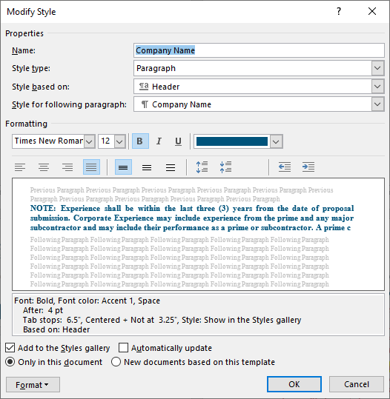
Parent and Child Styles
Parent styles such as body text are based on no style to prevent style corruption
Child styles such as bullet in a paragraph or table are based on parent style such as body text (‘Style based on’)
Changes in parent style automatically cascade through the child styles

Slide 28
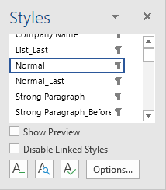
Creating and Editing Styles in Word
To create a new style in Word, create a section of text with the properties you want, then highlight it and right-click
In the drop-down menu, select Save Selection as a New Quick Style…
When you access the dialogue, you will have additional options to modify the new style
Alternatively, you can open the Styles pop-out menu and click on the New Style button
To edit an existing style, you can right-click on it in the Quick Style Toolbar or the Style menu and select Modify
Notes:
Styles stick. Table formats don’t always stick from version to version of Word.

Slide 29
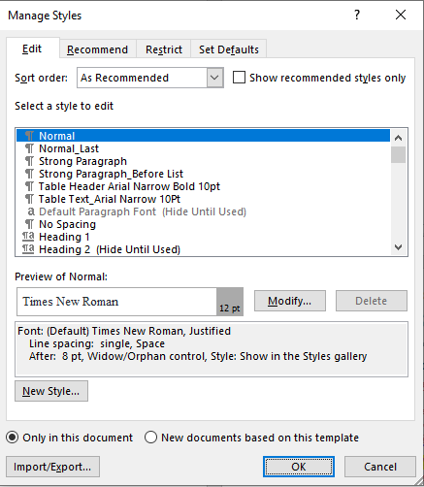
Managing and Importing Styles, and Using Quick Styles
Open the Styles menu, and click on the rightmost bottom button to open the Manage Styles window
From here, import styles from a pre-existing template, clean up the list of styles, and select which styles appear in Quick Styles
Display only the Normal style, the number of headings corresponding to the document outline, and a bulleted list style in Quick Styles for the authors and editors
Remove anything you will never use
This is critical when your company reuses the same templates repeatedly, as different styles get built up like dust bunnies under the sofa
Having too many styles defined can lead to strange errors and mishaps
Under Recommend tab, you can Assign Value to set priority of styles, show or hide styles, and sort files alphabetically

Slide 30
Setting Up and Numbering Headings Styles
Manually numbered or automatically numbered?
Manual: Easy to use, especially for unusual numbering schemes, but onerous to update and may result in errors
Automatic: Save time, allow for chapter numbers in figure and table captions and page numbers, enable cross-reference to headings – but need to manually set sequence starting number if not “1”, and require hidden text to manage unusual numbering sequences
How many levels deep?
Consult the proposal outline
Are you allowed to use color in the document by the RFP?
Can you use a Sans Serif font per the RFP?

Slide 31
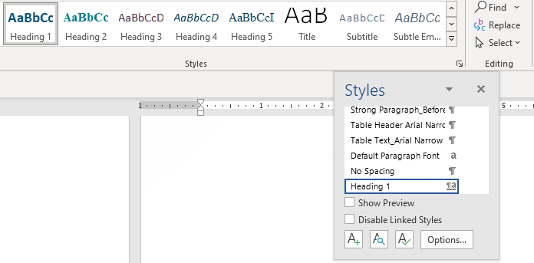
Cleaning Up Existing Style Sheets for Fast and Reliable Formatting
If you have been provided a template, de-cluttering styles early on will help keep the document clean
Click
To prevent the style sheet from becoming crammed with unused styles, consider setting the default paste to text only
Under File → Options → Advanced → Cut, copy, and paste → Change the first four options to Keep Text Only
To delete an unused style, open the Styles window, open the drop-down menu for the style, and select Delete style
or
You can also add a style to Style Gallery if it is not there

Slide 32
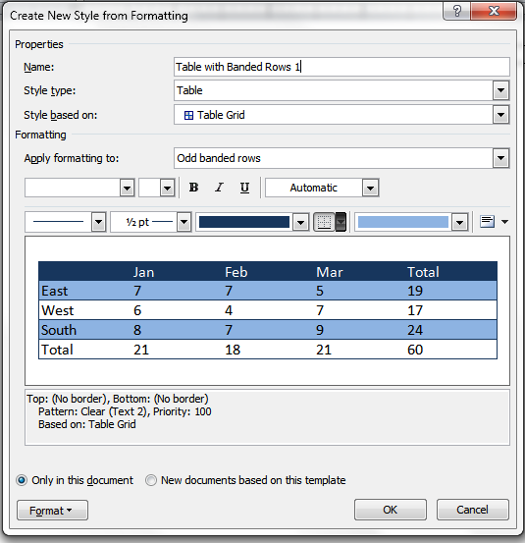
Defining Table Styles
Insert a 1 cell x 1 column table and place your cursor inside it to access the Table Design Ribbon
Expand the quick table styles drop-down, and select New Table Style…
Give the table style a descriptive name
Apply formatting to the whole table and different rows and columns
Change text alignment
Cell fill color
Choose which borders to apply
Change weight of borders
Click here in the ribbon to pull up the menu on the left
Choose border style
Advanced formatting options
Notes:
Creating a Template for Tables:
Insert a blank table, and format it as desired. Apply all font colors, styles, sizes, shading, and border colors you want your template to have.
Select the entire table.
Click the Insert ribbon up top.
Go to “Table” → “Quick Tables” → “Save Selection to Quick Tables Gallery”.
Name and save your table. You can now insert that style table any time you want without having to reapply all the special formatting.

Slide 33
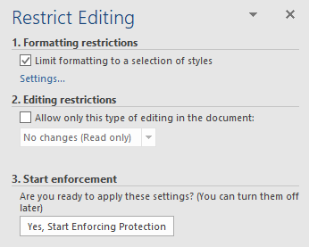
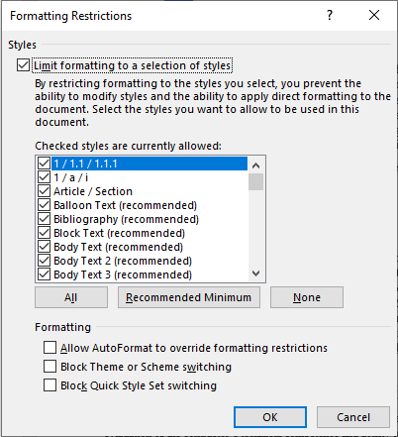
Keep Your Template Clean
Limit formatting by going to Review -> Protect/Restrict Editing
Under Formatting Restrictions, check Limit formatting to a selection of styles
Click on Settings to select styles
Click Yes, Start Enforcing Protection
Add password

Slide 34
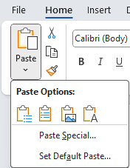
Importing Content into a Clean Document
Pasting from different programs requires different techniques to account for the quirks of moving data between programs
Use Paste as Keep Text Only when importing large blocks of text from one document to another
Use the same method when copying from a PDF or the web – be aware that text imported from PDFs often has hard returns at the end of every line and header and footer text; you may want to export it first into Word
When pasting from Excel, highlight the range of cells you want to bring in, then press Ctrl + V to insert the content as an unformatted table
When pasting from PowerPoint, make sure all your graphical elements are highlighted and grouped together; paste graphics as a PNG
Notes:
When pasting, consider the different Paste options.
If you grouped things in PowerPoint, you can bring it them over grouped but will have to edit individually.
When importing an image from InDesign to Word, determine the size needed from Word and set the image to that size in InDesign before importing. Don’t resize in Word.
Another Way: do the graphic in Power point and link it with text boxes. Makes it easier for editing by others. It may not be editable if you start with InDesign.

Slide 35
Please, Complete an Assignment or Quiz for Module 3 Prior to the Next Module

Slide 36
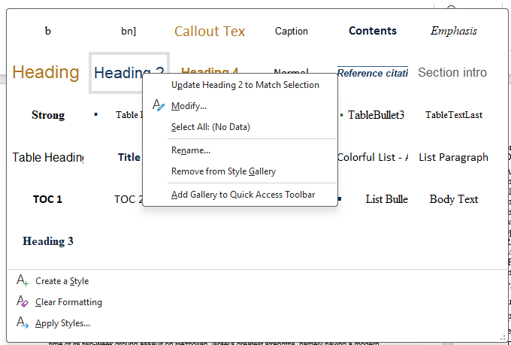
Module 3 Exercise: Creating and Applying Heading Styles
Practice Tasks:
In your newly saved clean proposal template, modify Normal style to match RFP requirements
Add text from the practice proposal to the clean template using the Paste Option of Keep Text Only (T)
Modify heading styles in your practice template document by right-clicking on them. Practice two ways of doing it:
Update Heading to Match Selection based on the way you format the heading in the document
Modify Style to create a heading style
Apply correct styles to all of document’s headings
Right-click
2
1
Use the following files:
Your new saved proposal template document
Practice proposal: Module 1 Volume I - Technical Proposal for Formatting.docx
RFP requirements: Module 1 Proposal Preparation Instructions.docx

Slide 37
Module 4
Headers and Footers

Slide 38
Header and Footer
A Header and Footer ribbon will appear by double-clicking in the header or footer of your document
Otherwise find Header and Footer in the Insert ribbon
To get out of Header and Footer, double-click anywhere in the document’s text
Header and Footer typically follow the RFP-specified font size for graphics instead of the text, but double-check to ensure there are no specific instructions for header and footer font size and what to include or exclude there
There are different ways to format but an easy solution is to insert an “invisible” No Border table with columns to insert the Header and Footer elements:
Header elements example: Column 1: Company logo; Column 2: Proposal in response to [solicitation name, solicitation number]
Footer elements example: Column 1: Volume number and title; Column 2: Legal disclaimer; Column 3: Page number
More time-consuming header and footer format: setting up tabs to insert elements
Play with the Position from top and bottom to fit the information needed – don’t go down past 0.2 or your header information may be cut off if the document is printed
Avoid text boxes and floating logo and lines
Position is the distance of the header from top of the page, and footer from bottom of the page to control how your margins look

Slide 39
Navigating the Headers and Footers Ribbon
Link to Previous is a key function – it allows you to change the content of headers and footers between sections of the proposal. Use section breaks.
Distance of the header from top and footer from bottom helps keep your margins compact
Automated page numbers live here
Don’t use – copyright issues and tacky
If you are required to print double-sided, using different odd and even header and footer designs will create a sleek look in production
Never use pre-generated headers and footers, or automatic parts other than page numbers
Use this to insert company logo
Use this when you only need a cover page and no front matter
Notes:
Adding page #’s to footers: If you want to avoid erasing the text you’ve already entered in your footer, click where you want the page # to appear (left, center or right side of footer), then select “Page Number” → “Current Position”

Slide 40
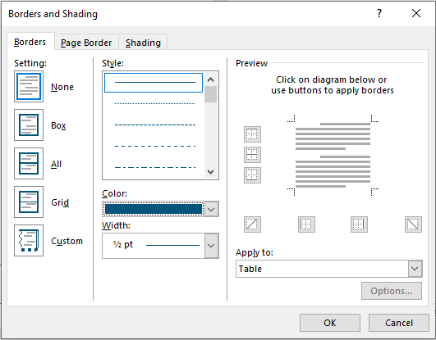
How to Show the Line in the Header and Footer
Table Design Ribbon appears as you click on the table
Expand the Borders and Shading menu
Make three sides of the table invisible by clicking on the table diagram for one border (top or bottom) to show
Set the color you want and the width of the visible line

Slide 41
Please, Complete an Assignment or Quiz for Module 4 Prior to the Next Module

Slide 42
Module 4 Exercise 2: Build Your Header
Start with inserting a 2-column table, align your left and right cell margins to 0” in Table Properties.
Practice Tasks:
Open a blank Word document
Set up the header using the proposal information provided in the file Module 4 Header and Footer Info.docx
Insert YOUR .PNG logo in 150 or 200 pixels per inch (PPI) (don’t use customer’s logo due to copyright limitations); set the logo graphic to be in front of text for easy manipulation; align the logo to text. Add RFP information (RFP # and title) using Header style; align right.
 | RFP #2324R-3345PV Consulting Support Services for the Office of Director, OCIO
Get rid of table borders in the Table Design ribbon that appears when you click on the table; keep bottom border if you would like to have a line and give it a color and set width.
Important: Always check the solicitation to see if it prescribes what to put in the header and footer
 | RFP #2324R-3345PV Consulting Support Services for the Office of Director, OCIO
Set paragraph below table font height at 6pt

Slide 43
Module 4 Exercise 2: Build Your Footer
Practice Tasks:
Set up the footer using the proposal information provided in the file Module 4 Header and Footer Info.docx
Start by inserting a page number (Insert or Header and Footer > Page Number > Current Position (and pick the style); align right the page number; hit enter; and insert a 3-column table and align your left and right cell margins to 0” in Table Properties.
1
Use Footer style. Insert Volume number and title on the left, put disclaimer in the middle and center it.
Volume 1 Technical Proposal | Use or disclosure of data contained on this sheet is subject to the restriction on the title page of this proposal. | 1
Get rid of table borders in the Table Design ribbon that appears when you click on the table; then pick the color, width, and the top border.
Important: Always check the solicitation to see if it prescribes what to put in the header and footer
Volume 1 Technical Proposal | Use or disclosure of data contained on this sheet is subject to the restriction on the title page of this proposal. | 1
Set paragraph font size to 6 pt above the table and play with distances: Header from Top, Footer from Bottom.

Slide 44
Module 5
Proposal Cover and the Front Matter

Slide 45
Creating Compliant Front Matter
Check how many separate items of front matter the RFP calls for:
Cover page? TOC? Table of Figures? Table of Tables? Glossary? Acronyms? Cross-Reference or Compliance Matrix?
Reference tables may be combined into a single section
Go to the Layout ribbon, and under Page Setup, click on the Breaks drop-down menu
Insert as many Next Page section breaks as there are pieces of front matter required
When adding in front matter, make sure you enter text and objects above and to the left of the section break
Make sure any legal language the RFP calls for is added to the cover page and body footer, as needed
Notes:
See what front matter the RFP calls for, such as a cover page, table of contents, glossary, acronym list, etc.
Go to Page Layout → Page Setup, and click on the Breaks drop-down menu.
Insert as many “Next Page Section” breaks as there are pieces of front matter required.
Add text and objects above and to the left of section breaks as you add in the front matter.
Add any legal language needed to the cover page and footer, as required.
Insert a Table of Contents (and Table of Figures, if needed). You can update it later, after adding all captions, by right-clicking on the ToC and selecting the “Update” option.

Slide 46
Making Placeholders for Reference Tables
First, make your table of contents:
Place your cursor above or to the left of the section break in the section immediately after the cover page
On the References tab, under Table of Contents, select the Table of Contents drop down menu and then choose Automatic Table 1
Depending on how complex the structure of your proposal is, you may want to go to the Add Text drop-down next to the Table of Contents menu, and de-select Heading 3 – you only need to include it if your headings go four or more levels deep or if the RFP requires it
Add a Table of Figures and/or Table of Tables if needed:
Either in the same section as the Table of Contents, or in the section following
To get a Table of Figures or Table of Tables to generate correctly, you must use the Insert Caption command to create all captions in the document

Slide 47
Updating and Troubleshooting Reference Tables
Once the document is fully formatted, go up to the front matter at the top of the document, right-click in each reference table, and select Update Table from the drop-down menu
Carefully check each table for missing or duplicated numbers, broken page numbering, or other unsightly errors
Ensure each table breaks neatly across pages, and doesn’t have Widows, Orphans, or blocks of white space between tables
If using long narrative captions for your figures and tables, you may choose to just have the numbering and title in the reference table
Be aware that you will have to remove this text every time you update the table

Slide 48
Please, Complete an Assignment or Quiz for Module 5 Prior to the Next Module

Slide 49
Module 5 Exercise: Setting Up the Cover and Inserting TOC
The government will usually specify the front matter and design elements you need to include in your proposal – typical requirements include:
Reference tables, such as a table of contents, a table of figures, or a table of tables; table of acronyms; compliance or cross-reference matrix
Information requirements for the cover page, such as solicitation number, offeror name and address, due date, and possibly signatures of senior leadership
A specific legal disclaimer for the first page, and other pages
Be ready to separate individual front matter elements with section breaks
Allows you to modify headers and footers within individual sections; for example, you don’t want page numbers on your cover page, and you often might want to use Roman numerals for front matter and Arabic numerals for the body of the proposal
Practice Tasks:
Read the Instructions or Section L carefully for cover design requirements
Create a cover for the proposal document
Insert a Table of Contents (TOC) into your practice document
Files:
Consult the Module 5 Typical Cover Components.docx file for instructions on what to include in a typical cover
Consult the practice RFP
Work in your proposal template

Slide 50
Module 6
Paragraph Spacing; Working with Graphics, Tables, and Callout Boxes

Slide 51
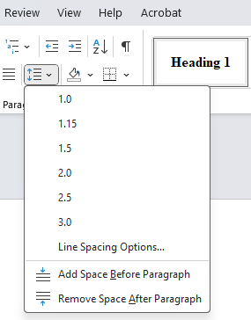
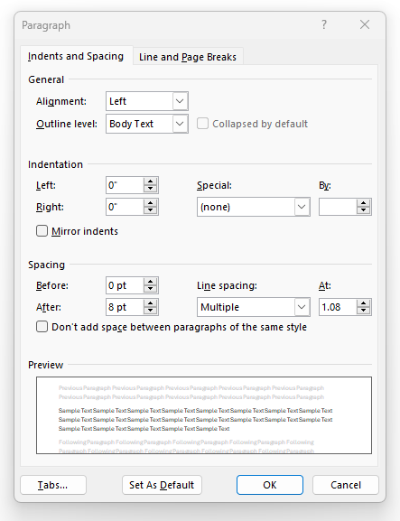
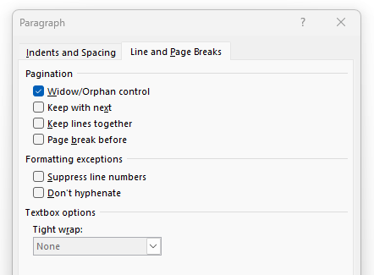
Set Up Paragraph Spacing
The more “negative space” you can afford to include in your document, the more readable and appealing it will be
Don’t use space to break up paragraphs – use pre-programmed paragraph spacing instead
When setting up paragraph style (Create a Style, New Style, or Modify Style -> Format -> Paragraph), use 1 or 1.15 spacing within paragraphs, or 1.50 if you have plenty of page count to spare
If the solicitation doesn’t tell you otherwise, add at least 6pt spacing after each paragraph to break up walls of text; using 12 pt spacing for 12 pt font, 10 pt spacing for 10 pt font is appropriate
Correct by using Widow/Orphan control and Keep with next later so that there are no lonely headings at the bottom of the page
Make sure your heading styles use a hanging indent instead of allowing the second line to begin at the margin
Set bulleted and numbered lists apart from the rest of the text using indentation
Indent bullets by at least ¼” from body text on the left side
Use hanging indents for multi-line bulleted or numbered text
Notes:
Newspapers and books are moving away from fully-justified text. It’s becoming the old way. The eye can read quicker with left-justified text.
Suggestion: Use Word Options => Proofing => AutoCorrect . Input things/tips you use often so it does the work for you.
Rulers help with formatting the bullets – using the large and small arrows. You can also use Styles for bullets.
Body Text:
Before you start writing a proposal, add a line of text and format it the way you want your main text to look throughout the proposal (e.g. Times New Roman, 11 pt., single spaced, with 6 pt. spacing after each paragraph). You can then select the text, right-click on “Normal” in the style menu, and choose “Update Normal to Match Selection”.
Once you’ve set the specifications for normal body text within your document, you can highlight any paragraph(s) and apply all desired settings simply by clicking “Normal” in the style menu.
Spacing: Use the darts in the ruler to adjust the spacing between bullets and text, or to move bulleted lists closer to the left margin (especially when you need to cut pages from a proposal).
Headers & Footers: Adding page #’s to footers: If you want to avoid erasing the text you’ve already entered in your footer, click where you want the page # to appear (left, center or right side of footer), then select “Page Number” → “Current Position”.
Labels for Tables & Figures:
Tables: labels go above.
Figures: labels go below.

Slide 52
Inserting Graphics Seamlessly Into the Document
Before you insert a graphic, check to make sure that it is sized properly for the space allotted for it
One of the biggest ‘no-no’s’ for a desktop publisher is manually resizing a graphic once it’s been pasted into Word – the proposal may be thrown out due to non-compliance on minimum font size in graphics
If the graphic artist has rendered a picture that is way too big or small, ask them to resize it to the full width of the margins allowed in the document, or to half of width
Insert each graphic alone, or into a text box, frame, or 1-cell by 1-column floating table (tables may cause unintended spaces in adjacent text)
Make sure that the graphic is placed inside the page margins
If inserting a floating graphic straight into a document, Group the graphic and its caption so that they stay together
Move the text above or below the graphic to eliminate white space but ensure the graphic is called out before it appears in the document: Ex. … shown in Figure 8, Organization Chart.)
Use the auto-caption feature on every graphic, either by right-clicking and selecting Insert Caption from the drop-down menu, or by clicking the Insert Caption button on the References Ribbon
If you move graphics around in the document, highlight the captions and press F9 to ensure the numbering stays in the correct order
Notes:
Graphics:
If you insert graphics from Adobe InDesign or Photoshop, make sure you start with an 6.5” x 8” canvas (if your proposal has 1” margins), use the RFP-specified font size for graphics in your design, and do not shrink the image after inserting it into Word.
It’s better to design graphics in PowerPoint, use the “Insert SmartArt” function, or insert images without text and add text boxes over top in Word to maintain version control and ensure that anyone can edit the text later, if needed.
You can anchor images and call-out boxes to a particular place in the document so other editors can’t move them around.
Use “in-line with text” option for larger graphics that appear in between paragraphs or the “tight” option to get text to wrap around call-out boxes.

Slide 53
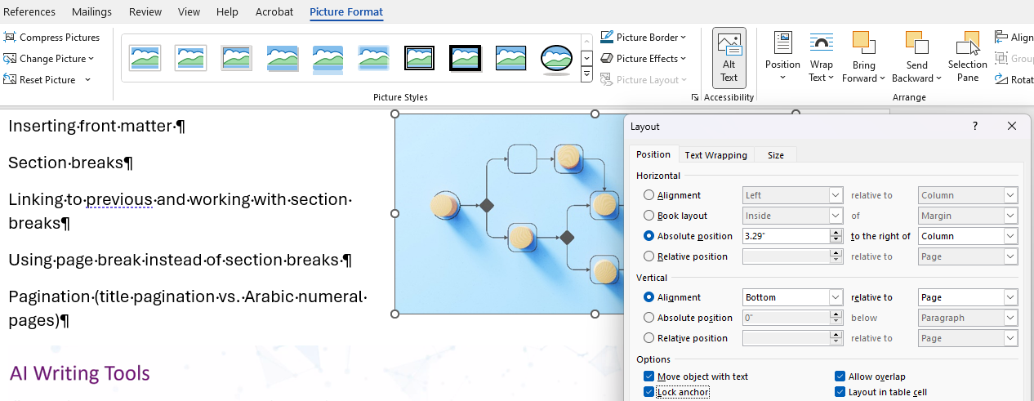
Anchoring Graphics
The use of anchors is important in proposals where the placement of graphics relative to text matters, and they help you better control the layout and flow of your long document
When inserting a graphic, it automatically becomes anchored to the paragraph closest to the insertion point. You can move the graphic around, and the anchor will move to the paragraph that the graphic is closest to.
You can see the anchor symbol when you select the graphic and Show/Hide is turned on (click the ¶ button in the Home tab or press Ctrl+*). It’s a small anchor icon in the left margin at the beginning of the paragraph.
To change the anchor point, drag the graphic to a different paragraph, and the anchor will move with it, or cut the graphic and paste it where you want the new anchor to be.
To anchor a graphic to a particular paragraph, lock the anchor. Right-click the graphic, select Size and Position, go to the Position, and check Lock anchor.
The text wrapping settings of the graphic determine how the text flows around it and whether the graphic stays on a specific page or moves with the text. Change this by selecting the graphic and selecting Wrap Text. Choose Square, Tight, Top and Bottom, etc.

Slide 54
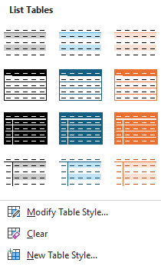
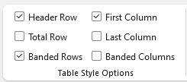
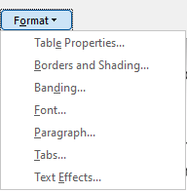
Formatting Tables
To apply a style to a table, insert a table and place your cursor inside the table. Then go to the Table Design Ribbon and click on the picture of the correct style
If you don’t see the style you want in the quick table styles top row, click on the downward arrow at the bottom right of the list to show all styles defined in the document
To create a style: Table Design -> New Table Style
If your table is more than a page long, make the header row repeat on the next page by going to the Table Layout Ribbon and clicking on Repeat Header Rows, under Data
Sometimes a table cell will contain a large amount of text, and will move the entire row to the next page instead of breaking in the middle – to prevent this, open the Table Properties, go to the Row tab, and select Allow row to break across pages
Adjusting the width of columns, either by dragging the cell borders with the mouse or by manually defining column widths on the Table Layout Ribbon, will allow you to make the most efficient use of space
Directly on the Table Design ribbon
At the bottom of the Table Style menu
Notes:
At times, the Split Cell and Merge Cell options may be useful.

Slide 55
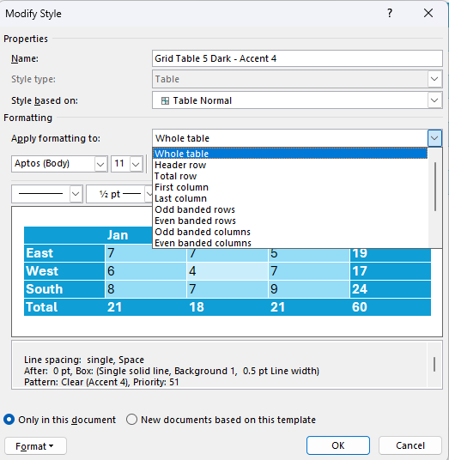
Table Banding
Banding is a way to improve the readability of your tables by automatically applying different formatting to alternate rows or columns. This visual distinction makes it easier for readers to follow the data, particularly in complex or lengthy tables that are common in proposals.
Apply banding to either odd and even rows and/or columns
Select the color and shading options for your bands to ensure that the colors have enough contrast with the text for readability for those with visual impairments (use Accessibility Checker) and are consistent with the proposal’s color scheme
Under the 'Format' options, set the pattern of banding – whether it is a two-shade alternation or a more complex pattern, like two light rows followed by a darker one, or interlacing of banded columns and rows
Define each element individually: Header Row, Total row, Banding Rows (main body of the table), First column, Last Column, or Banded columns
Format each table element separately

Slide 56
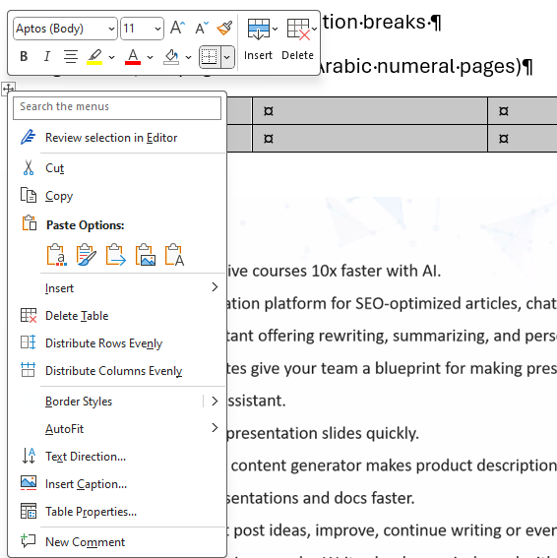
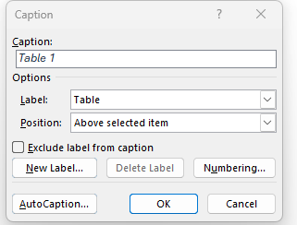
Labeling Tables
Caption goes above the Table (but below a Figure) because tables can continue trough multiple pages, and the reader needs to know from the Caption what’s going on without having to reach the end of the table
If you call both Tables and Figures an “Exhibit”, label all Exhibits above the table for consistency
Hover above the table and right-click on the cursor on the little square with crossed arrows or use the References ribbon, Insert Caption
Select Table from the drop-down menu if it is not already selected. If using the term "Exhibit" for both tables and figures, select Exhibit or add it as a new label if it's not available.
In the Caption box, type the caption text that you want to appear with the table
Ensure that the position is set to Above selected item for tables.
If an automated table of figures or table of tables, remember to update the references after adding or editing captions. Right-click on the table of figures or table of tables and selecting Update Field
Type the title here
Select the caption type: Table, Figure, …
Choose where to place the caption
Use to add an Exhibit option
Set up the numbering format

Slide 57
Troubleshooting Table Quirks
Common Table Issues | Remedy
Table splits across pages, separating rows that should stay together | To keep rows together, check 'Keep with next' in paragraph formatting for all cells in the row. For blank spaces, ensure 'Allow row to break across pages' is unchecked.
Table features are not working – cannot apply styles like shading or color fill | To apply table styles, select the table and use the Design tab options in Word. If that doesn't work, clear all formatting and reapply the style.
Cell margins are not adjustable, text too close to or hidden behind cell borders | To adjust cell margins, go to Table Properties > Options, and set the margins as desired. If text is hidden, consider resizing the cells or reducing the font size.
Automatic resizing of tables distorts layout when adding or removing text | To prevent automatic resizing, right-click the table, select Table Properties, and under Table tab, choose 'Preferred width' with a specific value.
Trouble with text alignment within cells | For text alignment issues, select the cells and use the alignment tools under the Home tab, or right-click and select 'Cell Alignment' to adjust.
Borders disappearing or not printing correctly | If borders are not displaying, select the table and manually set the borders using the Design tab. For printing issues, check the printer settings.
Headers and footers not repeating on subsequent pages | To repeat headers and footers, select the row(s), go to Table Properties > Row, and check 'Repeat as header row at the top of each page'.
Difficulty maintaining uniform row heights or column widths | To keep row heights and column widths consistent, manually set the height/width in Table Properties, or use the Distribute Rows/Columns feature under Layout tab.
Difficulty controlling the table's position on the page, affecting flow and design | For table positioning, use the Table Properties > Table tab to set the position relative to the page. Also, use text wrapping settings to adjust the flow around the table.

Slide 58
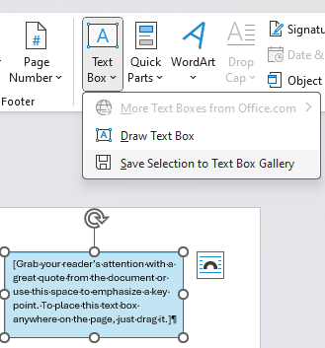
Adding and Formatting Focus and Callout Boxes
Focus and callout boxes are one of the places for showcasing win themes and any information you want to highlight; they also break up the monotony of text
Headline: 2-3 Lines Explaining or Summarizing the Bullets Below
4-7 Bullets 1-3 lines per bullet 12 to 18 total lines Use parallel construction with all bullets supporting the headline
Insert Text Box using Insert ribbon and use Shape Format ribbon to change fill colors, outline, effects, and more
In the Home ribbon, format the text inside the box – choose fonts, sizes, colors, and paragraph settings like alignment and spacing
Once formatted, under the Text Box drop down, Save Selection to Text Box Gallery. Give your new style a name, description, and choose the gallery where you want it to appear.
To use the saved style, go to Insert ribbon -> Text Box and find your style under Saved Boxes. Clicking it will insert a new text box with the style you saved.
Use a text box vs. a floating table since text boxes have borders, shading, and effects formatting available
Can reposition them easily using Text Box Tools
Has an anchor visible
Notes:
Keep the same format in boxes – colons before lists, etc. Maintain parallel grammar and punctuation.

Slide 59
Please, Complete an Assignment or Quiz for Module 6 Prior to the Next Module

Slide 60
Module 6 Exercise: Format Your Proposal Document
Go through the document and apply your template styles as needed to all the pieces of the document
You have already set the Normal style to match the government’s specifications
Make sure you format headers at the appropriate level, as doing so is crucial for getting the Table of Contents to generate correctly
If you see any paragraphs that break across pages with two or fewer lines of text on the previous or next page, open the Paragraph dialogue from the Home Ribbon, go to the Line and Page Breaks tab, and uncheck Widow/Orphan control
If a header appears on the last line of a page, highlight them along with the first line of the body paragraph, and in the Line and Page Breaks tab check Keep with Next
Set up and apply table styles accordingly, adding in captions
Add all visual elements (graphics, focus boxes) from the proposal document
Make sure your bulleted lists are formatted correctly, and if you have designed a last bullet style, it is applied to every final bullet in the document
Do not yet attempt to change the page layout where it becomes horizontal vs. portrait – this is subject of the next lesson
Files:
Work in your clean proposal template where you began transferring text.
Use Module 1 Volume I - Technical Proposal for Formatting.docx file for the rest of the materials.
Reference the practice RFP requirements to ensure you continue to follow all the parameters for formatting.

Slide 61
Module 7
Using Breaks, Inserting Horizontal and Larger Pages, and Working with Page Numbers

Slide 62
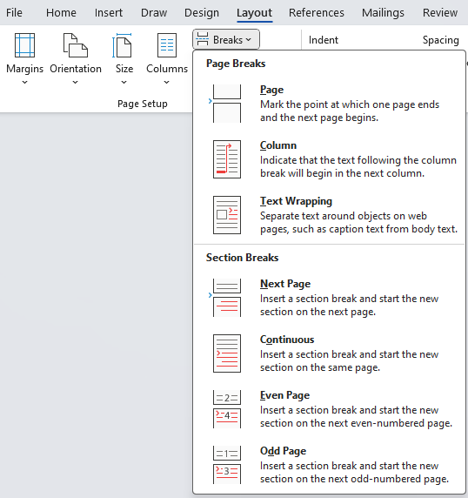
Formatting the Document Using Breaks
Word has 3 main types of document breaks:
Page breaks are most useful for a piece of text that is not auto-formatting nicely (not good for much else, so use sparingly)
Column breaks save space on bulleted lists, and smooth over awkward automatic text breaking in a two-column-formatted proposal
Section breaks are a desktop publisher’s bread and butter—they let you:
Change header and footer formatting from page to page
Insert large and complex graphics without disturbing the flow of text
Format parts of the same page differently
Use Roman numerals for front matter and special section page numbering for appendices, and so on
Notes:
Add a Cover Page – Insert page. Unlink it so that it can have it’s own formatting. Make a section break
Layout=> Breaks. Choose “continuous”.

Slide 63
How Breaks Work
Use Page Breaks to start a new section of the proposal document on a new page if the page count, page layout, or headers do not need to change – otherwise use section breaks
Breaks are visible when Show/Hide ¶ is turned on (CTRL+*)
Prevent awkward splits of text and graphics
Place breaks after text
Avoid using continuous section breaks as they may introduce confusion with pagination and references
Breaks can “hide”
After the last word in a full line
Behind a graphic or a text box
To unhide and remove, check behind objects; place cursor before the break, at the end of text, and insert a space to see that break
If you cannot highlight a break to remove it, type some text near it, and highlight that break together with the text to remove it

Slide 64
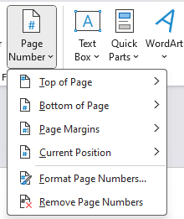
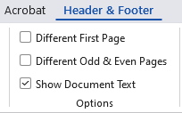
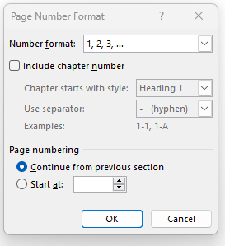
Working with Page Numbers
To insert a page number, go to Insert -> Page Number
Format the page number by going into footer, select and right-click on it
Select Format Page Numbers and select 1,2,3,, i, ii, iii, A, B, C, etc.
Select the starting number or continue from the previous section
Can include chapter number to precede the page number
Before each chapter, insert a Next Page section break
Go to Insert > Page Number and position where you want the chapter number to appear
Click Format Page Numbers, select Include chapter number, and choose the appropriate heading level and format
Repeat for each document section
In the Header and Footer ribbon, you can navigate to the Different First Page click box to remove header or footer on the cover or set different ones without affecting the subsequent page
To differentiate the front matter, insert a section break to separate the front matter from the rest of the document
Click on the footer of the main proposal body section
Unlink the proposal section that follows the front matter from the front matter section by unclicking Link to Previous
Modify the format (such as Roman numerals) for the front matter
Make sure the main proposal document numbering starts at Arabic number 1
Make sure page numbers aggregate correctly to avoid being over the proposal page count without intending to (count all the pages to double-check)

Slide 65
Please, Complete an Assignment or Quiz for Module 7 Prior to the Next Module

Slide 66
Module 7 Exercise: Demo of Breaks and Page Numbers
Demo Tasks:
Add section breaks
Use roman numerals page numbers for front matter vs. Arabic numbering for the rest of the proposal
Ensure the proposal pages are oriented correctly (portrait vs. landscape)
Insert 11x17 pages
Ensure the header and footer stretch the full width of the page on the landscape orientation

Slide 67
Module 8
Getting More Efficient with Word

Slide 68
Using Commands in Microsoft Word
Most professional DTPers use all three methods of working in Word
Depending on how you like to work, Microsoft Word gives you four different ways of accomplishing the same tasks
If you are comfortable with Microsoft Word, use the functions the Ribbon functions as they’re laid out
If you’re like Sally from When Harry Met Sally, and you like to have things your way, customize a Quick Access Toolbar of your most used commands
If you are fond of efficiency, memorize the keystroke shortcuts for all the DTP functions in Word (listed in your class materials)
If you don’t remember where functions live, type what you want to do in the search box to get to the feature

Slide 69
Customizing your Quick Access Toolbar
Accelerate your work by customizing your toolbar prior to starting
The Quick Access Toolbar is a special row of icons located below or above the Ribbon
If you prefer, move it below the Ribbon by right-clicking on it and selecting Show Below the Ribbon
To populate the Quick Access Toolbar, go to the File tab, select Options, then go to the Customize tab in the Options dialogue
In the drop-down menu, filter commands by popularity, the tab in which they appear, and even choose commands from tabs that are normally hidden
This is a great place to put commands used often but which take multiple steps to find
Notes:
Add your most commonly-used commands to the Quick Access toolbar above the “Home” ribbon. The following commands are suggested:
Print, Save, Save As, Undo, Redo, Email, Open, Print Preview
Choose File => Options => Quick Access Toolbar. Highlight items in the left column to Add/Remove from the toolbar (right column)

Slide 70
Use the Format Painter and Format Eraser Tools
Once you have a piece of text formatted the way you want, highlight the formatted text, including the line break marking
Click on the paintbrush, then select the text you want to paint with those attributes
To format multiple instances, leave Format Painter on by double-clicking the paintbrush, then click it to turn it off once you’re finished
You can “borrow” formatting from other documents and transfer it to the one your are working on
Click on Clear All Formatting (“Format Eraser”) tool to return the text to Normal style
Format Painter tool helps quickly reproduce the format of a piece of text or an object in other areas of the document
Clear All Formatting tool erases the formatting and returns the text to the Normal style
Notes:
Format Painter copies formatting so you can apply it elsewhere in the document.
Double-clicking Format Painter locks it so you can keep applying the formatting to other parts of the document (or use F4 to reapply formatting to other sections).
Ctrl + Shift + C will activate the Format Painter.
Use Find/Replace to replace all double spaces with single spaces, etc.

Slide 71
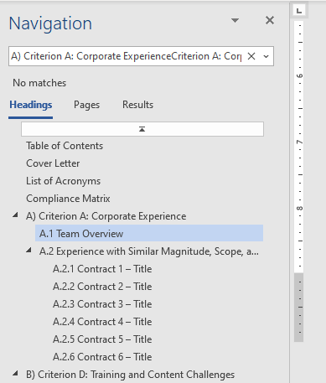
Navigate Quickly Through the Document
There are two efficient ways to move quickly through the document: Keyboard shortcuts and Navigation Pane
To navigate word by word in the document, use the shortcuts Ctrl + ← or Ctrl + →
To navigate paragraph by paragraph, use the shortcuts Ctrl + ↓ or Ctrl + ↑
Double-click words to highlight individual words
Put your cursor at the beginning of a line, hold the shift key down, and click at the end of the line to select the whole line
Ctrl + Click = Highlight Entire Sentence
Ctrl + A = Select Entire Document or textbox text
The Navigation Pane can be displayed by clicking the view tab and checking the Navigation Pane box in the show box, or press Ctrl + F
You can search by objects like headings, graphics, or tables, or by advanced objects like field codes
Browsing by heading or by graphic are effective methods of navigating the document
Once the Styles are applied to Headings, your Navigation pane should work with CTRL+F
Notes:
Double-click words to highlight individual words.
Put your cursor at the beginning of a line, hold the shift key down, and click at the end of the line to select the whole line.
Ctrl + Click = Highlight Entire Sentence
Ctrl + A = Select Entire Document

Slide 72
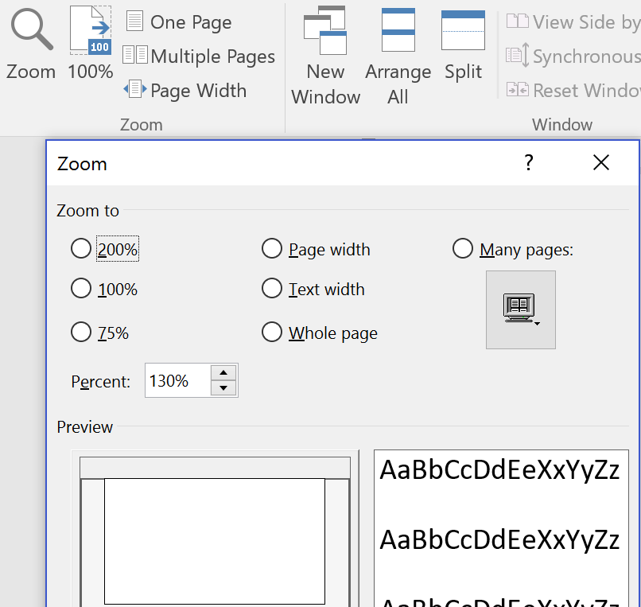
Additional Ways of Navigating
Zooming in and out enables you to see the entire document in thumbnails, as if on a proposal wall – and click on the desired page, zooming in again
Zoom in and out of the document quickly to find the right locations:
By using scroll bar on the right-hand bottom of the page
By using Many pages view on the View Ribbon, Zoom button
Left-click
Notes:
Zoom using the options under the “View” ribbon or using slide bar in the bottom-right corner.
Ctrl + Left/Right Arrows lets you move past whole words instead of individual characters. The Up/Down Arrows move up and down by paragraph instead of by line.
Ctrl + F = Find/Replace dialog box (or Ctrl + H to go right to Replace tab of the dialog box)

Slide 73
Selecting and Pasting Text, and Other Keyboard Shortcuts
Text Selection and Pasting Shortcuts
Selecting a single word | Place the cursor inside the word and double-click with the left mouse button.
Selecting a sentence | Click once inside the sentence while holding down the Ctrl button | +
Selecting a paragraph at a time | Hold down the Ctrl and Shift Buttons while pressing the up or down arrow | + +
Selecting the entire document | Press Ctrl and A | +
Using special paste options | Press Ctrl and V together to paste the text, then click Ctrl to activate the Paste Special dropdown | +
If there’s a function you use regularly and want to learn the command, hover over it in the tab menus above and if there’s a keyboard shortcut for it, it will appear in the pop-up.
Alt + Tab = Flip between documents; press Tab more and see all open documents and switch between them
Use Ctrl + Z to undo and Ctrl + Y to redo.
Ctrl + C = Copy
Ctrl + V = Paste
Ctrl + S = Save
Ctrl + P = Print
Ctrl + Q = Remove Bulleted/Numbered List Formatting
Ctrl + D = Font Dialog Box
Ctrl + Shift + * = Show/Hide Paragraph Markers
F4 = Repeat (typically used for formatting—e.g. if you just bolded text and want to bold another word or line, just click into the line or highlight it and press F4)
2
Ctrl
1
Ctrl
Shift
↑/↓
Ctrl
A
Ctrl
V
See file Module 8 – Quick Reference for Microsoft Word.docx

Slide 74
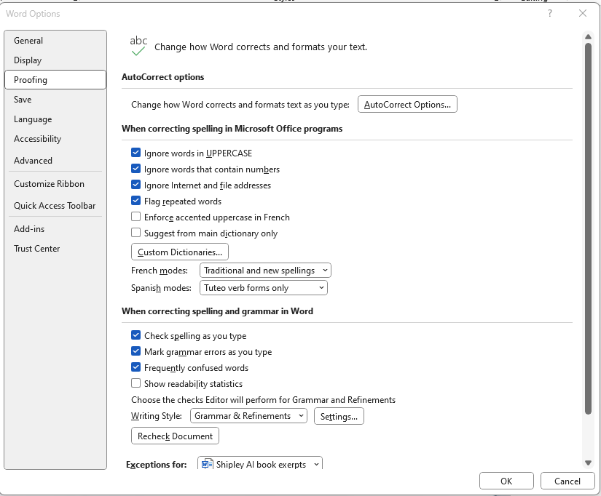
Important Options in the File -> Options Dialogue
Show or hide spelling and grammar mistakes
Customize AutoCorrect options
Change AutoSave frequency
Set AutoRecover directory
Embed fonts
Cut, copy, and paste options
Create backups of local and remote work
Detailed layout options
Notes:
We have already visited the Options tab under the File Ribbon to set up the Quick Access Toolbar. There are other items under Options that can be used to personalize your experience with Word. Some suggestions:
General: Set your name/initials so that when you edit or use Track, your initials will be added to your comments and other changes.
Save: Set your Auto Recover to every 5 minutes. You can also choose the location for the Auto Recovery documents.
Proofing: Under Spelling and Grammar choose all the options, including Show Readability Statistics.
Advanced: Turn off the option “Use CTR Click to follow the hyperlink” so that people won’t go to the hyperlink when reading your documents.!

Slide 75
Please, Complete an Assignment or Quiz for Module 8 Prior to the Next Module

Slide 76
Module 8 Quiz
Which of the following is NOT a method for customizing your work environment in Microsoft Word?
Using Ribbon functions
Customizing the Quick Access Toolbar
Memorizing all the Ribbon tabs
Typing functions into the search box
The Format Painter tool is used for:
Painting graphics in Word
Copying and applying text formatting
Erasing text from the document
Changing the font color
Using the Format Painter, you can format multiple instances by triple-clicking the paintbrush icon.
True
False
Fill-in the Blank: To display the Navigation Pane, press Ctrl + ____ and select the Headings tab.
Notes:
Correct answers:
Which of the following is NOT a method for customizing your work environment in Microsoft Word?
Answer: c) Memorizing all the Ribbon tabs
Explanation: Customizing your work environment in Microsoft Word includes using Ribbon functions, customizing the Quick Access Toolbar, and typing functions into the search box. Memorizing all the Ribbon tabs is not a method of customization but rather a strategy for remembering where functions are located.
The Format Painter tool is used for:
Answer: b) Copying and applying text formatting
Explanation: The Format Painter tool allows you to copy formatting from one section of text and apply it to another, which is useful for maintaining consistency throughout a document.
Using the Format Painter, you can format multiple instances by triple-clicking the paintbrush icon.
Answer: b) False
Explanation: You can format multiple instances using the Format Painter by double-clicking the paintbrush icon, not by triple-clicking it.
Fill-in the Blank: To display the Navigation Pane, press Ctrl + ____ and select the Headings tab.
Answer: f) F
Explanation: The correct shortcut to display the Navigation Pane is Ctrl + F. This allows you to easily navigate through the document using headings, pages, or search results.

Slide 77
Module 9
Document Cleanup

Slide 78
Principles of Effective Print Design
Contrast
repetition
Use dark text over white background for best contrast
Use the C.R.A.P. design principles
Leave a larger space before the heading than under the heading so that the heading and text are grouped together attractively and it’s clear that the heading belongs with the text under it
Ensure the callouts are in text before each graphic and table
Use a different design elements to help things stand out: size, shape, color, direction
Reuse the same layout patterns and “building blocks” throughout the proposal for predictability and trust
Align
Use Align tool, grids, the Rule of Thirds, left-aligned or justified text, and same-sized boxes to line up everything
Move elements that belong together closer to each other, and those that are separate further apart, for pages to look more organized
proximity
alignment

Slide 79
Do a Thorough Error Check Before Producing the Document
Have you applied the right heading styles to the correct headings and styles to text? Are any body paragraphs in a style other than Normal? Do you have any styles in the document that’s extraneous?
Have you checked section number flow, and does it flow properly?
Are any tables split?
Are any exhibits (graphics, tables) in the wrong color palette and need re-rendering or reformatting?
Are all the exhibits in the latest versions?
Do exhibit numbers increment correctly? Are they all present, or are any missing?
Are exhibit callouts introduced in the text prior to their appearance, near the exhibit?
Do all exhibits have action captions, ending with a period at the end?
Has the double-spacing after a sentence been changed globally to single spacing?
Notes:
Check before production
Check print preview or print a copy in black and white. This will make it easier to see glaring mistakes.
Did you use parallel format and language throughout?
Troubleshooting Tip for Headlines:
When your H1, H2, H3, etc., labels aren’t consistent, sometimes the easiest thing to do is add 4 lines to your document like this:
Heading 1
Heading 2
Heading 3
Heading 4
Then, apply the 1, 1.1, 1.1.1… list format and use the tab key to indent H2, H3, etc., like this:
Heading 1
Heading 2
Heading 3
Heading 4
Then apply the formatting you want, like this:
Heading 1
Heading 2
Heading 3
Heading 4
Next, highlight the H1 line, right click on “Heading 1” in the Style menu, and click “Update Heading 1 to Match Selection”. Repeat for each of the other heading styles you’re using. All section headers that had those heading styles applied should automatically updated with the correct numbers. You can then delete the lines you used to establish proper formatting.

Slide 80
Checklist (Continued)
Is the spacing correct and consistent between paragraphs and sections?
Are there any sections starting at the bottom of the page, with a heading alone?
Do all bulleted lists use the same bullets and indentation?
Are all headers and footers extended to fit landscaped pages?
If the requirement is to print double-sided, are the mirrored headers and footers generated correctly, so that page numbers sit at the outside margin?
Do page numbers in the document increment correctly across section breaks?
Is the page size back to normal in the section after a pullout?
Has the document been spell-checked and edited?
If you have converted the document to PDF, does it look the way it should or are there noticeable differences from the Word file?

Slide 81
Please, Complete an Assignment or Quiz for Module 9 Prior to the Next Module

Slide 82
Module 9 Quiz
What does C.R.A.P. stand for in design principles?
Contrast, Repetition, Alignment, Proximity
Creativity, Rationality, Accuracy, Precision
Contrast, Response, Accuracy, Purpose
Creativity, Repetition, Alignment, Proximity
Where should callouts for exhibits be placed in a document?
At the end of the document
In the footer
In the text before the exhibit
They are not necessary
Double-spacing should be changed globally to single spacing after sentence completion for a professional look.
True
False
Describe why leaving a larger space before the heading rather than under it is beneficial in print design.
Notes:
Correct Answers:
What does C.R.A.P. stand for in design principles?
Answer: a) Contrast, Repetition, Alignment, Proximity
Explanation: The C.R.A.P. design principles stand for Contrast, Repetition, Alignment, and Proximity. These are key concepts used in design to create visually appealing and organized layouts.
Where should callouts for exhibits be placed in a document?
Answer: c) In the text before the exhibit
Explanation: Callouts for exhibits should be placed in the text immediately before the exhibit. This ensures that the reader is properly guided to the exhibit at the right point in the document. Only in “desperate” page count situations when nothing could be done to introduce the exhibit in the text prior to its appearance, it’s okay to refer to the exhibit shown above.
Double-spacing should be changed globally to single spacing after sentence completion for a professional look.
Answer: a) True
Explanation: In professional documents, single spacing is preferred over double spacing for a cleaner, more compact appearance. This setting is usually applied globally to maintain consistency.
Describe why leaving a larger space before the heading rather than under it is beneficial in print design.
Answer: Leaving a larger space before the heading helps in visually grouping the heading with the text that follows it. This creates a clear association between the heading and its content, making the document easier to read and more visually appealing.

Slide 83
Module 10
Production and Shipping

Slide 84
Inserting Documents into Word Attachments
Windows has two key features to capture screenshots:
Fn+HOME (Grab the image on the screen)
Type “Snip” in the Windows Search bar and a Snipping Tool will appear that will enable you to control your screen capture tools
Make sure the pages for screenshots are all the same size, and you copy the same area on each page
Insert the document page-by-page and ensure that you didn’t miss anything – it is easy to omit or duplicate pages in long documents

Slide 85
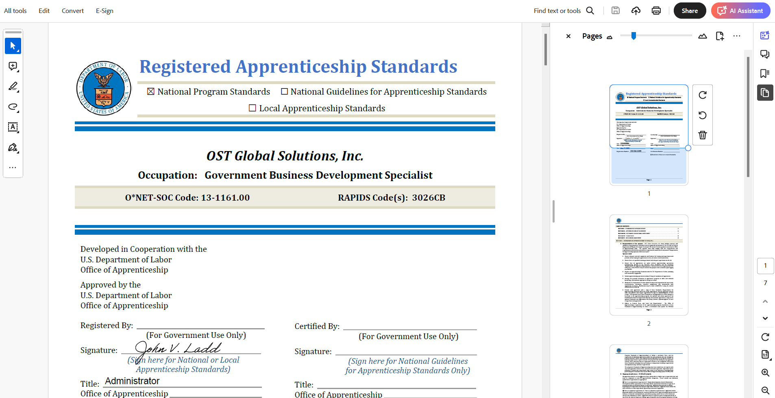
Prepping the Electronic Submission
Begin by saving all relevant Word documents as PDFs using the Save As PDF command in the File tab in Word
Open your copy of Adobe Acrobat Pro, and select Combine Files
You can insert multiple documents at once
Adobe will guide you through the steps

Slide 86
Completing an Electronic Submission
Read through each file, page by page, checking for any mis-inserted or missing pages, showstopper errors caused by converting the file from docx to PDF, or any other irregularities
Electronic submissions are easier in that they require less time to produce and fewer contingency plans, but…
They are harder because it’s much easier for a large mistake to go by unnoticed
NEVER wait until the last day to complete an electronic submission – do it 24 hours in advance to ensure it’s accepted even if a government upload or email system glitches
Quadruple-check your attachments before submitting your proposal
Do not assume your proposal has gone through unless you receive confirmation from the government
If uploading, look for system confirmation; if emailing, check delivery and read receipt options
If you submitted but haven’t heard anything, give the government Contracting Officer a call

Slide 87
For the Rare Cases of Having to Print and Bind a Hard-Copy Proposal
Always allow at least half a day to a full day for production
Length of time needed varies based on length of proposal, number of copies needed, and type of printer being used
If you do not have the capacity in-house to print and guillotine inserts for the front and spine of each binder, you will need to go to a print shop to have it done
Check to make sure that soft copies on CD or thumb drive load and open correctly on a computer other than yours
Always print an archival copy of the proposal for your own records
See Module 10 – Binder Sizes Table.pptx for binder sizes for various lengths proposals
White Glove
Upon printing and binding your proposal, you need to round up 2-5 volunteers to go through and do a White Glove Review.
White glove reviews involve a team of people paging through multiple copies of the same volume together, looking for errors, misprints, blank pages inserted by the printer, or missing pages.
Usually, the person who owns the proposal will call out page numbers, so the others can verify that all copies were correctly produced.
See examples “For Proposal Center” that allow to formally track production requirements

Slide 88
Preparing the Proposal for Hand-Delivery
The government provides the correct shipping address in the RFP, in the Proposal Submission Instructions
Instructions will include the location to which the proposal must be delivered and the due date and time of submission
If hand-delivering the proposal to a local address, draw up a delivery receipt with the solicitation information, including RFP number and due date, and a place for the recipient to print his/her name and sign the receipt
Learn in advance about security checkpoints or peculiarities of the building to which you’re making the delivery – ensure you know facility access procedures and allow ample time
See file Module 10 – Delivery Receipt.docx for sample text

Slide 89
Preparing the Proposal for Shipping
If you are shipping the proposal, it is wise to produce two sets of binders:
One that is shipped several days before the deadline
Second set which can be hand-carried to the customer site if something goes awry
Use a box large enough to neatly fit all the binders
Tape a printed copy of the shipping address or shipping label to the top of the box
Always write solicitation number on the box, and follow any additional solicitation instructions

Slide 90
Please, Complete an Assignment or Quiz for Module 10 Prior to the Next Module

Slide 91
Module 10 Quiz
What is the key shortcut for capturing an image of the entire screen in Windows?
Alt + Print Screen
Fn + Home
Ctrl + Shift + S
Windows + Shift + S
It is recommended to complete an electronic submission at least 24 hours in advance to account for any potential system glitches.
True
False
Explain the benefit of making sure the pages for screenshots are all the same size when inserting into a Word document.
Notes:
Correct answers:
What is the key shortcut for capturing an image of the entire screen in Windows?
Answer: b) Fn + Home
Explanation: The Fn + Home shortcut is a common way to capture an image of the entire screen on certain keyboards, particularly on PC laptops. This captures the screen and can be pasted into a document or image editing tool.
It is recommended to complete an electronic submission at least 24 hours in advance to account for any potential system glitches.
Answer: a) True
Explanation: Submitting 24 hours in advance is recommended to ensure there is enough time to address any potential issues, such as system glitches, that could arise during the submission process. This proactive approach helps avoid last-minute complications.
Explain the benefit of making sure the pages for screenshots are all the same size when inserting into a Word document.
Answer: Ensuring that the pages for screenshots are all the same size when inserting them into a Word document maintains consistency in the appearance of the document. It prevents uneven alignment, reduces visual clutter, and ensures that all screenshots are presented uniformly, making the document more professional and easier to read.

Slide 92
Summary and Recap
What have you learned?
What are the attributes of a great DTPer?
What are the different ways of navigating quickly through a document?
What is the visual hierarchy?
What is the most readable page layout?
What is your biggest take-away from the class?
Notes:
Wrap Up/Summary Exercise: Using the handout, Volume 1 – Technical Proposal for Formatting, do a review of the concepts.
Step 1: Have the students go through the document to find quick errors.
Step 2: Have them do a review:
Heading styles
Bullet styles
Heading numbering format
How to change the formatting of charts (Smart Art)
Inputting an org chart - Use PowerPoint or Smart Art
How to add captions – Insert Caption or right click
Text for figures and tables – Figures above, Tables below
How to change caption numbering – Reference tab or right click
How to group to objects: Shift to highlight both, then right click to group
Anchor: Position – Layout - ____ : Benefit of anchoring
Tighten spacing around a table: Highlight table and drag it. Or Choose layout to position text (e.g., centered) in row. Also, use Auto fit to improve spacing; Can adjust the paragraph to control line spacing in row/columns of table
How to make sections with different layouts – part portrait; part landscape: Paragraph – Layout- Breaks – Continuous; Then fix the section as needed.
Change the header/footer putting in page numbers and #1 starting on the page 2.
Use different first page.
Or, use section break and break the link.
Position # where you want in footer or header: Position it, then go to page # then Current Position
Get rid of borders, add into Styles.

Slide 93
We’d Love It If You Left Us a Five-Star Review!
Did you find our training valuable and impactful?
You can leave a Google review HERE
and/or a Facebook review HERE
Notes:
Google: https://g.page/r/CeQcAmyWUhUZEAI/review
Facebook: https://www.facebook.com/OSTGlobalSolutions/reviews

Slide 94
Interested in an In-depth Exploration of the Awarded.AI?
Scan the QR code with your phone camera to book a demo or click this link!
https://calendly.com/psci-sales/demo-for-psci-ai-ost
Notes:
Google: https://g.page/r/CeQcAmyWUhUZEAI/review
Facebook: https://www.facebook.com/OSTGlobalSolutions/reviews

Slide 95
What Are Your Takeaways from Today’s Class?
7361 Calhoun Place, Suite 560
Rockville, MD 20855
Phone: 301-384-3350
service@ostglobalsolutions.com
Improving Our Country Through Better Proposals!™
www.ostglobalsolutions.com
Copyright © 2024 OST Global Solutions, Inc. All rights reserved. This material may not be reproduced, distributed, transmitted, or used for any commercial purpose without the express written permission of OST Global Solutions, Inc.

