Slide 1



Funding
Fundamentals
NASA SEWP VI Strategic Pause

Slide 2


Teresa Moon
Director of Business Development & Marketing
  Has extensive experience in business development within government contracting, marketing and branding, relationship building and partnership management
  Board MemberBoard Member on the HUBZone Contractors National Council
  Hosts Parabilis’ podcast, “Spilling the Tea on GovCon”

Slide 3
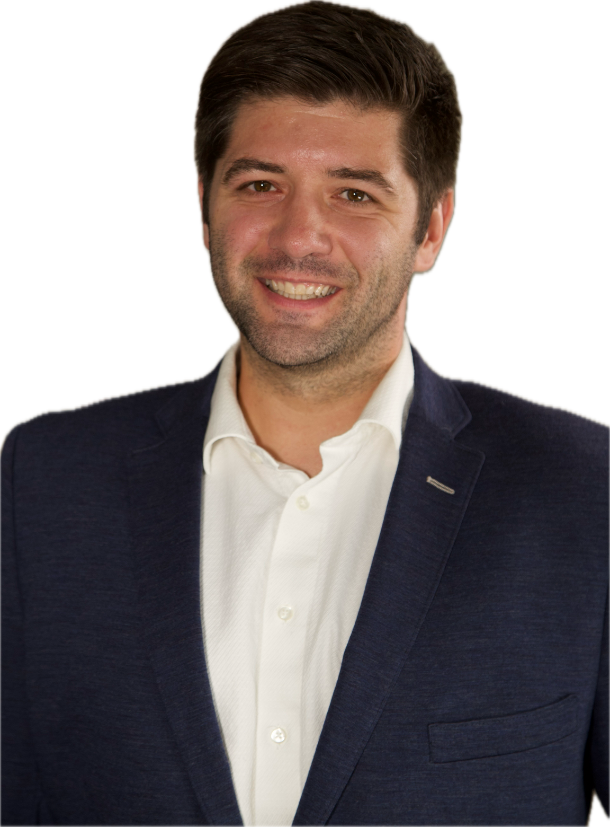
David Huff
CEO
  Has 18 years of experience in federal government business development, across a wide variety of industries, and the military
  Has captured and managed proposals winning over $3 billion in funded contracts for clients
  Teaches courses at OST’s Bid & Proposal Academy and provides free educational webinars

Slide 4
Funding
Fundamentals
What is the SEWP VI opportunity?

Slide 5
Solutions for Enterprise-Wide Procurement VI
  SEWP VI is a Government Wide Acquisition Contract (GWAC) with a $60 Billion ceiling value over the next 10 years
  SEWP V is the current contract that is still active and it’s used by every single federal government agency – including the intelligence community
  In 2023, SEWP V saw over $10.8 Billion in contract transactions and over $7.5 Billion in contract transactions so far in 2024
  SEWP VI has an expanded scope and includes:
    Category A: IT Solutions (Products-Information Computer Technology (ICT) and Audio Visual (AV))
    Category B: Enterprise-Wide Solutions (solutions and services)
    Category C: IT Professional Services
  SEWP V has become the most desirable contract to have for government contractors – SEWP VI is looking to grow in customers and vendors

Slide 6

Category Scope of Work
Category A: IT Solutions
  IT Computer Systems / Compute Facilities
  IT Storage Systems
  Networking and Communication Equipment
  Imaging Equipment and Supporting Technology
  IT Power and Cabling Equipment
  Audio / Video Equipment
  Security and Sensor Equipment
  Software and Cloud Technology
  Product- based services
Category B: Enterprise-wide IT Solutions
  IT Managed Services
  Enterprise-Wide Network Services
  Enterprise-Wide Innovation Services
  IT Service Management
  Enterprise Service Program Integration
  Enterprise-Wide Information and Data Analytics Services
  Enterprise-Wide Application Services/Software Development
  Enterprise-Wide Cybersecurity Services
  Enterprise-Wide Cloud Services
  Enterprise-Wide Digital Multimedia and Technical Communications Services
  Program Management/Ancillary Services and Supplies
Category C: IT Professional Services
  Network Services
  Innovation Services
  Information and Data Analytics Services (IDAs)
  Application Services/Software Development
  Cybersecurity Services
  Cloud Services
  Digital Multimedia and Technical Communications Services
  IT Operations and Maintenance / Help Desk/Call Center Support
  Database Services
  In-Scope Training
  Program Management/Ancillary Services and Supplies

Slide 7
Category Scope of Work
  With specific regard to professional services and Category C—it's important to note that ongoing need and consistent and growing task orders require a level of financial responsibility that you should be prepared for in advance.
  Is your current lender prepared to assist you with the significant growth that can amass in a successful execution plan?

Slide 8
Funding
Fundamentals
How do you win a SEWP VI contract?

Slide 9

Funding
Fundamentals
  NASA conducted a strategic pause while they work on the answers to 6,000 questions/comments
  NASA will announce an Industry Day when they are ready to un-pause the SEWP VI acquisition
  There is an unknown timeline for restarting but we should expect a 30-day due date after the acquisition goes live again
  This time is a second chance to get your proposals prepared in anticipation of the acquisition restart
SEWP VI Status and Timeline

Slide 10
Proposal Volumes and Content
Volume 1: Offer Volume Major Requirements
  AbilityOne Commitment Letter
  ISO 9001:2015 (all categories) and CMMI Certification (only for Category B)
  Mandatory Experience/Offerings
    Category A: complete Exhibit 3a – Category A Solutions Spreadsheet
    Category B:
      Other than Small Business: 4 different projects from 4 different technical areas that are minimum $30m per project
      Small Business: 3 different projects from 3 different technical areas that are minimum $5m per project
      HUBZone, VOSB, SDVOSB, WOSB, EDWOSB, 8(a): 2 different projects from 2 different technical areas that are minimum $4m per project
    Category C:
      Small Businesses: 3 different projects from 3 different technical areas that are minimum $2 per project
      HUBZone, VOSB, SDVOSB, WOSB, EDWOSB, 8(a): 2 different projects from 2 different technical areas that are minimum $4m per project

Slide 11
Funding
Fundamentals
In your discussions with your clients pre-RFP, do you inquire on their financial capability to perform?
What are typical small businesses working on the contract doing to maximize their ability to gain access to the greatest award value?

Slide 12
Proposal Volumes and Content
Volume 2: Past Performance Major Requirements
  10-page limit for all of the past performance narratives
  Minimum of 1 but no more than 3 past performance projects
  Must be complete or ongoing within 3 years of the solicitation release date
  Category A:
    Small Business: minimum average annual cost incurred of $150k per project and all projects must cover 3 of the technical areas
    Other than Small Business: minimum average annual cost incurred of $2.5m per project and all projects must cover 4 of the technical areas
  Category B:
    Small Business: minimum average annual cost incurred of $1m per project and all projects must cover 3 of the technical areas
    Other than Small Business: minimum average annual cost incurred of $2.5m per project and all projects must cover 4 of the technical areas
  Category C:
    Small Business: minimum average annual cost incurred of $500k per project and all projects must cover 3 of the technical areas

Slide 13
Proposal Volumes and Content
Volume 3: Mission Suitability Volume Major Requirements
  Technical Approach – 15 pages
    Demonstrate your ability to provide solutions and services for all technical areas
    Discuss how you will incorporate next-generation technology
  Management Approach – 15 pages
    Commitment to Supply Chain Risk Management
    Commitment to Sustainability
    Commitment to Product and Service Diversity
    Program Management

Slide 14
Funding
Fundamentals
  Meet the mandatory relevant experience requirements, show certification for ISO* and CMMI*, provide accurate NAICS crosswalk
  Achieve a past performance rating of neutral or satisfactory level of confidence
  Achieve a high confidence rating in Mission Suitability Volume
  Everyone who passes these three bullets will receive an award
Selection Process

Slide 15
Funding
Fundamentals
What does it look like after award?

Slide 16
Successful GWAC Management
  NASA wants companies who are going to aggressively bid on everything they qualify for
  The Contractor Holders Only Portal (CHOP) will release RFIs/Sources Sought and RFQs on a daily basis
  You will need to actively market your vehicle to your customers, so you’ll need to learn how to sell SEWP VI to your prospects
  SEWP has a .36% contract access fee, which is less than half of GSA schedules/GWACs (.75%)
  Many hardware/software orders will require large purchases and delivery before payment will be issued by the Government
  Companies will need either terms from their OEMs/Distributors or a LOC to successfully perform – the same is true for Cat B and C
  Plan for success

Slide 17
Parabilis Line of Credit
  A revolving line of credit is the most straightforward and affordable financial tool to solve cash flow issues
  Unlike factoring an invoice, which requires you to sell entire invoices to get cash, a line of credit allows you to borrow against your invoices and other collateral
  A Parabilis line of credit allows you to borrow against:
    BILLED invoices up to 90%
    UNBILLED invoices up to 65%
    DELIVERY ORDERS up to 30%

Slide 18
Do you believe that an aggressive approach to bidding on everything they qualify for should include a letter of financial capability sharing the level of access the Small Business has to a line of credit?
Funding
Fundamentals

Slide 19
What is a typical amount or cost incurred on the contract access fee? Do small businesses ever have trouble with this fee? Does it inhibit some from bidding?
Funding
Fundamentals

Slide 20
How far do your services extend into the bidding process? Do you help with the ongoing marketing for your clients?
Funding
Fundamentals

Slide 21
Funding
Fundamentals
Audience Questions

Slide 22
Funding
Fundamentals
Connect with Us
David Huff
dhuff@ostglobalsolutions.com
www.ostglobalsolutions.com
Teresa Moon
teresa@parabilis.com
www.parabilis.com

