Slide 1
How to Create a Gen AI-Enhanced Proposal Library for Winning Government Contracts
Olessia Smotrova and Christian Ferreira

Slide 2
Welcome and Introductions
Speakers: Christian Ferreira (Procurement Sciences) and Olessia Smotrova (OST Global Solutions)
Your competition is using Gen AI to write proposals - what are your actions?
Olessia Smotrova, CF APMP Fellow
Chief Strategy Officer
OST Global Solutions
Christian Ferreira
Founder/CEO
Procurement Sciences AI

Slide 3
Problem
Business development and ai integration Maturity Levels
differentiated
COMPETITIVE DIFFERENTIATION DRIVES LIFETIME CLIENT BASE. AI AUTOMATION RESULTS IN MAXIMUM VOLUME AND QUALITY.
6
Many organizations are “data hoarders” – sitting on mountains of past proposal content that never gets revisited
Businesses at levels 1 through 3, “Ad Hoc” trough “Defined,” keep this data across multiple employee’s computers and cloud spaces and haven’t consolidated it into one organized Library
Optimized
STANDARD BD PROCESSES ARE IMPROVED USING DATA DRIVEN BY FIRM, GROUP, AND INDIVIDUAL GOALS. AI AUTOMATION REACHED.
5
Quantitatively Managed
STANDARD BD PROCESS IMPLEMENTED THROUGHOUT THE FIRM, MEASURING WHAT MATTERS. AI EMBEDDED IN STRATEGY.
4
Defined
STANDARDIZED BD PROCESS IN POCKETS WITHOUT ORGANIZATIONWIDE PROCESS IMPROVEMENTS. AI BECOMES OPERATIONAL.
3
reactive
CHAOTIC AND TACTICAL, RESPONDING BASED ON INDIVIDUAL PERFORMANCE. EXPERIMENTATION WITH MAINSTREAM AI.
2
Ad hoc
UNORGANIZED. AUTOMATICALLY AT THIS MATURITY LEVEL. INTERESTED IN AI.
1
© 2024 OST Global Solutions, Inc. All rights reserved. Unauthorized reproduction or distribution of this material is prohibited.

Slide 4
Traditional Boilerplate Reuse Process Is Fraught With Issues
Troubles with locating the right data
1
Drowning in irrelevant information while digging through mountains of data
2
Importing stale materials to the new proposal while failing to formulate a unique new solution
3
Failing to weed out leftover artifacts that may be as egregious as another customer’s name
4
© 2024 OST Global Solutions, Inc. All rights reserved. Unauthorized reproduction or distribution of this material is prohibited.

Slide 5
AI Is the Solution
Working with boilerplate is like shoveling mounds of trash into the proposal trying to dig through and find gems in it
Surgical approach of finding relevant concepts and statements is a lengthy process – so much that many prefer to write from scratch rather than reuse and recycle
AI is like a high-speed archeologist digging through years of past proposals unearthing treasures and transforming them into highly relevant content much faster than a human could
© 2024 OST Global Solutions, Inc. All rights reserved. Unauthorized reproduction or distribution of this material is prohibited.

Slide 6
Five Components of Successful AI Integration Into the Proposal Development Process
1
2
3
4
5
Proposal management
Solution & win themes development
Content library
Content authoring & editing
reviews
Schedule, outline, compliance matrix, RFP analysis, etc.
Brainstorming, solutioning, proposal themes, etc.
Library of past proposals, past performance, resumes, graphics, and other artifacts
Knowledge searching, section writing, graphics conceptualization, action captions, tables, cost volume, editing, etc.
Color reviews, compliance checks
Integration with collaboration platforms such as SharePoint, Teams, Office, Outlook, browsers
© 2024 OST Global Solutions, Inc. All rights reserved. Unauthorized reproduction or distribution of this material is prohibited.

Slide 7
Gen AI 101: Introduction to Generative AI
Generative AI: Artificial Intelligence that can create new content, including audio, code, images, text, simulations, and videos.
Large Language Model (LLM): The core component of AI systems that power Generative AI capabilities. These models are trained on large datasets and come in various types, such as OpenAI’s GPT Series, Anthropic’s Claude Series, and Meta/Facebook’s LLAMA Series.
Natural Language Processing (NLP): A method for interacting with LLMs using natural language text input and output, mimicking human communication.
Semantic Searching: Finding information by understanding the meaning behind words, not just the words themselves. It is the next evolution of the Control+F word search.
Retrieval Augmented Generation (RAG): An algorithm that allows company data to be retrieved and used without the risk and high cost of training a custom LLM.
Hallucination: When an AI responds with inaccurate information that sounds convincing to the user.
AI Prompting: A natural language command given to the AI.
Prompt Engineering: The advanced formatting of prompts to achieve stronger responses and reasoning.
© 2024 Procurement Sciences, Inc. All rights reserved. Unauthorized reproduction or distribution of this material is prohibited.

Slide 8
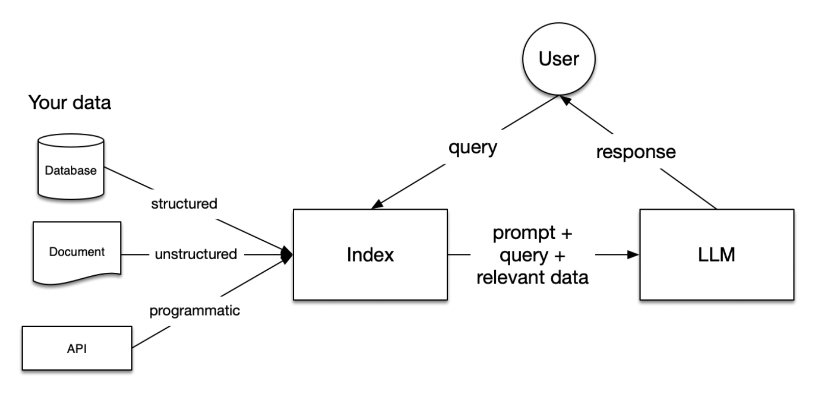
Gen AI 101: Enhancing Proposals w/ Company-Aware AI
https://codingscape.com/blog/rag-101-what-is-rag-and-why-does-it-matter
Benefits of Retrieval Augmented Generation (RAG) for Proposals and Information Retrieval:
Accuracy: Ability to cite the sources of information.
Affordability: RAG doesn’t require large expenditures to train custom models.
Security: Data is held in a private vector database and is not available for the LLM to use for training, ensuring your information remains confidential and secure. *Check w/ AI Software Providers*
Data Control: You choose what data to use, whether it’s a set of specific files or all company files.
Ease of Management: Simple process for updating and managing the content the AI can and cannot use.
Speed to Value: Quick implementation with virtually instant results.
Flexibility: Leverage continuous breakthroughs in foundational models without being locked into a single outdated model.
© 2024 Procurement Sciences, Inc. All rights reserved. Unauthorized reproduction or distribution of this material is prohibited.

Slide 9
Gen AI 101: Best Practices for Using AI in Proposals
Generative AI: A predictive algorithm that tries to generate the best answer based on the provided knowledge or training dataset.
Deterministic Algorithms: Use logic to build answers, offering less creativity but greater accuracy.
Right vs. Wrong Times to Use Generative AI:
Right:
When a human is involved to review content.
When you need creative and unique content generation.
When aiming to add efficiency to the first drafts of various deliverables.
Wrong:
For cost volume calculations without heavy review.
For mission-critical answers where a human is not reviewing.
For using it as an "easy button" to do your work.
© 2024 Procurement Sciences, Inc. All rights reserved. Unauthorized reproduction or distribution of this material is prohibited.

Slide 10
How an AI-Augmented Proposal Library Will Help You Leverage Previously Written Proposals
AI helps transform static, passive content into an active, strategic asset with your existing knowledge library
AI is not just finding and copy-pasting old content
It is transforming high-value strategies, narratives, and win themes that worked before into the currently relevant solutions
AI is like a master chef remixing ingredients from 20 previous recipes to create a dish that’s better than any one individual recipe
…And simultaneously tailoring it to this one customer’s picky eating preferences and food sensitivities to create something completely unique
© 2024 OST Global Solutions, Inc. All rights reserved. Unauthorized reproduction or distribution of this material is prohibited.

Slide 11
Easiest AI Tasks
The easiest proposal tasks AI can perform and save time is to find the right past performance examples, references, graphics, and resumes
An AI-augmented proposal library also simplifies the hardest tasks such as win themes development, section content brainstorming, and text and graphics generation
e
© 2024 OST Global Solutions, Inc. All rights reserved. Unauthorized reproduction or distribution of this material is prohibited.

Slide 13
Creating Your Content Library for AI Purposes
Upon proposal completion, archive:
Source and PDF proposal files
RFP and amendments
Delivery receipt
Lessons learned results, win/loss debriefs, and info on competitors that won
Delete redundant or unnecessary documents to save space and make relevant information easier to retrieve
To protect the integrity of your files, implement a Security Plan defining access to the documents and levels of authority to modify, move, or delete the documents
Set up your directory with a clear navigation and file names such as YYYY -> Agency -> Proposal Name_Volume_Final_Date
keep Pink, Red, and Gold Team versions along with the final
© 2024 OST Global Solutions, Inc. All rights reserved. Unauthorized reproduction or distribution of this material is prohibited.

Slide 14
Special Libraries
Graphics library with source files
Past performance library (yours and teammates’) that includes statements of work and scope modifications
Using AI to restructure information
Giving it past proposals to extract past performance
Resumes library
Prompt library
People
Time-Phased Manufacturing process
Tools
Name
Program Manager
Name
Logistics Manager
Name
Senior Engineer
Production:
Tool 1
Tool 2
Tool 3
Logistics:
Tool 4
Tool 5
$
1
2
3
4
5
suppliers
Store
Cut
Weld
Assemble
Distribute
base
$
1 hour
30 minutes
5 minutes
5 minutes
$
GLD-084-v3
3 hours
30 minutes
10 minutes
30 minutes
3 hours
Tip for graphics library: use unique proposal name abbreviation, graphic number, and version number in the file name and on the face of the graphic visible in the proposal for easier searches.
© 2024 OST Global Solutions, Inc. All rights reserved. Unauthorized reproduction or distribution of this material is prohibited.

Slide 15
Library Collateral for AI Use
Example Sections for Prompts
For structured document authoring, AI prompting is best done using cut-and-pasted examples into the prompt vs. attaching the document or automatic library retrieval
Executive Summary
Management Section
Management Section Checklist
Technical Section
Technical Section Checklist
Cost Volume Narrative with:
Cost baselines to support technical volume templates
Cost models and Basis of Estimate (BOE)s
Model Plans
IMP/IMS
Risk Plan
Quality Control Plan and QASP
Transition Plan
Recruitment and Retention Plan
Procurement Plan
Safety
Travel
Staffing Plan
Mobilization Plan
Subcontractor Management Plan
Systems Engineering Management Plan
Integrated Logistics System Plan
Training Plan
IT Plan
Continuity of Operations/Contingency Plan
Security Plan
Sustainability Plan
© 2024 OST Global Solutions, Inc. All rights reserved. Unauthorized reproduction or distribution of this material is prohibited.

Slide 16
More Collateral
Proposal Management Aids
Proposal manager’s checklists
Outline
Compliance matrix
Kickoff slides
Proposal schedule for typical durations
Contact list template with proposal team’s information
List of proposal resources (internal, consultants, teammates) with contact information
Abbreviated and detailed style guides for writers and editors
Collateral for running color reviews (kickoff and debrief decks for pink and red teams, reviewer forms, process)
Structured lessons learned process that passes on the lessons learned to support new proposals
Master Proposal Documents
Cover and title sheet
Proposal template with custom toolbars
Nominal WBS template
Schedule
ROM
Cost volume
BOEs
BOM
Pre-prepared estimating rules (e.g. for "training" costs, other frequent deliverables)
Transmittal letter
© 2024 OST Global Solutions, Inc. All rights reserved. Unauthorized reproduction or distribution of this material is prohibited.

Slide 17
Additional Collateral
“Golden nuggets”
Reusable win themes
Customer kudos
Relevant studies that you may want to reference such as Gartner Reports
Accomplishments and certifications details
Marketing and Capture Collateral
Technical and management solution development checklists
White papers developed by technical gurus that relate to the specific areas this IDIQ or GWAC covers
Vehicle-specific capability statement
Case studies
Capability statements
Other information your BD or program staff can hand to the customer for them to get to know you better and to build trust
Win Strategy White Papers
Competitive analysis deck
Just-in-Time training materials

Slide 18
Techniques for Maintaining Up-to-Date and Accurate Content
Select a champion responsible for organizing, updates, and cleansing
Cleanse the data monthly
Data cleansing involves removing or correcting inaccurate, incomplete, or irrelevant data.
Enhances the quality of AI-generated outputs by ensuring the input data is clean and accurate.
Remove all irrelevant and piecemeal proposal sections, leaving only the color review versions
Remove automatically saved old document versions
Delete older versions of the graphics unless they are useful content-wise

Slide 19
AI to Classify and Tag Your Library
Classification:
The process of categorizing data into predefined groups or classes.
Ex 1: Transition Plan
Ex 2: Resume
Helps in organizing data into meaningful categories, making it easier to manage and retrieve.
Streamlines data management and improves the AI's ability to generate contextually accurate responses.
Tagging Data:
Labeling your data with relevant keywords or categories.
Ex: Transition, recruitment, onboarding, mobilization, U.S. Army, C-TNOSC
Ex 2: Ph.D, TS-SCI, Engineering, PMP
Helps in organizing and retrieving information quickly and efficiently.
Improves searchability and ensures that the AI can easily identify and use the most relevant information.
© 2024 Procurement Sciences, Inc. All rights reserved. Unauthorized reproduction or distribution of this material is prohibited.

Slide 20
Steps For Using AI to Cleanse, Tag, Build a New Library
1. Collect
Gather all relevant documents and data sources.
Consider using synthetic data to fill in gaps.
2. Cleanse
Use AI tools to identify and correct inaccuracies.
Remove irrelevant or duplicate information.
3. Tag
Apply relevant tags to each document or data point.
Ensure consistent tagging for better organization.
4. Classify
Categorize data into predefined groups (e.g., Winning Proposals, Capabilities Statements).
Use AI to automate the classification process for efficiency.
5. Build
Organize the cleansed, tagged, and classified data into a structured library.
Use simple folder structures for easy navigation.
© 2024 Procurement Sciences, Inc. All rights reserved. Unauthorized reproduction or distribution of this material is prohibited.

Slide 21
Use AI to Create Synthetic Data For Your Proposal Library
Synthetic Data Definition: Synthetic data is artificially generated data that mimics real-world data.
Use-Case:
Augments your existing data.
Fills gaps where real data may be sparse or unavailable. Benefit: Enhances your dataset with new and creative content.
Using Generative AI to Create Synthetic Data:
Use Generative AI to create new synthetic data based on patterns and structures found in your existing data.
Review and curate the generated synthetic data to ensure it meets quality and relevance standards
Adjust and refine the synthetic data to better fit your specific needs and contexts.
Approve the curated and tweaked synthetic data for inclusion in your library, ensuring it aligns with your data requirements and standards.
© 2024 Procurement Sciences, Inc. All rights reserved. Unauthorized reproduction or distribution of this material is prohibited.

Slide 22
Steps For Using AI to Create Synthetic Data
1. Identify Data Gaps
Analyze your existing data to identify areas where synthetic data can fill gaps.
2. Generate Synthetic Data
Use Generative AI tools to create synthetic data that mimics the patterns and structures of your real data.
3. Curate Synthetic Data
Review the generated data to ensure it is relevant and high-quality.
Remove any inconsistencies or inaccuracies.
4. Tweak and Refine
Adjust the synthetic data to better align with your specific requirements.
Customize data attributes as needed.
5. Approve Data
Validate the curated and refined synthetic data.
Ensure it meets your quality standards and data requirements.
6. Integrate into Library
Incorporate the approved synthetic data into your existing data library.
Organize it within your library structure for easy access and use.
© 2024 Procurement Sciences, Inc. All rights reserved. Unauthorized reproduction or distribution of this material is prohibited.

Slide 23
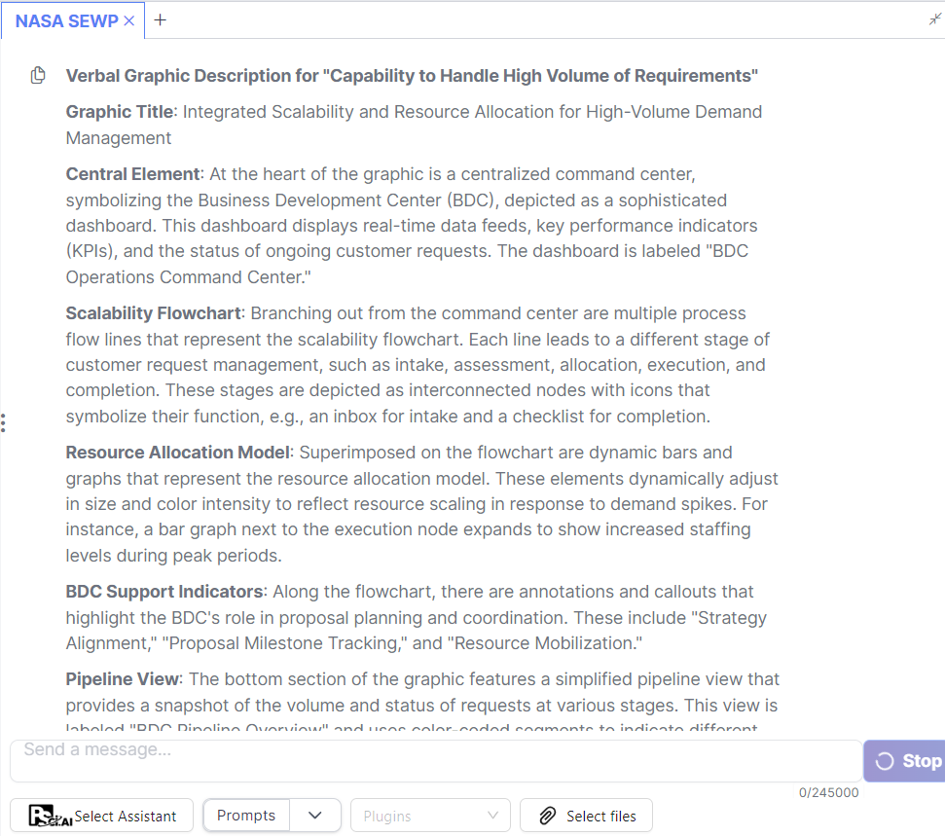
Example of Using AI in Proposal Development
“You are a proposal graphic artist asked to create a verbal graphic description with text for all of the graphic’s elements for the following NASA SEWP VI proposal section: Capability to Handle High Volume of Requirements. The draft RFP specifies the need for offerors to demonstrate their strategy for managing a potentially high volume of customer requests (A.3.7.3(b)(4)(i)). The hot button here is the ability to scale and handle numerous requirements efficiently. The rationale is that NASA anticipates a significant demand for services under this contract and needs a contractor who can keep pace. Please, create a verbal graphic description that incorporate elements that reflect the BDC's role in managing opportunities, such as a centralized tracking system or a dashboard view of the pipeline. The graphic should also indicate the BDC's support in proposal planning and coordination, as well as resource direction for proposal development. Please, incorporate your concepts of Scalability Flowchart and Resource Allocation Model. Base it on the following guideline for Business Development Center (BDC) operations: [Excerpts from AASG Business Development Playbook]”

Slide 24
Q&A Session
Interested in exploring Awarded.AI? Scan the QR code with your phone camera to book a demo or click this link!
https://calendly.com/psci-sales/demo-for-psci-ai-ost
Master AI to Enhance BD, Capture, & Proposal Processes - Updated to Include the Latest AI Developments | OST Global Solutions, Inc.
service@ostglobalsolutions.com
301-384-3350
www.ostglobalsolutions.com
Notes:
Google: https://g.page/r/CeQcAmyWUhUZEAI/review
Facebook: https://www.facebook.com/OSTGlobalSolutions/reviews

