Slide 1
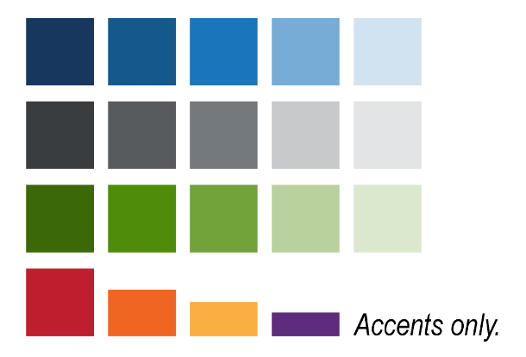

Primary Colors
Secondary Colors
R: 23
G: 55
B: 94
R: 20
G: 88
B: 140
R: 27
G: 117
B: 187
R: 59
G: 105
B: 7
R: 79
G: 140
B: 9
R: 114
G: 163
B: 58
R: 58
G: 61
B: 63
R: 87
G: 91
B: 94
R: 116
G: 121
B: 125
Accent Colors Only
R: 190
G: 30
B: 45
R: 241
G: 101
B: 34
R: 250
G: 175
B: 64
R: 95
G: 43
B: 124

