Slide 1
Competitive Analysis and Price to Win Bid & Proposal Academy Course
www.ostglobalsolutions.com

Slide 2
Agenda
09:00 – 10:30 AM Training
10:30 – 10:45 AM Break
10:45 AM – 12:00 PM Training
12:00 – 01:00 PM Lunch Break
01:00 PM – 02:45 PM Training
02:45 PM – 03:00 PM Break
03:00 PM – 04:00 PM Training
04:00 PM – 05:00 PM Flex
Please, give yourself the benefit of focus and limit email and use of cell phones to breaks

Slide 3
Learning Objectives
Understanding how to lay the groundwork for competitive analysis
Identifying three to five competitor teams and preparing for the Black Hat Analysis
Organizing and conducting the Black Hat exercise
Performing the competitive analysis before and during the Black Hat
Using a variety of data sources to determine and correlate information about competitors
Conducting SWOT analysis and postulate competitor win strategies
Ranking competitors against the stated requirements and customer hot buttons
Developing a competitive analysis-based win strategy
Understanding Price to Win principles and process
Gathering information for the PTW effort using a variety of paid and free sources
Performing the PTW analysis
Performing the labor rate competitive analysis, including reverse-engineering competitors’ wrap rates
Developing pricing strategy based on the Price to Win
Day 1:
Black Hat
Day 2:
PTW

Slide 4
How to Maximize the Learning Process
How adults learn:
Understand WHY things work a certain way
Participate in exercises
Ask questions
Relate the material to your own experience
Take notes
Bring up topics of interest to your job
Move around during exercises

Slide 5
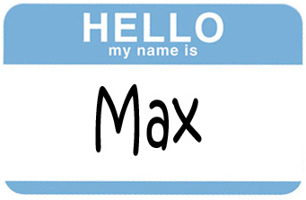
Introductions – Who is Who
Your name and position
An interesting fact about your life or career
Your experience with competitive analysis and price to win
What are you looking to get out of this training?

Slide 6
Module 1 Importance of Competitive Analysis in the Business Development Lifecycle

Slide 7
Business Development Lifecycle: The Larger Context
Begin Business Development Process
Build Capacity to Do Business with the Government
Conduct Strategic Business Development Planning
Perform Market Research
1.0
2.0
3.0
Market to the Feds & Partners
Enough Info to Make Decisions?
Yes
No
4.0
Yes
Develop Business During Project Execution
Build and Manage an Opportunities Pipeline
Check for Strategic Fit
9.0
5.0
Prepare Proposal
Conduct Capture
Qualify Each Individual Opportunity
8.0
7.0
6.0
PTW
Black Hat

Slide 8
Relationship Between Black Hat and Price to Win
1. Customer Engagement
6. Solution Development
2. Intelligence Gathering
Competitive Intelligence (Analysis) – Opportunity-specific
Identify Competitors
Black Hat: Gather competitive information; impersonate competitors to determine competitor’s solutions and win strategies, and develop action items to counteract them
Decide whether you should bid, what teaming partners and strategy to use
PTW: Determine customer’s competitive range, price competitors’ solutions discovered during Black Hat, and counteract their win strategies from the pricing perspective; determine your winning price
5. Teaming
3. Win Strategy
Competitive Intelligence (Non-Opportunity-specific)
4. Competitive Analysis
OST Capture Process

Slide 9
Reasons Competitive Analysis is a Relatively Infrequent Practice
Starting late on pursuits: Skipping or delaying capture and running out of time is common; consider that successful companies spend 60% of their B&P budget on capture. This is like a runner skipping crucial warmup exercises and expecting to win the race.
Reluctance to spend money on competitive analysis: Hesitating to invest in competitive analysis due to cost is shortsighted. Consider what it costs your company to lose more bids than could be won with better insights. Use competitive analysis only on those bids you want to win.
Assuming there is nothing new to learn about your competition: It’s like getting complacent about relationship and being unpleasantly surprised – taking someone or something for granted often is a symptom of a problem and a recipe for heartbreak.
Failing to get the right tools: Not budgeting to subscribe to competitive analysis tools is like being a hair stylist in a celebrity beauty salon with cheap, dull scissors and a weak blow drier while being expected to make $1000 per haircut by the salon’s owner; use professional tools to do your job and get professional results.
Not seeking help from experts: This is comparable to facing a complicated medical condition without consulting a specialist or seeking a second opinion. Engage consultants or experts when necessary to enhance your competitive analysis efforts.

Slide 10
Review the Case Study
What would be the most important questions you would need to answer to win this opportunity from the technical and pricing perspectives?

Slide 11
Module 2 Laying the Groundwork for Competitive Analysis

Slide 12
What Happens if There is No Competitive Analysis and PTW?
You do your best without considering your competitors – like training for a muay thai match with a punching bag only
Just swag a salary and put wrap rates on it and hope no one else competes
Accept the targets from primes and then try to manage profitability (may suffer in performance, hard to be profitable)
Solution is developed late, jeopardizing your Pwin; costing efforts wait till you solidify the solution, and you write a mediocre cost proposal at the last minute
Cannot set effective and conscious pricing strategies
Don’t document your costing assumption properly and strategically to ghost your competition through BOEs, WBS, and BOM, and to excel in audits later
Fail to write a non-boilerplate narrative in the cost volume that ghosts competition, without convincing supporting documents that prove you are right
Make mistakes in your pricing because it doesn’t go through an iterative process and multiple SME and management reviews

Slide 13
Competitive Analysis Elements
Strategic Competitive Intelligence (CI): analysis of the entire competitive field
Part of market analysis
Examples:
Tactical CI: opportunity-specific analysis
Win/loss analysis as relevant to the target pursuit
SWOT analysis to identify strengths, weaknesses, opportunities, and threats
Blind spots analysis to analyze previous strategies that are likely to be reused
Alliance analysis to determine competitors’ teaming
Strategy hypotheses (usually at a Black Hat)
War Gaming to pressure-test your plans against competitors’ responses (usually at a Black Hat)
Price To Win Analysis: intimately connected to CI
Are your rates competitive?
How do you benchmark against your competitors?

Slide 14
Ethics of Competitive Intelligence
Good capture is not corporate espionage
Follow laws and regulations
Procurement Integrity Act
Prohibits release of source selection and contractor bid or proposal information (other than through FOIA)
Introduces “cooling off” periods for government officials, and non-soliciting of gov cons for jobs
Economic Espionage Act
Cannot steal trade secrets, which would result in injury to the secrets’ owner
Knowledge and intent are key – and what is considered a trade secret (is preserved by the company, and company derives economic value from this information not being widely known)
Cannot steal secrets for a foreign power
National Information Infrastructure Protection Act
Limits access to computers, financial records, and government systems, and makes it a crime to plant viruses, crack passwords, and use computer systems as part of extortion

Slide 15
Information You Should Not Get
Source Selection Information
Bid prices
Proposed costs or prices
Source selection plans
Technical, cost, and price evaluation plans and evaluations
Competitive range determinations, rankings, and source selection reports
Other information marked as source selection sensitive
Contractor bid and proposal information:
Cost or pricing data as defined by 10 U.S.C. 2306a(h))
Indirect costs and direct labor rates
Proprietary information and other “contractor bid or proposal information” – if properly marked, submitted to a federal agency as part of bid and proposal, and not previously made publicly available

Slide 16
Additional “Don’ts” of CI
False Pretenses
Obtain information under false pretenses (intent is key)
Fake Interviews
Conduct fake job interviews just to pump candidates for data
Proprietary Data
Ask new employees or consultants to furnish proprietary information and documents from former employers or clients
Government Info
Use proprietary information from government customers
Competitor Info
Get proprietary competitors’ information from teaming partners
Illegal Activities
Do anything else that’s illegal

Slide 17
Develop a Knowledge Base for CI Information
Capture your analysis results and relevant source data
1
Collect all your debriefs and lessons learned in the database
2
Focus on your competitors’ strategies, not rates (as rates change)
3
Always document your sources (you don’t want sensitive information you have collected to be subpoenaed and with no cited sources look like results of espionage)
4

Slide 18
Other Competitive Analysis Tips
Start Early
Start early, after the Win Themes/Win Strategy Session
Document
Document your findings in the CI Knowledge Base
Continue Analysis
Continue collecting competitive information throughout the capture process, refining the results of your Black Hat and PTW
Recognize Changes
Recognize when changes impact your win strategy
Accept Limited Data
Don’t be discouraged by incomplete or imperfect information; quantity transforms into quality over time

Slide 19
Module 3 Identifying the List of Competitors and Preparing for the Black Hat

Slide 20
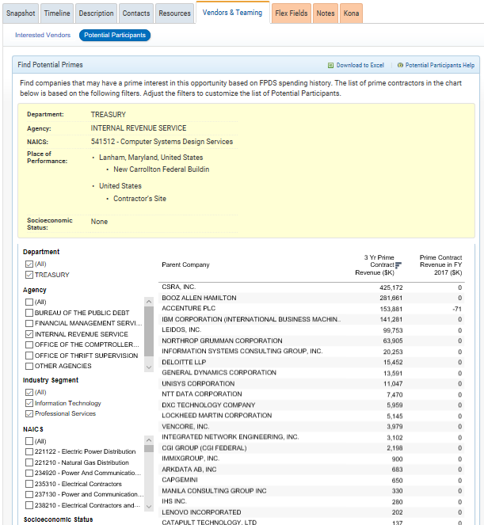
Identify the List of Competitors
Use the GovWin IQ Vendors & Teaming tool in the opportunity to discover Potential Participants:
Set the same agency, then also similar agencies
Pick a NAICS, socioeconomic status, and other parameters
Pay attention to those with 3 Yr Prime and Last Year Prime Contract revenue at the agency
Consult the Agency tools in GovWin IQ
Use GovWin IQ Advanced Research (included with most subscriptions)
Industry day information and historical interested vendors data
Use AI to research competitors
Use USAspending.gov NAICS and PSC combination

Slide 21
Discovering Teaming Partners is Harder
Use rumors and information from government and yours and teammates’ project personnel at the agency
Use BGov to understand company prime and subcontractor relationships – companies often team with the same partners
Google press releases and IDIQ pages
Look up other successful companies in adjacent NAICS codes at the agency
Call around in search of a teaming partner and ask a question if the company is already teaming with someone
Correlate your findings

Slide 22
A Typical Black Hat Set Up
Competitor A
Competitor B
Facilitator
Competitor C
The “Home” Team

Slide 23
Prepare for the Black Hat in Advance
Preparing the slides typically takes 3-4 weeks
Identify Black Hat participants in advance: those knowledgeable about the competition and the pursuit (not just warm bodies)
Send the slides to the participants 1 week in advance to analyze and add to; collect and consolidate (and reissue) inputs the day before the Black Hat
Send an email explaining what’s expected in a Black Hat: impersonating your competition, developing a winning approach – and then adjusting your win strategy based on the findings
Use the slides below for the slide deck structure

Slide 24
Sample Black Hat Agenda
Reviewers are split into groups assigned to a specific competitor.
10:00 Kick off the exercise; go through slides structure and competitor intel.
11:00 – 1:00 Teams discuss and refine the slides and develop win strategies as if they were the competitors. Add to the strategy of the competitor represented, perform a SWOT analysis, and fill the matrix with evaluation criteria and top hot buttons.
12:00 – 12:30 Working lunch
1:00 – 1:20 Break
1:20 – 2:00 Team leaders debrief all the participants of their findings per competitor.
2:00 – 5:00 Based on the findings, the entire Black Hat group develops solutions and action items that would impact home team’s win strategy and answer the posed questions. Assign action items based on the Black Hat results.
If this is not enough time for the final part of our strategy adjustments and action items, use another session via a GoToMeeting or an in-person get-together to adjust home team’s strategy and solution.

Slide 25
Black Hat Groups Organization
Competitor 1/Teaming Partners
1
Name
Name
Name
Name
Competitor 2/Teaming Partners
2
Name
Name
Name
Name
Competitor 3/Teaming Partners
3
Name
Name
Name
Name

Slide 26
Customer’s Hot Buttons
Customer’s hopes, fears, and biases
Main focus during the Customer Engagement portion of Capture
Collected directly from customer and other research
Specific, deep-reaching, down to the emotional needs
May apply to the program in general or span the entire scope of work
Must be captured verbatim, as close to the source as possible
1. Customer Engagement
6. Solution Development
2. Intelligence Gathering
5. Teaming
3. Win Strategy
4. Competitive Analysis
OST Capture Process

Slide 27
Potential Source Selection Board Members
Customer Name, Title, Org | Possible Role in Selection | Profile (Be Tactful!) | Attitude towards us: Positive, Negative, Neutral | Top three hot buttons
Glenn Smith (GS-15, COR) USSOCOM | PCO | No-nonsense; knows both the program and the acquisition sides; creative | Neutral | Efficiencies, no saying “no”, constant improvement
Example

Slide 28
Competitive Analysis Overview
8. Assess our own standing versus competition and develop our strategy, story, and action items
1. Review the Draft RFP for Written and Unwritten Customer Requirements
8
7. Determine competitors’ win strategy
7
1
Tasks 5-8 are conducted at the Black Hat Session
2. Develop Customer Profile
Competitive Analysis Goals
2
6
6. Perform competitors’ gap analysis to neutralize weaknesses and play up the strengths
3. Define and Prioritize Customer’s Hot Buttons
5
3
4
5. Determine competitors’ strengths and weaknesses
4. Research and Develop Competitors’ Profiles

Slide 29
Viable Competitor Profiles
Serious Competitors: | Strengths | Weaknesses
Competitor 1 / Teammates
Competitor 2 / Teammates
Competitor 3 / Teammates

Slide 30
Exercise 1: Determine a Competitor List for the Case Study
Break into groups
Read the “Home Team” profile
Go through the steps to identify competitors
Fill out the viable competitor profiles: strengths and weaknesses represent the initial “gut feeling” and findings
Debrief and explain your selections
Desired Outcome: Learn how to use tools to identify competitors

Slide 31
Module 4 Performing the Competitive Analysis

Slide 32
Competitor 1/Teammates [replace with the specific names]

Slide 33
Minimum Competitive Analysis Checklists
1
2
3
GENERAL QUESTIONS
INCUMBENT (DEFENDS)
NEWCOMER (ATTACKS)
Who else is chasing this?
Why is the customer recompeting?
What is the expected budget?
Who are this customer’s most favored contractors?
What did we learn if we competed the last time?
What do our potential subs know?
What do our employees know?
Are there any industry, policy, or political shifts that favor you or competitors?
What is our call plan and messages?
What is our current performance?
How will the competition drive the price and tech evaluation?
How do we introduce competitive solutions early?
Which part of the Customer solution must we protect from changing?
How do we protect information?
How can we best influence the RFP?
What are the risks of changing contractors?
How do we defend our workforce from being poached?
Who is the incumbent?
How is their performance?
What can we change in how the incumbent does their work?
Where can we level the playing field?
What employees can we talk to and/or (contingent) hire away?
What unique solution options are available?
Has this offering become commoditized and can be standardized, automated, productized, or done with more junior staff?

Slide 34
Exercise 2 Setup: Competitive Analysis Simulation
Break into groups
Throughout this module, perform analysis steps as they are covered by the class material, for an assigned firm
Instructor will provide the cue when to practice each step of the analysis
Desired Outcome: Know where to find the specific information required by the slides

Slide 35
Competitor 1: Prime [Company Name]
Use GovWin IQ Teaming -> Company Profiles
Year founded, EIN, CAGE
Business size, socioeconomic status, 8(a) graduation date if applicable
Primary NAICS with description
Facility Clearance; cleared staff
HQ and other locations
Website address
Any other interesting and relevant information for this pursuit – e.g. aircraft available, radars, etc.
Prime contract obligations in the past 5 years (relevant past performance projects): Use BGov, USAspending.gov or FPDS.gov
Any known subcontractor projects from website and Googled press releases and articles
Use GovWin IQ Advanced Research to request competitor information and save yourself time with some of these items

Slide 36
Prime Contracts Awarded to Competitor 1 Prime
Contract Number | Task / Delivery Order | Vendor Name | Transition Signed Date | Transaction Value
*Summarize past experience information from: Deeper research into interesting prime and subcontractor projects – look up and add summaries from old RFPs and Statement of Work/Contracts from GovWin IQ or GovTribe
*Look up any SBA-approved joint ventures and their past performance to check if there is hidden performance
*Add slides for scope detail if you are able to find more detailed information on opportunities

Slide 37
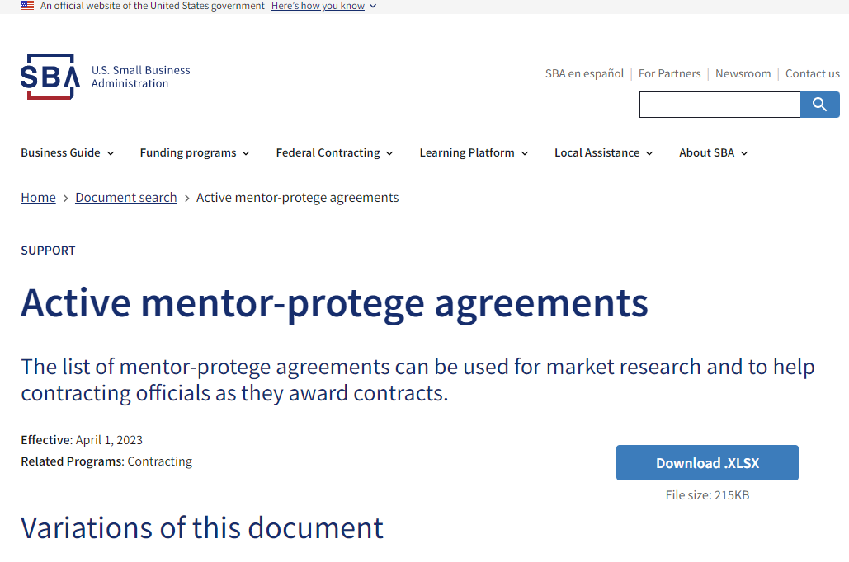
Look for Joint Ventures: Don’t miss “hidden” Competitor Past Performance
JVs have their own CAGE Code and Sam.gov registration
SBA no longer approves joint venture agreements formed to pursue competitive 8(a) contracts. This includes joint venture agreements formed under the SBA MPP to perform a competitive 8(a) contract. SBA will continue to review and approve all joint venture agreements formed to pursue sole source 8(a) contracts.
A mentor and its protégé can joint venture as a small business for any small business contract, provided the protégé individually qualifies as small. The joint venture may also pursue any type of set-aside contract for which the protégé qualifies, including contracts set aside for 8(a), service-disabled veteran-owned, woman-owned, and HUBZone businesses.
SBA Lists Active Mentor-Protégé Agreements: Active mentor-protege agreements | U.S. Small Business Administration (sba.gov)

Slide 38
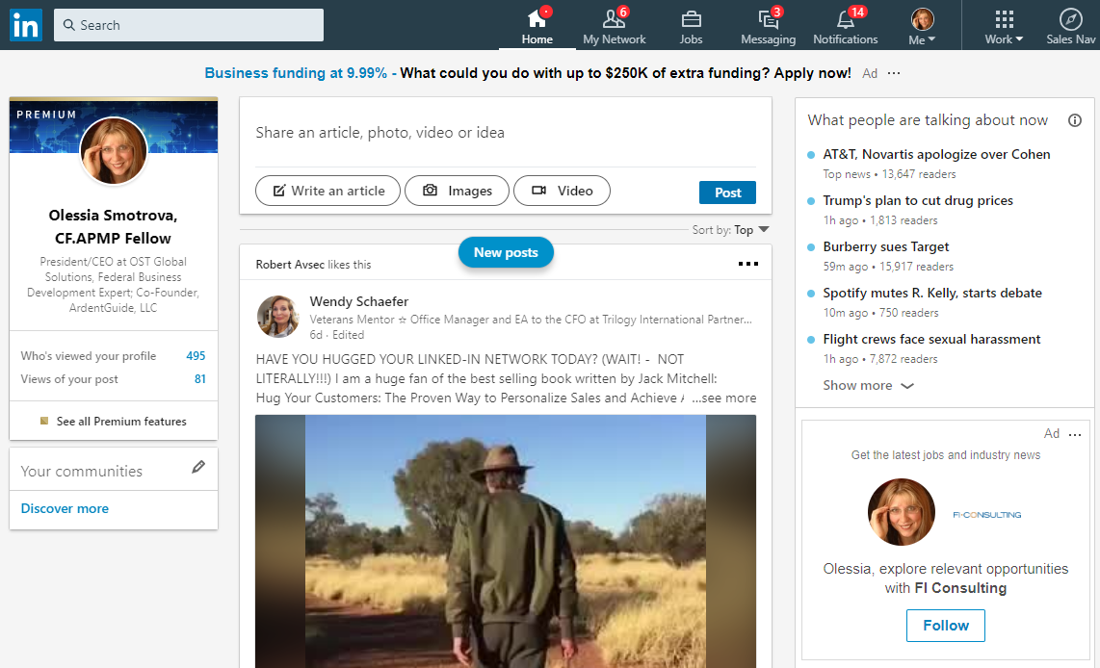
Identify Competitor’s Leadership
Use competitor’s website and LinkedIn to find leadership’s and key personnel bios
Check for experience and connections that could be relevant to the pursuit
Identify possible key personnel
Check LinkedIn for connections with the customer

Slide 39
Other Information Examples
Company’s products, patents, and innovations relevant to this project
Customer’s feedback on company’s performance and other likes/dislikes
User’s experience with company’s services (does the customer know about negative experiences?)
Company’s credit/financial history from D&B (Hoovers) and EDGAR
Attrition (from LinkedIn, website, job boards: multiple vacancies related to the program)
Recent mergers and acquisitions
Potential PM candidate and other key personnel
Potential approaches and solutions
Other areas covered in our Foundations and Advanced Capture Management courses

Slide 40
SWOT Analysis Overview
Strengths: characteristics of the bidder that give it an advantage over others
Weaknesses (or Limitations): characteristics that place the bidder at a disadvantage relative to others
Opportunities: external chances to improve win probability in the environment
Threats: external elements in the environment that could cause trouble for the pursuit and the likelihood of winning
Helpful
to Winning
Harmful
to Winning
S
W
Internal Origin
Attributes of the bidder
Strengths
Weaknesses
O
T
External Origin
Attributes of the environment
Opportunities
Threats

Slide 41
Competitor 1 Team SWOT
Strengths
Examples: Incumbent, implicitly understand this contract and work, past performance, customer environment savvy
Weaknesses
Examples: Continuous overruns; Prime has a reputation as a long-lead decision-making company
Opportunities (for them, from their perspective)
Example: Recent HQ move established executive presence on the ground at XXX to reduce the executive long-lead chain
Threats (to them, from their perspective)
Examples: Their list of personnel is not exclusive and is leaked around; government is beginning to question the lack of transparency

Slide 42
Competitor 1 Team Postulated Win Strategies
How Will They Maximize Their Strengths?
Examples:
No risk, low-cost transition
No change to management
Exploit fear of change due to the created dependency of customer on the incumbent
How Will They Minimize Their Weaknesses?
Examples:
Illustrate a new approach for how not to break budget ceiling; learned the lessons
Move the HQ to make quicker decisions for customer’s resources allocation and say yes more
How Will they Neutralize Our Team’s Strengths?
Example:
Will ghost our team as an entity not known to the customer (“we know the customer and the work unlike anyone else”)
How will they Emphasize Our Team’s Weaknesses?
Example:
Tell the customer about our loss of superstar PM and a core team member that we had previously heavily marketed to the customer
What Kind of “Innovative Deal” Might They Propose?
Example:
New types of reporting and monitoring to keep costs down

Slide 43
Competitor 1 Team Ranking
Potential Customer Evaluation Criteria | Ranking (+, 0, -) | Rationale
Written Requirements
Factor 1: Mission Capability (Support continuity) | +
Staffing plan | + | Already have personnel in place
Asset mgmt | + | Have established chain
Logistics Support | + | Have enough airplanes to stage in HI
Information Assurance for Maintaining support
Factor 2: Past Performance | + | Were there anymore mishaps? Do they have a high sortie completion rate? Is the customer happy with their performance?
Factor 3: SB Participation Plan
Factor 4: Price
Unwritten Requirements
Minimizing risk of interruption | -
Flight safety | -

Slide 44
Competitor 2/Teaming Partners Use the same slide succession as before for Competitor 2 Team and so on (no more than 5)

Slide 45
Module 5 Developing a Competitive Analysis-Based Win Strategy

Slide 46
The “Home” Team
Prime/Teaming partners

Slide 47
Home Team Profile
Profile the company and the team similarly to the competitors to be able to compare and contrast objectively
1
Include the same level of information as the competitors to avoid looking more pertinent because of all that’s known to us
2
Profile every teaming partner, including their past performance
3
Perform an honest SWOT analysis
4
Perform the win strategies analysis and complete the ranking table similar to the competitor analysis
5

Slide 48
Aggregate View

Slide 49
Exercise 3: Rank Competitors and Develop a Home Team Win Strategy
Review the Home Team’s profile again
In an instructor-led group discussion, develop:
Competitors’ aggregate rankings against the home team
Home Team’s win strategy
Resulting strategic action items
Desired Outcome: Understand the nuances of ranking competitors, and translating your findings into win strategy

Slide 50
Home Team’s and Competitors’ Aggregate Ranking Against Evaluation Criteria
Customer Evaluation Criteria | Air Wings
Written Requirements
Factor 1: Mission Capability
Factor 2: Past Performance
Factor 3: Small Business Participation Plan
Factor 4: Price
Unwritten Requirements
Low risk of interrupting training exercises
Flight safety
Total Score: | + | 0 | + | -

Slide 51
Resulting Strategies and Actions

Slide 52
Our Resulting Win Strategies Based on the Black Hat
How Will We Maximize Our Strengths?
Examples:
Provide capabilities of the team slick to the customer to show our cost control capabilities through metrics
Incumbent’s execution problems; customer is aggravated about busting of the ceiling twice – look into ghosting language in the proposal
How Will We Minimize Our Weaknesses?
Examples:
Capture superstar incumbent personnel and teaming partners through a targeted recruiting campaign
How Will We Neutralize Each Competitor’s Strengths?
Examples:
There is no pricing for transition that’s priced separately
Ghost no change to management
How Will We Emphasize Each Competitor’s Weaknesses?
Examples:
Ghost possibility of overruns on the program if business as usual

Slide 53
Resulting Action Items
Action | Priority | Responsible | Due Date
Develop capabilities of the team slick to the customer | 1 | John Doe will provide the first draft | 7/1
Schedule Price to Win exercise | 2 | Jane will line up the resources | 7/7

Slide 54
Day 1 Recap
?
What materials need to be prepared ahead of the Black Hat session?
What is a typical Black Hat session set up, and how would you modify it for a small business development team?
What techniques would you use to determine competitors’ primes and teams?
What is your biggest take-away from today’s material?

Slide 55
Price to Win

Slide 56
Module 6 Price to Win Principles and Process

Slide 57
Why Price to Win?
Help you prepare a solution-to-price (“design to cost”) bid that can outdo the fiercest competitor and produce a profitable win
Pricing a bid safely is the best bet, as proven by the GAO study; out of 68 DOD best value awards:
21 resulted in higher priced bidder with high technical score
18 to the lower priced bidder with lower technical score
29 to the bidder with lower price and higher technical score
Solution and price are intimately connected
Understanding the relationship between technical and price is at the heart of the PTW

Slide 58
The Tradeoff Between Value and Price
High Price, No Value
(Will never win)
High Value, High Price (May not win; Use strong proof that price is credible)
Maximum budget
Addressable budget
Low Price, Low Value (May win but will have problems)
High Value but Low Price (Will almost always win)
Proposal Price
Main competitor’s likely bid
PTW
Minimum reasonable price
Value
Minimum acceptable value
Maximum justifiable value

Slide 59
Understand the Best Value Continuum in Proposal Evaluation
FAR Parts 13-14
FAR Parts 8 and 12
LPTA where the customer reads all the proposals and it is possible to influence the perception of what’s technically acceptable; cost factors significantly more important
Full trade-off analysis between the cost and non-cost factors; non-cost factors are more important than price
Highest Technically Rated Offeror (HTRO): emphasis on technical merits
Simplified and sealed bids
Best Value Continuum
LPTA where the customer only reads the lowest-priced proposal; cost factors are most important
Performance/Price Trade-off (PPT) – once the proposal is deemed technically acceptable, the customer decides between price and performance; cost and non-cost factors are equally as important
Value Adjusted Total Evaluated Price (VATEP): a balance of cost and non-cost factors with an emphasis on adjusted value.

Slide 60
Evaluation Criteria Weighting Example
Note that no matter what, the price is usually the deciding factor when everything else is found equal; and is the deciding factor in more than 85% of all procurements
Relative Order of
Importance
Non-Cost
Cost
55%
45%
Approximately equal to cost or price
80%
20%
Significantly more important than cost or price
20%
80%
Significantly less important than cost or price

Slide 61
Create a Scoring Tree to Understand the Weighting of the Evaluation Criteria
Evaluation factors:
(1) Mission Support
Factor 1 – Technical Approach
Factor 2 – Management
Factor 3 – Quality Control
(2) Past Performance
(3) Price
The Mission Support factor is more important than the Past Performance factor and more important than the Price Factor
The Past Performance Factor and Price Factor are equal in importance
Under Mission Support, Factor 1 - Technical Approach, and Factor 2 - Management are of equal importance, and each of these Factors is more important than Factor 3 - Quality Control
From the Black Hat, you should already understand how you and your top competitors might score against each evaluation factor

Slide 62
Your Scoring Tree Should Be Similar to This:
In a Best Value competition, don’t look at price in a vacuum – if you score blue in all areas, you may have some breathing room with price.
For example: if you don’t have the greatest past performance, you will need to take money off of price, and vice versa.
Everywhere there may be a risk to the Government, it will impact price downward.
Proposal
100 points
Mission Support
50 Points
Price
25 Points
Past Performance
25 Points
You should understand from Black Hat where you are compared to your competitors’ scores overall, and against each factor
Factor 1 Tech Approach
20 Points
Factor 2 Management
20 Points
Factor 3 Quality Control
10 Points

Slide 63
PTW Development Process
Understand the PTW development process and its iterative relationship with the minimally compliant solution and price strategies
1
Old RFP and/or DRFP
RFP
Estimate the Funding Budget (both government and contractor costs) and Addressable Budget
6
2
3
Home Team
Estimate preliminary PTW (Top-down proposal price): Price to Compete (PTC))
4
5
Estimate Solution-Based Cost from PTC
Establish proposal price and apply strategies to achieve it
Higher
Win
Probability
Competitors’ Technical Solutions
Finalize the PTW Target
Minimally compliant independent technical solution
Determine fixed and competitor-dependent cost elements
Develop Competitor 1- Competitor n BOE solutions and price them
Revisit top-down estimation after final RFP
Adjust competitor prices
Use PTC to establish the overall solution price budget for Home Team
Estimate bottom-up solution (develop internal BOEs)
Decompose price budget to ID cost budget
Match labor categories, analyze labor rates: develop direct labor rates and loading
Develop competitor wrap rates
Establish cost bogies for components
Final Requirements
Bottom-Up Estimation
Develop winning solutions:
Design/Solution Scenario 1
Design/Solution Scenario N
Based on final evaluation criteria – what are the trade-offs?
Incumbent Contract
Old RFP and related procurement information
Burn Rate
FOIA
Competitors’ Awards and Average Rates
Black Hat Analysis (Competitive Assessments)
Other inputs
Postulated Requirements
Customer Budget
Analysis of Customer’s Buying Trends
*Don’t forget to consider: Return on Investment, new business investments, warranty for products, learning curves, management reserve, etc.
Notes:
Minimally compliant solution = LPTA; price strategies will be variations from that
Look at the contracts officer’s buying trends specifically – not just that contracting shop or the agency.
Find recent protests that were upheld – they may be gun-shy in that specific area.
People forget ODCs are included in the burn rate (need to subtract out), and it is location-depended (for labor pricing purposes). For product – should be able to look at the related data.
Estimators always overestimate – because they are engineers. You use top-down to give them target (bogie) – make it less than the number that you want – you want them to come back and cry to you that the number is too low. Otherwise they will over-engineer the situation.
Do top down, then give them lower estimate, and have them cry mercy – if they are happy, they are not low enough.

Slide 64
Module 7 Gathering Information for the PTW Effort

Slide 65
Mobilize Information Sources for Situational Assessment for PTW
Your
BDers
Your Operations
personnel working
for this customer
Customer-specific
GAO protest
decisions,
budgets,
plans, etc.
Consultant SMEs
Understanding of
the PTW
Environment
HR and
Technical Team
Pricing analysis
and FOIA data
on recently
awarded
contracts
Teammates with
Customer
Experience
Internal analysis
of Competitor’s
activities, wins,
losses, and rates

Slide 66
Estimate the Funding and Addressable Budgets
Collect budget information (money from Congress, user fees, etc. that customer gets) to determine total funding budget
Calculate addressable budget: Total Budget minus the money it takes the customer to manage this program
Between 5% (usual), 10% (middle of the road and safest), and 15% (when the government has built large cushions for critical programs) of the total, depending on how lean they run
TIP: Look at the last year of the current program; customer’s costs are similar when customers recompete
Understand funding cycles and schedules – what can your customer use and when
Often when reviewing budget documents, you will find they are not contract-specific (allocated to major programs and agency divisions); then look at the FPDS data to determine annual burn rate to derive total annual contract value for the project (and therefore total value)
1
Estimate the Funding Budget (both government and contractor costs) and Addressable Budget
What may be included in customer’s costs of procuring and managing projects:
Program management
Reserves for change orders – either errors in estimation or scope creep
Agency or department overhead
Additional services such as IT, communications, SETA contractor, QA/QC, test and evaluation, etc.
Travel and temporary duty costs
Vehicle fees
Where to get information:
Paid and free sources: BGov, GovWin IQ, DACIS for DOD, NASA, OMB (annual budget, Exhibit 300s), President’s Budget, Individual agency acquisition sites, agency procurement forecasts, award documents (government may indicate the funding level there – can see what the winning bid price was and what the funded value was to figure out the agency adder), GAO protests (may not be much help with budget though), historic spend on previous programs, new draft RFPs or old procurement information, etc.
Acquisition data: Industry day slides, other published documentation, asking the customer, FOIA requests of competitors’ proposals, including costs, etc.

Slide 67
Analyze Customer’s Award Trends
1
How does the same contracting officer buy over the past 3-5 years for relevant types of pursuits?
How does that entire procurement office buy over the past 3-5 years?
What evaluation criteria do they use?
What price requirements do they impose?
What protests were filed and what information could you glean from the protest documents on source selection and decision-making process?
Are there any published debriefs from that contracting office or agency?
What to do with the information:
Identify what the budget must have been
What was the award value?
Has the customer always awarded to the lowest bidder, or higher bidders? (Source: GAO Protests)
What ended up being the program spend after all the modifications?
Figure out what portion of the budget the customer used internally vs. contracted out
Is there anything pointing to the awardee’s performance issues?
Visualize the information and plot budget and awards/spend along the axis of award value and program’s relevancy
Estimate the Funding Budget (both government and contractor costs) and Addressable Budget

Slide 68
Analyze Your Competitor’s Awards
What did the same contracting officer (or other contracting officers in the same office or the SSA for a larger program) buy from your competitors over the past 3-5 years for relevant types of pursuits?
How many bids were submitted?
What was those programs’ addressable budget?
How far below that budget did the competitors bid? Did they win on low price, greatest capability, or best value?
What protests have your competitors filed and what information could you glean from the protest documents on source selection and decision-making process?
Are there any published debriefs from that contracting office or agency that are specific to your competitors?
Do you have any spend information on your competitors’ contracts?
How realistic were your competitors in their bids – did they overrun the program? What modifications were made on the program? Were these overruns or additional scope mods?
Plot this information on a graph of Award Value vs. Program Relevancy
IMPORTANT: Make sure you deal with the same division of the company as different facilities often have different cost centers
DACIS looks at companies by CAGE code (Facility code) that has the same cost center
If you look at all the contracts from the same CAGE code – all of them should have the same wrap rate
2
Estimate preliminary PTW (Top-down proposal price): Price to Compete (PTC))

Slide 69
Plot Your Information for Visual Trend Analysis
2
Plot relevancy and award value to visualize government award trends:
If the government is always awarding to lower bidder or higher bidder will give you insight into how to bid
Also can plot or draw conclusions from the following information, to gain understanding of customer’s award trends:
How many bidders (get from USAspending.gov Competition data, DACIS, or BGov)
Proposed $ from each bidder (usually obtainable from GAO protest reports, if there was a protest that was upheld or denied)
Award $ value
Estimate preliminary PTW (Top-down proposal price): Price to Compete (PTC))
Award Value
Relevancy

Slide 70
Burn Rate
2
Burn Rate is the pace at which a contract consumes resources annually
Retrieve FPDS data for individual contracts, including those that are combined into a single procurement; this information provides the basis for calculating the total burn rate for the upcoming contract
When different contracts are combined into one, pull FPDS data from each individual contract to get the total for the upcoming procurement
Align the data by converting fiscal years to contract years, which enables a more accurate comparison and analysis
Calculate the average annual burn rate by dividing the total contract value by the number of contract years
In some cases, it may be beneficial to exclude the first year of the contract from the burn rate calculation, as this period often involves ramping up operations and may not represent full performance levels; and it may not even be full 12 months
For contracts with a longer duration (e.g., 10 years), concentrate on the burn rate for the most recent 3 years, as the contract's resource consumption may have evolved over time
Account for 3–6-month FPDS data lag in DOD contracts for national security reasons. Adjust your analysis accordingly to ensure accuracy
Examine contract modifications, especially those with detailed notes, to gain further insights into changes in the contract's scope, requirements, or performance
Estimate preliminary PTW (Top-down proposal price): Price to Compete (PTC))

Slide 71
Filing FOIA Requests for Cost Proposals
Generally you will get cost proposal copies back but it is so redacted that you may not get a lot of data (up to 70% may be blacklines)
Valuable information you are after:
Any golden nuggets someone omitted in redacting – totally legitimate amazing information
Total number of personnel and labor categories on the contract – highly valuable in wrap rate and labor rate derivation
The number of task orders, size, and funding orders on the task orders
FOIA won’t be the “holy grail” BUT it doesn’t cost you much time or effort to file it
The best source of data is still talking to people but you absolutely should FOIA every contract on your pursuit list for the next 1-3 years (FOIA early as the FOIA process could take a year or longer)
If you are the incumbent on a large contract – always FOIA your own information to see what the competitors get
2
Estimate preliminary PTW (Top-down proposal price): Price to Compete (PTC))
FOIA

Slide 72
Reverse Engineer the Winning Average Labor Rates
Understand the government's and competitors' behavior to inform your pricing strategy and increase your chances of winning.
2
Estimate preliminary PTW (Top-down proposal price): Price to Compete (PTC))
1
Review competitors' awarded contracts: Examine previously awarded contracts to identify labor hours and Other Direct Costs (ODCs) if specified in the Request for Proposal (RFP).
1
Extract ODC information: If ODCs are specified in the RFP, pull out the relevant data to isolate labor costs.
2
Extract labor hours: If labor hours are specified in the RFP, extract the relevant data to calculate the average labor rate.
3
Calculate the winning average labor rate: Subtract the ODC amount from the awarded contract amount and then divide the result by the total labor hours.
2
3
4
Benefits of Reverse Engineering Winning Average Labor Rates:
Gain insight into government preferences and expectations for pricing on similar contracts.
Compare your proposed labor rates to the winning average labor rates to assess the competitiveness of your bid, to make necessary adjustments.
Analyzing winning average labor rates can provide valuable insights into your competitors' pricing strategies, allowing you to anticipate their bids and adjust your own proposal accordingly.
Reverse engineering the winning average labor rates can help you refine your cost estimation methods and improve the win probability of your proposal.

Slide 73
Exercise 4: Gathering Information to Prepare for the PTW Analysis
What key pieces of information would you like to know about the incumbent?
Research what is available
Debrief:
What were you able to find?
What difficulties and contradictions did you run into?
Desired Outcome: Understand uneven data quality; see how much information is available publicly and what information you would need to obtain from SMEs, vendors, or FOIA

Slide 74
Module 8 Performing the PTW Analysis

Slide 75
Identify the Price to Compete (PTC)
2
Estimate preliminary PTW (Top-down proposal price): Price to Compete (PTC))
Price to Compete is your perception of what the competitive range would be before you get the final RFP
PTC is your top-down proposal price boundary
Determine the top-down price not to exceed based on:
Customer’s award trends
Your competitors’ bid trends
Any deltas between past contracts that you have looked at and current opportunity’s contract type, requirements, and evaluation criteria
What conclusions can you make based on this information, and how far below should the price to compete be from the customer’s addressable budget?
Plot the results on the award value vs. program relevancy graph

Slide 76
Another Way of Envisioning PTC in a Best Value Competition
2
Estimate preliminary PTW (Top-down proposal price): Price to Compete (PTC))
Above the IGCE
Within 10%-30% of the IGCE
Below the IGCE
Your Calculations of What the Competitive Range May Be (PTC)
Even if you price is higher than Competitor B, you could still win if your non-price score is significantly better
Home Team (You)
Competitor C
*IGCE: Independent Government Cost Estimate (also referred to as ICE – Independent Gov’t Cost Estimate) – we won’t have insight into this number but it’s a way to visualize the competition from the government’s vantage point
Competitor A
Competitor B
Understand where competitors may be and how they may compare to the government calculations

Slide 77
Develop a Bottom-Up (Solution-Based) PTW
3
Estimate Solution-Based Cost from PTC
Use DRFP, or old RFP with your capture intel-based updates of the requirements.
Update when the final RFP comes out
Based on the PTC, develop a compliant solution that meets but doesn’t exceed the requirements
Create the baseline of the solution that enables you to compare postulated competitors’ solutions with yours
Focus on cost elements, not price
Define labor categories and location-based salaries
Assess evaluation criteria, determine price competitiveness by each competitor
Develop price to win model, model what if scenarios by each competitor
Construct Work Breakdown Structure for BOE development
Conduct high-level Basis of Estimates (BOE), and identify where the risk levers are
Assess materials and subcontracting cost (at a high level)

Slide 78
Price Competitors’ Solutions Based on Black Hat Findings and Gathered PTW Data Analysis
4
Competitors’ Technical Solutions
Define each competitor’s solution based on SWOT analysis
1
Adjust for gaps in your knowledge based on:
2
Analyze competitor as a team – include teaming partners based on workshare and roles (especially if the sub is a large business driving the solution)
3
Determine difference between the minimally compliant solution and each competitor-specific solution to determine customer value
4
Competitor’s behavior on similar programs and blind spots analysis
Labor costs based on prevalent rates and benefits packages in the area
Wrap rates (purchased or calculated from other labor-based programs with information that you have FOIA’ed)
Other Direct Costs (ODC)

Slide 79
Price Competitors’ Offerings Per the RFP and Their Postulated Win Strategies
4
Competitors’ Technical Solutions
Will your competitor offer free transition?
Does your competitor perceive they having a technical advantage over others? Or will they buy their way in, investing now and eating costs or proposing Engineering Change Proposals (ECP) later?
How much or little will they escalate labor prices?
How will they treat uplifts (for foreign/dangerous locations) and shift differentials (different base pay)?
What efficiencies may they propose such as learning curve, technology replacing labor, etc.?
Will they green the workforce? (Greening can be senior vs. junior or changing the roles – ex. Software development vs. COTS solution with lower level of support)
What fee might they propose? Is there a team fee (e.g. – fee sharing or no fee on subs?)
How aggressively might they behave on price?
Independently of the capture team, re-run the Black Hat table evaluation considering price details
Compare results to the earlier Price to Compete and Addressable Budget
Identify your price to win range and where the competitors will be
Keep gathering competitive intelligence over time to refine your results and track changes in conditions

Slide 80
Check Glassdoor, Indeed, Zip Recruiter, Major Job Boards, Competitor Website, and Industry-Specific Job Sites
Are competitors actively pursuing this contract, judging from the relevant job openings listed, and their Business Development activities such as attending Industry Day, Site Visits, etc.?
Is there any salary information in their job openings?
What are their employees saying about the company regarding management, turn over rates, benefits, compensation, work hours, work conditions, and so on?
Compile information in AI tools to analyze and draw conclusions on all of the above
Did competitors have any recent re-org, key hires?
4
Competitors’ Technical Solutions

Slide 81
Integrate Competitive Analysis with a Pricing Model
Create a pricing model that directly feeds key data into the PTW pricing model
Build a detailed pricing model for each potential competitor, so that you could update all models simultaneously as key data changes
Directly link all data that is considered fixed (the same for everyone) such as staffing, government-dictated hours, productive hours dictated by government or local labor laws, government-set escalation, FTE definition, labor positions subject to Wage Determination (WD) or CBA wages, etc.
Program the competitive pricing elements as variables or “levers” for each bidder (“levers” are numbers you can modify – things that are not dictated by solicitation that you can control; this is how each bidder differentiate their bid from others)
Use gathered intelligence to inform competitive pricing variables such as headcount, G&A, fee, exempt wages, expat wage packages, international employee content, nationality mix requirements typical to base operations work overseas, overhead, and more.
Determine the "Lowest Conceivable" price point (how low could competitors get if they really wanted to win this contract) to gauge their pricing strategies as a percentage above the lowest conceivable threshold
Assess competitors' motivations for bidding low and analyze potential implications
Calculate margins of error based on the lowest conceivable price, creating a high and low range for each competitor
Separate pricing and PTW models and run them in parallel, analyzing each variation thoroughly – this is an error checking tool/process
3
4
Estimate Solution-Based Cost from PTC
Competitors’ Technical Solutions
Notes:
Some people build an overall pricing model that collects all the elements that are static (the same) and then individual models, and some build individual models and have them feed into the main overarching one (so you can see price by competitor in the summary format).
Would build competitor model first, and then the overarching model. Depends how your mind thinks about it.
Example in our case study – strategic plan for the owner for Draken – all revealed in the Black Hat – to low-bid

Slide 82
Exercise 5: Walk Through the Steps of PTW Analysis
As an instructor-led exercise, walk through the steps of PTW analysis required for the case study
Combine the information found with plug numbers, identify additional information requirements and possible sources, and your lessons learned
Desired Outcome: Understand the level of work involved in the PTW process and PTW’s limitations and opportunities

Slide 83
Module 9 Mastering the Labor Rate Analysis

Slide 84
The Process for Performing the Labor Rate Analysis
Labor rates weigh heavily into your bid-no-bid decision on a recompete or new contract
The goal is to present realistic and competitive rate ladder (wage rates for all positions) in your proposal, that highlight your overall bid strength, with highly valued technical solution at the best price to the government
Ensure the overall average labor rate meet the target in your Price to Compete
1. Get Labor Category Descriptions
3
4
2. Match Labor Categories
Estimate Solution-Based Cost from PTC
Competitors’ Technical Solutions
3. Pull Salary Survey Data
4. Select Labor Percentiles
5. ID Gamed Rates (Throw Away and Protected (Key) LCats)
6. Perform Competitors’ Wrap Rate Analysis
7. Develop Burdened Rates
8. Verify If Weighted Average Rates Meet Target from PTC
9. Make Adjustments to Meet Target
Notes:
Work with base contract with base hours – awarded separate CLINs by labor cat – but usually you can’t – average labor year per year for that effort. Want to do it every year to see how they escalated. Will project if they are incumbent – not going to be much different.
If have labor cats and labor cat descriptions…

Slide 85
1. Get Labor Category Descriptions
Review the labor categories description provided with the RFP
If there is none or they are sparse, look into an old RFP or relevant RFP, and work with the technical SMEs to develop them
Usually, when the RFP doesn’t provide good labor category descriptions and you are not the incumbent, the RFP could be rigged towards the incumbent
Ask the question stating that the incumbent has an advantage because they are the only one who knows what the work entails
Also ask the government to provide years of experience and education for each position as a minimum
Always file a FOIA request for competitors’ proposals or at least contracts with labor category descriptions (FOIA one year in advance – start capture early)
3
4
Estimate Solution-Based Cost from PTC
Competitors’ Technical Solutions
1. Get Labor Category Descriptions
2. Match Labor Categories
3. Pull Salary Survey Data
4. Select Labor Percentiles
5. ID Gamed Rates (Throw Away and Protected (Key) LCats)
6. Perform Competitors’ Wrap Rate Analysis
7. Develop Burdened Rates
8. Verify If Weighted Average Rates Meet Target from PTC
9. Make Adjustments to Meet Target

Slide 86
2. Match Labor Categories
The primary goal of labor category matching is to create a fair and accurate comparison between your organization's labor rates and those of your competitors for similar labor categories or positions
The problem is that labor categories are rarely titled the same so it’s unclear which positions are equivalent to one another
To do the proper matching, it’s important to understand the functional duties of each labor category
Map by functions, not merely by titles
If not in the RFP, ask SMEs to clearly define each labor position and their intended functions
Pay special attention to education, years of experiences, and make appropriate adjustments up or down if these don’t match
Example: We need HS + 2 years of experience for a Junior position. The Salary Survey starts with BS + 1 year, which is equivalent to HS plus 5 years. We could remove 3 years of experience by equating every year of experience with 5-10% of salary.
3
4
Estimate Solution-Based Cost from PTC
Competitors’ Technical Solutions
1. Get Labor Category Descriptions
2. Match Labor Categories
3. Pull Salary Survey Data
4. Select Labor Percentiles
5. ID Gamed Rates (Throw Away and Protected (Key) LCats)
6. Perform Competitors’ Wrap Rate Analysis
7. Develop Burdened Rates
8. Verify If Weighted Average Rates Meet Target from PTC
9. Make Adjustments to Meet Target

Slide 87
3. Pull Salary Survey Data
Use paid sources such as the Economic Research Institute (ERI) for salary survey data and geographic pay differentials
DCAA strongly prefers ERI over free sites such as Salary.com
U.S. Bureau of Labor Statistics https://www.bls.gov average median wage info is also appropriate (older data than what ERI has but it also has location adjusters)
Use the closest (appropriate) metropolitan area if the location doesn’t appear on the list
Key challenge – ERI and other salary survey data is more generic than government labor categories
Invest time to ensure your mapped salary survey labor categories match the government’s – don’t go off names only, but by functions and duties (read labor category description carefully)
Combine 2-3 different ERI labor categories that may correspond to one RFP labor category (if a mix of commercial roles translated into government RFP roles)
Blend rates from different labor categories based on relevance in job functions and skill level
For example, blend a Sr Systems Administrator with Mid Systems Administrator, or Systems Engineer to blend to the needed skill set and skill level
Have a reason for picking percentiles of each job (percentiles are a bell curve (10th, 25th, 50th, 75th, 90th)) and support the decisions with explanations, even if a proposal doesn’t require it
Read requirements in solicitation and know the end client – do they care about quality of people or care about paying as little as possible. If they value quality, competitors may bid 30th - 50th percentile or higher; if not, the lower the rate will be
Document a reason why you chose those categories and that percentile; if audited, you will have a baseline to go to
3
4
Estimate Solution-Based Cost from PTC
Competitors’ Technical Solutions
1. Get Labor Category Descriptions
2. Match Labor Categories
3. Pull Salary Survey Data
4. Select Labor Percentiles
5. ID Gamed Rates (Throw Away and Protected (Key) LCats)
6. Perform Competitors’ Wrap Rate Analysis
7. Develop Burdened Rates
8. Verify If Weighted Average Rates Meet Target from PTC
9. Make Adjustments to Meet Target
Notes:
Find out from Glassdoor – does the competitor hire at the lower end of the bell curve?
If compensation plan is required – they want to know what you will pay people.
Some customers will want to pay the lowest possible rate feasible – they don’t care about the people
Other customers that talk in the RFP about retention etc. – care about the people – bid at least in 50%th percentile or higher. The more skills they put in there and make sure we keep people – the higher I bid. The less they care, and drive us to LPTA, the lower we will go. Very rarely do you get below 25% percentile – won’t staff it with good people (will get lower-end staff).
Will write this up in your BOE for labor categories. You will state “we match it to the labor cats because it’s the closest match” Show that you stratified the salary survey data by the NAICS code, location of the work, years of experience. We know that we can find talent in this labor category in the 50%th percentile and there are many candidates in that range. Or – we will hire in the 75th percentile because we want to retain people and this category is hard to find in the market.
Competitors go through the same thing. You go to Glassdoor and see if competitors pay well or not, and do they do much to retain people?
For you – look if govt includes into solicitation – so if you are underpricing the labor cats, govt may think that you don’t understand the work. Same for the competition.
If compensation plan is required, they really want to know what you will pay these people. Want to think about how we are paying people, how we understand the work and market for hiring people. Must talk to recruiters – is this skillset available readily in the area where we are trying to recruit. If we are hiring IT professional and there are only 5 people in DC area that do that (4 of them gainfully employed, 1 available) – we will pay a premium. Explain this to the government.

Slide 88
Use Professional Judgement When Choosing Salary Surveys to Use
Different salary surveys skew towards their target industry and based on their survey participants. For example:
ERI tends to run lower; use ERI for more competitive industries such as maintenance, help desk, call center, etc.
Payscale.com is more competitive, similar to ERI
KENEXA tends to run higher; works well for higher-end IT and engineering industries, such as cyber security, digital modernization, systems engineering, etc.
Salary.com tends to run higher, similar to KENEXA
Government Contractors Compensation Survey by Western Management Group is popular among large government contractors for high-end IT and other technology positions
Bureau of Labor Statistics (BLS) captures data on a wide range of industries and company sizes, which can make it more difficult to select an exact position for a specialized skillset in the target industry, and/or pick the appropriate percentile due to the greater variability. But you can blend in the appropriate BLS selections to achieve more balanced rates as it has minimal skewing toward any particular industry.
3
4
Estimate Solution-Based Cost from PTC
Competitors’ Technical Solutions
1. Get Labor Category Descriptions
2. Match Labor Categories
3. Pull Salary Survey Data
4. Select Labor Percentiles
5. ID Gamed Rates (Throw Away and Protected (Key) LCats)
6. Perform Competitors’ Wrap Rate Analysis
7. Develop Burdened Rates
8. Verify If Weighted Average Rates Meet Target from PTC
9. Make Adjustments to Meet Target

Slide 89
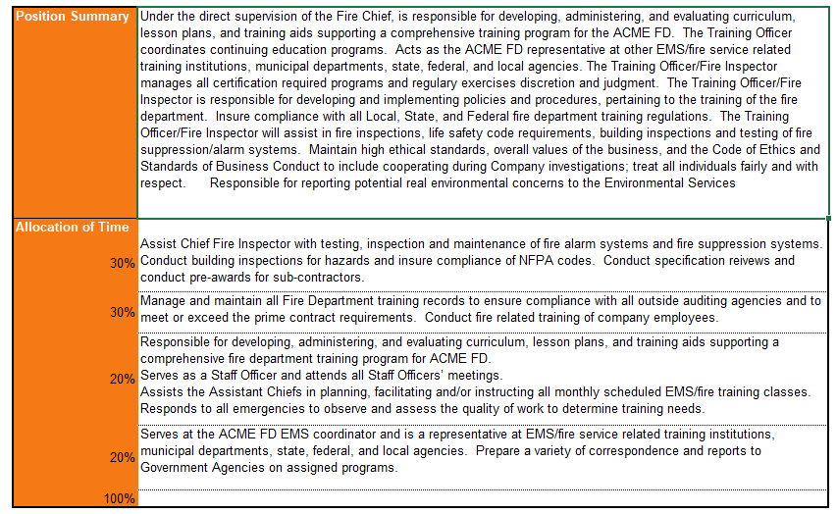
Example of Time Allocation Percentages and Blending Rates
LCAT: Training Officer
3
4
Estimate Solution-Based Cost from PTC
Competitors’ Technical Solutions
1. Get Labor Category Descriptions
2. Match Labor Categories
3. Pull Salary Survey Data
4. Select Labor Percentiles
5. ID Gamed Rates (Throw Away and Protected (Key) LCats)
6. Perform Competitors’ Wrap Rate Analysis
7. Develop Burdened Rates
8. Verify If Weighted Average Rates Meet Target from PTC
9. Make Adjustments to Meet Target
Notes:
Break down to see what they are spending time on – and if we will blend categories, we need to understand what they do.

Slide 90
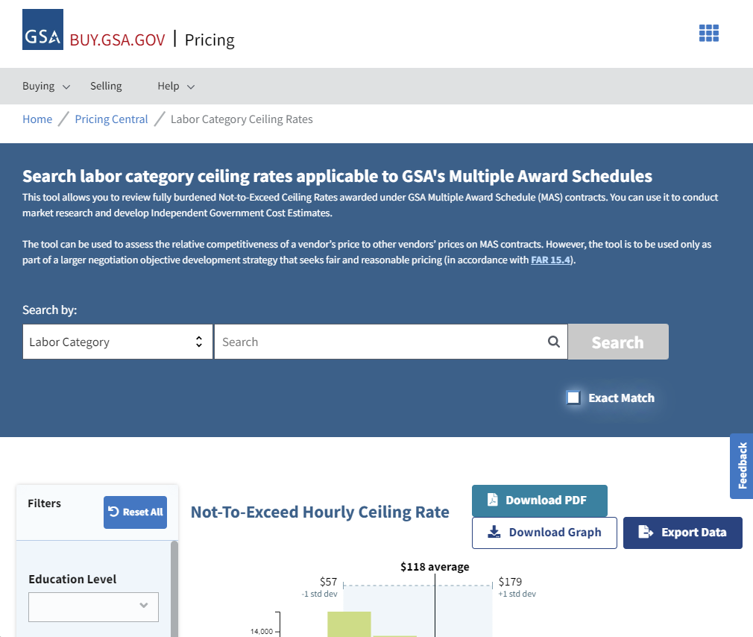
When and How to Use GSA or GWAC Rates as Data Points
When look for GSA or GWAC rates – recognize companies rarely use the rates exactly as they are in schedules; they are ceilings – not a legitimate bid rate
Analyze GSA or GWAC rates – most info is public (try Buy.GSA.gov, BGov, or GovWin IQ Labor Pricing module)
Looking across multiple schedules to determine which rates are similar and which aren’t
Don’t look at rates by category names – look at the descriptions: same position can be vastly different for each company
Note that now you may be dealing with three sets of labor categories – RFP, salary survey, and GSA or other GWAC rate category
3
4
Estimate Solution-Based Cost from PTC
Competitors’ Technical Solutions
1. Get Labor Category Descriptions
2. Match Labor Categories
3. Pull Salary Survey Data
4. Select Labor Percentiles
5. ID Gamed Rates (Throw Away and Protected (Key) LCats)
6. Perform Competitors’ Wrap Rate Analysis
7. Develop Burdened Rates
8. Verify If Weighted Average Rates Meet Target from PTC
9. Make Adjustments to Meet Target

Slide 91
GWAC/GSA Rates Analysis Tips
Map GSA/GWAC rates to the RFP labor categories – don’t worry about mapping GSA/GWAC to the salary survey (skip the “middleman”)
Try to find any contracts that company has won that are GSA schedule contracts – and see if you could get loaded rates from that contract to see how much they discounted those rates
Apply location factors – what’s the competitor’s highest priced location in the U.S.? DC, CA?
Assume it will be lower in other locations
Some companies’ GSA rates are truer than they would like them to be as GSA has been pushing rates down
If data is available, look across multiple schedules, GWACs, and other awarded contracts to determine the wrap rate
Note that wrap rates derived from GSA schedule rates will be on the high end; don’t ignore them but understand you need to validate them first
The larger the proposal – the more time you could spend on analysis; do it early as there is only so much you can do in a narrow window of time
Analyze all the labor rates for every bid you submit; as you get better at it, the work will average to roughly 1 hour per labor category for 3-5 competitors
3
4
Estimate Solution-Based Cost from PTC
Competitors’ Technical Solutions
1. Get Labor Category Descriptions
2. Match Labor Categories
3. Pull Salary Survey Data
4. Select Labor Percentiles
5. ID Gamed Rates (Throw Away and Protected (Key) LCats)
6. Perform Competitors’ Wrap Rate Analysis
7. Develop Burdened Rates
8. Verify If Weighted Average Rates Meet Target from PTC
9. Make Adjustments to Meet Target
Notes:
GSA schedule rates are for people at the highest price location – can apply location factor depending on where work is being done. DC and LA – highest, Mid West may be a lot lower. Check: What is the competitor’s highest priced location where they do the work? Even if their HQ in a cheaper location mid-country?
Over the last 5 years GSA has pushed people lower and lower in their rate – and Category management has pushed prices down. Some are closer to reality than they would like to be. Especially if companies did a lot of subcontracting, the rates they were negotiated down to become their GSA rates – their rates are more true than they would like them to be. The big guys tend to have more ability to discount – and they won’t discount a lot – and don’t want GSA to come back to them and make their discounted rates the rates going forward. Therefore companies are diligent on their discounts.
10 min for salary survey data, 10 min to pull competitor info for each labor cats, time for each competitor (3-5).

Slide 92
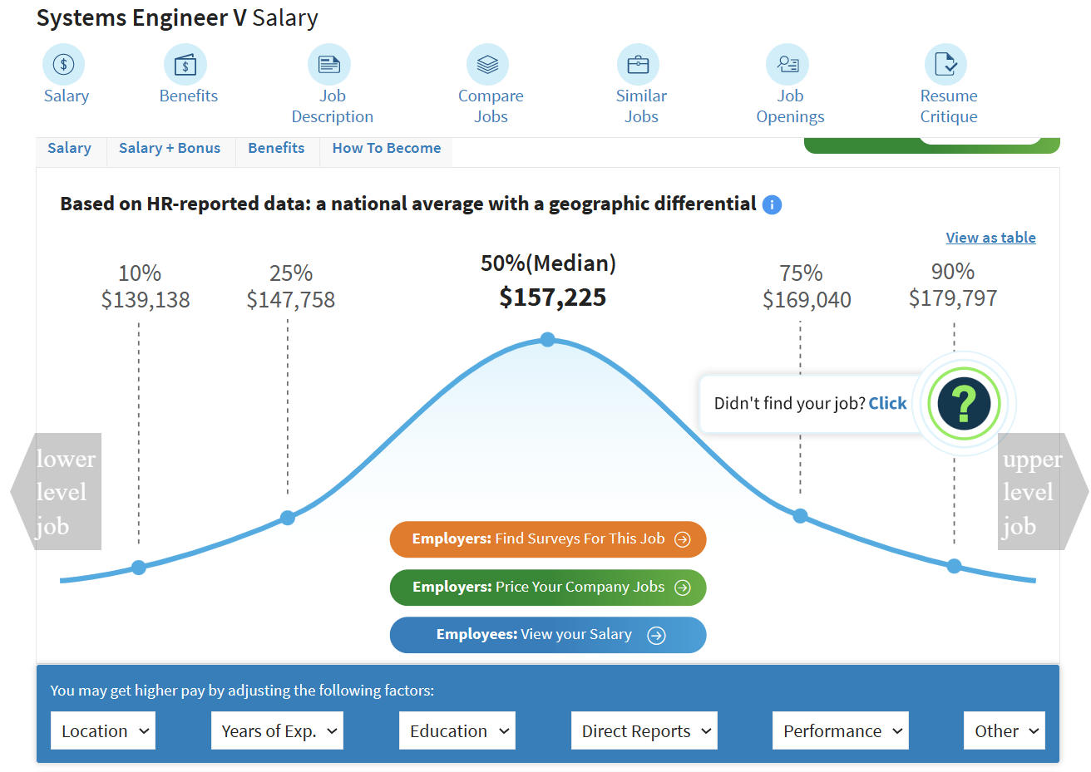
4. Select Labor Percentiles
Understand the bell curve of direct labor rates (or salary) for each labor category
Understand the weighting effect of each labor category that moves the needle:
Ex: if 80% of the contract are Sr. Engineers, then the labor rate for Sr. Engineers is the “needle mover” on the Total Evaluated Price.
Must be careful with assigning the right labor percentile, to be both sufficient and competitive.
Understand competitors’ behavior in selecting “labor penetration” (same as labor percentile) analyzing historical trends, vehicle rates, interview data, Glassdoor information, GAO reports, etc.
Example from Salary.com
3
4
Estimate Solution-Based Cost from PTC
Competitors’ Technical Solutions
1. Get Labor Category Descriptions
2. Match Labor Categories
3. Pull Salary Survey Data
4. Select Labor Percentiles
5. ID Gamed Rates (Throw Away and Protected (Key) LCats)
6. Perform Competitors’ Wrap Rate Analysis
7. Develop Burdened Rates
8. Verify If Weighted Average Rates Meet Target from PTC
9. Make Adjustments to Meet Target

Slide 93
5. ID Gamed Rates: Goal and Definitions
This step’s goal is to identify and differentiate between "gamed," "protected," and "throw-away" labor rates to develop a balanced and competitive pricing strategy
Definitions Gamed labor rates (bid high or low):
Strategically adjusted labor rates that bidders use to gain a competitive advantage
Companies may lower rates for certain labor categories to create an overall lower price for their proposal, making it more attractive to government
These lowered rates may not accurately reflect the actual costs of employing the labor categories in question
Companies must be cautious with gamed labor rates, as they can lead to financial risks or performance issues if the actual labor costs end up being higher than anticipated
Protected labor rates (bid high):
Associated with key personnel or critical positions that are essential to the successful execution of the contract – everyone must have them; these positions often require a higher level of skill, experience, or expertise
Companies may assign higher labor rates to ensure to attract and retain qualified candidates
Assign a higher penetration (bell curve percentile) to these positions (such as Program Manager, Senior Systems Engineer), reflecting their importance and the need for competitive rates to secure top talent
Throw-away labor rates (bid low):
Refer to rates that are less critical or less used in the overall contract (they are not weighted much, and the lower is the weighting of the hours, the less important is the position – however, it may be the opposite depending on the pricing and executed profit objectives)
These rates may be assigned to labor categories with minimal contract impact on quality, or those that require a lower skill level
Assign low penetration on low skilled positions (such as administrative assistants (general clerks), cable pullers, etc.)
Companies might assign lower rates to these categories to reduce their overall bid price, but they should be cautious not to underestimate the actual labor costs, which could lead to financial risks or performance issues
The remaining labor categories are treated as averages (neither high nor low)
3
4
Estimate Solution-Based Cost from PTC
Competitors’ Technical Solutions
1. Get Labor Category Descriptions
2. Match Labor Categories
3. Pull Salary Survey Data
4. Select Labor Percentiles
5. ID Gamed Rates (Throw Away and Protected (Key) LCats)
6. Perform Competitors’ Wrap Rate Analysis
7. Develop Burdened Rates
8. Verify If Weighted Average Rates Meet Target from PTC
9. Make Adjustments to Meet Target

Slide 94
5. ID Gamed Rates: Process
Examine all the data by gathering salary survey data, incumbent data, technical estimate salary, other relevant data, and outliers for all labor categories
Identify labor rate types by examining the skill levels, weighting of hours, and importance of each labor category to identify "gamed," "protected," and "throw-away" labor rates.
Adjust competitors' and home team's rates according to the identified labor rate types to balance competitiveness and risk.
Result: Realistic and competitive "rate ladder”: a comprehensive analysis and visualization of labor rates across various categories, incorporating salary survey data, incumbent data, technical estimate salary, other relevant data, and outliers. This ladder helps to differentiate between different types of labor rates and supports the strengths in technical volume; adjust the bidding strategy accordingly
1
2
3

Slide 95
5. ID Gamed Rates: Run Analysis Results by the SMEs
Most critical data source: ask the technical SMEs who hire (not the HR staff) for their best guess of salary for each category
Purely subjective opinion – never use it in your proposal submission
It is your validation and some of the best data you will ever get
Ask to do it independently – don’t give information on the labor categories data you pulled – have them give their own opinion based on their experience; you are looking for feedback like: “This category says this – and they usually do that – those are different jobs in reality – and we have to really pay them this much.”
SMEs will also help select the percentile for the salaries (step (4) in labor rates analysis)
3
4
Estimate Solution-Based Cost from PTC
Competitors’ Technical Solutions
1. Get Labor Category Descriptions
2. Match Labor Categories
3. Pull Salary Survey Data
4. Select Labor Percentiles
5. ID Gamed Rates (Throw Away and Protected (Key) LCats)
6. Perform Competitors’ Wrap Rate Analysis
7. Develop Burdened Rates
8. Verify If Weighted Average Rates Meet Target from PTC
9. Make Adjustments to Meet Target

Slide 96
6. Perform Competitors’ Wrap Rate Analysis: Wrap Rate Overview
The wrap rate usually consists of Fringe benefits, G&A, and Overhead on top of direct labor cost
“Wrap rate” term doesn’t mean the same thing to everyone: fee may be also included in the wrap rate
Direct Labor Rate x Wrap Rate (with fee) = Fully Burdened Labor Rate (with fee)
Labor Multiplier = Labor Rate Load Factor: a financial metric that compares the fully loaded price for an hour of direct labor with the base salary of the employee doing the work
The most useful competitor labor multiplier information doesn’t include fee because the wrap rate stays the same for a period of time whereas the fee percentage varies – even on the elements of the same program
Example: Higher fee on labor, lower fee on materials, lower fee on subcontractors
Fee also varies based on the contract type (T&M, FFP, Cost Plus, etc.)
Wrap rates usually differ for the contractor and government sites (although they may not for really small companies); also vary on skill level and industry – ex: higher-end cyber security job will have a higher wrap rate as it may involve costs of R&D vs. maintenance labor
Example:
Assume that a direct labor employee is paid $20 per hour in base pay
Apply indirect cost rates for fringe, OH, and G&A -> $20 per hour in base pay grows to $42, including indirect costs
A fee is then applied to the $42 in total costs, resulting in a fully loaded price per hour of $46
The labor multiplier or effective wrap rate is 2.3, which is derived by dividing $46 by $20
Note that this wrap rate includes the fee
3
4
Estimate Solution-Based Cost from PTC
Competitors’ Technical Solutions
1. Get Labor Category Descriptions
2. Match Labor Categories
3. Pull Salary Survey Data
4. Select Labor Percentiles
5. ID Gamed Rates (Throw Away and Protected (Key) LCats)
6. Perform Competitors’ Wrap Rate Analysis
7. Develop Burdened Rates
8. Verify If Weighted Average Rates Meet Target from PTC
9. Make Adjustments to Meet Target

Slide 97
6. Perform Competitors’ Wrap Rate Analysis: Calculate Competitors’ Wraps
If you FOIA incumbent labor bill rates in the proposal, all you do is divide the loaded labor rate by the incumbent Direct Labor (DL) rate
Ex: Your researched salary for the position is 70K/year. 70K divided by 2080 (unloaded DL rate)
When you divide the loaded rate by the DL rate, you get the $33.65 hourly rate
Bill rate will be more than $33 – let’s say it is $60 billed
Divide $60/$33.65 = wrap rate (it includes fee)
Wrap rate always changes – get the most recent contracts from the same cage code (1-5 years); if older, it’s not great but it is something
Do that calculation across as many categories as you can across multiple contracts from that company’s division – the more consistent the results are, the more accurate is your wrap rate; salaries got to be the right ones
Second way to do it is great but hard to find: using Wage Determination categories
If you know the bill rate, you don’t need the salary; you can pull the current WD from SAM.gov
Can buy wrap rates from companies that sell them for valuable bids for the right cage code in the company; do a “selfie” to check how good they are
When a company is a sub – it may not be their true rates – higher or lower due to target rates imposed – it is a tougher rate analysis on subs than it is on primes
3
4
Estimate Solution-Based Cost from PTC
Competitors’ Technical Solutions
1. Get Labor Category Descriptions
2. Match Labor Categories
3. Pull Salary Survey Data
4. Select Labor Percentiles
5. ID Gamed Rates (Throw Away and Protected (Key) LCats)
6. Perform Competitors’ Wrap Rate Analysis
7. Develop Burdened Rates
8. Verify If Weighted Average Rates Meet Target from PTC
9. Make Adjustments to Meet Target
Notes:
Fringe is dictated for SCA category – this could inflate the wrap rate artificially; you must be careful. Often a small company won’t have a fringe package that rich. For a larger company –they will probably have a fringe package that rich. The wrap rate for wage determination is 1.7-2 – and small companies don’t have it that high. Even larger ones with rich fringe that’s more than 30-50%...
Let’s say you pay 10 per hour, and pay them $4+ dollar plus vacation and holidays – it becomes 2 wrap rate. Many people have separate wage determination pools for those labor categories. Have to know your competition.
WD is not the most precise way to pull the wrap rate – you could go down the wrong path.
Can buy wrap rates between $1000-$3000/wrap rate.
Cage code: awards on contracts align to cage code – some companies have one cage code – and others will have different cage codes
May have a blended wrap rate for a competitor.
Can set up wraps by location, discipline, and all different kinds of things. If you have different business units in the same location – need to understand the competitor.

Slide 98
6. Perform Competitors’ Wrap Rate Analysis: Wrap Rate Derivation Process
1. Gather competitors’ award history for similar contracts (especially for the prescribed Level of Effort (LOE) contracts that offers more insight into the labor rate variables, as the government also often fixes equipment and material costs in the LOE RFPs).
2. Obtain copies of contracts available in paid databases, and if the process is started early, file a FOIA request (if “FOIAing,” weigh the pros and cons requesting the proposal in addition to contract as proposals take longer to obtain).
3. Reverse-engineer labor costs from past contracts. Base your estimates on past contract’s dictated LOE, industry standards, historical data, and a thorough understanding of the contract requirements.
Use labor rate analysis from previous steps to determine direct labor cost
Derive an average wrap rate for the contract (the total labor cost: the difference between total award $ and ODCs), and divide by direct labor cost/wages)
4. Gather financial data about competitors, such as publicly available financial statements, annual reports, 10K Reports, or Securities and Exchange Commission (SEC) filings. This information can provide insight into their direct costs, indirect costs, and fee structures.
5. To tease out the wrap rate details, determine indirect costs that include overhead, G&A, and fringe benefits. Analyze your competitors' financial data, Glassdoor intelligence, HR interview intelligence, and other sources to estimate indirect cost rates. As placeholders for the unknowns and/or to validate information, use industry benchmarks applicable to the contract, SMEs, teaming partners, or your own company's data as references.
6. Assess the types of fees competitors are likely to charge, such as fixed fees, cost-plus fees, or incentive fees. Review past contracts, financial data, industry trends, and government customer buying trends to estimate their fee percentages.
7. Calculate competitor wrap rates using findings from steps 1-6 above. Wrap rates are the sum of direct costs, indirect costs, and fees, expressed as a percentage of the direct costs. For each competitor, divide the sum of their direct costs, indirect costs, and fees by their direct costs to calculate their wrap rate.

Slide 99
6. Perform Competitors’ Wrap Rate Analysis: Tips
The more data points, such as the actual salaries of incumbent personnel, the more accurate is your wrap rate analysis
Know to be skeptical about incumbent salaries as the staff may have been hired many years ago in a booming market or hired in recession and depression – so they may be overpaid or underpaid
Adjust incumbent rates for current market with technical SME’s input
HR and especially personnel on the ground may be a good source of incumbent salary data
Pay attention as HR personnel can get too rigid sometimes about matching labor categories exactly and may not be as creative
For Service Contract Act Labor Categories (non-exempt staff), use DOL Wage Determinations on Sam.gov or DOL Wage Determinations listing
For Labor Union work, use the Collective Bargaining Agreement (CBA) rates
Those rates are always provided by the RFP – they are contract-specific; if they are not provided, request them from the government
You may renegotiate Labor Union agreement and rates and adjust the price after award
Use the market rate in the most appropriate percentile for every labor category; you may not have all the labor categories or have an exact match – but it is good for comparison
Look up information on Glassdoor – sometimes people post salary and benefits information
3
4
Estimate Solution-Based Cost from PTC
Competitors’ Technical Solutions
1. Get Labor Category Descriptions
2. Match Labor Categories
3. Pull Salary Survey Data
4. Select Labor Percentiles
5. ID Gamed Rates (Throw Away and Protected (Key) LCats)
6. Perform Competitors’ Wrap Rate Analysis
7. Develop Burdened Rates
8. Verify If Weighted Average Rates Meet Target from PTC
9. Make Adjustments to Meet Target
Notes:
Non-exempt: look for Wage Determinations.
You can have non-exempt staff that are not subject to SCA.
You can have admin staff that are paid much higher than SCA, have supervisory skills – paid hourly.
Exempt staff are paid salary.
There are all kinds of requirements in the Fair Labor Standards act on who gets paid what.
Normally bid CBA rates but later renegotiate price after award.
The way the government looks at for salary data:
Always prefer existing employee and backup is payroll record
Next: have LOI to hire new person, and you offered a documented salary signed by you and candidate agreeing to salary
Then salary survey data
They would rather have real people – even if it’s representative person you won’t use on the job but you have documented what an equivalent gets paid.
Glassdoor posts salary info and benefits.

Slide 100
Additional Tips Regarding Wrap Rates
Consider the calendar year for the salaries you look up; make adjustments as the salaries have been escalating every year and there are inflation/job market factors to consider
You may have to consider work allocation in the team as a whole and not just the prime contractor for your PTW – as the contractor may offload some work to lower-rate subs (Your Black Hat findings are important)
Learning the composition of a competitor’s wrap rate matters
A company with a lower G&A rate will be taken more seriously than a company with higher G&A but lower overhead rate
Contracting officers don’t take G&A rates over 13% very seriously and may ding the company during analysis even if overall wrap rates are the same
This is a ghosting opportunity for you
Indirect rates vary by industry
Examples: Professional, Scientific & Technical (541 NAICS) is 2.4 typical contractor-site multiplier; Administrative and Support (561 NAICS) is 1.8 contractor-site typical multiplier
Deriving wrap rates for an Engineering company, for example, is not straight-forward: Research & Development (R&D) wrap rates are typically higher, services wrap rates are lower – need to be able to tease out the rates into different cost pools (R&D will have a higher overhead)
Manufacturing wrap rates are toughest to determine (have additional labor costs built in when you are delivering systems)
U.S. Census bureau calculates every 5 years industry data useful for deriving a wrap rate for different NAICS codes – use the first three digits of the NAICS code; can find some manufacturing information there; government uses that for fair and reasonable pricing determination. Done in 2017, 2022, then 2027: https://data.census.gov/cedsci/
Services pools are often done at a government location
Typical formula used by the government to check reasonableness of wrap rate reduction from contractor site to government site wrap rate:
((multiplier-1)*.67)+1= x
Example: ((2.4-1)*.67)+1=1.9
3
4
Estimate Solution-Based Cost from PTC
Competitors’ Technical Solutions
1. Get Labor Category Descriptions
2. Match Labor Categories
3. Pull Salary Survey Data
4. Select Labor Percentiles
5. ID Gamed Rates (Throw Away and Protected (Key) LCats)
6. Perform Competitors’ Wrap Rate Analysis
7. Develop Burdened Rates
8. Verify If Weighted Average Rates Meet Target from PTC
9. Make Adjustments to Meet Target
Notes:
When obtain well-sanitized FOIA info – may get no numbers at all…
G&A is how efficiently you run your company – want to see it approaching 10% rather than much higher than that.

Slide 101
SCA and CBA Wrap Rates
SCA Wrap Rates
CBA Wrap Rates
Understand the SCA's key provisions and requirements, such as prevailing wage determinations, H&W benefits, and paid leave (see SCA DOL Fact Sheet on SCA and the full text for SCA in Title 41 of the U.S. Code, Sections 6701-6707)
Read location-specific Wage Determination (WD) for the conditions for the geographic location of place of performance (POP)
The wrap rate may be higher for some low-wage positions than the exempt personnel: someone paid $17/hour with SCA-dictated heath and welfare (H&W) may have a higher effective wrap rate than an exempt employee paid the same wage
Obtain the appropriate WD for the contract by visiting the Wage Determinations page on sam.gov and searching for the applicable WD using the contract's geographic location of POP and occupation
Carefully review the labor categories specified in the WD and ensure they align with the labor categories included in the contract
Examine the H&W benefits required by the SCA and incorporate them into wrap rate calculations; these may vary depending on the specific WD and geographic location
Account for the required paid leave and holiday provisions outlined in the SCA, as these can impact the wrap rate
In addition to the SCA-mandated H&W benefits, consider any other fringe benefits provided by the competitor that may impact the wrap rate
Factor in overtime and shift differentials: Account for any overtime pay rates and shift differentials that may be applicable under the SCA
CBA wrap rate could be drastically different than cost bands for exempt employees’ wrap rates (typically higher)
Thoroughly analyze the CBA to understand its structure, including the various labor categories, wage scales, and any specific provisions that can affect the wrap rate
Consider all the conditions in the CBA: ex: workweek, shift differentials, fringe benefits such as health insurance, retirement plans, paid leave, and other employee benefits
Account for overtime pay rates, as well as any rules or conditions governing the payment of overtime as specified in the CBA
Factor in any predetermined escalation rates or cost-of-living adjustments (COLAs) that are outlined in the CBA, as these can impact labor costs over the life of the contract
Account for potential productivity loss due to work stoppages, strikes, or other labor-related disputes that may occur under the CBA
Examine historical wrap rates and trends for similar CBAs to gain insight into industry practices and potential cost drivers

Slide 102
How Do Specialty Firms Determine Competitor Wrap Rates?
PTW companies that specialize in deriving detailed wrap rates (with breakouts of fringe, OH, G&A, and fee) normally never do technical and cost proposals (they don’t want to see companies’ proprietary information)
They develop and perfect over the years models and algorithms (and libraries) that get populated with available bits of information about the company, and use industry-specific plug numbers for unavailable pieces
For publicly owned companies, they can access tremendous amount of detail for the specific division/facility (401K matching percentage, benefits offered, headcount from projects, layers of leadership, FOIA, etc.)
For privately owned companies, they still collect bits of publicly available data although it’s harder, and combine it with statistics on similar size and type companies
To verify how accurate a company may be in calculations of wrap rates, always ask them to calculate your company’s wrap rate first (a “selfie”)
Always inquire about how ethical is the company – you can still get in trouble if you purchase information that was obtained unethically (want them to be compliant with the Society of Competitive Intelligence Professionals (SCIP))
3
4
Estimate Solution-Based Cost from PTC
Competitors’ Technical Solutions
1. Get Labor Category Descriptions
2. Match Labor Categories
3. Pull Salary Survey Data
4. Select Labor Percentiles
5. ID Gamed Rates (Throw Away and Protected (Key) LCats)
6. Perform Competitors’ Wrap Rate Analysis
7. Develop Burdened Rates
8. Verify If Weighted Average Rates Meet Target from PTC
9. Make Adjustments to Meet Target

Slide 103
Examples of Outputs of a Labor and Wrap Rate Analysis (Depending on What Data is Available)
Contract Labor Cats and Loaded Rates |  |  | Salary Adjusted for Calendar Year |  | Salaries from Competitor Verified Through Additional Sources, Including Job Boards |  |  |  |  |  | Wrap Rates
Labor Category | Govt Site | Contr. Site | Base Salary | Escalated Salary | Competitor Job Description | 10th% | 25th% | 50th% | 75th% | 90th% | Govt Site Wrap | Contr. Site Wrap
Program Manager | $166.36 | $196.72 | $180,794 | $185,314 | Program Directors 3A,B,C | $148,500 | $154,900 | $180,794 | $180,794 | $191,400 | 1.8673 | 2.1968
Project Manager | $110.66 | $130.19 | $119,790 | $122,786 | Program Manager Technical 3 | $102,800 | $111,218 | $119,759 | $130,070 | $136,000 | 1.8746 | 2.2064
Senior Subject Matter Expert | $163.35 | $195.72 | $180,794 | $185,314 | Program Directors 3A,B,C | $148,500 | $154,900 | $180,794 | $180,794 | $191,400 | 1.8673 | 2.1968
Median and average wrap rates for government and contractor sites
Wrap (X Market) | Govt Site | Contr. Site
Median | x.xxx | x.xxx
Average | x.xxx | x.xxx
Always document key assumptions made, analytical process used
xxxx

Slide 104
7. Develop Burdened Rates
For Exempt positions: Multiply direct labor rates by the Exempt wrap rate to account for overhead, general and administrative (G&A) costs, and profit/fee.
For SCA positions: Multiply direct labor rates from the location-specific WD by the SCA wrap rates from the WD, considering factors such as health and welfare benefits, paid leave, and other SCA-mandated requirements.
For CBA positions: Multiply direct labor rates from the CBA by the CBA wrap rates, factoring in elements such as H&W workweek conditions, benefits, and shift differentials outlined in the CBA.
3
4
Estimate Solution-Based Cost from PTC
Competitors’ Technical Solutions
1. Get Labor Category Descriptions
2. Match Labor Categories
3. Pull Salary Survey Data
4. Select Labor Percentiles
5. ID Gamed Rates (Throw Away and Protected (Key) LCats)
6. Perform Competitors’ Wrap Rate Analysis
7. Develop Burdened Rates
8. Verify If Weighted Average Rates Meet Target from PTC
9. Make Adjustments to Meet Target

Slide 105
8. Verify If Weighted Average Rates Meet Target from PTC
Multiply the burdened rates by the hours to get to the Total Evaluated Price (TEP)
Can also derive the overall weighted average of fully burdened labor rate including fee (“sell rate” – what you sell to the government)
Compare the sell rate to the reverse-engineered average burdened labor rates from the earlier exercise
Is there a delta?
If there is a delta, how can it be closed by pulling different pricing “levers”?
3
4
Estimate Solution-Based Cost from PTC
Competitors’ Technical Solutions
1. Get Labor Category Descriptions
2. Match Labor Categories
3. Pull Salary Survey Data
4. Select Labor Percentiles
5. ID Gamed Rates (Throw Away and Protected (Key) LCats)
6. Perform Competitors’ Wrap Rate Analysis
7. Develop Burdened Rates
8. Verify If Weighted Average Rates Meet Target from PTC
9. Make Adjustments to Meet Target

Slide 106
9. Make Adjustments to Meet Target
Re-visit the BOE
For a solution type of bid, LOE and headcount usually are the largest price lever.
If the LOE is too conservative, this will lead the analyzed company to be priced out of the competitive range.
If the LOE is too low, it will cause technical deficiencies in evaluation.
Check productive hours
Do productive hours meet all contract requirements (especially in the cases if there’s significant CBA work)?
Is there any additional unproductivity need to be factored in (such as travel time, downtime, weather-related productivity reduction, etc.)?
Look at labor penetration
Do you have sufficient differentiation between keys/non-keys, high/low skilled labor positions?
Have you modeled competitors to protect enough key positions, and get lower on any of the non-key and low skilled positions?
Examine escalation:
Can competitors live with a lower escalation?
Can escalation be higher in the start of the contract but lower in the out years because escalation is compounded?
Check fee levels (ex: for prime’s work vs. for subcontractor’s labor)
Examine prime and subcontractor workshare mix: allocate more workshare to a cheaper subcontractor while meeting small business goals
3
4
Estimate Solution-Based Cost from PTC
Competitors’ Technical Solutions
1. Get Labor Category Descriptions
2. Match Labor Categories
3. Pull Salary Survey Data
4. Select Labor Percentiles
5. ID Gamed Rates (Throw Away and Protected (Key) LCats)
6. Perform Competitors’ Wrap Rate Analysis
7. Develop Burdened Rates
8. Verify If Weighted Average Rates Meet Target from PTC
9. Make Adjustments to Meet Target

Slide 107
Exercise 6: Perform Labor Category Matching for Labor Rate Analysis
In groups, research the available data
Find the equivalent labor rates using Internet (free sources)
Identify the limitations of publicly available information that would require you to reach out to SMEs and FOIA
Desired Outcome: Understand the process steps and complexities involved in the labor category matching
Notes:
Fighter pilot labor category – how to find it?
Check on O*NET – easier way of searching Bureau of Labor Statistics Data
Onetonline.org
Wages and Employment Trends – select location or zip code
Airline Pilots, Copilots, and Flight Engineers
They give you median, 10th percentile and 90th – Bureau of Labor Statistics gives you more details. But most people will look at the middle number.
Gives you a quick average.
Fighter pilots – would not find that labor category easily.
GovWin IQ – Pilot (Jet) - cannot find anything.
Check beta.Sam.gov Wage Determinations
Go to SCA Directory of Occupations
15070 Flight Instructor (Pilot)
Wage Determination Type – Check Service Contract Act (SCA)
Add location.
Nellis is in Clark County, Nevada
SCA: Previously Performed
Check: Yes, in the same locality
SCA: Subject to CBA
No
SCA: Non-Standard Services – the Default is Yes, choose No and search.
Click on the link and scroll down a posted document: 15000 series – Pay 41.62, and come back to make sure to see what they need to be paid for health and wellfare, vacation/holidays, etc.

Slide 108
Module 10 Last Steps for PTW and Developing Your Pricing Strategy

Slide 109
Develop Competitors’ Technical Solutions
Collaborate with estimators and technical SMEs: Engage with subject matter experts (SMEs) and estimators early in the process to develop an initial Basis of Estimate (BOE) that reflects a comprehensive understanding of the technical requirements and workload.
Develop multiple BOE scenarios: Create at least two additional BOE scenarios, one more aggressive (lower cost/riskier) and another less aggressive (higher cost/conservative), to represent potential competitor approaches. This comparison allows you to analyze different cost and risk trade-offs.
Ensure minimal compliance: Confirm that all three BOE scenarios are minimally compliant, meaning they can sufficiently handle the workload specified in the RFP without exceeding the required scope.
Identify cost elements: Determine the “fixed" cost elements, which are prescribed (dictated) by the government, and the competitor-dependent cost elements, which vary based on each competitor's technical approach and cost structure.
Analyze hours ranges: Examine the range of labor hours required for various tasks, considering both conservative and risky estimates. For example, a specific task may take 2 hours (risky) or 5 hours (conservative), or anywhere in between. Understanding these ranges can help you identify potential areas of differentiation between your solution and competitors' solutions.
Evaluate technical trade-offs: Assess the potential impact of different technical approaches on cost, risk, and performance. This evaluation can help you identify areas where you might gain a competitive advantage or areas where you need to address potential weaknesses.
Continuously refine and update: Regularly review and update your BOE scenarios and competitor technical solutions as new information becomes available or as the competitive landscape evolves. This ongoing refinement ensures that your PTW analysis remains accurate and up-to-date.
4
Competitors’ Technical Solutions

Slide 110
Finalize the PTW Target
Revisit top-down estimation after the final RFP because of:
More data available in FPDS on burn rates and more recent contracts
Revised RFP scope, performance requirements, and evaluation criteria
Additional insights into the government's preferences, priorities, and expectations, to better align with their objectives
Additional intelligence on what moves competitors are making, what solutions they may use, and what types of employees they may capture for this contract (incumbents or new staff) may inform adjustments to bottom-up BOEs and PTW target
Review and analyze updated data to identify trends, changes, or new insights that may impact your PTW target
Update BOEs and fine-tune your estimates to reflect changes in cost, risk, and performance
Reconcile top-down and bottom-up estimates: Compare your updated top-down target with your adjusted bottom-up BOEs, ensuring they are closely aligned; identify any discrepancies and refine your pricing strategy accordingly
Analyze competitors' potential pricing approaches, considering their technical solutions, staffing plans, and recent contract awards; adjust your PTW target to reflect these insights and maintain a competitive edge
5
Finalize the PTW Target

Slide 111
Establish Proposal Price and Apply Strategies to Achieve It
6
Based on the PTW exercise, establish proposal price target
Apply strategies and pull all available price levers to achieve the price target
Continuously update PTW model and predicted competitor behavior as each new discovery occurs
Proposals are a process of discovery – things change as the procurement proceeds – amendments, answers to questions, pursuit team revelations
Challenge other qualified, yet uninvolved experts within the organization or outside SMEs to create alternate PTW views of competitor behavior by employing the same baseline model
Never stop “what if” drills – consider Pwin and Margin of error implications of key management decisions prior to final proposal delivery such as fee position, investment and relative financial risk of overall offering
Home Team
Establish proposal price and apply strategies to achieve it

Slide 112
Create the Win
As competitor models become complete, model ways that you can position to win
Ghost competitor behavior that is of concern: if you expect lower than market wages, write in the price and management narratives about different bad things it may cause for the Government
Make a list of things, however extreme, that would put you in a position to win, such as:
Start your due diligence early; try one year ahead on FOIA, CA, initial BOE, and PTW based on old or similar RFP, get most of the relevant information at your fingertips, this will help you to position yourself better to win when you meet with the customer and teammates
Change the makeup of your team – swap prime/sub
Create a mentor-protégé JV – grow work share of least expensive member
Bid projected rates based on winning the bid (but don’t forget all the expenses associated with growth)
Change your Cost Accounting Standards (CAS) Disclosure statement, and bid a stand-alone cost center
Offer indirect rate ceilings
Bid other than Forward Pricing Rate Proposal (FPRP) (Forward pricing rate agreements (FPRAs) are negotiated by the government with contractors to set the pay standard for a variety of skill sets within a specified geographical region)
Create unique fee structure – lower your fee on select elements of the offering
Take risk on exempt wages
Offer a cheaper fringe benefit plan at the risk of upsetting the employees
6
Home Team
Establish proposal price and apply strategies to achieve it
Notes:
Some of these action items are long-lead items – cannot do that at the final proposal stage.

Slide 113
Day 2 Recap
?
What PTW sources are new to you?
Explain how the solution and price are related?
What is the difference between customer’s overall budget, addressable budget, the price to compete, and solution-based PTW?
What is the most reliable way to calculate a wrap rate?
What is your biggest take-away from today and this class overall?

Slide 114
We’d Love It If You Left Us a Five-Star Review!
Did you find our training valuable and impactful?
You can leave a Google review HERE
and/or a Facebook review HERE
Notes:
Google: https://g.page/r/CeQcAmyWUhUZEAI/review
Facebook: https://www.facebook.com/OSTGlobalSolutions/reviews

Slide 115
Interested in an In-depth Exploration of the Awarded.AI?
Scan the QR code with your phone camera to book a demo or click this link!
https://calendly.com/psci-sales/demo-for-psci-ai-ost
Notes:
Google: https://g.page/r/CeQcAmyWUhUZEAI/review
Facebook: https://www.facebook.com/OSTGlobalSolutions/reviews

Slide 116
Thank You! Continue Taking More Courses to Advance Your Knowledge!
7361 Calhoun Place, Suite 560
Rockville, MD 20855
Phone: 301-384-3350
service@ostglobalsolutions.com
www.ostglobalsolutions.com

