Slide 1
Mission-Driven Business Development Capabilities
Partnership with the GovCon Incubator

Slide 2
Tackling the Funding Challenges
Growing capacity and capabilities by identifying sources of funding, developing concepts, building partnerships, and developing winning proposals and applications for contracts, grants, and foundation funding
Building on and expanding your existing programs
Obtaining long-term funding to expand the team
Developing new programs and capabilities to benefit the ecosystem served by your organization
Identifying revenue streams to develop capabilities that turn into sources of matching funds for opportunities
$

Slide 3
Business Development Support
Strategy Session
Compile BD-relevant details about your organization and growth goals, and baseline ideal opportunity search parameters
Opportunity Identification
Identify opportunities to pass biweekly Interest/No Interest Decision Gate 1
Opportunity Qualification
Qualify opportunities to pass Pursue/Don’t Pursue Decision Gate 2
Concept and Partnerships
Facilitate brainstorming to develop the program concept and help build partnerships
Proposal Development
Write AI-enabled proposals using a proposal factory and develop applications
Success
At least triple the organization’s bid rate and double the win rate

Slide 4
Value Proposition
Partner with the GovCon Incubator to be your Business Development provider
We will identify opportunities for your organization, develop concepts and partnerships, and help develop winning proposals, as well as help deliver those projects
Reduced rates for pipeline, advance preparation (capture), and proposal development
Subject Matter Expertise we can provide as a partner on program execution:
  SBIR/STTR proposals
  Government contracts and business development
  Grants development support
  Entrepreneurship
  Identifying sources of capital
  Investment readiness
  Grant management, finance, and reporting

Slide 5
Benefits: Better, Faster, and Cheaper Organization Growth
BETTER
More opportunities that are better aligned with capabilities
Strong program concepts that strengthen the ecosystem
CHEAPER
A whole team for a price of one business developer
Reduced proposal costs
$
FASTER
Rigor in process that moves opportunities through the pipeline, leading to >50% win rate
Early pursuit start to gain insight into customer’s goals, build strong concepts, and forge partnerships
Identify
Qualify
Prepare
Propose

Slide 6


OST Credentials
Maryland woman- and veteran-owned consulting and training company founded in 2005, that won $26 Billion in funded contracts and grants for clients, including top government contractors
GovCon Incubator founded in 2017, and Bid & Proposal Academy founded in 2010
U.S. Department of Labor Registered Apprenticeship in Government Business Development – the only one in the Nation
Eligible for the U.S. Department of Veteran Affairs educational reimbursement funding such as GI Bill and VR&E
On the Eligible Training Provider List (ETPL)
Highly Trained BD Team
Detailed
Processes
Professional Subscriptions and AI

Slide 7
GovCon Incubator’s Notable Successes
Business Development and program partner for Maryland TEDCO, The Alabama Collective (TAC), and The Catalyst Center for Business & Entrepreneurship
Co-creator and partner on the SBIR/STTR Proposal Lab as a program of record for Maryland TEDCO since 2018
  130 companies that submitted proposals won 59 proposals
  SBA selected TEDCO for the 2022 Tibbetts Award for the Very Best in SBIR
Program designer, curriculum designer, and instructor for the DOD-focused SBIR Proposal Lab for Alabama, awarded in 2024 in partnership with The Catalyst Center
Awardee of the 2024 SBA Growth Accelerator Fund Competition: Stage Two in partnership with The Catalyst Center and TAC
Program designer for the $10,000,000 2024 SSBCI Bridge Program, including the BRIDGE Proposal Lab, in partnership with Maryland TEDCO and SBDC
Guest speaker at Alabama’s HBCUs on SBIR/STTRs
Instructor for the Maryland and Virginia APEX Accelerators, and the Veterans Institute for Procurement (VIP)

Slide 8
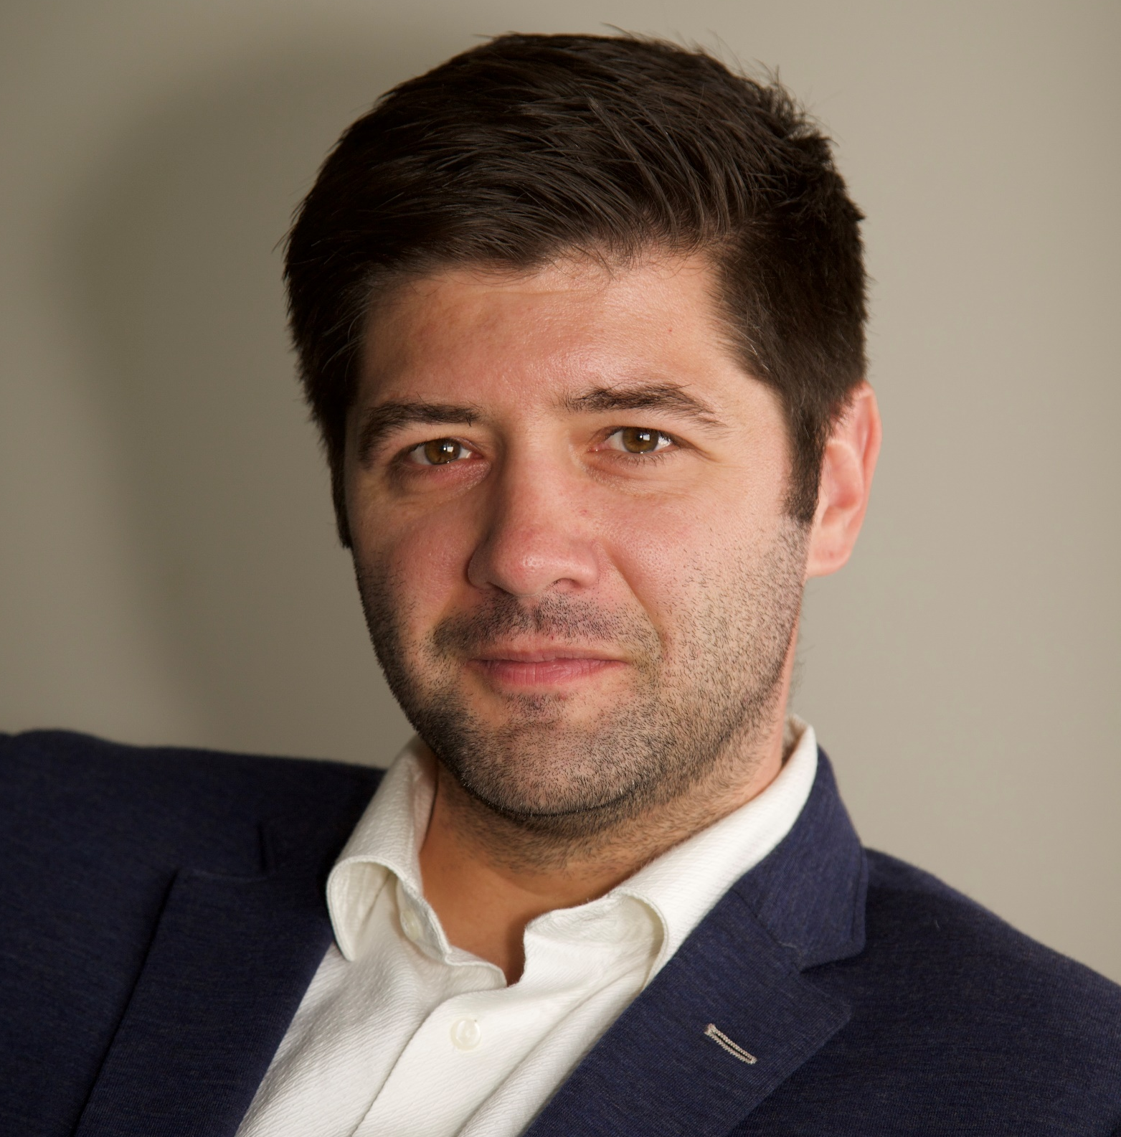
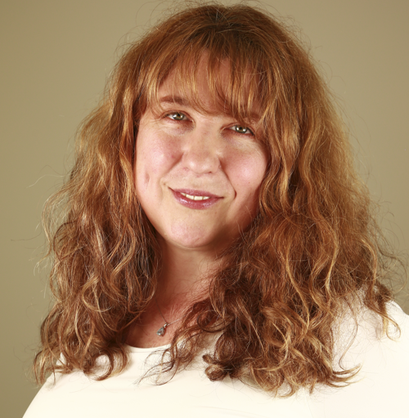

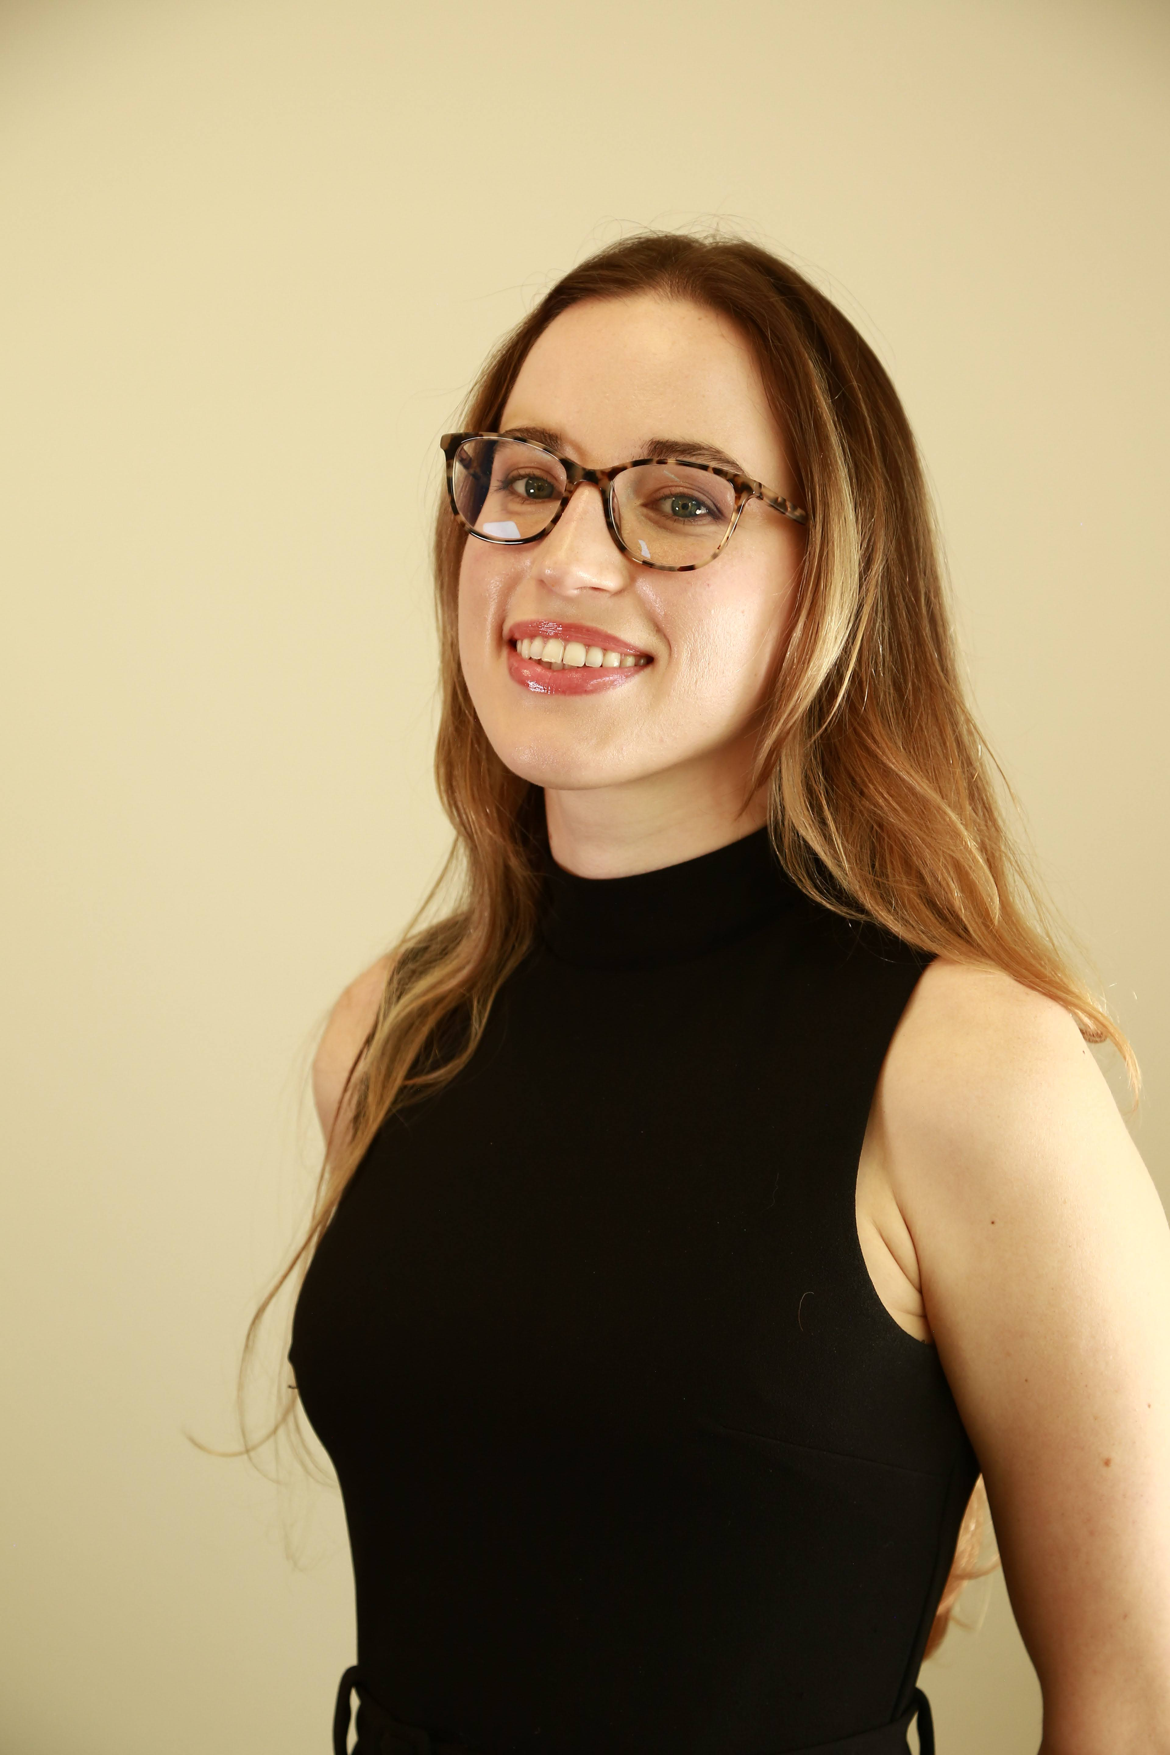
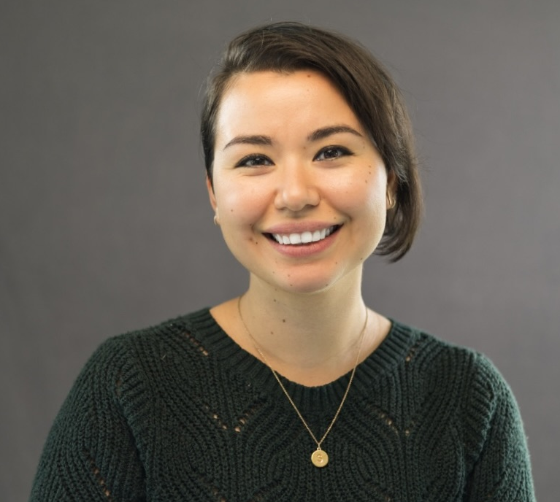
Meet Our Management Team
David Huff
CEO, BD/Capture/Proposals SME
19 years’ professional experience
Managed and won 350+ pursuits from $3M to $7B+ over the past 8 years for DOD and Civilian agencies
Expert facilitator of Win Strategy and Black Hat workshops
B&P Academy instructor for industry and government
Army veteran with 2+ years in deployments to Afghanistan
Olessia Smotrova, CF APMP Fellow CSO, BD/Capture/Proposals SME
Won $22+ billion in new business
25 years’ BD, capture, and proposal experience
Author, How to Get Government Contracts: Have a Slice of the $1 Trillion Pie
Former president of the APMP-NCA chapter (2 years) and NCMA Bethesda-Medical Chapter (2 years)
Published author, speaker, founder of B&P Academy
Bill Schalik
COO
BD, capture, and proposal operations lead with 35 years of professional experience managing proposal operations, PMOs, large accounts, projects, and teams
Headed operations and large programs for large government contracting companies, including Lockheed Martin
Val Bryan
WinMoreBD Manager
Manages multiple pipelines worth $20+ Billion
Leads market analyses, account planning, Black Hat competitive analyses, and other efforts for large, medium, and small businesses
Certified in Government Business Development by the Maryland Department of Labor
Sofia Velazquez
Chief of Staff
Supports SBIR/STTR Proposal Labs, and the Technical Assistance BRIDGE Proposal Lab
Leads TEDCO grant and proposal efforts such as the Black Tech Week
10+ years teaching staff at Harvard University
Master of Science in Epidemiology, with a minor in Biostatistics

Slide 9



Customers Span Government, Nonprofits, and Large and Small Businesses
TEDCO
Quasi-Government Agency, Non-Profit
TEDCO provides funding, resources and connections that early-stage technology and life sciences companies need to thrive in Maryland
OST Services:
Market Analysis
Opportunity Identification
Opportunity Qualification
Capture
Proposal Support
SBIR/STTR Proposal Lab
BRIDGE Proposal Lab
DLH Holdings Corp
Large Business
A health solutions company that includes four entities:
DLH Solutions, Inc.
Danya International, LLC
Social Scientific Systems, Inc.
Irving Burton Associates, LLC
OST Services:
Opportunity Qualification
Black Hat Analysis
ICMS
Small Business, 8(a), HUBZone
A multidisciplined technical consulting firm offering facilities management, IT, program management, scientific, and engineering services
OST Services:
Opportunity Identification
Opportunity Qualification
Capture
Proposal Support

Slide 10
Contact Us
www.ostglobalsolutions.com
David Huff
CEO
c: 513.316.0993
o: 301.384.3350
e: dhuff@ostglobalsolutions.com
Olessia Smotrova, CF. APMP Fellow
CSO
c: 240.246.5305
o: 301.384.3350
e: osmotrova@ostglobalsolutions.com

