Slide 1
Strategic Business Developing Planning and Budgeting:
Build a Winning Pipeline and Budget for Success
14 November 2024

Slide 2












OST Global Solutions
We've Won Our Clients Over $26 Billion in Government Contracts Since 2005
BUSINESS DEVELOPMENT, CAPTURE, AND PROPOSAL CONSULTING
Build Portfolio of Indefinite Delivery Vehicles
Develop Opportunity Pipelines
Capture Opportunities
Win Proposals
Optimize Your Processes
REGISTERED APPRENTICESHIP IN GOVERNMENT BUSINESS DEVELOPMENT; 18 COURSES IN ALL ASPECTS OF FEDERAL BUSINESS DEVELOPMENT
SBIR/STTR Proposal Lab for Maryland and Alabama
Certified Business Developer
Certified Capture Manager
Certified Proposal Manager
Certified Proposal Coordinator
Certified Proposal Writer

Slide 3

B&P budgeting starts with a qualified pipeline

Slide 4
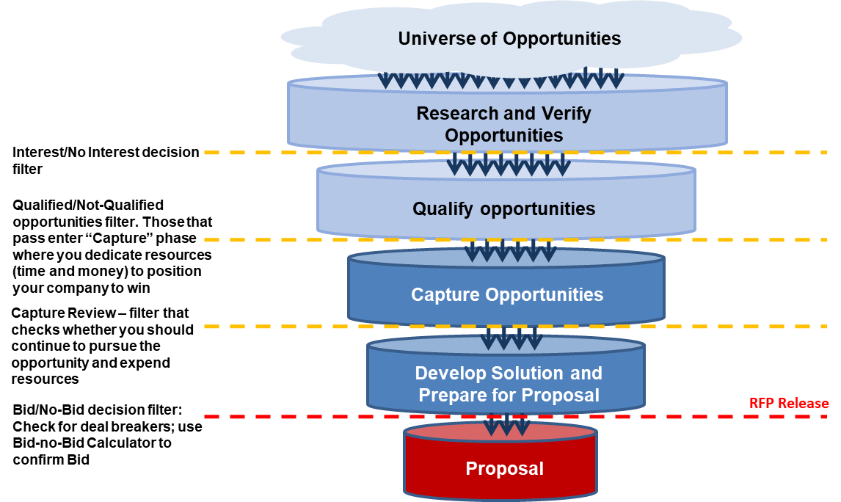
High Quality Budgeting Focuses on the Quality of Pipeline
Reporting on the total size to the pipeline is an important metric, but:
  How many of those opportunities are real?
  How many of those opportunities have progressed to capture?
  What is the probability of go?
  What is the win probability?
Quality of the opportunities are the key to B&P budgeting

Slide 5
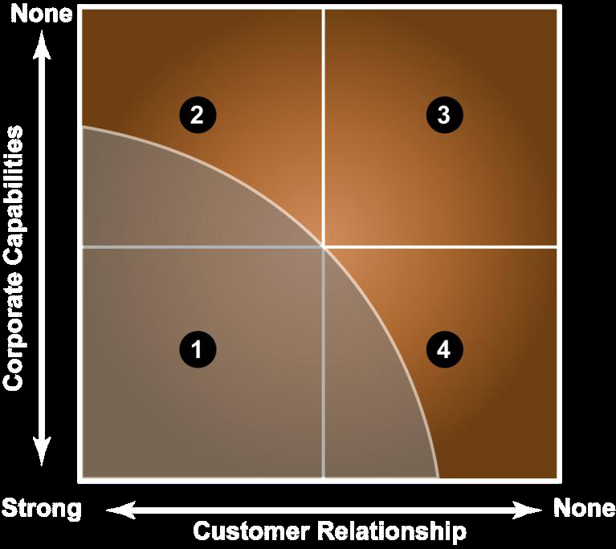
Qualified Opportunities
BD leaders need to be able to control costs responsibly – if there’s no scrutiny, then there might as well not be a budget
Questions to answer in your qualification sessions for every deal:
  What exactly is the opportunity?
  Why does the company want this opportunity? How does it fit within the strategic BD plan and what is the ROI?
  Do company’s past performance and capabilities match the requirements to be able to respond and execute, perhaps with a teaming partner?
  What is the current status – where is it in the procurement cycle?
  What other opportunities would this opportunity position us for?
  What opportunities would it preclude us from bidding on?
  Is this a possible candidate for a MUST WIN opportunity status – and if so, why?
  How does the company stack up per the initial customer and competitive analysis, and could it win?
  Does the company have the required facilities?
  Does the company have the resources to run a capture effort, write a proposal, and execute?
Don’t let your business development be a balloon ride
  Invest time to research the opportunity
  Check the documents that exist (old RFP, old contract, draft RFP, final RFP, notices)
  Read the solicitation documents carefully – use AI to help you save time
Sub
No-Bid
Prime
Sub
1: Prime; 4 & 2: – should probably sub;
3: unless joint-venturing, stay away

Slide 6
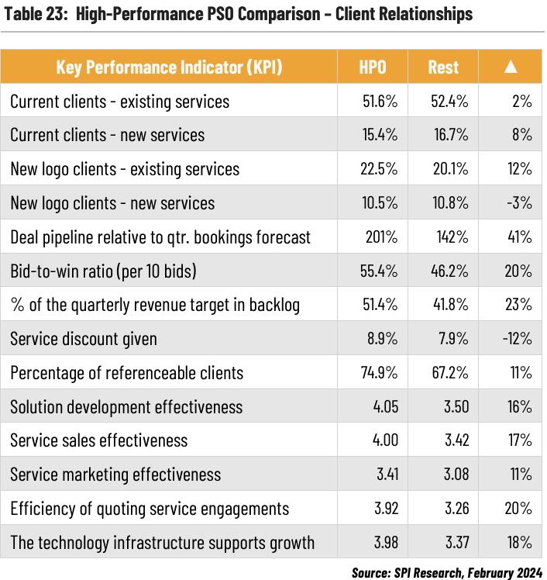
Review Short and Mid-Term Opportunities
Opportunities slip all the time
Review the short-term opportunities – imminent release to those expected in the next 2-5 months
Review the mid-term opportunities – 6 months to 1 year
Typical well-functioning small to mid-size business will work on opportunities 9 months away – “the goldilocks zone”
Then proceed to your long-term opportunities, including your incumbent recompetes
Ensure opportunities are real (e.g. you didn’t just get them off of GovWin IQ and didn’t verify)
Identify your must-win opportunities
Rank in the order of priority (new, must-win, important, nice-to-have, and flavors of no-bid)
Data Source: SPI 2024 Professional Services Maturity Benchmark. February 2024.

Slide 7
Key Terminology and Definitions
Awarded Value is the total dollars exercised on the contract at time of award
Backlog is bookings – billings ( i.e. the total value of contract commitments yet to be executed or earned)
Bid Rate is the number of proposals submitted divided by the number of opportunities inputted into the pipeline
Bid Win Ratio (win rate) is the number of successful bids divided by the number of bid submitted
Billings is the completed, accepted work that can been billed (T&M, Work in process, Milestone, Deliverables)
Bookings is the total value of signed contracts
Book to Bill Ratio is the bookings divided by total revenue; a value >1 represents growth
Capture Rate is the total dollars won divided by the total dollars bid
Debookings is revenue that never materializes as a result of de-obligated funding or expiring period of performance
Gate 1 is the go/no-go decision to move an opportunity into capture
Gate 2 is often a decision to proceed with capture
Gate 3 is the bid/no-bid decision when the final RFP is released to start the proposal effort

Slide 8
Building an Estimate for the Year

Slide 9
Deal Velocity Benchmarks
How fast and well opportunities progress through the pipeline (your Gate process) are critical for budgeting and managing the health of the BD process
Win Rate, Capture Rate, and Bid Rate are the most common pipeline metrics
Benchmarks/goals for a well functioning BD organization with defined Gate Review processes are:
  50% of opportunities inputted into the pipeline are qualified (i.e., pass Gate 1)
  75% of qualified opportunities proceed to capture (i.e., pass Gate 2)
  90% of captured opportunities proceed to the proposal phase (i.e., pass Gate 3)
These metrics will be critical for budgeting – use your actuals
Organizations With a Rigorous Gate Review Process Are x2 More Likely to Have a >50% Win Rate
54%
of organizations with a comprehensive process for all gate reviews have win rates that >50%
27%
of organizations with no documented process for most gate reviews have >50% win rates
Gate 1 and 2 Reviews happen on a consistent schedule
Qualifications are done on time so captures start early, in pace with government procurement
Good opportunities don’t languish in the pipeline
Data Source: APMP U.S. Bid & Proposal Industry Benchmark Report, 2019

Slide 10

Start with the Goal
BD goals are set as revenue targets by the end of the year or a bookings goal (i.e., net new business)
Realistic BD goals needs to account for:
  Contracts that are in source selection already for proposals submitted
  The lag time for government to evaluate proposals and make an award for new proposals
  Backlog that will be burned during the year that accounts for the funded or awarded value – the amount of contract dollars exercised under the contract
  Anticipated on-contract growth
  Potential mergers and acquisitions
  Resources available to conduct an effective gate review process, capture, and proposal development for a sufficient number of bids
Decide how you will measure success of your BD efforts – will you measure success in Total Contract Value (TCV) won or will you measure success by annual revenue growth (important for managing size)?
We should assume that only proposals submitted within the first 6-9 months of a calendar year may get awarded by calendar year end
For illustration purposes, let’s assume a bookings goal of $20M TCV for CY2025 – how many proposals do you need to submit and how many opportunities do you need in your pipeline to meet this goal?

Slide 11
Determine the Number of Proposals and Deals in the Pipeline
Start with your TCV new bookings goal of $20M by the end of CY 2025
Divide the bookings goal by your actual win rate to determine the TCV you have to submit proposals for
  $20M / .33 = $60.6M
  Industry average win rate for new business is approx. 33% (but you should use your actual win rate)
Determine the average size of the deals you submit proposals for – in our example, we’ll assume $7.5M in average TCV we submit proposals for
Divide $60.6M by $7.5M to determine how many proposals we need to submit
  $60.6M / $7.5M = 8 average size proposals
Divide 8 by your Gate 3 pass percentage (benchmark is 90% pass rate)
  8 / .9 = 9
Divide 9 by your Gate 2 pass percentage (benchmark is 75% pass rate)
  9 / .75 = 12
Divide 12 by your Gate 1 pass percentage (benchmark is 50% pass rate)
  12 / .5 = 24
With this math, we need 24 opportunities in our pipeline today that are expected to be released within the next 6-9 months in order to bid on 8 contracts with an average TCV of $7.5M in order to meet our $20M bookings goal by the end of CY 2025
77%
Companies state that #1 business practice is determining if an opportunity is aligned with capabilities
3 of 18
Most Important Best Practices in BD are:
Mapping win strategy to customers
Learning customer hot buttons
Assessing competitor positions
#1
The strongest predictor of high win rate is whether a firm has an established set of business practices
Data Source: APMP U.S. Bid & Proposal Industry Benchmark Report, 2019

Slide 12

Accounting for B&P Costs
Allocations of BD and capture management costs are guided by the FAR and Cost Accounting Standards (CAS)
FAR 31.205-18 defines B&P costs as expenses incurred in preparing, submitting, and supporting bids and proposals on potential government and non-government contracts (typically treated as indirect expenses and are included in the G&A expense pool)
When an opportunity becomes more defined, generally at the DRFP or similar solicitation stage, contractors generally establish a separate charge code for that opportunity, which allows for charging proposal costs for a specific contract
CAS 402 allows contractors to charge proposal preparation costs as direct or indirect, depending on the circumstances (you must do it consistently to result in an equitable distribution of costs to final cost objectives)
  DCAA audits contractors for compliance with FAR and CAS – DCAA expects contractors to have consistent and compliant practices for allocating BD and proposal preparation costs
Establishing a charge code for a specific opportunity upon the release of a Draft RFP is a common practice that facilitates proper cost allocation and compliance
DCAA's Selected Areas of Cost Guidebook, Chapter 33, discusses Independent Research and Development (IR&D) and B&P costs

Slide 13
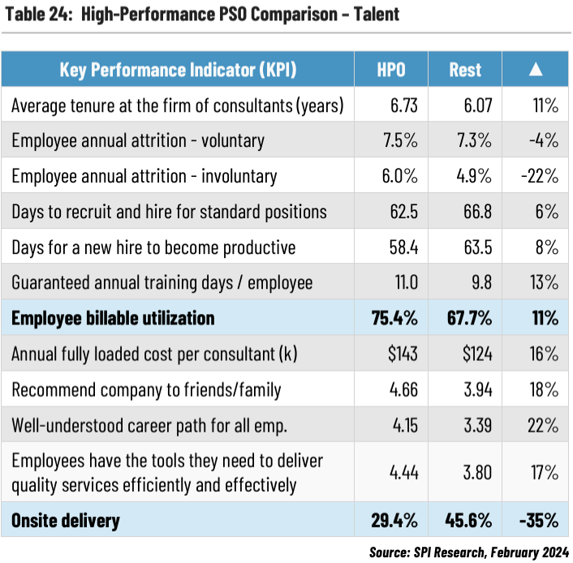
Estimating Bid Costs
Capture Manager: ~5-10% of total proposal development hours (even if done by the company leadership)
Proposal Manager: ~25-35% of total proposal development hours (for larger efforts)
Subject Matter Expert/Project Personnel Support: 2-4 hours per page
Proposal Writing:
  Technical Writing: 3-6 hours per page for a custom solution
  Non-Technical Volume: 1-3 hours per page
  Resumes: 1-2 hours per page
Editing:
  Substantive Editing: 2-5 pages per hour
  Copy Editing: 5-10 pages per hour
Graphics:
  CONOPS/OV1: 24-30 hours per graphic
  Complex Graphics: 4-5 hours per graphic
  Simple Graphics: 2-3 hours per graphic
DTP/Page Layout: ~8 pages hour
Reviewing: 8-15 hours per review per person (even with AI – the quality is higher but the time doesn’t go down as feedback is human-processed)
Labor Rate Justification/Research: 1.5-2.5 hours per LCAT
BOE Writing: 3-5 hours per page
Cost Model Development: 20-40 hours
Data Source: SPI 2024 Professional Services Maturity Benchmark. February 2024.

Slide 14

Total Budget
BD, Capture Managers, other leadership, and proposal staff involved in BD are salaried, so make assumptions on their time spent on BD tasks and multiply their hours by their internal rates.
Need to estimate at least 8 proposals at our average TCV of $7.5M to submit within the next 6-9 months to achieve our $20M in new bookings.
  Create a budget for each deal that you will submit a proposal on
  What is the complexity of your deal? Is it for an engineering contract or a training contract? Engineering is expensive; training is not
Need to evaluate upcoming must-win IDV on-ramps and estimate those as well, but they won’t count toward your bookings goal
Add 20% to your budget for “blue birds”
Align your BD goal with your B&P budget
B&P can get expensive real quick and consume your profit
  Need to have scrutiny upfront to determine what deals you’re going to pursue
  The gate review process is there to controls costs – no-bid the opportunities that are not progressing
  Create a set of pass criteria for each Gate Review and hold your G&A staff accountable for turning in quality work
  If B&P budgets are too high, then make your staff show their work (i.e., assumptions, rates, hours, etc.)
Don’t let your BD be a balloon ride

Slide 15
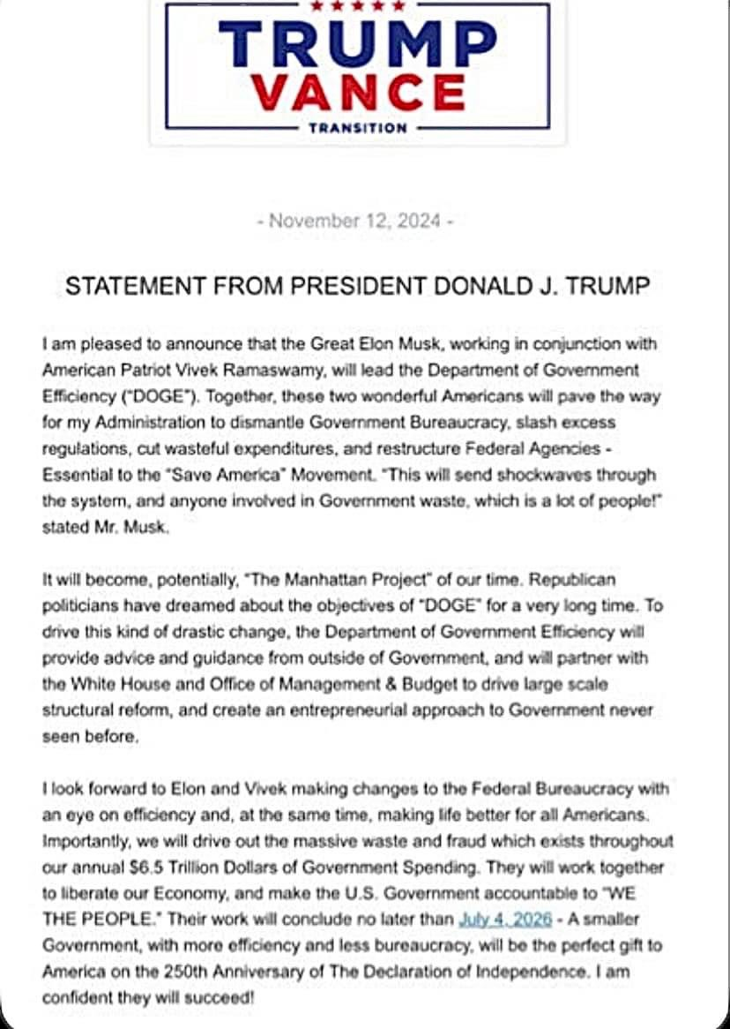
Planning for Uncertainty in the Administration Change
The Trump Administration has announced that they will make changes
An early indication of policy change will be the Presidential Budget Request due in February 2025
Other budget deadlines to watch include:
  April 15th – Budget Resolution Deadline
  June 10th – Appropriations Bills Markup
  June 30th – House Appropriations Deadline to pass all 12 appropriations bills before the August recess
  September 30th – Fiscal Year End (Congress must pass a budget or the continuing resolution to prevent Government Shutdown)
The last time Congress passed a full set of appropriations bills on time was Oct 1, 1997
In recent years, Congress has relied on a combination of CRs and omnibus or minibus appropriations bills
As of yesterday, ABC News is projecting a 222 to 213 Republican advantage in the House
The Senate is expected to be 53 Republicans and 47 Democrats
These are relatively small majorities for Republicans in Congress so radical change may face hurdles
Takeaways for BD leaders:
  Evaluate your current contracts for alignment with Biden administration priorities that may be at risk of defunding
  Stay up-to-date on budget priorities
  Stay up-to-date on agency forecasts when they change or are updated
  Listen to new political appointees to see what programs/initiatives they will champion
  Monitor key personnel changes within your clients’ organizations
  Over-fill your pipeline with opportunities to ensure you maintain your revenue levels if money is deobligated

Slide 16
Next Steps & Resources
We provide BD Planning, pipeline management, opportunity qualifications, capture, and proposal support.
We are happy to schedule time to discuss your BD efforts and goals:
  https://calendly.com/ostglobalsolutions/bdconsulting?month=2023-09
We have a subcontractor portal where you can upload your capabilities for future opportunities:
  https://www.ostglobalsolutions.com/teaming-partner-match-portal/
We regularly publish updates to major contracts through our newsletter and blog:
  Blog: https://www.ostglobalsolutions.com/blog/
  Newsletter sign up: https://www.ostglobalsolutions.com/tag/email/

Slide 17

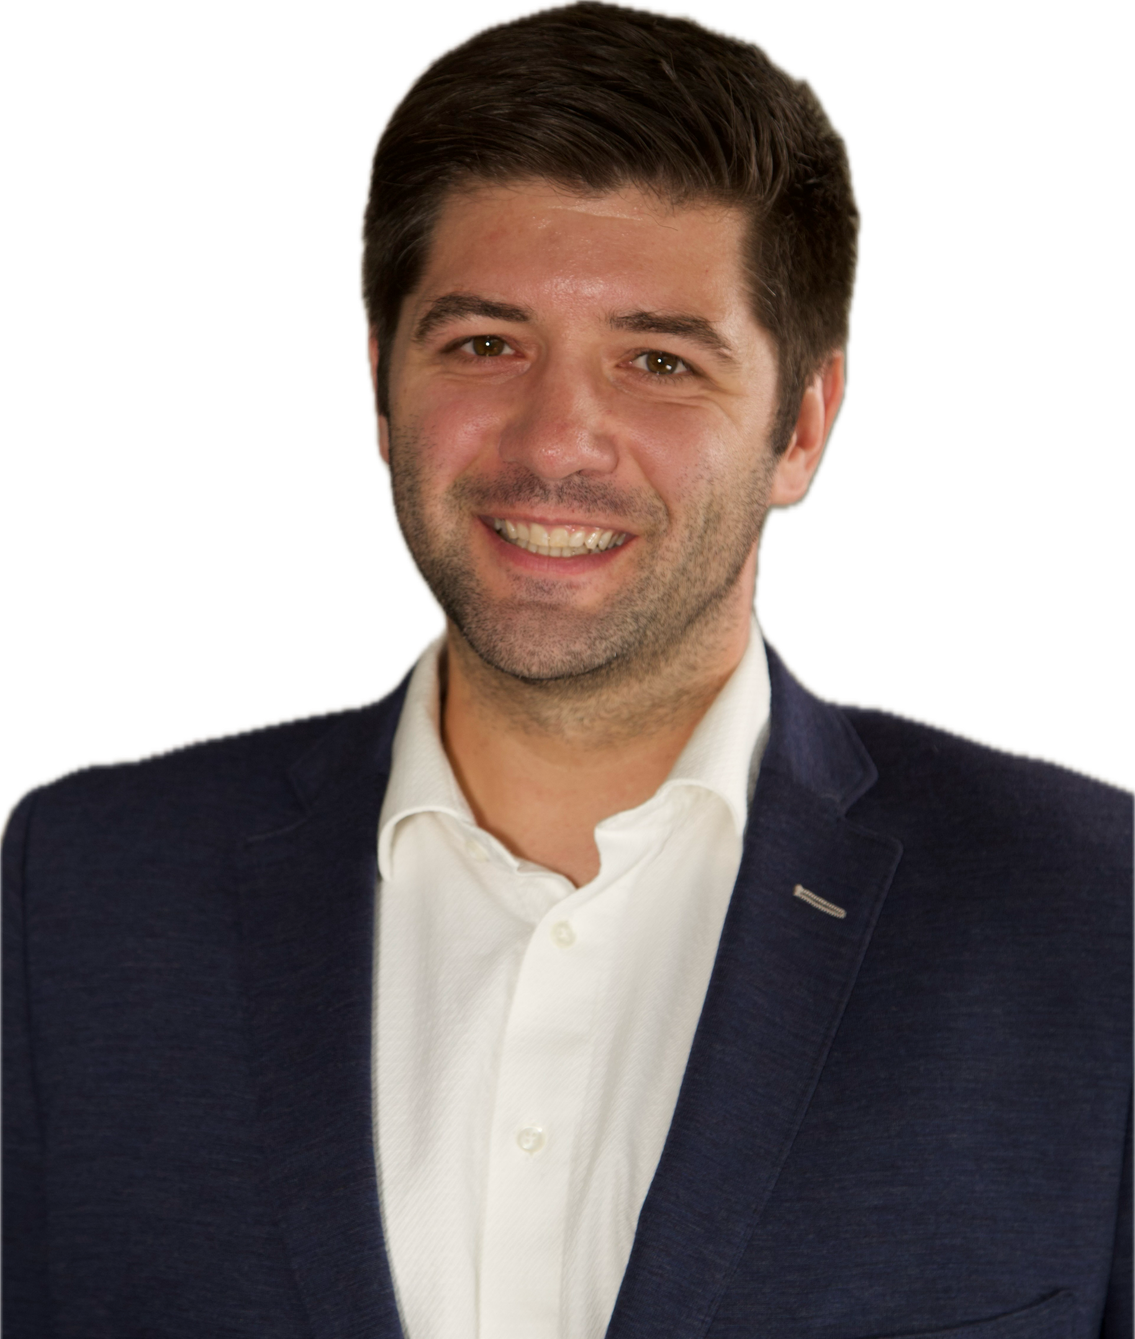
Let’s Partner in Winning Business
David Huff
CEO
c: 513.316.0993
o: 301.769.6602
e: dhuff@ostglobalsolutions.com
www.ostglobalsolutions.com

