Slide 1
Marketplace for the Acquisition of Professional Services (MAPS) IDIQ
22 January 2025

Slide 2
About OST
We've Won Our Clients Over $26 Billion in Government Contracts Since 2005
BUSINESS DEVELOPMENT, CAPTURE, AND PROPOSAL CONSULTING
Build Portfolio of Indefinite Delivery Vehicles
Develop Opportunity Pipelines
Capture Opportunities
Win Proposals
Optimize Your Processes
REGISTERED APPRENTICESHIP IN GOVERNMENT BUSINESS DEVELOPMENT; 18 COURSES IN ALL ASPECTS OF FEDERAL BUSINESS DEVELOPMENT
SBIR/STTR Proposal Lab for Maryland and Alabama SBA FAST Grant
Certified Business Developer
Certified Capture Manager
Certified Proposal Manager
Certified Proposal Coordinator
Certified Proposal Writer

Slide 3
OST’s MAPS IDIQ Support
Independent review of your scorecard and proposal content
Full proposal development
We offer:
Color Reviews
Compliance Reviews
Proposal Management
Proposal Writing & Editing
Graphics and DTP
Schedule a call to learn more about our support

Slide 4
About Army MAPS
Army Program Executive Office Enterprise Information Systems’ (PEO EIS) Enterprise Services Project Management Office and the Army Contracting Command Aberdeen Proving Ground (ACC-APG) consolidates the Information Technology Enterprise Solutions 3 – Services (ITES-3S) and Responsive Strategic Sourcing for Services (RS3) follow-on contracts
The Government intends to award 100 awards total; 20 per domain
Technical Domain (NAICS code: 541330)
Management and Advisory Domain (NAICS code: 541611)
RDT&E Domain (NAICS code: 541715)
Emerging IT Domain (NAICS code: 541512)
Foundational IT Domain (NAICS code: 541519)
Awards go to the top 20 scores in each domain
In the event of a tie, the Government will look at the percentage of those tied Offeror’s CPARS element ratings over the last 3 years, within the 5 NAICS codes under this acquisition, that are rated as Exceptional. The Offeror that has a higher percentage of Exceptional ratings will win the tie.
If this review does not resolve the tie, the Government will then invoke a second tie breaker. The Government will look at the percentage of those tied Offeror’s CPARS e element ratings over the last 3 years, within the 5 NAICS codes under this acquisition, that are rated as Very Good. The Offeror that has a higher percentage of Very Good ratings will win the tie.

Slide 5
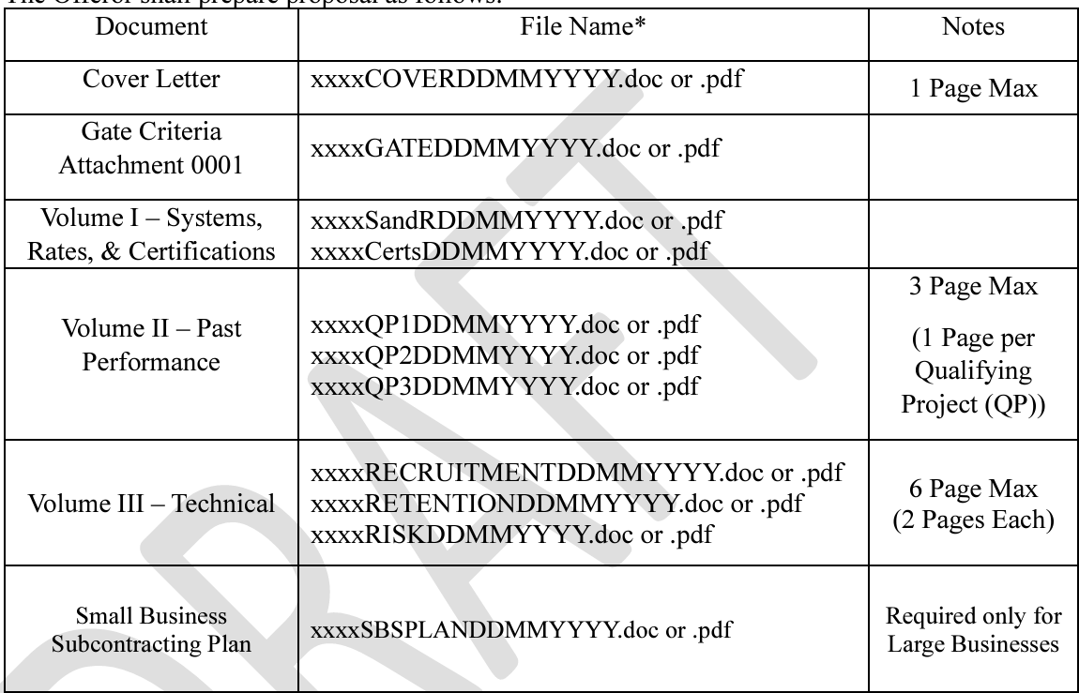
MAPS Proposal Outline

Slide 6
MAPS Gate Criteria
Offerors shall fully complete Attachment 0001 “Gate Criteria Questions” and provide required supporting documentation to include with their proposal.
The Government will utilize Attachment 0001, to first determine if the Offeror will make it through the gate questions onto the next step of the proposal evaluation process.
The Gate Criteria consists of the following for large businesses:
Active Facility Clearance (Secret)
Certifications (ISO 9001:2015 and CMMC Level 2 or higher)
Government Approved Accounting System
Contractor Performance Assessment Reporting System (CPARS) Ratings
The Gate Criteria consists of the following for small businesses:
Small Business Certification
Active Facility Clearance (Secret)
Certifications (ISO 9001:2015 and CMMC Level 2 or higher)
CPARS Ratings

Slide 7
Volume I – Systems, Rates, and Certifications
Large Business (Max Points: 2): receives 1 point for having 2 of the following approved systems or rates; Offeror receives 1 additional point for having 3 or more approved systems or rates:
Approved Rates (e.g., Forward Pricing/Billing)
Purchasing System
Estimating System
Property Management System
Large Business (Max Points: 2): Offeror receives 1 point (per certification), for having any of the additional certifications:
CMMC Level 2 or Higher
ISO/IEC 27001:2022
Small Business (Max Points: 2) Offeror receives 1 point (per certification), for having any of the additional certifications:
Small Business Certification
CMMC Level 2 or Higher

Slide 8
Volume II – Past Performance
Qualifying Project (QP) Submission: QPs will be used to evaluate the Past Performance factor. Offerors may submit a maximum of 3 distinct QPs for each specific Domain they are proposing to. The Offeror may not use QP’s of their teaming partners.
To be considered a QP, each submitted project must meet all the following minimum criteria:
Be any of the following:
A single contract – including prime contracts, subcontracts, and commercial 239 contracts; or
A single Task Order awarded under an IDIQ contract, Blanket Purchase Agreement (BPA), or Basic Ordering Agreement, including single or multiple award; or
A Task Order under a Federal Supply Schedule contract (FAR 8.405-2) or BPA (FAR 8.405-3)
Meet or exceed a minimum total contract value of $2M;
Have at least 1 year of performance, but not over 4 years old. The period of performance end date shall be within the last 4 years of the final proposal submission due date identified in this RFP.
The NAICS code of the QP must be the same as 1 of the 5 NAICS codes aligned to the Domains of this solicitation. Please note, while this is required, the QP does not have to match the exact NAICS code the Offeror is proposing to.
For example, Offeror A may submit a proposal to the Technical Domain (NAICS code: 255 541330) and utilize a QP that has a NAICS Code: 541715 (the RDT&E Domain).

Slide 9
Volume II – Past Performance
The Offeror shall provide the following information for each QP:
The Specific Contract/Agreement number. If the Offeror was a subcontractor, they need to submit a copy of the signed agreement.
Dollar value;
NAICS code;
A brief description of the work performed and a mapping to the PWS to demonstrate the work performed is relevant to the Offerors proposed Domain; and
If the Offeror’s QP is not available in the CPARS or does not have a specific NAICS identified, then the Offeror shall provide a Past Performance Questionnaire, Attachment 0002, which will not be counted toward the QP page limitation.

Slide 10
Volume III – Technical (6-page Limit)
Recruitment (2-page limit)
The Offeror shall provide an overview of its processes, procedures, and mechanisms utilized when it comes to employee recruitment. The overview shall demonstrate the Offeror’s ability to recruit and hire staff for specialized and non-specialized labor categories to limit staffing issues.
At a minimum, the Offeror shall address the following:
How qualified candidates will be recruited;
How key positions will be recruited and staffed;
Identify the timeline needed to recruit and staff positions not already filled;
Identify how many recruiter positions are currently staffed;
Identify if you have a Human Resources department; and,
Provide an organizational structure of your Human Resources Department.

Slide 11
Volume III – Technical (6-page Limit)
Retention (2-page limit)
The Offeror shall provide an overview of its processes, procedures, and/or mechanisms utilized for retaining employees. The overview shall demonstrate the Offeror’s ability to retain employees throughout the life of the program.
At a minimum the Offeror’s response shall address the following:
Provide an explanation of how your company supports internal and professional development;
Identify any mentorship programs currently offered to employees; and,
Provide an overview of the specific processes currently being utilized to retain employees.

Slide 12
Volume III – Technical (6-page Limit)
Risk Management (2-page limit)
The Offeror shall provide an overview of its policies and procedures for identifying, mitigating, and managing risks in order to demonstrate its ability to identify and manage risks.
At a minimum the Offeror’s response shall address the following:
Identify any proactive risk management strategies, to include risk identification, risk assessment, risk avoidance, risk monitoring, and risk response planning; and,
Provide an overview of your current Organizational Conflict of Interest plan that prescribes responsibilities, general rules, and procedures for identifying, evaluating, and resolving organizational conflicts of interest in accordance with FAR Subpart 9.5.

Slide 13
MAPS Scorecard: Systems and Rates
Large Business
Small Business

Slide 14
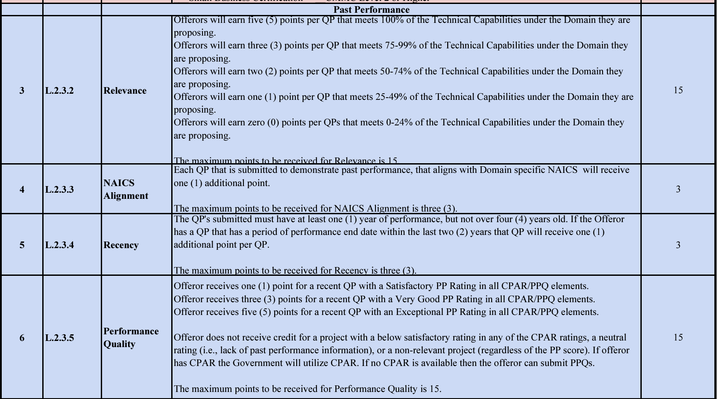
MAPS Scorecard: Past Performance

Slide 15
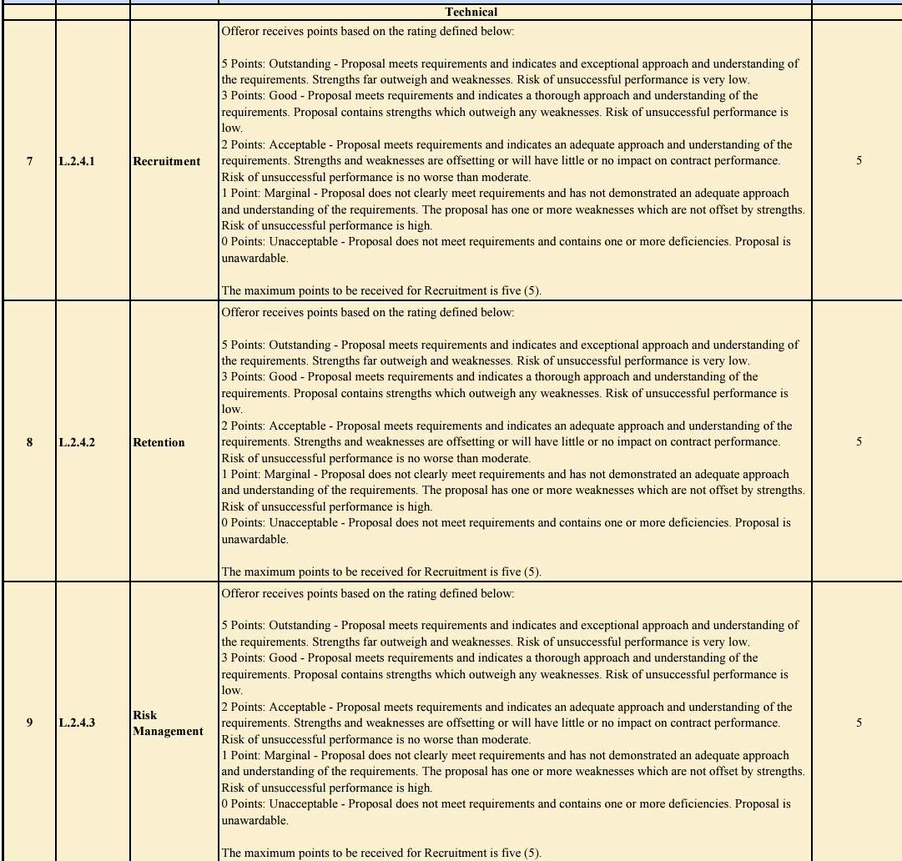
MAPS Scorecard: Technical
Large Business max points: 55
Small Business max points: 53

Slide 16
Next Steps
& Resources

Slide 17
Next Steps & Resources
We provide gap analysis, color reviews, and proposal support.
We have a subcontractor portal where you can upload your capabilities for this opportunity and others:
https://www.ostglobalsolutions.com/teaming-partner-match-portal/
We are happy to schedule time to discuss your Army MAPS bid:
https://calendly.com/ostglobalsolutions/bdconsulting?month=2023-09
We regularly publish updates to major contracts through our newsletter and blog:
Blog: https://www.ostglobalsolutions.com/blog/
Newsletter sign up: https://www.ostglobalsolutions.com/tag/email/
Sign up for our newsletter and schedule an appointment

Slide 18
Let’s Partner in Winning Business
David Huff
CEO
c: 513.316.0993
o: 301.769.6602
e: dhuff@ostglobalsolutions.com
www.ostglobalsolutions.com

