Slide 1
AI Disrupting BD & Proposals: Adapt or Fall Behind
OST Bid & Proposal
Academy Course
Copyright © 2025 OST Global Solutions
www.ostglobalsolutions.com

Slide 2








About OST Global Solutions
We've Won Our Clients Over $26 Billion in funded Government Contracts Since 2005
BUSINESS DEVELOPMENT, CAPTURE, AND PROPOSAL CONSULTING
Opportunity Identification (WinMoreBD™)
Opportunity Qualification
(WinMoreBD™)
Capture Management
Proposal Development
Proposal Pricing Support
SUPPORT FOR R&D BUSINESSES FOCUSED ON SBIR/STTR
REGISTERED APPRENTICESHIP IN GOVERNMENT BUSINESS DEVELOPMENT
ACCEPT VETERANS ADMINISTRATION (VA) FUNDING
FULL BD LIFECYCLE TRAINING

Slide 3

Industrial Revolution: 25% Productivity Increase
Art: Google Gemini

Slide 4

AI Transformation: Estimated 30% - 80% Productivity Increase
PwC claims AI could add nearly $16 trillion to the world economy by 2030.
McKinsey predicts $13 trillion in the same time. frame.
Art: Google Gemini
Notes:
Oxford University researches predict that machines might be able to perform half of all US jobs by 2033.

Slide 5

Understanding AI in the Context of Government BD
Many inventions in the past were initially regarded as cheating but now are an integral part of our lives: spell check, calculator, Grammarly, etc.
Leveraging AI as a collaborative partner is no longer optional to keep pace with the industry and remain relevant and in-demand.
  AI is rapidly becoming the standard in Government BD, with the Association of Proposal Management Professionals (APMP) leading the charge with AI-focused events and conferences.
  Government source selection is embracing AI, adding new scrutiny to evaluation of compliant and compelling offers.
    Acqbot expedites contract writing and the federal acquisition process.
    GSAi is a custom AI chatbot designed to boost productivity among GSA's employees by analyzing contract and procurement data
Future-proof your career to ensure you remain valuable as the field evolves.
Art: DALL-E

Slide 6
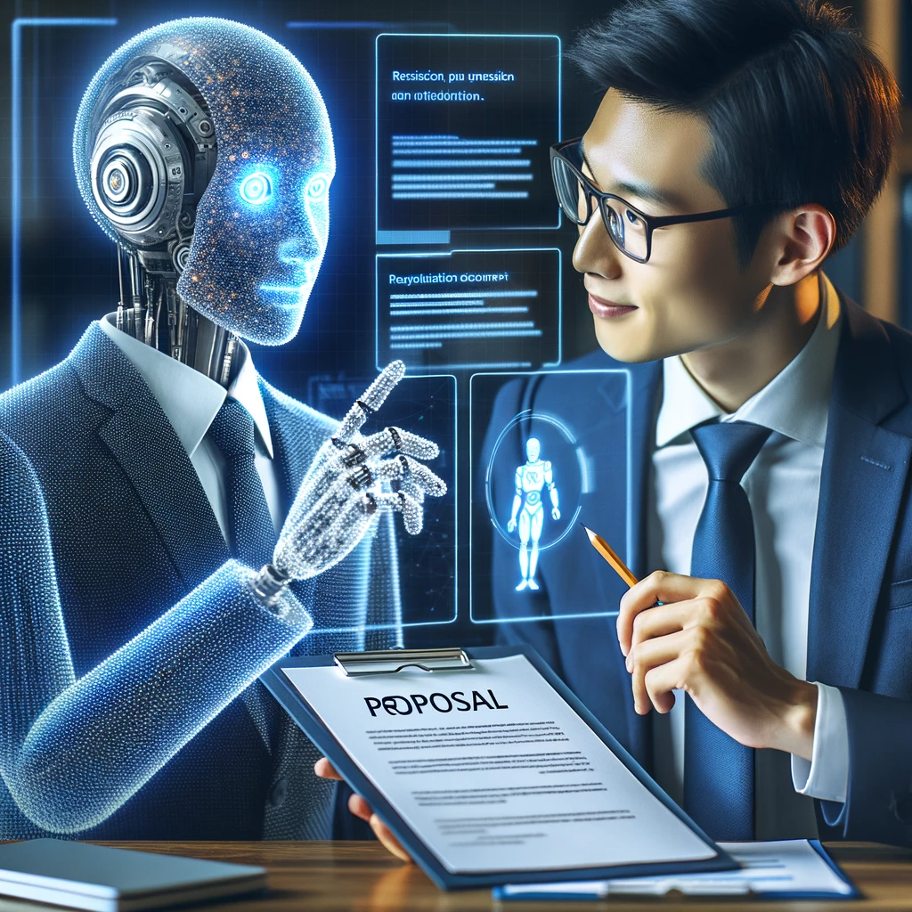
AI Advantages in Government BD
Provides strategic advantage in analyzing vast amounts of opportunity, pursuit, proposal, past performance, resume, and financial data.
Allows precision by providing insights into patterns and trends, and offers predictive analytics results that may escape the human eye.
Currently increases productivity at least 30%, and results in 20% higher win rates and 25% labor cost savings.
Helps identify risks and devise proactive mitigation strategies that save time and resources.
AI will not take your job, but another professional who masterfully uses AI will – be the one who remains.
Art: DALL-E

Slide 7

Don’t think of AI as a Computer – it is a fellow thinker. AI creators don’t understand how an AI arrives at conclusions. Algorithms are still a “black box”: while researchers understand how they generally function, it’s often unclear why a specific output follows a particular input. We just experiment and add “guardrails.”
Art: Google Gemini

Slide 8
AI Fundamentals: AI in Government BD Lifecycle (2)
Analyze good opportunities you no-bid or lost for requirements you couldn’t fulfill
Devise strategies to obtain these missing credentials
Strategy development
Metrics development and analysis
Portfolio analysis
“Must Win” opportunity identification
Priority-based B&P budget allocations
Agency deep-dives
Market landscape trends research and analysis
Competitive analysis
Other market research tasks associated with data analysis
Begin Business Development Process
Build capacity by investing in new capabilities
Conduct Strategic Business Development Planning Session
Perform Market Research
AI is transforming government BD, capture, and proposal development workloads in every step of the BD lifecycle.
1.0
2.0
3.0
Account plan development
Multitude of uses for marketing purposes: white paper copy development, case study development, web pages, press releases, cap statement tailoring, etc.
Market to Target Agencies & Partners
Enough Info to Make Decisions?
Yes
No
4.0
Map out and manage stakeholder engagement
Compile and analyze performance data from the current project to use as part of the evidence of past performance in future bids
See capture and proposal tasks lists
Yes
Analysis of expiring and new opportunity announcements
Opportunity fit analysis for interest/no-interest decision
Budgets/appropriated funds analysis
Perform Business Development During Project Execution
Build the Opportunities Pipeline
Check for Strategic Fit
9.0
RFX analysis
Schedule/proposal plan development
Compliance matrix/outline
Brainstorming, drafting, writing, editing
Past performance, resumes
Graphics conceptualization
Reviews
5.0
Customer hot buttons analysis
Researched data analysis
Win themes/strategy development
Competitive analysis
Teaming analysis
Solution development
“Top-Down” capture research
Granular analysis against search criteria, “deal breakers”
Old, draft, or related RFX analysis
Prepare Proposal
Conduct Capture
Qualify Each Individual Opportunity
8.0
7.0
6.0

Slide 9

Challenge
Business development and ai integration Maturity Levels
differentiated
COMPETITIVE DIFFERENTIATION DRIVES LIFETIME CLIENT BASE. AI AUTOMATION RESULTS IN MAXIMUM VOLUME AND QUALITY.
6
Many organizations are not leveraging AI even if they are at the Level 3 maturity “Defined,” or above
Much of the useful data that could enhance AI-enhanced employee productivity is kept across multiple employee’s computers and cloud spaces and hasn’t been consolidated it into one organized Library
Competitive opportunities are missed
Optimized
STANDARD BD PROCESSES ARE IMPROVED USING DATA DRIVEN BY FIRM, GROUP, AND INDIVIDUAL GOALS. AI AUTOMATION REACHED.
5
Quantitatively Managed
STANDARD BD PROCESS IMPLEMENTED THROUGHOUT THE FIRM, MEASURING WHAT MATTERS. AI EMBEDDED IN STRATEGY.
4
Defined
STANDARDIZED BD PROCESS IN POCKETS WITHOUT ORGANIZATIONWIDE PROCESS IMPROVEMENTS. AI BECOMES OPERATIONAL.
3
reactive
CHAOTIC AND TACTICAL, RESPONDING BASED ON INDIVIDUAL PERFORMANCE. EXPERIMENTATION WITH MAINSTREAM AI.
2
Ad hoc
UNORGANIZED. AUTOMATICALLY AT THIS MATURITY LEVEL. INTERESTED IN AI.
1
© 2024 OST Global Solutions, Inc. All rights reserved. Unauthorized reproduction or distribution of this material is prohibited.

Slide 10






Traditional Boilerplate Reuse Process Is Fraught With Issues
Troubles with locating the right data
1
Drowning in irrelevant information while digging through mountains of data
2
Importing stale materials to the new proposal while failing to formulate a unique new solution
3
Failing to weed out leftover artifacts that may be as egregious as another customer’s name
4
© 2025 OST Global Solutions, Inc. All rights reserved. Unauthorized reproduction or distribution of this material is prohibited.

Slide 11


AI Equipped with RAG Enables AI-Augmented Proposal Libraries
Retrieval Augmented Generation (RAG): An algorithm that helps you get and use your company data without the risk and high cost of training a local language model.
You want your data in a private vector database and not available for the LLM to use for training, so that your data stays secure.
Retain all proposal artifacts in a library to help AI search and retrieve information efficiently
  Classify your data into groups and classes like Management Plan, Resume, etc.
  Tag Your Data: Master’s, Top Secret, U.S. Navy, etc.
AI is like a high-speed archeologist digging through years of past proposals unearthing treasures and transforming them into highly relevant content much faster than a human could

Slide 12

Five Components of Successful AI Integration Into the Proposal Development Process
1
2
3
4
5
Proposal management
Solution & win themes development
Content library
Content authoring & editing
reviews
Schedule, outline, compliance matrix, RFP analysis, etc.
Brainstorming, solutioning, proposal themes, etc.
Library of past proposals, past performance, resumes, graphics, and other artifacts
Knowledge searching, section writing, graphics conceptualization, action captions, tables, cost volume, editing, etc.
Color reviews, compliance checks
Integration with collaboration platforms such as SharePoint, Teams, Office, Outlook, browsers
© 2024 OST Global Solutions, Inc. All rights reserved. Unauthorized reproduction or distribution of this material is prohibited.

Slide 13
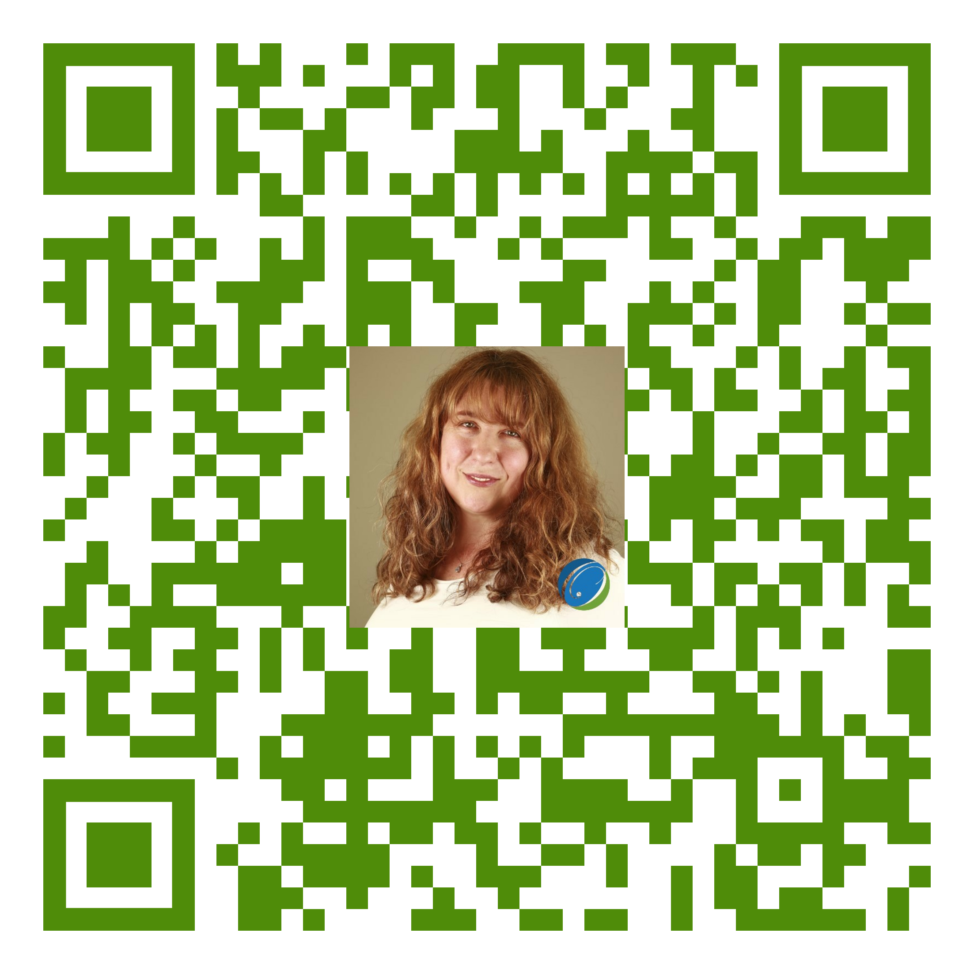
Interested in an In-depth Exploration of the AI for Your Company?
Take our AI in BD, Capture, and Proposals course on Feb 24-26:
https://www.ostglobalsolutions.com/class/master-ai-to-enhance-bd-capture-proposal-processes-updated-to-include-the-latest-ai-developments-3/
ostglobalsolutions.com -> Training -> Shop All Training
Scan the QR code with your phone camera to meet with me or click this link!
https://calendly.com/olessia-ost/25-minute-meeting
Notes:
Google: https://g.page/r/CeQcAmyWUhUZEAI/review
Facebook: https://www.facebook.com/OSTGlobalSolutions/reviews

Slide 14


Evolving Relationship of Human BD Expert and AI: Bloom’s Taxonomy
Human BD Expert
AI
CREATE
Produce new or original work
Help design, assemble, author, develop, formulate, investigate
Help review, argue a point, defend, judge, select, value, support, critique, weigh
EVALUATE
Review, justify a decision
ANALYZE
Help differentiate, organize, relate, compare, contrast, distinguish, experiment, question, test
Draw connections among ideas
APPLY
Execute, implement, solve, use, demonstrate, interpret, operate, schedule, sketch
Use information in new situation
UNDERSTAND
Classify, describe, discuss, explain, identify, locate, recognize, report, select
Explain ideas or concepts
REMEMBER
Define duplicate, list, memorize, repeat, state
Recall facts and basic concepts

Slide 15
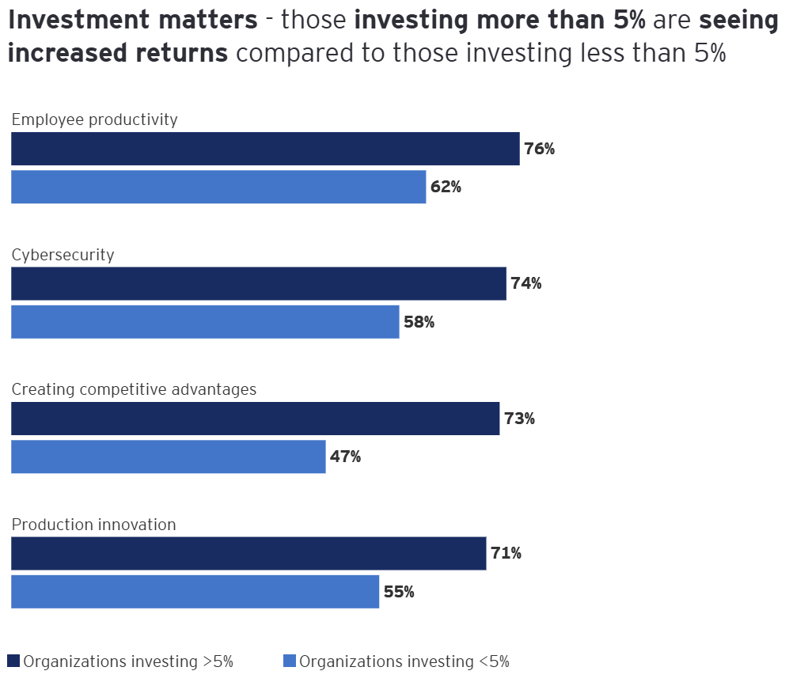
AI Adoption Rates Per EY
The “EY 2024 Work Reimagined Survey” highlights a significant rise in generative AI usage at work, increasing from 22% in 2023 to 75% across 27 industries globally.
GenAI adoption is high in the tech sector (90%), while government and public sectors trail (60%).
Generative AI is fast taking over the workplaces.
Anyone hesitating will be left behind.
Adoption involves expanding use cases and mastery of the tools and takes time.
Those who start early will significantly outpace the competitors.
“Those who invest wisely in AI today will be the industry trailblazers of tomorrow.”
Enterprise AI adoption key to corporate growth | EY - US

Slide 16

About Artificial General Intelligence (AGI)
AGI is a "Full AI," a machine with the ability to understand, learn, and apply its intelligence broadly across a wide range of tasks, similar to how a human being operates.
AGI would have the capacity for general reasoning, problem-solving, and learning, such that it could be applied to any domain without being specially tailored for it.
AGI does not yet exist and remains a theoretical concept although leaks show that progress was made.
AGI is not just designed to perform specific tasks but is capable of understanding and acquiring knowledge in a generalizable and adaptable manner.
Prior to that or simultaneously, there may be agents that are able to perform highly specialized tasks.
The timeline for the development of AGI is uncertain, and there is a robust debate about the nature and implications of creating machines with general intelligence.
The human elements of trust, empathy, and relationship-building are deeply ingrained in BD and will always require a human touch – work on your EQ and personal growth.
Art: Gemini

Slide 17
OpenAI Stages of Artificial Intelligence
Level 1 | Chatbots, AI with conversational language
Level 2 | Reasoners, human-level problem solving
Level 3 | Agents, systems that can take actions
Level 4 | Innovators, AI that can aid in invention
Level 5 | Organizations, AI that can do the work of an organization

Slide 18
"Levels of AGI: Operationalizing Progress on the Path to AGI”: arXiv.org
Performance (rows) x Generality (columns) | Narrow clearly scoped task or set of tasks | General wide range of non-physical tasks, including metacognitive tasks like learning new skills
Level 0: No AI | Narrow Non-AI calculator software; compiler | General Non-AI human-in-the-loop computing, e.g., Amazon Mechanical Turk
Level 1: Emerging equal to or somewhat better than an un-skilled human | Emerging Narrow AI GOFAI (Boden, 2014); simple rule-based systems, e.g., SHRDLU (Winograd, 1971) | Emerging AGI ChatGPT (OpenAI, 2023), Bard (Anil et al., 2023), Llama 2 (Touvron et al., 2023), Gemini (Pichai & Hassabis, 2023)
Level 2: Competent at least 50th percentile of skilled adults | Competent Narrow AI toxicity detectors such as Jigsaw (Das et al., 2022); Smart Speakers such as Siri (Apple), Alexa (Amazon), or Google Assistant (Google); VQA systems such as PaLI (Chen et al., 2023); Watson (IBM); SOTA LLMs for a subset of tasks (e.g., short essay writing, simple coding) | Competent AGI not yet achieved
Level 3: Expert at least 90th percentile of skilled adults | Expert Narrow AI spelling & grammar checkers such as Grammarly (Grammarly, 2023); generative image models such as Imagen (Saharia et al., 2022) or DALL-E 2 (Ramesh et al., 2022) | Expert AGI not yet achieved
Level 4: Virtuoso at least 99th percentile of skilled adults | Virtuoso Narrow AI Deep Blue (Campbell et al., 2002), AlphaGo (Silver et al., 2016; 2017) | Virtuoso AGI not yet achieved
Level 5: Superhuman outperforms 100% of humans | Superhuman Narrow AI AlphaFold (Jumper et al., 2021; Varadi et al., 2021), AlphaZero (Silver et al., 2018), StockFish (Stockfish, 2023) | Artificial Superintelligence (ASI) not yet achieved
Progression towards AGI by examining both the depth (performance) and breadth (generality) of AI capabilities​
Levels from "No AI" to "Superhuman AI“
Distinctions between narrow AI (focused on specific tasks) and general AI (capable of a wide range of tasks)

Slide 19
Interested in an In-depth Exploration of the AI for Your Company?
Take our AI in BD, Capture, and Proposals course on Feb 24-26:
https://www.ostglobalsolutions.com/class/master-ai-to-enhance-bd-capture-proposal-processes-updated-to-include-the-latest-ai-developments-3/
ostglobalsolutions.com -> Training -> Shop All Training
Scan the QR code with your phone camera to meet with me or click this link!
https://calendly.com/olessia-ost/25-minute-meeting
Notes:
Google: https://g.page/r/CeQcAmyWUhUZEAI/review
Facebook: https://www.facebook.com/OSTGlobalSolutions/reviews

