Slide 1
Modern Software Delivery (MSD) IDIQ
5 February 2025

Slide 2
About OST
We've Won Our Clients Over $26 Billion in Government Contracts Since 2005
BUSINESS DEVELOPMENT, CAPTURE, AND PROPOSAL CONSULTING
Build Portfolio of Indefinite Delivery Vehicles
Develop Opportunity Pipelines
Capture Opportunities
Win Proposals
Optimize Your Processes
SBIR/STTR Proposal Lab for Maryland and Alabama SBA FAST Grant
REGISTERED APPRENTICESHIP IN GOVERNMENT BUSINESS DEVELOPMENT; 18 COURSES IN ALL ASPECTS OF FEDERAL BUSINESS DEVELOPMENT
Certified Business Developer
Certified Capture Manager
Certified Proposal Manager
Certified Proposal Coordinator
Certified Proposal Writer

Slide 3
OST’s MSD IDIQ Support
Experience selection, scorecard, and narrative development to focus on the extra consideration points
We offer:
Proposal Management
Proposal Writing & Editing
Orals coaching and preparation
Graphics and DTP
Color Reviews
Compliance Reviews
Labor rate analysis and basis of estimate development
How to Develop & Coach Winning Oral Proposals
Prices are increasing March 1st
Schedule a call to learn more about our support

Slide 4
MSD Key Details
Estimated Value: $10 billion or greater
Contract Type: Multi-award IDIQ with:
Firm Fixed Price
Cost Plus Fixed Fee
Time and Materials
Labor Hour task orders
Duration: Five-year base period with a five-year option
Primary NAICS: 541511 - Custom Computer Programming Services
Small Business Reserve: A minimum of 10 small business awards or 20% of all awards, whichever is greater
Estimated Timeline:
Final RFP: Jan 2025
IDIQ Award: FYQ2 2025
TO Issuance Begins: FYQ3 2025

Slide 5
About Army MSD
Procured by the Army Program Executive Office Enterprise Information Systems’ (PEO EIS) Enterprise Services supported by:
Deputy Assistant Secretary of the Army (Data, Engineering, and Software) (DASA (DES))
Digital Capability Contracting Center of Excellence (DC3oE)
The MSD MAIDIQ is designed to provide the U.S. Army with the ability to rapidly design, develop, test, deploy, and maintain mission critical applications and systems.
It aligns with Army Directive (AD) 2024-02 for Enabling Modern Software for Defense and Acquisition Practices and DoD Modern Software Strategy Memorandum, 2 February 2022.
The MSD MAIDIQ enables the Government to build functionality, implement, and extend the capabilities of U.S. Army and to modernize the Army through rapid development and delivery of software capability. This vehicle will have in place mechanisms to sense, respond, and adjust deliveries to increase effectiveness and efficiency throughout the software lifecycle.
This MAIDIQ is designed to provide a vehicle to award task orders in an efficient manner to support software capability efforts that incorporate but are not limited to the following:
Software development, security, and operations (DevSecOps, DSO)
Software delivery using modern architectures, infrastructure, and platforms
Support digital transformations that apply modern technologies
Currently only available to Army customers, per the Q&A

Slide 6
MSD IDIQ and MAPS IDIQ
Different vehicles with different scopes

Slide 7
Draft RFP #3 Structure & Evaluation

Slide 8
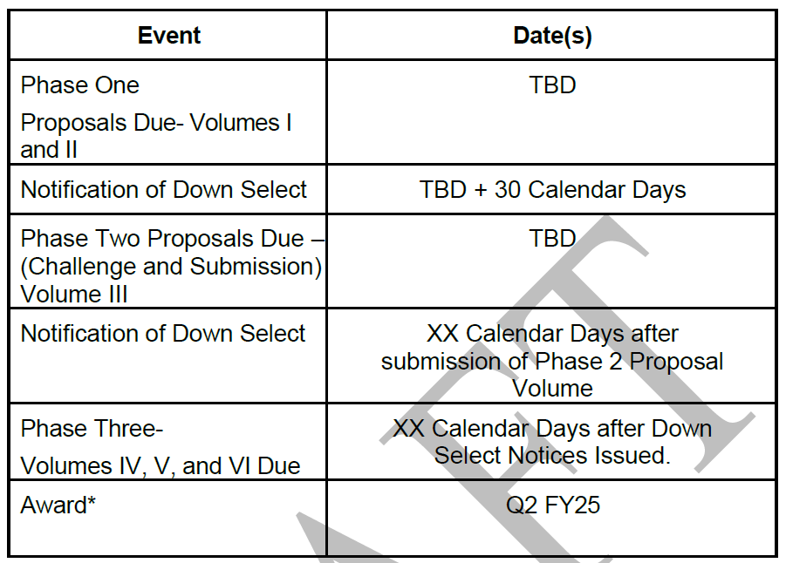
Three Phase Evaluation
Must submit a Phase 1 proposal in order to be considered for Phases 2 and 3

Slide 9
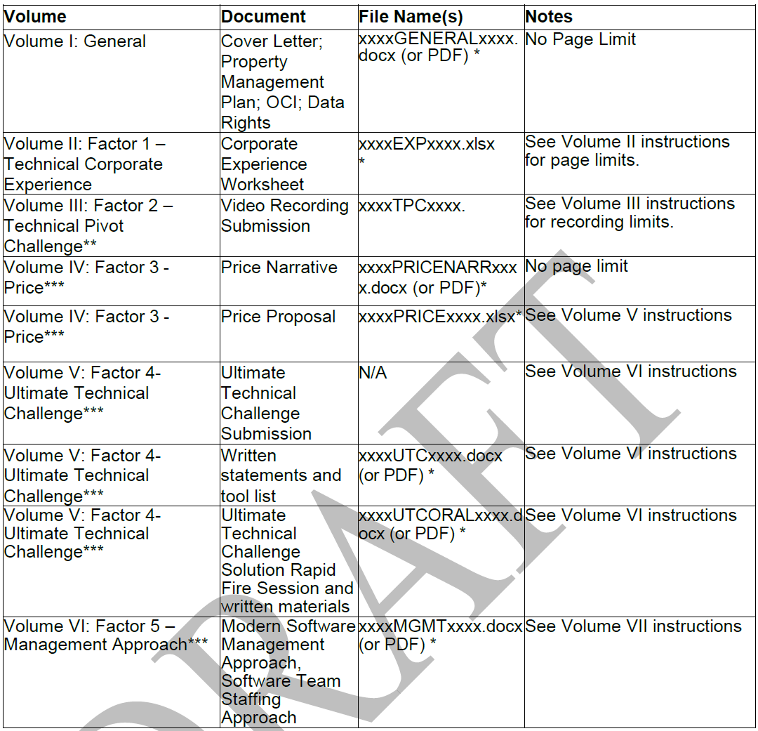
Total Proposal Structure

Slide 10
Phase One – Volume I: General
Element 1: Cover Letter
Typical proposal front matter and contractual submissions
Element 2: Property Management Plan – addresses each of the 10 outcomes
Acquisition
Receipt
Records
Physical Inventory
Subcontractor Control
Reports
Relief of Stewardship Responsibility and Liability
Utilization
Maintenance
Property Closeout

Slide 11
Phase One – Volume II – Factor 1: Technical Corporate Experience
Each Prime Offeror shall complete the Technical Corporate Experience Worksheet found within Solicitation Attachment 0004 in its entirety.
Technical Corporate Experience shall be demonstrated utilizing 3 examples of projects executing requirements relevant to those required in the PWS.
Offerors shall not propose a base IDIQ contract or a Blanket Purchase Agreement (BPA) as an example, however offerors may propose individual orders as examples.
1 contract, 1 order, OR multiple orders under the same IDIQ contract or BPA for identical requirements, constitutes 1 example.

Slide 12
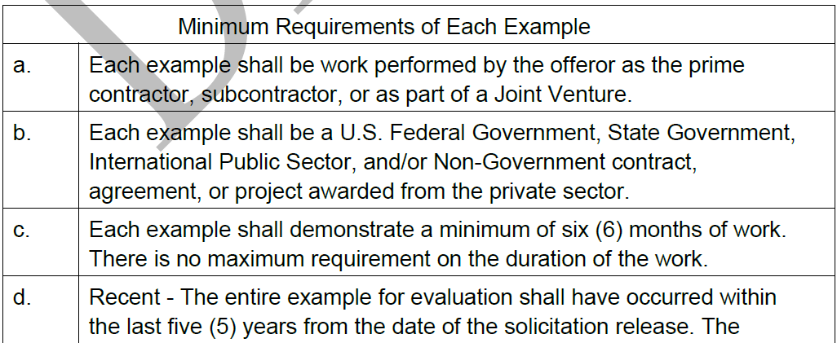
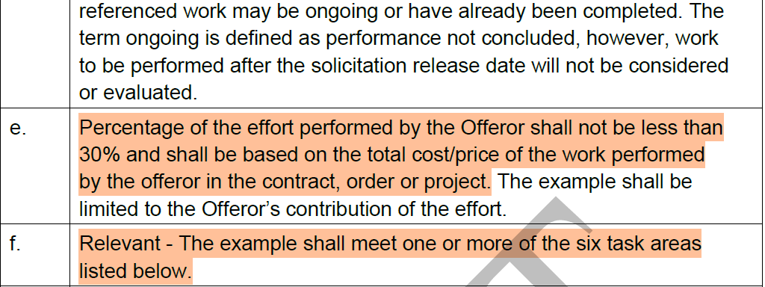
Phase One – Volume II – Factor 1: Technical Corporate Experience
Each example included in the corporate experience proposal shall meet all of the following minimum requirements:

Slide 13
Phase One – Volume II – Factor 1: Technical Corporate Experience
Offerors shall provide sufficient information for the Government to determine its level of confidence based on whether the Offeror has the experience necessary to execute the scope of work IAW the PWS by evaluation of the below 7 Task Areas.
The below Task Areas (Items 1-7) shall be demonstrated across the 3 Technical Corporate Experience examples.
Each Technical Corporate Experience example may demonstrate as few as 1 Task Area or as many as all 7 Task Areas, provided that the 3 examples in total address all 7 Task Areas.
The Government may note facts and/or findings that raise or lower the Government’s expectation of successful performance. Please note, the Government may assess increased confidence for examples with more task areas addressed in each example.
Task Areas:
Configuration and Integration of Software as described in PWS paragraph 2.1.1
Low Code Software Solution as described in PWS paragraph 2.1.2
Custom Software Development as described in PWS paragraph 2.1.3
Modern Software Hosting & Operations as described in PWS paragraph 2.2.1
Software Security as described in PWS paragraph 2.2.2
Data Mesh principles as described in PWS paragraph 2.2.3
Agile Program Management as described in PWS paragraph 2.2.4

Slide 14
Phase One – Volume II – Factor 1: Technical Corporate Experience
The following specialized experience will also be considered for the evaluation of confidence and are opportunities to increase the Government's level of confidence for this Factor:
The frequency of tested software deployments in support of a software solution in use by the DoD, either a weapon system or a business system (or commercial equivalent).
The Impact Level (IL) that software has been delivered into DoD cloud instances and/or a proven standardized commercial approach to security assessment, authorization, and continuous monitoring for cloud products and services.
Whether the software is deployed through automation, or other than automated procedures. Automation in this context means that the build, package, test, and release of new code merges to staging servers without manual intervention after a code review occurs.
The level of Authority to Operate (ATO) achieved in the example. The Agency who granted the ATO and the amount of time it took to achieve the ATO.
Demonstration of simplification and streamlining of unnecessary complexity in software design to achieve the core functionality with minimal effort and resources.
The Government will use the fields in the Technical Corporate Experience Worksheet (Solicitation Attachment XXX) for the evaluation of Technical Corporate Experience and determining the overall confidence level for this Factor.

Slide 15
Q&A Impacts to Phase One
Question 11: the 30% of TCV seems restrictive for Small Business. We are a sub on a multi billion dollar contract, we do the majority of the work in our core capabilities and NAICS, but it is no where near 30% of TCV.
Answer 11: The Government team is continuing to develop the corporate experience factor, please provide feedback in the RFP comment matrix.
Question 95: At the IDIQ level for MSD, Subcontractors are not allowed to submit past performance or assist with the tech challenge correct?
Answer 95: This is correct

Slide 16
Phase One Evaluation
The Government will first evaluate Factor 1 – Technical Corporate Experience as outlined below.
Based on a comparative analysis of Factor 1 – Technical Corporate Experience, the Government reserves the right to select no more than approximately the top 60% of offerors with the highest confidence to continue into Phase 2.
If an offeror is not selected to participate in Phase 2 or Phase 3, the Government will not accept Phase 2 or Phase 3 proposal submissions and will not be evaluated further.
If the Government’s Phase 1 evaluation determines that the offerors with the highest confidence represents approximately 30 or less offerors, the Government reserves the right to bypass Phase 2 in its entirety. A Phase 2 bypass will result in Offeror’s receiving a Phase 3 invitation.
The Government reserves the right to consider the Small Business reserve percentage into the selection of Offerors to continue into Phase 2.

Slide 17
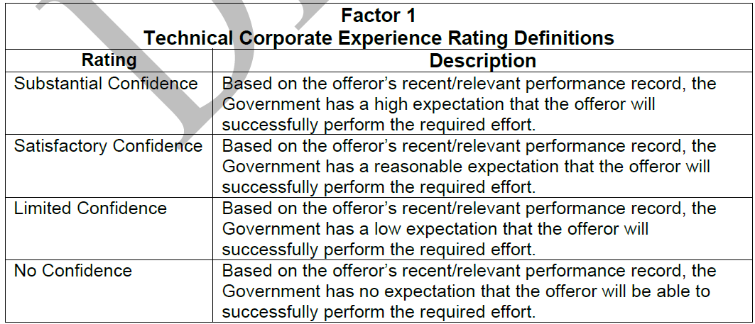
M.2.2 Factor 1- Technical Corporate Experience
For Factor 1 –Technical Corporate Experience, the Government will assess its confidence that the Offeror has the experience necessary to execute the scope of work IAW the PWS.
The Government will note facts and/or findings from the Offeror’s proposal that may raise or lower the expectation of success (if any) and/or other findings, which may be of importance in determining the appropriate confidence rating and/or the best suited offeror.
Recent is defined as experience occurring within the last 5 years from the date of solicitation release. Relevant is defined as all 3 examples meeting the 6 [sic] task areas listed in Section L, Factor 1.

Slide 18
Phase Two: Volume III Factor 2 – Technical Scenario Pivot Challenge
The Technical Scenario Pivot Challenge will be used to assess the Offeror’s capability to satisfy the requirements set forth in the PWS.
The offerors chosen to participate will receive an invitation to the Technical Scenario Pivot Challenge, which will include a date to receive the Technical Scenario Pivot Challenge scenario, timeline for completion and submission of video proposal instructions to be completed within 180 minutes of receipt of the Government issued scenario. The Government will provide a written formal scenario via an email. Submission instructions will be provided in the email.
Participation Representation.
All Contributing Personnel shall have at least twelve months of continued employment with the Prime concern (or predecessor company as appropriate)
An Offeror may only participate in 1 Technical Scenario Pivot Challenge as a prime Offeror (to include Joint Ventures).
Additionally, an individual representative may only attend/participate in a single Technical Scenario Pivot Challenge with 1 prime Offeror.

Slide 19
Phase Two: Volume III Factor 2 – Technical Scenario Pivot Challenge
The Offeror shall submit a 7 minute or less video based on a response to the Technical Scenario Pivot Challenge scenario that provides an approach, plan and demonstrates proficient knowledge and understanding of at least 3 of the 8 following focus areas:
Secure Development practices
DevSecOps Software Development Practices
Modular Open System Development
API First Development Practices
Data Centricity Development Practices
Human Centered Design Development Practices
Integration of AI into workflows
Use of Digital Engineering and Model Based System Engineering practices to develop software
Offerors are cautioned that the Government is looking for in-depth discussion on the offeror’s selected focus areas rather than high level discussion on all focus areas. Offerors will not be evaluated on the production quality of the video.
Offerors are discouraged from using generative AI tools in developing their Technical Scenario Pivot Challenge submissions.

Slide 20
Phase Two: Volume III Factor 2 – Technical Scenario Pivot Challenge
The Government shall provide a written scenario of the Technical Scenario Pivot Challenge and competency focus areas electronically, where the offeror shall independently develop their video submission during their allotted caucus time slot.
The offeror will be required to submit an Offeror created 7 minute or less video by the Technical Scenario Pivot Challenge submission time.

Slide 21
Q&A Impacts to Phase Two
Question 18: Can any of the Udemy courses, DAU Workshops be made available to industry, or at least the course titles?
Answer 18: The DC3oE recommends Digital Transformation 2023 Masterclass, Agile Samurai Bootcamp, and Product Management for AI & Data Science. These courses are available to the public with a fee.
Question 84: Are subcontractor employees allowed to be used on the tech challenge - or do they all need to be from the prime offeror?
Answer 84: Participants shall be Prime Contractor’s existing employee(s) with a minimum of one (1) year of continuous employment via a signed affirmative written statement. RFP L.3.4.2
Question 89: Subs and consultants will be integral parts of every team - why would you exclude them now?
Answer 89: The MSD Team anticipates flexible teaming at the order level. The IDIQ evaluation is focused on the prime contractor's capability.
Question 96: If a joint venture is bidding, can members from both entities participate in the code challenge?
Answer 96: Yes

Slide 22
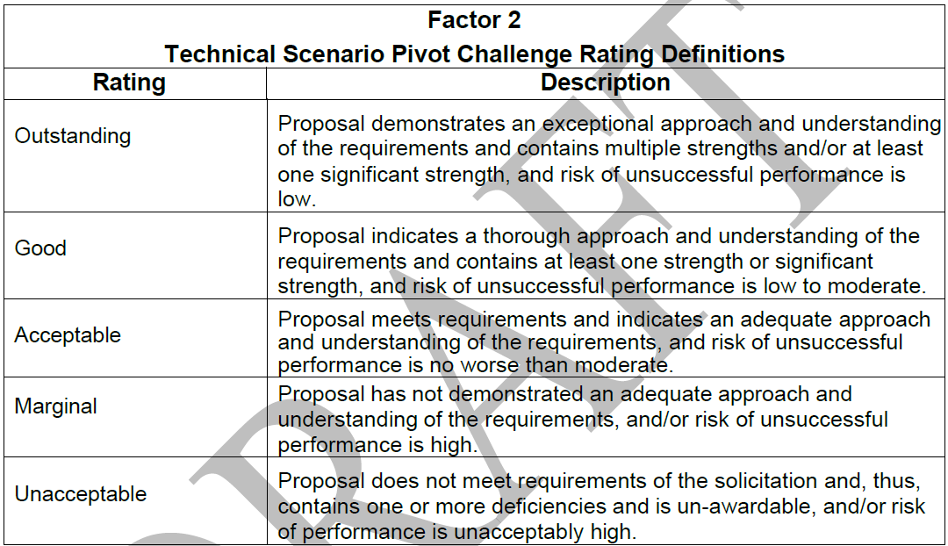
M.2.3 Factor 2- Technical Scenario Pivot Challenge
Based on a comparative analysis of Factor 2, the Government will select approximately 30 of the highest rated offerors to proceed to Phase 3.
The Government reserves the right to select fewer offerors.
The Government reserves the right to consider the Small Business reserve percentage into the selection of Offerors to continue into Phase 3.
The offeror shall demonstrate proficient knowledge and understanding of Modern Software capability/methodologies through completion of a Technical Scenario Pivot Challenge.

Slide 23
Phase Three: Volume IV – Factor 3 – Price
This solicitation is for the award of a hybrid Cost-Plus-Fixed-Fee (CPFF), Firm Fixed Price (FFP), Labor Hour (LH), Time and Materials (T&M), and Cost Reimbursement (CR) Indefinite Delivery/Indefinite Quantity (ID/IQ) contract and for the necessary licenses, travel, and Other Direct Costs (ODCs) to support those efforts.
Labor Hour Model Worksheet Instructions: The Offeror shall complete and submit Attachment 0003 the MSD IDIQ Labor Hour Model.
The proposed labor rates shall be fully burdened labor rates encompassing all direct labor costs, applicable indirect costs, and profit in accordance with your companies accounting system.
The Offeror shall propose median rates applicable to Labor Hour type orders. These rates are to be based upon an analysis of the median labor rate within a given labor category, working in the highest paid area within CONUS, on a complex Modern Software requirement including work requiring a secret clearance.
Top Secret/SCI and OCONUS work are excluded.
Requires a basis of estimate

Slide 24
Phase Three: Volume V – Factor 4 – Ultimate Technical Challenge
The Ultimate Technical Challenge will be used to assess the Offeror’s technical capability to satisfy the requirements set forth in the PWS and determine how each Offeror performs in a real-time scenario resulting in a solution.
The Ultimate Technical Challenge shall follow the Agile Manifesto and Agile principles.
Solutions that do not comply with the Agile Manifesto and Agile principles may be determined as a weakness, significant weakness or a deficiency.
The submission is anticipated to be required 10 business days, post receipt of the Government issued challenge.
Offerors shall provide a technical solution utilizing an Offeror selected development and deployment environment. Offerors shall provide the government access into the deployment environment to verify functionality of the solution. Offerors shall not utilize Artificial Intelligence (AI) tools and resources under this Factor.

Slide 25
Phase Three: Volume V – Factor 4 – Ultimate Technical Challenge
Focus areas for evaluation of the Ultimate Technical Challenge solution include, but is not limited to the following:
Open Architecture – Extent to which the system design allows for easy adding, upgrading, testing, and swapping of components
Cyber Hygiene – Extent to which the submission is comprised of secure coding practices and complies with current Army cybersecurity regulations.
Resiliency of the system – Extent to which the structure of the system that allows for high availability, avoidance of errors, and rapid recovery from issues.
DevOps Integration – Utilization of “as-code” functionality in the development, integration, testing, and deployment processes.
During the tech challenge the offerors shall instrument the collection of metrics to drive the following outcomes:
Improved team efficiency – Automation/code coverage
Improved code security and quality
Improve release frequency
Improve system modularity
Offerors are limited to no more than 7 representatives and shall be the Prime Contractor’s existing employee(s) with a minimum of 1 year of continuous employment via a signed affirmative written statement

Slide 26
Phase Three: Volume V – Factor 4 – Ultimate Technical Challenge
Upon submission of the Ultimate Technical Challenge solution, the Government will schedule a rapid-fire virtual, oral demonstration session and will include 4 elements.
Offerors shall present Element #1 through #3 for up to 45 minutes and Element #4 will be for up to 15 minutes.
Element #1: Offerors shall demonstrate 1 Offeror selected pull request and deploy the change within their environment. The offeror will then demonstrate successful deployment of the changed functionality to the government.
Element #2: The Offeror shall demonstrate their solution and discuss how their solution addresses the 4 focus areas of the Ultimate Technical Challenge. Additionally, the Offerors shall demonstrate a quality assurance audit to explore the development process and that standards and specifications were met during the development process.
Element #3: Offerors shall demonstrate how they instrumented the metrics in the Offeror’s environment and then explain the approach for using those metrics to improve the performance of software delivery teams.
Element #4: The Government reserves the right to ask a standard set of questions to the Offeror. Each Phase 3, Factor 4 Offeror will be provided the same set of questions. The Government anticipates providing the questions at the beginning of Element 4.
Offerors shall include their Rapid Fire Session Presentation materials as xxxxORALPRESENTATIONxxxx.docx (or PDF or PPT) within 5 business days by 12:00PM EST after conclusion and submission of the Ultimate Technical Challenge.
The Rapid Fire presentation submission shall be a PDF or PPT, not exceeding 36 slides/pages.

Slide 27
Phase Three: Volume VI – Factor 5 – Management Approach
3 Page Limit
This factor will evaluate the Offeror’s Management Approach to adequately support the execution of Modern Software Delivery.
Offeror’s shall provide the following information:
Describe the process to fill advanced expertise or "niche" positions to support orders issued under MSD. Provide examples within the last 2 years when your company filled advanced expertise or "niche" positions.
Describe the process and approach for retaining personnel for Orders issued under MSD taking into consideration the potential for shorter performance periods of 12 months or less and multiple orders concurrently performing.
Describe the approach and process for organizing the scaling and staffing of Agile teams across multiple active orders.
Describe the current process to foster personnel enrichment and innovation that addresses upskilling, reskilling, tech enablement, innovation, culture and knowledge sharing.

Slide 28
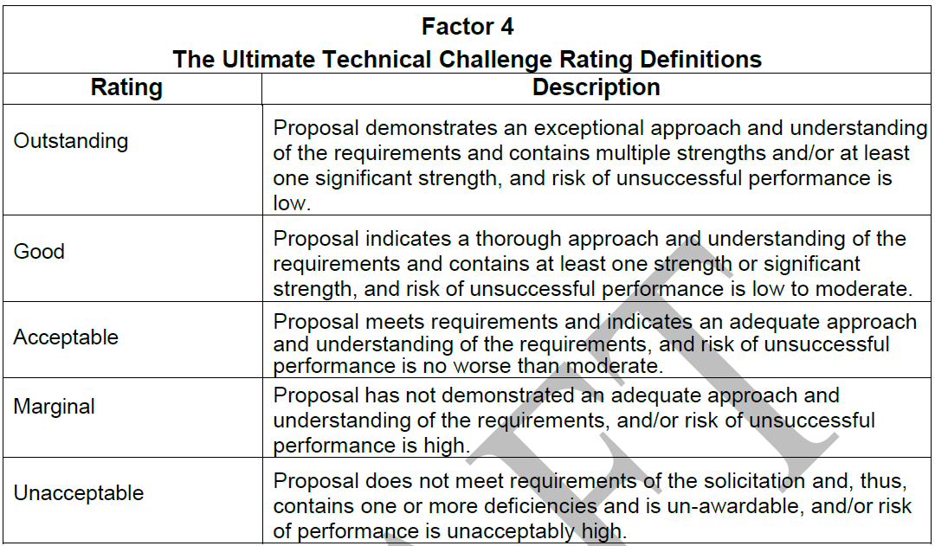
M.2.4 Factor 3 – Price; M.2.5 Factor 4 – The Ultimate Technical Challenge
M.2.4 Factor 3 – Price: To evaluate Factor 4, the Government will review the information contained in Volume V (see RFP Section L.3.4.2), and the information contained in Solicitation Attachment 0003.
M.2.5 Factor 4 – The Ultimate Technical Challenge: For Factor 5 – The Ultimate Technical Challenge, the Government will evaluate the Offeror’s technical capability to satisfy the requirements set forth in the PWS. The offeror shall demonstrate knowledge and understanding of Modern Software capability through completion of the Ultimate Technical Challenge. The ratings are defined as follows:

Slide 29
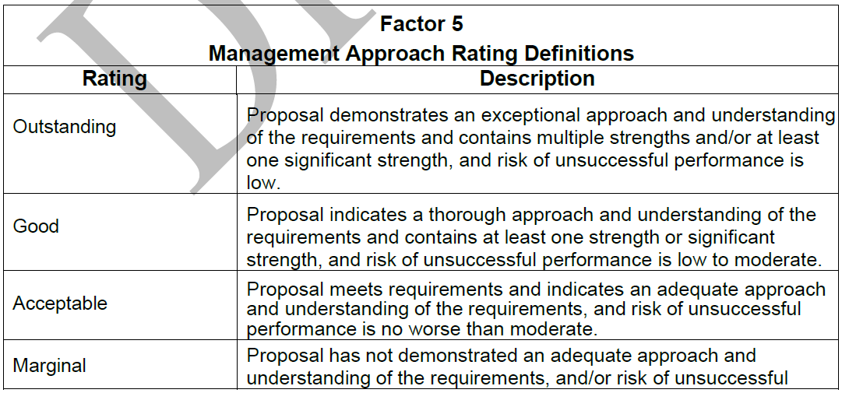
M.2.6 Factor 5 – Management Approach
For Factor 5 – Management Approach, the Government will evaluate the Offeror’s Staffing approach to adequately support the execution of Modern Software Delivery. The ratings are defined as follows:

Slide 30
M.1 BASIS FOR AWARD
For this requirement the best value basis will be determined by the Highest Technically Rated Offerors with a Fair and Reasonable Price.
The Government intends to make multiple contract awards under this solicitation which will include reserve awards with a minimum guarantee of 10 small business base awards or 20% based on the total awarded MSD MAIDIQ base contract awards to be set aside for Small Businesses, whichever is greater of all contract awards.
Factor 4 - The Ultimate Technical Challenge Factor is significantly more important than Factor 1 – Technical Corporate Experience, Factor 2 – Technical Scenario Pivot Challenge, and Factor 5 – Management Approach.
To be considered eligible for award, an Offeror’s proposal at a minimum shall provide all submission requirements for all Volumes, be found to be compliant with Volume 1 – General and receive a rating as stated below:

Slide 31
Number of Awards
Question 70: With 20 total awards, that's 10 for Large and 10 for small businesses?
Answer 70: The Government anticipates a reserve with a minimum guarantee of 10 small business base awards or 20% based on the total awarded MSD MAIDIQ base contract awards to be set aside for Small Businesses, whichever is greater. There is not a maximum number of Small Business awards. RFP paragraph H.12.
The Government is only inviting “approximately 30” Offerors to participate in Phase 3.

Slide 32
Next Steps
& Resources

Slide 33
Next Steps & Resources
We provide gap analysis, color reviews, and proposal support.
Review our How to Develop & Coach Winning Oral Proposals before price increases:
How to Develop & Coach Winning Oral Proposals | OST Global Solutions, Inc.
We have a subcontractor portal where you can upload your capabilities for this opportunity and others:
https://www.ostglobalsolutions.com/teaming-partner-match-portal/
We are happy to schedule time to discuss your Army MDS bid:
https://calendly.com/ostglobalsolutions/bdconsulting?month=2023-09
We regularly publish updates to major contracts through our newsletter and blog:
Blog: https://www.ostglobalsolutions.com/blog/
Newsletter sign up: https://www.ostglobalsolutions.com/tag/email/
Sign up for our newsletter and schedule an appointment

Slide 34
Let’s Partner in Winning Business
David Huff
CEO
c: 513.316.0993
o: 301.769.6602
e: dhuff@ostglobalsolutions.com
www.ostglobalsolutions.com

