Slide 1
Preparing for GSA Changes & Rightsizing MAS Webinar
22 April 2025

Slide 2
About OST
We've Won Our Clients Over $27 Billion in Government Contracts Since 2005
BUSINESS DEVELOPMENT, CAPTURE, AND PROPOSAL CONSULTING
Build Portfolio of Indefinite Delivery Vehicles
Develop Opportunity Pipelines
Capture Opportunities
Win Proposals
Optimize Your Processes
REGISTERED APPRENTICESHIP IN GOVERNMENT BUSINESS DEVELOPMENT; 18 COURSES IN ALL ASPECTS OF FEDERAL BUSINESS DEVELOPMENT
SBIR/STTR Proposal Lab for Maryland and Alabama SBA FAST Grant
Certified Business Developer
Certified Capture Manager
Certified Proposal Manager
Certified Proposal Coordinator
Certified Proposal Writer

Slide 3
Overview
GSA & MAS Expansion
Updates from GSA Refresh 26
Deregulation Recommendations Initiative
Prepare for the Future
Next Steps & Resources

Slide 4
GSA & MAS Expansion

Slide 5
The Future of GSA & the MAS Program – A Bold New Mandate
On March 20, 2025, an Executive Order directed all federal agencies to shift purchasing of common goods and services to GSA.
GSA will serve as the central authority for standardized federal procurement.
OPM, Education, SBA & HUD have started this process, 11 more to follow.
Develop a government-wide procurement strategy.
Oversee all government IT contract vehicles, rationalizing the use of GWACs.

Slide 6
FAR
GSA and the FAR Council tasked with the first major rewrite of the FAR in over 40 years.
Agencies must justify non-commercial purchases.
This is the most comprehensive acquisition reform since FASA/FARA in the 1990s. These directives aim to reduce waste, increase competition, and simplify procurement—but bring risks of disruption.

Slide 7
IT Contracting Authority
GSA is now executive agent for all federal IT procurement.
Will oversee GWAC use and eliminate duplicative IT vehicles.
Agencies must seek GSA approval to buy non-commercial or agency-unique systems.
This marks a huge shift for CIO-SP4, SEWP VI, and other agency-led contracts. Expect realignment, fewer GWACs, and a bias toward commercial IT solutions.

Slide 8
Risks for Agencies and Contractors
Centralized purchasing may slow down missions.
Consolidation may benefit large primes, not small firms.
GSA infrastructure may not be ready for the full shift.
This isn't just a policy change—it’s an operational overhaul. If GSA can’t scale quickly, delays and confusion could undermine intended efficiencies.

Slide 9
The Future of GSA MAS Refresh 26

Slide 10
GSA Refresh 26 Implications
At the time of the option, MAS Contractors will not be eligible to exercise the option if the minimum sales requirement isn’t met.
GSA is automating their compliance to review regulatory compliance and delivery.
Understand when and how you need to switch to the new FCP Catalog System & Submit a baseline modification.
Review your scorecards.
Deletion of SIN(s) including SBSA SIN(s).
Understand there will be future changes to SINs with low market demand. Submit your feedback to GSA.

Slide 11
Stay compliant with MAS
Check your SIP File and understand when and how to transfer to FCP.
Review SINs, what additional products and services can you offer?
Sign Mass Mods and file sales reports on time.
Offer Feedback to GSA on consolidation efforts or SIN(s)-They are listening to the industry.
Understand the MFC/BOA and give feedback to GSA.

Slide 12
Deregulation Feedback

Slide 13
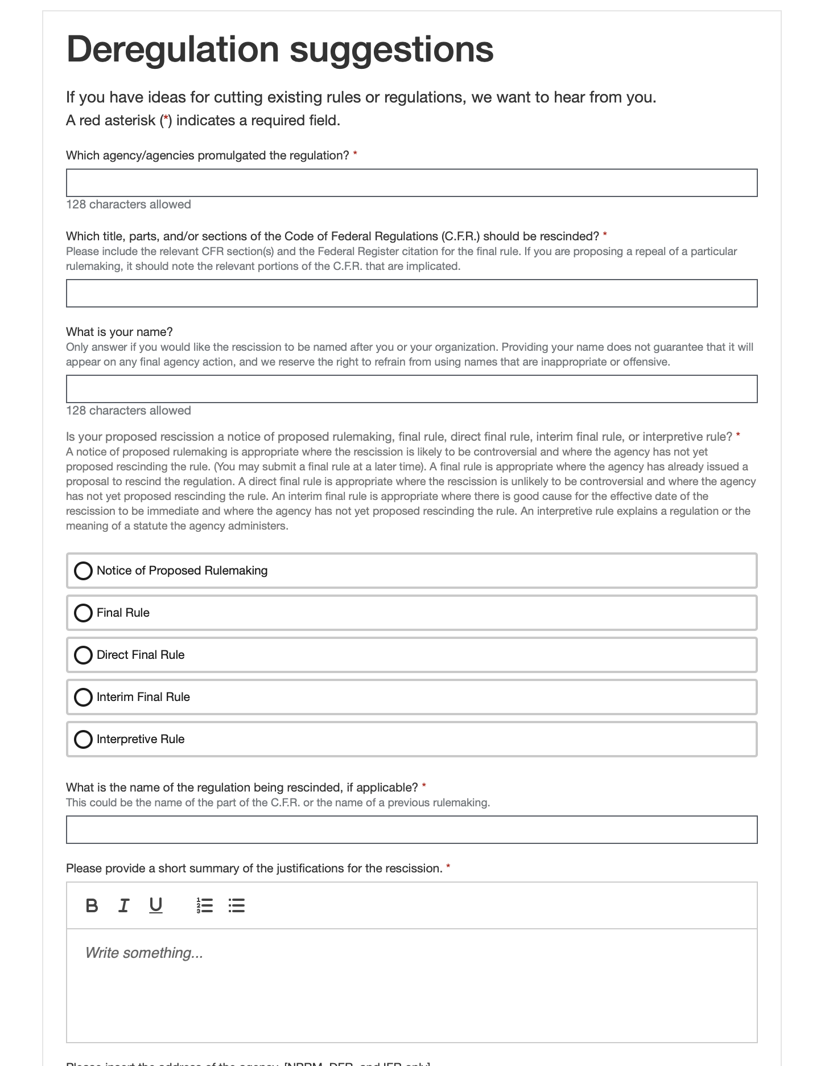
GSA, OMB launch deregulation recommendations initiative
Make your voice heard on Regulations.gov
When providing a submission focus on explaining:
The rule’s original purpose and context
Reasons why the rule should be rescinded (canceled), such as:
Conflicts with law or Constitution
Costs outweighing benefits
The rule is no longer relevant
The rule unexpectedly creates problems for businesses

Slide 14
What can you submit to make an impact?
GSA MAS Price Reductions Clause (GSAR 552.238-81) – Request for Elimination
Original Purpose and Context: The Price Reductions Clause was designed to ensure that the federal government receives fair and reasonable pricing from contractors, particularly by requiring vendors to track discounts provided to a Most Favored Customer (MFC) and extend those discounts to the GSA.
Why It Should Be Rescinded:
The rule is outdated in the context of commercial pricing models and undermines the government's shift to market-driven pricing strategies.
It conflicts with the goals of the Transactional Data Reporting (TDR) initiative, which already provides price transparency through actual sales data.
The clause creates unreasonable administrative burdens, requiring constant monitoring of pricing across commercial clients and risking unintentional non-compliance.
For small businesses, especially those with custom pricing or subscription models, this rule can lead to significant legal and accounting costs without any demonstrable benefit to the government.

Slide 15
Trade Agreements Act (TAA) Country of Origin Restrictions – Request for Reassessment
Original Purpose and Context:
The TAA restricts GSA Schedule purchases to products from designated countries to ensure alignment with U.S. trade policy.
Why It Should Be Rescinded or Modernized:
The rule conflicts with modern supply chains, especially in technology and publishing, where critical components are manufactured in non-TAA countries like China or India.
The question of what constitutes “substantial transformation” is broad in scope.
It limits access to competitively priced and innovative products, undermining the MAS Program’s intent to provide the best value to government buyers.
Small businesses must either forgo contracts or invest heavily in alternative sourcing—costs that are unsustainable without the volume of large primes.
A revision to allow waivers for low-risk or low-dollar items (like books or standard electronics) would maintain security goals while restoring access and flexibility.

Slide 16
FAR 9.104-1 – General Standards of Responsibility
Original Purpose and Context:
According to FAR 9.104-1, to be determined responsible, a prospective contractor must have adequate financial resources to perform the contract, or the ability to obtain them.
Why It Should Be Rescinded or Modernized:
This clause is the foundation for any contracting officer's responsibility determination. If a contractor is found not to have adequate financial resources, they may be deemed non-responsible and not eligible for award. Balance sheets and profit/loss statements often look weak or negative for companies investing heavily in R&D or software development. These companies are often deliberately reinvesting revenue or capital into growth, which temporarily suppresses margins or creates operational losses.
Suggested Exception Policy for GSA:
GSA may consider exceptions to traditional financial capability indicators for offerors demonstrating a track record of innovation, prior federal awards under R&D initiatives, or firm commitments from institutional investors or grant-making entities. Such vendors may provide alternative evidence of readiness, including funded R&D history, technical milestones, and SaaS delivery models that carry lower operational risk.

Slide 17
Prepare for the Future

Slide 18
Learn from Google
​The recent strategic agreement between GSA and Google exemplifies the future trajectory of federal procurement. This deal underscores a shift towards centralized, government-wide purchasing strategies that leverage collective bargaining power to achieve significant cost savings and operational efficiencies.
By treating the federal government as a single customer, the agreement simplifies procurement processes, reduces redundancy, and ensures standardized terms across agencies. This approach aligns with GSA's broader efforts to consolidate procurement and eliminate waste.
The deal reflects a broader policy shift encouraging the adoption of commercially available products and services, aiming to integrate private sector innovations into government operations while reducing unnecessary custom developments. ​
Talk to your partners, talk to your primes, talk to your competitors, now is the time to work together. Help your customer solve the problem now.

Slide 19
What can you do to be successful with GSA?
Update your MAS Contract to add SIN’s.
Is your pricing ready to submit a proposal?
Utilize partnerships and CTA’s
As of now, GSA has not publicly released a specific deadline or completion date for when it will finish reviewing all acquisition vehicles to determine which will continue, consolidate, or sunset. However, there is clear evidence that a strategic review and rationalization process is underway, driven by both internal policy and government-wide acquisition reform efforts.

Slide 20
Next Steps
& Resources

Slide 21
Next Steps & Resources
We provide market analysis, BD strategy, pipeline management, opportunity qualification, and other capture support.
Utilize OST to help you build your teams.
Think about problems you can solve for GSA or any of your customers to help improve their processes.
Update your MAS Contract and be prepared.
Sign up for our newsletter and schedule an appointment

Slide 22
Let’s Partner in Winning Business
David Huff
CEO
c: 513.316.0993
o: 301.769.6602
e: dhuff@ostglobalsolutions.com
www.ostglobalsolutions.com

