Slide 1
Writing Persuasive Government Proposals
Days 1, 2, 3
OST Bid & Proposal Academy Course
www.ostglobalsolutions.com

Slide 2
Agenda
01:00 PM – 02:45 PM Training
02:45 PM – 03:00 PM Break
03:00 PM – 04:00 PM Training
Please, give yourself the benefit of focus and limit email and use of cell phones to breaks

Slide 3
How to Maximize the Learning Process
How adults learn:
Understand WHY things work a certain way
Participate in exercises
Ask questions
Relate the material to your own experience
Take notes
Bring up topics of interest to your job
Move around during exercises

Slide 4
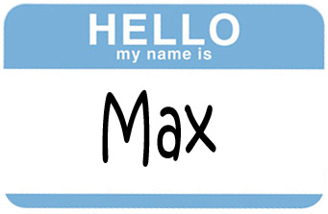
Introductions – Who is Who
Your Name, Position, Company
An interesting fact about your life
Your experience writing proposals
What are you looking to get out of this training?

Slide 5
Module 1 Class Roadmap and Three Elements of the Proposal Speed Writing System

Slide 6
Can You Relate to Any of These?
You have taken a step to gain advantage over majority of your competitors who are using outdated techniques and tools for writing
Have you pulled one too many all-nighters rewriting otherwise atrocious proposal sections?
Do you want to manage or write proposals more efficiently so that they don’t occupy so much of your time?
Do you struggle, or see others in your organization struggle, with writer’s block where it comes to proposals?
Do you dislike writing wholesale?
Do you want to gain professional skills (or know how to teach others those skills) in ensuring your sections are both compliant and highly compelling so that your proposals win?

Slide 7
Class Roadmap
This class covers basic and advanced elements of proposal writing, and offers you hands-on workshop elements to practice them in real time
Edit and polish your text, using helpful tools, techniques, and automation
A must-have
Use persuasive structure and “good” proposal language
Integrate advanced elements of persuasive writing such as story and metaphor
Aerobatics
Master three elements of the proposal speed-writing system
Cornerstone of the system
Make your sections compliant and structure your outline so that it is compelling from the get-go
Foundation where most get stuck

Slide 8
Three Elements of the Proposal Speed Writing System
All three must be present to ensure the most efficient and enjoyable proposal writing process
Process
Psychology
2. Learning and practicing the correct writing process
1. Changing counterproductive
beliefs about your writing abilities
Speed Writing
Tools
3. Leveraging the 21st Century writing tools, including AI

Slide 9
Please, Complete an Assignment for Module 1 Prior to Proceeding to the Next Module

Slide 10
Module 1 Quiz: Speed Writing System
What is the first foundational step where most proposal writers get stuck, according to the Class Roadmap?
Editing for polish
Using metaphors
Structuring outlines to be compliant and compelling
Learning how to automate compliance checks
Three elements of the proposal writing system are:
1. Process, 2. People, 3. Psychology
1. Process, 2. Psychology, 3. Tools
1. Tools, 2. Process, 3. Counterproductive Beliefs
True or False? The use of AI and other 21st-century tools is discouraged in the writing process because it’s cheating and produces low-quality content.
Notes:
Question 1:
What is the first foundational step where most proposal writers get stuck, according to the Class Roadmap?
Correct Answer: C. Structuring outlines to be compliant and compelling
Explanation: According to the pyramid in the “Class Roadmap” slide, the bottom level is labeled “Foundation where most get stuck.” The associated guidance states:
"Make your sections compliant and structure your outline so that it is compelling from the get-go.” This identifies outlining and compliance as the first major bottleneck in proposal writing, which the course aims to address before moving to higher-level elements like editing or storytelling.
Question 2:
Three elements of the proposal writing system are:
Correct Answer: b) 1. Process, 2. Psychology, 3. Tools
Explanation: The Venn diagram on the slide titled “Three Elements of the Proposal Speed Writing System” clearly labels the components as:
Psychology (changing counterproductive beliefs),
Process (learning the correct writing process), and
Tools (leveraging 21st-century tools including AI). “People” is not listed as one of the core elements, and “counterproductive beliefs” are part of the psychology component, not a standalone category.
Question 3:
True or False? The use of AI and other 21st-century tools is discouraged in the writing process because it’s cheating and produces low-quality content.
Correct Answer: False
Explanation: Far from being discouraged, the modern tools, including AI, are essential to speeding up and improving the proposal writing process when used properly. The course encourages intelligent integration of modern tools into a well-structured proposal development workflow.

Slide 11
Module 2 A Close Look at Compliance and Outlining Inside a Proposal Section

Slide 12
The Foundation for Proposal Sections: Compliant and Compelling
Before we dive into the Three Elements, let’s look at compliance closely
Compliance gets you in the door
Non-compliant sections get your proposal in the trash can or simply lower your score
Compliant sections make your proposal barely passable
Compliance will not win you a proposal
Compelling is what counts AFTER you are compliant
Being persuasive within the bounds of being compliant is the tough part in writing government proposals

Slide 13
Getting Your Section Compliant
Note that this course is not about outlining the whole proposal, it is about outlining within sections – but it will make your outlines better for the entire proposal
Analyze the RFP requirements
Remember that RFP doesn’t have requirements in one neat package – they come from different places
Determine which sections “intersect” where it comes to the requirements and double-check the proposal manager’s decisions
Don’t get hung up on the Statement of Work section headings – they are often misleading – carefully read what’s being requested
Pull together the requirements in the section
Determine the overall focus (top-down)
Then look at the key words (bottom-up)

Slide 14
Here is an Example of How to Find Key Words
Note that there are several different possible keyword combinations and ways to outline the section
Section L: Describe a qualified on-site support team availability to support testing during regular operations and surges.
Summarize your approach for supporting all test needs using personnel, tools, and systems, as described in the SOO.
Go Slow
Men at Work
Go
Slow Men at Work

Slide 15
Please, Complete the Assignments for Module 2 Prior to Proceeding to the Next Module

Slide 16
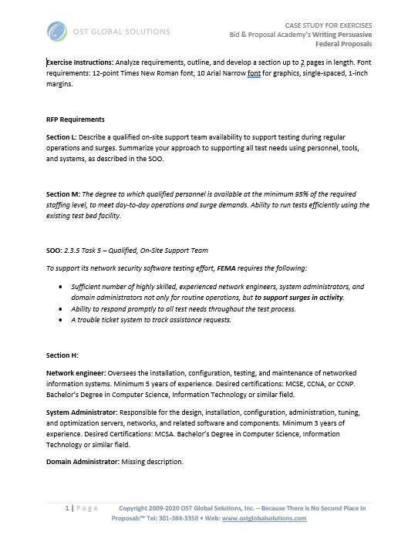
Module 2 Exercise 1: Compliance Phrases
See Word File: Writing Assignment for Exercises
In this scenario, you are responding to a FEMA RFP requiring an onsite support team for an IT testbed. You will analyze requirements from Sections L (proposal instructions), M (evaluation criteria), C (Statement of Objectives), and H (Special Contract Requirements) to create a two-page section outline that demonstrates both compliance and logical structure.
Read the requirements and determine the main focus of the section (what it is about). Select the most appropriate option.
Specifying the required technical qualifications, certifications, and educational credentials for key support personnel.
Demonstrating your approach and qualifications to field a fully-staffed, on-site support team that meets FEMA’s staffing thresholds, performance metrics, technical objectives, and contract credentials.
Outlining a risk management plan for network security testing, including backup and recovery procedures.
Providing a detailed approach to satisfying the Statement of Objectives.
Notes:
Correct Answer: B.
Explanation:
Why this is the right choice:
Section L (Proposal Instructions) – Tells you what to describe about your team: availability during regular operations and surges, and your overall “approach to supporting all test needs using personnel, tools, and systems.”
Section M (Evaluation Criteria) – Defines how FEMA will score you: staffing at ≥ 95 % of required levels, ability to run tests efficiently in day-to-day and surge conditions.
Section C (Statement of Objectives) – Lays out which technical objectives you must meet: number and mix of skilled engineers/system and domain administrators, prompt response, and a trouble-ticket system.
Section H (Special Contract Requirements) – Specifies who must deliver: roles, minimum years of experience, certifications (MCSE, CCNA, CCNP, MCSA), and educational credentials.
Together, the four sections combine to show both your approach (Sections L & M) and your qualifications (Sections C & H) for staffing and executing the support-team requirement.
Why the other options don’t fully fit:
“Specifying the required technical qualifications, certifications, and educational credentials…” Only covers Section H—ignores the instructions, metrics, and objectives.
“Outlining a risk management plan…” That’s not anywhere in L, M, C, or H.
“Providing a detailed approach to satisfying the Statement of Objectives.” Too narrow—misses the proposal instructions, evaluation criteria, and contract credentials.

Slide 17
Module 2 Exercise 2: Identify Key Phrases
Read and highlight all the key phrases in text on your sheet of paper. Next, select only the key phrases that are compliance-critical and disregard any words or phrases that are filler, irrelevant, or not explicitly required by the RFP. Think like an evaluator—what would they be scanning for?
Instructions (L) | Evaluation Criteria (M) | Statement of Objectives (SOO) (C) | Special Contract Requirements (H)
Qualified on‑site support team availability As described in the SOO Comprehensive surge staffing model Detailed schedule management Summarize your Support testing during regular operations Support testing during surges Approach to supporting all test needs Using personnel, tools, and systems | Qualified personnel available at minimum 95 % of required staffing level Continuous improvement processes Meet day‑to‑day operations demands Resource optimization guidelines Meet surge demands Run tests efficiently using the existing test bed facility Efficiency‑gain projections | Sufficient number of highly skilled, experienced network engineers Sufficient number of system administrators Sufficient number of domain administrators Automated backup protocols For routine operations To support surges in activity Help desk call volume forecast Ability to respond promptly to all test needs To support its network security software testing effort Highly skilled, experienced Onboarding workflow diagram Trouble ticket system to track assistance requests | Professional development stipend Network Engineer: Installation, configuration, testing, and maintenance of networked information systems Minimum 5 years of experience Desired certifications: MCSE, CCNA, or CCNP Alternative certification paths Bachelor’s degree in computer science, information technology, or similar field System Administrator: Design, installation, configuration, administration, tuning, and optimization of servers, networks, and related software/components Minimum 3 years of experience Desired certification: MCSA Domain Administrator: Preferred resume templates
Notes:
Interactive Drag and Drop

Slide 18
Module 2 Exercise 2 Answer Key
Your answers should look like this:
Instructions (L) | Evaluation Criteria (M) | Statement of Objectives (SOO) (C) | Special Contract Requirements (H)
Qualified on‑site support team availability As described in the SOO Comprehensive surge staffing model Detailed schedule management Summarize your Support testing during regular operations Support testing during surges Approach to supporting all test needs Using Personnel Tools Systems | Qualified personnel available at minimum 95 % of required staffing level Continuous improvement processes Meet day‑to‑day operations demands Resource optimization guidelines Meet surge demands Run tests efficiently using the existing test bed facility Efficiency‑gain projections | Sufficient number of highly skilled, experienced network engineers Sufficient number of system administrators Sufficient number of domain administrators Automated backup protocols For routine operations To support surges in activity Help desk call volume forecast Ability to respond promptly to all test needs To support its network security software testing effort Highly skilled, experienced Onboarding workflow diagram Trouble ticket system to track assistance requests | Professional development stipend Network Engineer: Installation, configuration, testing, and maintenance of networked information systems Minimum 5 years of experience Desired certifications: MCSE, CCNA, or CCNP Alternative certification paths Bachelor’s degree in computer science, information technology, or similar field System Administrator: Design, installation, configuration, administration, tuning, and optimization of servers, networks, and related software/components Minimum 3 years of experience Desired certification: MCSA Domain Administrator: Preferred resume templates
Notes:
Interactive Drag and Drop

Slide 19
Module 3 Exercise 3: Outline Your Section
Notice different possible logical groupings of key words – how do L, M, C, and H intersect?
Decide how to structure your section outline and develop your outline
Note that you don’t need to put any numbers in the outline since it is just one section – just use bullets and sub-bullets
Submit your outline to service@ostglobalsolutions.com

Slide 20
Module 3 Annotating a Compliant Proposal Outline Inside a Section

Slide 21
Annotating Your Section
Proposal Managers sometimes stop at a top-level outline and leave figuring out the details to subject matter experts
Some of this information can be added right away, and other after brainstorming
Be prepared to rearrange and tweak as your thinking matures
Just like anything in proposals, outlining is an iterative process, even with AI-based tools
Proposal Manager
Creates the
Requirements-Based Outline
Proposal Manager May Take the First Cut
But Authors Finish the Annotated Outline
Rearrange bullets within sections and streamline while minding compliance
Add your interpretation of requirements
Start with L
Add templates for tables
(Instructions)
Add must-have figure placeholders
Add in M (Evaluation
Criteria)
Add applicable win themes
Submit for in-process reviews, improve, and freeze the compliance part after Pink Team
Add C or J
Add other points of discussion if known
(Statement of Work)
Add cross
-
references between sections
Add H, CDRLs, etc.
and volumes
Add introductions and transitions

Slide 22
Points to Keep in Mind
Rules of outlining within the section are less strict than those for outlining the whole proposal
At the top level, try to present the major points in order as they appear in the requirements
Within the section, often you don’t have to follow the exact order of the requirements
You can tell a better story, even if it entails changing the order of the key words
The most important thing is to ensure that nothing gets overlooked, and you don’t end up with “orphan” requirements
The best practice is to bold the compliance key phrases for ease of navigation

Slide 23
Infuse the Section Flow
Design the proper paragraph flow for greater persuasion, to make your sections compelling by design; use 8Ws to guide the paragraph flow
Higher level summary sections - X or X.X outline levels
Why: Customer problem, challenge, or key risk factor behind the requirement
What: What do we propose to do in response to the requirement?
Lower-level sections for X.X.X levels and beyond
Who: Who exactly is going to do this part of work, by name and title?
Only if you have room: Why
How: Step-by-step approach with benefits to the customer and risk mitigation
What, Who, and How
When: In what sequence we are going to do it per schedule, or when have we done it before?
Only if you have room: When, Where and Wow
Where: Indicate the location or facility, or say where we have done it before successfully
Wow: Powerful section conclusion

Slide 24
Proposal Level Section Flow
If the RFP permits, go from general to specific, and from an overview to greater detail
1.0 - Overall Top-Level Summary or Overview Section
Example: Technical Solution or Management Approach Intro
1.1 – First Topic
This is where your practice section fits
1.1.1 - Detail*
FLOW
1.1.2 - Detail
1.2 – Second Topic
1.2.1 - Detail
1.2.2 - Detail
1.2.3 - Detail
Evaluator that doesn't have expertise in the field (usually the contracting officer)
Evaluator with some expertise (usually the project manager, other evaluators who are not as familiar with the program)
Subject Matter Expert Reader (Contracting Officer's Technical Representatives, SETA or A&AS contractors, etc.)

Slide 25
Determine Where Your Section Fits in the Overall Proposal Flow
This helps you determine the focus of your section, and the level of detail
Is your section outline level like this?
The level of detail depends on where your section is in the proposal outline
Examine the outline and determine your section’s hierarchy and therefore the level of the story detail you are going to include
Know your page count allocation
Sometimes you cannot afford to address every single key word
You need to figure out how to group the requirements in reasonable “chunks” that you can address together
Determine what other sections (and authors) you must coordinate with
Or this?

Slide 26
Please, Complete the Assignments for Module 3 Prior to Proceeding to the Next Module

Slide 27
Module 3 Quiz
Which “W” belongs at the very top level of each section’s paragraph flow? A. When: In what sequence we’ll do the work. B. Where: Which locations or facilities we’ll use. C. Why: The customer’s problem or risk factor behind the requirement. D. Wow: A powerful conclusion.
In the Proposal Level Section Flow, a detailed subsection level is usually meant to be thoroughly understood by the following government evaluator: A. The Contracting Officer with no technical background. B. Other non-technical evaluators unfamiliar with the program. C. Subject-matter experts (e.g., COR, SETA, A&AS contractors). D. The Source Selection Authority.
Which statement best describes how you should handle the order of key phrases within a section? A. You must follow the exact order as written in the RFP—no exceptions. B. You can rearrange phrases to tell a more logical story, as long as nothing gets dropped and key phrases are easy to find. C. Always group all technical requirements first, then management requirements. D. You’re free to omit any phrase you think is unimportant.
True or False? Outlining is an iterative process—you may rearrange, add transitions, and tweak after your first draft.
Notes:
1. Which “W” belongs at the very top level of each section’s paragraph flow? Answer: C. Why: The customer’s problem or risk factor behind the requirement. Explanation: At the highest (X or X.X) outline level you always open with Why—it frames the customer’s pain point or risk and sets the stage for everything that follows. It also generates interest for the customer.
2. In the Proposal Level Section Flow, a detailed subsection level is usually meant to be thoroughly understood by the following government evaluator: Answer: C. Subject-matter experts (e.g., COR, SETA, A&AS contractors). Explanation: The very granular third and below levels of detail blocks are written for the Subject Matter Expert (SME) reader—they’re looking for proof of technical accuracy and exact methods. The Contracting Officer or non-technical evaluator may not be proficient in all the technical details and may rely more heavily on the higher-level summary to explain the advantages of the solution.
3. Which statement best describes how you should handle the order of key phrases within a section? Answer: B. You can rearrange phrases to tell a more logical story, as long as nothing gets dropped and key phrases are easy to find. Explanation: While your overall proposal outline must mirror the RFP order, within each section you have flexibility to group and sequence bullets for clarity and flow—provided you preserve every compliance phrase and they are easy to find by bolding key phrases or even using a different font color.
4. True or False? Outlining is an iterative process—you may rearrange, add transitions, and tweak after your first draft. Answer: True Explanation: Outlining is rarely perfect on the first pass. You expect to refine structure, remove redundancies, cross-reference information to avoid duplication, add annotations, and shuffle bullets as your thinking—and team reviews—mature.

Slide 28
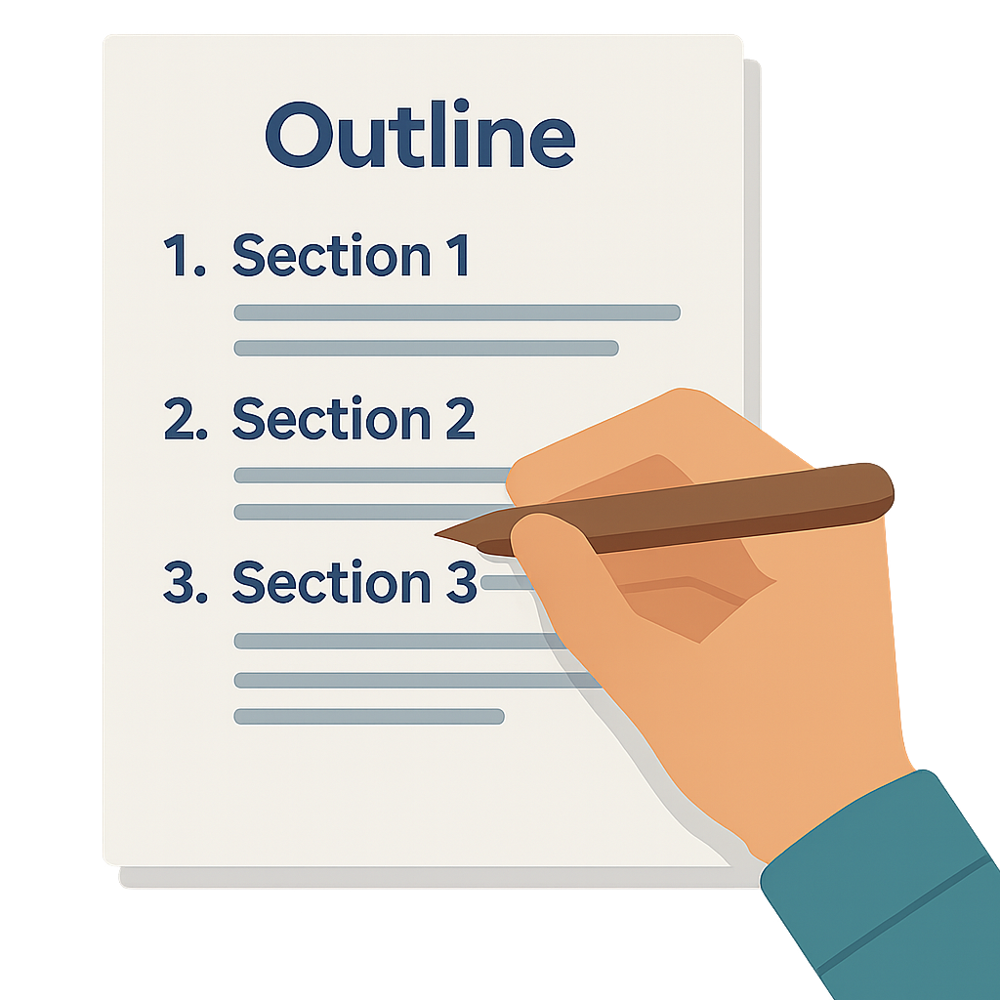
Module 3 Exercise 2: Outlining and Annotating
Laws of speed writing don’t apply at the whole proposal level; they don’t even apply at the annotated outline level; they become useful at the heart of each section
Annotate your section
Add content notes
Add tables and raw graphic concepts
Notice where you reach the limits of where you can take your section without further brainstorming, decisions, or AI advice
After this step, once your outlining stops, the laws of speed-writing begin to apply
Send your annotated outline to service@ostglobalsolutions.com

Slide 29
Module 4 Element 1: Psychology

Slide 30
Element 1 of the Proposal Speed Writing System
Mental blocks lower our ability to do anything: if we believe we can’t, we can’t
Psychology matters: most elite athletes, successful actors, or high-performing busines executives have coaches that focus on psychology of performance
Mental state is key to achieving the height of human abilities
Changing the psychology and unhelpful beliefs about writing transforms you and your proposal team

Slide 31
Questions to Uncover Self-Limiting Beliefs About Writing
Even if you are a willing and able writer, knowing how to deal with people’s self-limiting beliefs will transform the nature of your proposal work
Do you believe you are not good at writing?
Has someone else told you this or is there a “voice” in your head judging you?
What specifically makes you feel that you are not good?
Do you feel like a writing or even an intellectual fraud?
Do you just simply dislike writing but will write well if needed?
OR… Do you believe you are a good writer and can even enjoy it but inevitably procrastinate and dread writing anyway?

Slide 32
Overcoming the Initial Blocks
It is amazing how quickly we got stereotyped as kids and how we perpetuate these stereotypes years later
Most myths about writing come from early education experiences
Believe there are the anointed ones for whom writing is a birthright (unlike us):
“Special people” with the soul of a poet who are clever at their use of words (may wear a French beret)
Have large vocabularies with the right adjectives to define anything
Are “artistic” and “creative”
Few were taught the correct process for transforming thought into written word
Many were punished with a perpetual “C” in English
Most adult writing classes are about editing and hence don’t work
“C”

Slide 33
Dispelling the Myths About Writing
Remember: if you can think and talk, you can write (ability to talk is optional)
Proposal writing does not require exceptional talent
Passion is conveyed through:
Clear plans, customer knowledge, facts, and proof
…Not the clever wording and large vocabularies
Negative self-talk is more common than you would imagine
Most everyone with critical thinking abilities questions and criticizes themselves … a lot
Don’t need to get to the root of it: just recognize the voice and decide to silence it whenever it comes up
Temporary silencing is perfectly OK

Slide 34
Getting Down to Specifics is the Only Way to Help
Let’s explore: What do you and/or your writers SPECIFICALLY dislike about writing?
The typing itself or the challenge of putting thoughts into words?
The effort of organizing the ideas into a logical order?
The writing not well-connected to what you are trying to say?
Appearing to be "padding" to fill the pages after getting the basic idea across?
Failing to find the right words?
Seeing too many connections so it's hard to structure the thoughts or focus?
Fear of seeming incompetent or not as smart when your section doesn't come out quite as intended?
The dread of how long the writing takes, and how much time this proposal is going to steal out of your life?
Notes:
If it bothers them intensely that writing takes so long, I ask them to suspend their belief that writing has to take dedicated hours of quiet time. They usually postpone the writing project until that perfect time block is found, which is usually too late. I ask them instead to dedicate 15 minutes in the morning, and 15 minutes in the afternoon daily. I found that oftentimes, when people get started, they end up getting on a roll and do more than they had planned. I ask them to post their work daily so that I can see their progress. Even if people use only two 15-minute time slots each day, the quality of their sections improves because in the in-between times, authors get to percolate and generate new ideas. Plus, they stop dreading writing because it does not consume too much of their precious time.
If there is negative self-talk, I ask people to stop themselves, even if just for the duration of the proposal, from telling themselves they are bad writers and this work is boring. With the negative self-talk gone they have a greater chance of succeeding. Finally, I get to the real reason many people don’t believe they can write well. They expect perfection right away, and cannot get past the first few sentences without harshly judging what they have written. I tell them that they are about to get a lesson in writing they never got in school, that's going to teach them a proper writing process where writing badly at first is almost a mandatory requirement. I remove the pressure of being great writers from the team altogether and give them a blanket permission to write badly at first, and get away from expecting perfect prose in the first draft, promising them the tools that will make them better writers.
I also offer practical means: To make writing with nouns and verbs very simple, I provide a handout of 80 most useful proposal action verbs. This kills two birds with one stone: 1. Arms writers with an easy tool that makes the task seem more feasible; and 2. Helps avoid a situation where the only verbs that exist in a proposal are bring, ensure, deliver, and provide, other than the various forms of the verb "to be".
For those who don’t like typing, it costs very little to get the digital recordings transcribed – you can use a transcription service or an intern
YOU CAN ALSO:
Tell about upcoming just-in-time training
Position yourself as someone who is there to help.

Slide 35
Dealing with the Dislike of Typing or Translating Thoughts Into Words…
There are tools to help you or your writers through both difficult blocks
When it is a dislike of typing:
Assign another writer to interview
Use voice to text transcription software (Teams, Zoom, Otter.ai, Fireflies.ai, voice to text in gen AI apps, etc.)
Create bullet points or stream of consciousness thoughts and have AI write the first draft
When it’s a hard time translating thoughts into words:
Get away from outlining
Master mind mapping techniques
Don’t require precise “words” – concepts, associations, or pictures are OK as a first pass
Accept it may be a multi-step process

Slide 36
When It is Hard to Organize the Ideas into a Logical Order
The biggest problem for people who have this issue is the temptation to cut and paste; they usually drown in a sea of text
Avoid cutting and pasting wholesale
Use a hard copy print out of boilerplate sections to stimulate ideas
The less text to wade through, the better
Use the 8Ws sequence to:
Sort out who does what to whom and why
Answer questions about every aspect of the problem
Use pre-built section flow to develop your first draft
Create an AI prompt around 8Ws to sort through the material and move it in the right order
Prioritize your mind maps or use UNO or Rico Clusters to figure out the hierarchy of ideas when brainstorming

Slide 37
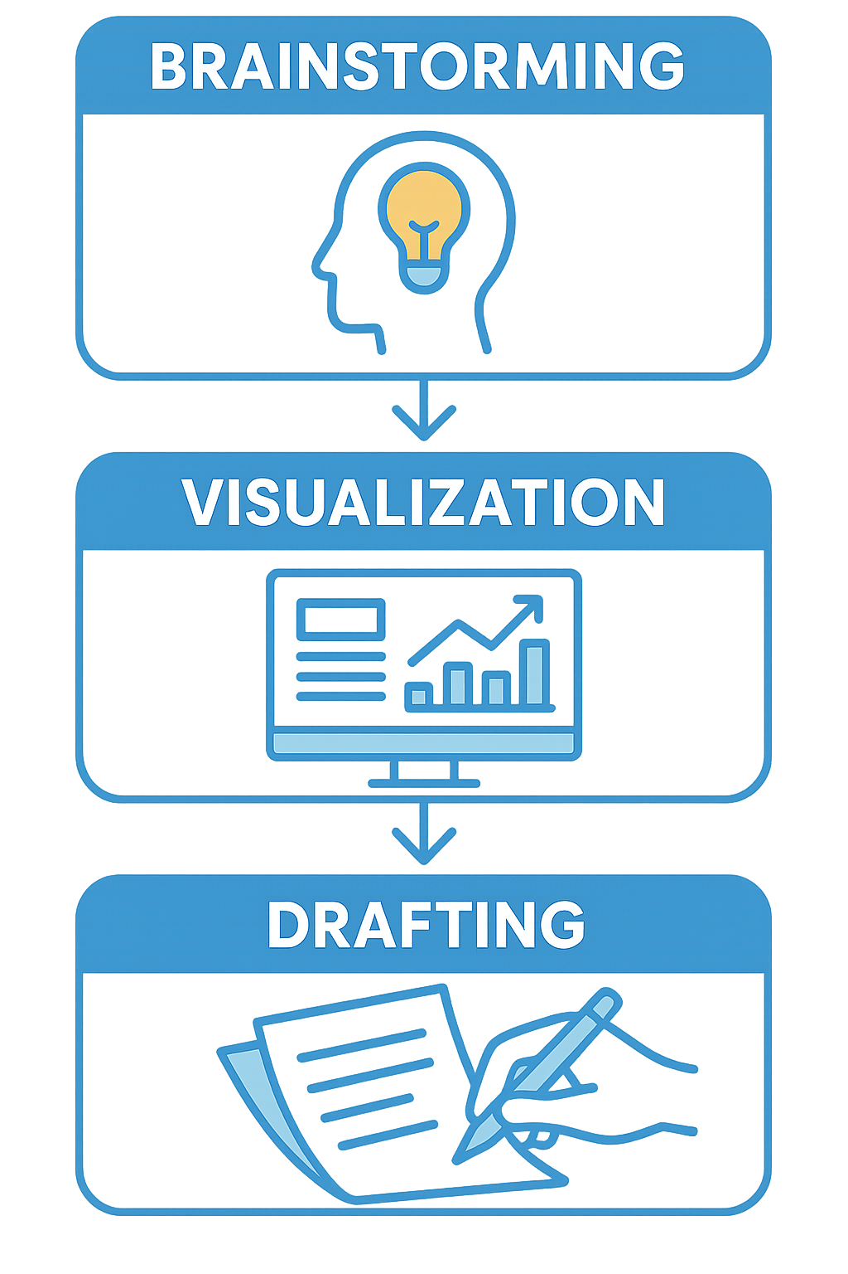
If the Writing is Not Well-Connected to What You are Trying to Say
Some of the blocks are tough but it doesn’t mean they don’t have a solution
Get your thoughts together first, before starting to write; don’t skip the brainstorming
What is the approach?
What are you going to say?
Picture an evaluator clearly in your head while writing – what are you trying to convey?
Be ready to edit radically if you are verbose
Experiment with images and flowcharts:
Write an entire thought or idea in pictures
Make the pictures as simple as possible
Draw the pictures almost as if you were writing a sentence
Run your pictorial by others and have them talk through it
Feed your pictorial to AI and ask the AI to talk through it
Get rid of anything extra from the pictures that doesn’t help

Slide 38
What if You Feel Like You are “Padding" to Fill the Pages After Getting the Basic Idea Across?
Padding is good in contact sports but not so good in writing
Put more emphasis on developing content and brainstorming: have more things to say rather than saying the same thing repeatedly
Know that it is possible to tell a meaningful and elaborate story even about the simplest of things if you think through it well
Answer all the 8Ws
Explore the WHY and the HOW in detail
Tell anecdotes of past performance and customer “kudos”
Use AI to develop additional content and point out what aspects of the solution you are missing

Slide 39
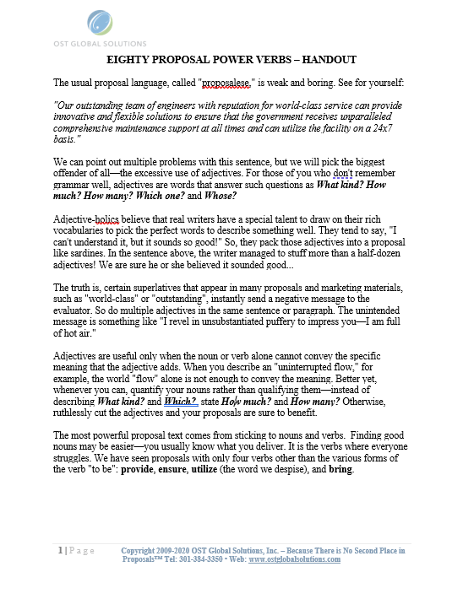
Failing to Find the Right Words
Remember – knowing what to say is half the battle – if you stick to nouns, verbs, and assorted facts, there will be no room to worry whether the words are “right”
Remember – power writing is about nouns and verbs
Adjectives and adverbs are there for specific descriptions
Red car vs. state-of-the-art car
Issue a list of action verbs appropriate for proposals
Use pictorials and flowcharts – start with section graphics first
Don’t focus on the craft of writing – just convey the content
Finding the right words for proposals is overrated

Slide 40
Fear of Seeming Incompetent When Your Section Doesn't Come Out Quite as Intended
This is a consequence of psychology impeding our ability to write
A direct result of the “voices” and the impostor syndrome
Rejoice in knowing that first drafts are almost NEVER perfect
You only technically WRITE the first draft (the rest is editing)
Talk out the section with someone BEFORE you begin to write, to gain confidence in what you have to say – or run it by AI
When in doubt, check if you answered all the “W” questions, and don’t focus on the act of writing

Slide 41
The Dread of How Much Time This Proposal is Going to Steal from Your Life
Many people don’t write well because they dislike the very idea of how long it takes; but the correct writing process and writing in short intervals work miracles
Writing doesn’t have to take hours; hence no need to procrastinate because of the state of overwhelm and dread
Don’t try to schedule “one solid day” or another large time slot for writing ‒ it is hard to pull off and is unnecessary
Schedule instead short periods of time throughout the day
Go for 15-20 minute intervals
If you feel like continuing after you got yourself started, do so
Use your smart phone timer, and turn off the distractions such as email and phone

Slide 42
Where Dealing with Psychology Fits in the Proposal Process
You can dedicate a small part of your kickoff to dealing with psychology of writing
Predecessor: Capture Process
Read RFP
Prepare for Kick-Off
Conduct Kick-Off to Reach 9 Goals
Develop Work Packages
Prepare Draft 1
Conduct Pink Team
Prepare Draft 2
Prepare Draft n
Conduct Red Team
Prepare Final Draft
Read-Out-Loud
Print, Check, Deliver
Implement Post-Delivery Win Strategy
Update Lessons Learned
Annotated Outline
Assignments
Compliance Checklist
Style Guide
Background Materials
Briefing
Pink Team Recovery
Outline Frozen
Red Team Recovery
Decision to proceed
Award
Make Bid-No-Bid Decision
Brainstorm & Research
In-Process Review(s)
In-Process Review(s)
DTP, Edit
DTP, Edit
Conduct Gold Team
Collect Lessons Learned
Attend Debrief
Integration Phase
Planning Phase
Writing Phase
Polishing Phase
Production
Phase
Post-Proposal
Phase
Successor: On-Contract Growth that Includes Capture of Additional Scope and Projects

Slide 43
Please, Complete an Assignment for Module 4 Prior to Proceeding to the Next Module

Slide 44
Module 4 Quiz
Use of boilerplate helps especially when you have a hard time organizing ideas into logical order. It can speed up the process.
a) True b) False
True or False? Power writing is all about using big adjectives and fancy adverbs to make your prose stand out.
a) True b) False
3. When your brain is faster than your typing fingers, and it frustrates you, the best strategies include:
Using someone else to interview you and using voice to text transcription tools.
Brainstorming more and answering the 8Ws.
All of the above.
None of the above.
True or False? It’s OK to temporarily silence your inner critic whenever it pops up, rather than digging into its root cause.
True b) False
Match each block type with its recommended technique:
Block Type | Recommended Unblocking Technique
1. Hard to translate thoughts into words | a) Don’t skip the brainstorming, picture the evaluator in your head, and feed flowcharts and pictorials to AI
2. Writing not well-connected to what you are trying to say | b) Get away from outlining and master mind-mapping, UNO, or Rico clusters techniques
3. Padding pages after basic idea | c) Brainstorm, answer all 8Ws, and tell anecdotes
4. Failing to find the right words | d) Don’t get hung up on adjectives or adverbs, or “pretty” writing – stick to nouns & verbs
Notes:
Answer: b) False Explanation: Relying on boilerplate text often backfires when you’re trying to organize fresh ideas—it can leave you drowning in irrelevant copy and slow you down. Instead, carve out only the exact statements you need sentence by sentence or use a hard-copy printout of boilerplate for reference. You could also use boilerplate for prompts as an example. Just don’t cut and paste boilerplate in the body of your content. This will keep you focused on developing original, compliant prose rather than wrestling with and getting lost in chunks of mismatched text.
Answer: False Explanation: “Power writing” is not about throwing in flowery adjectives and adverbs. It’s about using precise nouns and verbs to drive your message home. Adjectives and adverbs have their place—when you really need to specify specific characteristics such as color, timing, degree, or some other quality—but the bulk of your writing should rest on strong, concrete action words and clear facts. That discipline makes your proposal easier to read and more trustworthy.
Answer: c) All of the above. Explanation: When your mind outpaces your keyboard, you need someone interview you or use voice-to-text tools (Teams, Otter.ai, Fireflies.ai, etc.) to capture your rapid thoughts. Prior to that, you need to lean into brainstorming techniques like mind mapping or answering the 8Ws to organize those ideas. Combining transcription, structured prompts, and free-form creativity ensures nothing gets lost in translation from brain to page.
Question 4 Answer: a) True Explanation: It’s perfectly acceptable—and often necessary—to temporarily silence your inner critic rather than dissect why it’s there. The goal is to keep momentum and capture raw ideas first. You can circle back later with editing and reflection. Silencing that critical voice gives you the mental freedom to brainstorm, draft, and then refine without getting bogged down in self-doubt mid-stream.
Answer Key: 1 → b) Get away from outlining and master mind-mapping, UNO, or Rico clusters techniques 2 → a) Don’t skip the brainstorming, picture the evaluator in your head, and feed flowcharts and pictorials to AI 3 → c) Brainstorm, answer all 8Ws, and tell anecdotes 4 → d) Don’t get hung up on adjectives or adverbs, or “pretty” writing—stick to nouns & verbs
Explanation:
Block 1: When thoughts won’t turn into words, abandon rigid outlines and use visual clustering (mind maps, UNO, Rico) to let ideas flow freely.
Block 2: If your draft doesn’t feel connected, go back to raw brainstorming, picture your evaluator’s face to focus on their needs, and then use talking through your pictorials or giving pictorials or diagrams to AI to convert visuals into prose.
Block 3: Feeling like you’re just padding? Answer the full set of 8Ws and enrich your narrative with real-world anecdotes to add substance rather than filler.
Block 4: Struggling to find the “right” words? Resist the urge to hunt for elaborate adjectives—focus on clear, active nouns and verbs so your meaning shines through.

Slide 45
Module 5 Element 2: The Correct Writing Process

Slide 46
Centers in Brain Hemispheres Are Responsible for Different Tasks
Processes details of visible objects
Plays a major role in grammar and decoding literal meaning
Those stuck in the traffic jam in corpus callosum (connecting the hemispheres) will take longer to complete tasks
Processes overall shape of objects
Plays a role in understanding verbal metaphors and decoding indirect or implied meaning
Logical, sequential, rational, analytical, objective, and focused on parts
Creative, random, intuitive, holistic, synthesizing, subjective, and focused on wholes

Slide 47
The Correct Writing Process
The act of writing requires the shortest time in the writing process
Three distinct stages: when skipped or tackled out of order, they make writing painful and time-consuming
Mixing right- and left-brained tasks is the mother of all writer’s block because of how narrow the bridges are between the hemispheres
40%
..
40%
20%
RESEARCH AND
BRAINSTORMING
WRITING
REWRITING AND EDITING
Notes:
Many years ago when I was just starting in proposals, I used to have an 80-20 rule, and no time left for editing – (funny). I had editing and polishing poorly planned for, and therefore how it made me and the whole production team scramble at the end of the proposal… Tell the story of perfecting the 40-20-40 rule (as an improvement).
Then explain the stages.
The secret to writing fast lies in developing the discipline of writing without using backspace or mouse. It is important to “bake the cake” first, without looking back. It does not matter if it is an ugly cake—it just has to be there in its fullness before the cycle of revisions can start.
I ask people to repeat a little mantra—“I will have a chance to go back and make it better”—when they start changing words or rereading what they just typed. They have to remember that writing does not end with the “writing” stage. In fact, proportionally, the time allocated to revisions and editing should be about twice as long as the writing itself. If research is 40 %, writing should be 20 %, and revising and editing should take another 40%. Knowing that usually relaxes our inner grammarians and judges.
Stage 3: Editing.
Entering the editing stage is usually a huge relief to the left-brainers because this is a more familiar territory. One thing that you need to teach the writers is that there are several depths of editing. At the deepest level, editing amounts to rewriting and restructuring the section and adding compliance-related topics and language. Then, there are parts that one can automate to assist in editing process where they can shorten the sentences, get rid of the word "will", fix the grammar, change terminology, and other tasks. Although logically someone would start with the in-depth editing first, before attempting to polish the section, in reality it does not matter where one starts. The writer can start with copy-editing and then fall into rewriting, and then dive back out to fix the passive and active voice problems.
I usually provide a detailed editing checklist at this stage with instructions on what to look for. Here is what I include in it:
1. Content (which covers such areas as compliance, accuracy, consistency, missing information, redundancy, win themes, and acronyms)
2. Length and Structure (which covers proper paragraph order, flow, and paragraph and section length)
3. Sentences and Words (which covers such areas as passive and active voice, word use, tone, style, and a variety of other issues)
4. Mechanics (which covers such areas as spelling, typos, punctuation, capitalization, use of pronouns, subject-verb agreement, and verb tense throughout the document).
Just like writing, one cannot automate parts 1 and 2 of my checklist that have to do with content and structure. All you can do is provide the handouts and training on how to do it right, and what to look for. But, where it comes to parts 3 and 4, Sentences and Words, and Mechanics, it is a different story. We will discuss it in more detail later when we talk about tools.
Since editors frequently refrain from making in-depth content edits, it is the writers’ task to make their sections more readable before these go to the editors.

Slide 48
Please, Complete an Assignment for Module 5 Prior to Proceeding to the Next Module

Slide 49
Module 5 Quiz
Where are the centers you are primarily using when you are generating ideas during brainstorming?
Right hemisphere
Left hemisphere
Where are the centers you are primarily using when you are editing?
Right hemisphere
Left hemisphere
What happens when you mix the stages of writing?
You experience writer’s block
You are stuck in the “traffic jam” in the corpus callosum
All of the above are correct
Notes:
1. Answer: A) Right hemisphere Explanation: Brainstorming taps into your creative, holistic, and intuitive faculties—qualities governed by the right cerebral hemisphere. When you generate ideas, you’re looking at overall shapes, metaphorical connections, and non-linear leaps. That “random, synthesizing” mode of thought is what makes the right side of your brain light up during free-flow brainstorming.
2. Answer: B) Left hemisphere Explanation: Editing demands logical, sequential, and analytical processing—exactly the strengths of the left hemisphere. You’re decoding literal meaning, checking grammar, verifying facts, and ensuring each sentence follows a clear, objective structure. That narrow, detail-focused work lives squarely in left-hemisphere territory.
3. Answer: C) All of the above are correct Explanation: If you blur the line between big-picture brainstorming and detail-oriented editing, you trigger what feels like a “traffic jam” in the corpus callosum—the narrow bridge linking left and right hemispheres. The result is classic writer’s block: your creative right brain and your analytic left-brain clash, slowing down every stage of the process. Mixing stages scatters your focus and inhibits both idea generation and coherent editing.

Slide 50
Module 6 Stage 1: Research, Brainstorming, Planning Brainstorming in a Group

Slide 51
Stage 1: Research, Brainstorming, Planning
Planning is the most important portion of writing – if it doesn’t go well, the writing process will stall
Takes at least 40% of the proposal duration
Includes:
Researching
Brainstorming as a group
Brainstorming by yourself & with AI
Section planning
Answering the “W” questions
Developing graphics
Talking though your section with a person or AI
Preparing storyboards or work packages

Slide 52
Where Stage 1 Fits in the Proposal Process
Predecessor: Capture Process
Read RFP
Prepare for Kick-Off
Conduct Kick-Off to Reach 9 Goals
Develop Work Packages
Prepare Draft 1
Conduct Pink Team
Prepare Draft 2
Prepare Draft n
Conduct Red Team
Prepare Final Draft
Read-Out-Loud
Print, Check, Deliver
Implement Post-Delivery Win Strategy
Update Lessons Learned
Annotated Outline
Assignments
Compliance Checklist
Style Guide
Background Materials
Briefing
Pink Team Recovery
Outline Frozen
Red Team Recovery
Decision to proceed
Award
Make Bid-No-Bid Decision
Brainstorm & Research
In-Process Review(s)
In-Process Review(s)
DTP, Edit
DTP, Edit
Conduct Gold Team
Collect Lessons Learned
Attend Debrief
Integration Phase
Planning Phase
Writing Phase
Polishing Phase
Production
Phase
Post-Proposal
Phase
Successor: On-Contract Growth that Includes Capture of Additional Scope and Projects

Slide 53
Why Does it Take so Long to Prepare to Write?
Thinking, planning, and research are important but can be onerous; use solution development checklists to speed up the preparation process
Starting to write before preparation is done leads to writer’s block
People don’t like to feel like fakes
It is hard to start if you can’t understand:
What the customer is looking for
What is being proposed
Why the customer should pick your team
Even AI can’t do a good job without explicitly answering those questions first

Slide 54
Brainstorming in a Group
Brainstorming is often under-appreciated and runs ad-hoc; instead, it should be run as a carefully planned and orchestrated session
Invite the right SMEs, and assign a lead (facilitator) and a time-keeper
Have a clear agenda and process
Warmup (getting your team in a creative mindset)
Idea generation without judgment (chaotic)
Organizing
Streamlining and troubleshooting
Keep reminding the team if left-brain dominant people become frustrated:
Where they are in the process
Where they have been
Where they are going

Slide 55
Step 1: Warm Up
You may find that many good thinkers stay within the confines of their current notions until you help them produce new ideas to help beat your competition
Example of a Story of Brilliance:
I am normally not a person who likes to repair things or even program a TV remote. But one time I was working late at night, alone in the building, trying to print a proposal for delivery. I was running behind and left myself little time to print it. It was due in the morning. The printing was going well until one of the pages got jammed in the gigantic printer. When I tried to get the paper out, it ripped and parts of it stayed in the machine. In desperation, I followed the book with troubleshooting diagrams and disassembled the whole printer into dozens of parts, got the paper out, and reassembled it. And I did it correctly! I printed the proposal, delivered it, and it won. I still feel on top of the world when I recall this incident.
Warm up and get Creative
One way to warm up is to recall stories of brilliance and relive how it felt then
How did each brainstorming participant figure out something that wasn’t clear before, came up with a clever idea, fixed something tricky, or otherwise felt like a genius?
Allocate 10 minutes for everyone to recall the stories and a few people to take no more than 2 minutes each to share
Focus on the positive emotions and capturing the feeling of resourcefulness

Slide 56
Step 2: Generate Ideas
You may find that many good SME thinkers stay within the confines of their current notions until you help them produce new ideas to help beat your competition
A right-brained activity meant to generate massive quantity of ideas – any idea goes
Go for quantity of the ideas without judging and criticizing
Write your ideas on post its and put them up on the wall in loose order or without any order; use transcription software to record the meeting
Reframe tasks: What if it were an ideal world? What if we were solving another problem?
Identify self-limiting assumptions and reframe: “How can we…”
Keep sense of humor
Move about, switch up leads, embrace chaos and outlandish concepts

Slide 57
Step 3: Organize and Streamline
This part of the brainstorming session is easier than the first for most technical personnel as it is dominated by the left hemisphere of the brain
Organize your post-its by major topics
Take a photo for capturing those ideas and sharing with the writers and AI
Sort through ideas
Remove duplicates
Refine and build on good ideas (record and transcribe the brainstorming discussion)

Slide 58
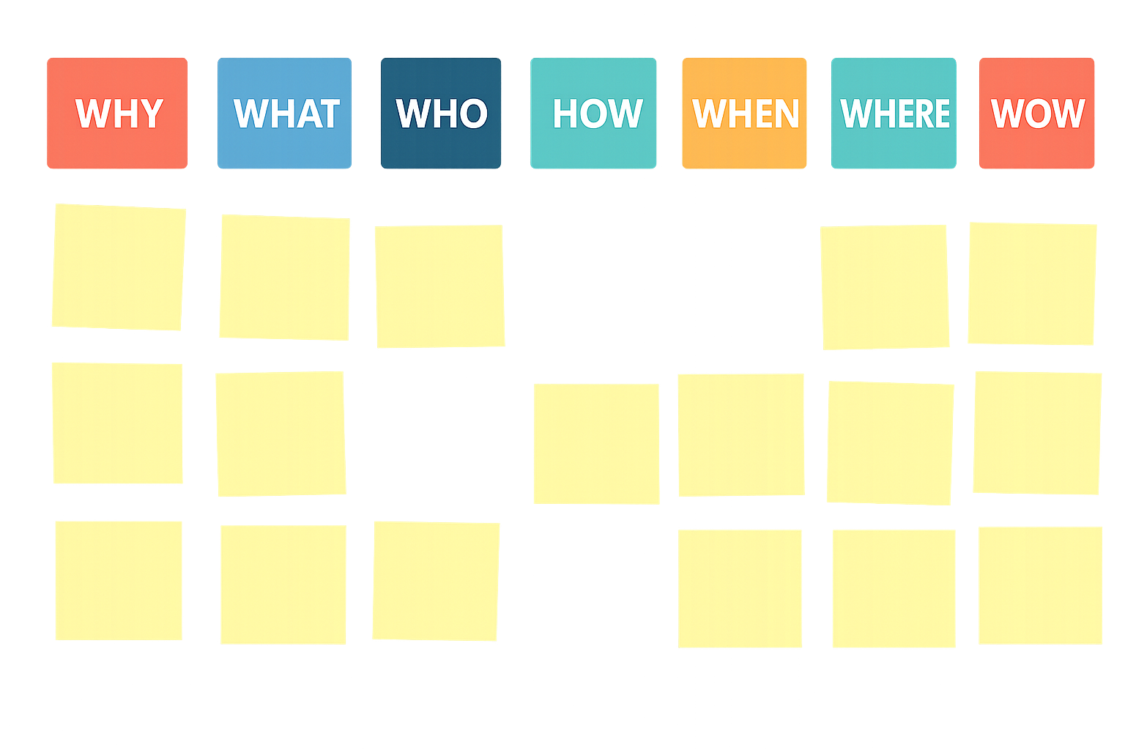
Step 4: Troubleshoot and Add
8Ws ensure comprehensive approach to covering all bases in brainstorming. In writing, the order of Ws matters for greater persuasion to make your sections compelling by design.
Reorganize ideas into 8Ws and find new gaps
Decide on how to tackle the un-addressed requirements
Fill in the gaps
Use AI in your transcription software to extract action items

Slide 59
Please, Complete an Assignment for Module 6 Prior to Proceeding to the Next Module

Slide 60
Module 6 Quiz
True or False? Stage 1 (Research, Brainstorming, Planning) should consume at least 40 % of your total proposal duration.
True b. False
Which of the following is not listed as part of Stage 1?
Brainstorming by yourself and with AI
Section planning and storyboarding
Writing your first full draft
Answering the “W” questions
Put these steps in the correct group-brainstorming sequence (enter numbers 1-4):
Generate Ideas without judgment
Warm Up with “stories of brilliance”
Organize and remove duplicate post-its
Troubleshoot gaps via the 8Ws
During “Troubleshoot and Add,” you reorganize ideas into the 8Ws. Which “W” is not one of the original eight?
Wow
Whom
Why
Where
You discover a critical requirement has no corresponding idea on your board. Your next move is to:
Skip it and hope you covered it in editing
Use your transcript and AI prompts to generate new bullets under the missing requirement and/or “W”
Assign it to the polishing phase for later
Remove a different idea to make room
Notes:
Question 1 Correct Answer: True Explanation: Stage 1—Research, Brainstorming, and Planning—lays the foundation for the entire proposal. Allocating at least 40% of your timeline to this phase ensures you fully understand the requirements, generate and organize ideas, develop graphics and possibly storyboards, and answer all the key “W” questions before drafting. Skimping on this stage leads to confusion and delay later in the proposal.
Question 2 Correct Answer: c) Writing your first full draft Explanation: Stage 1 is all about preparation—research, brainstorming (solo and with AI), section planning, storyboarding, and answering the “W” questions. Writing your first full draft belongs to the later Writing Phase (Stage 2), not the initial Planning Phase.
Question 3 Correct Answer: 1 – b) Warm Up with “stories of brilliance” 2 – a) Generate Ideas without judgment 3 – c) Organize and remove duplicate post-its 4 – d) Troubleshoot gaps via the 8Ws Explanation: A well-structured group brainstorm follows four clear steps: first, warm up and get creative; second, generate lots of ideas, including wild ones; third, organize those raw ideas into clusters and remove duplicates; and fourth, troubleshoot by weeding them, and mapping everything to the 8 Ws to find and fill any gaps.
Question 4 Correct Answer: b) Whom Explanation: The classic brainstorming “8 Ws” are: Why, What, Who, How, When, Where, and Wow. “Whom” is not one of them.
Question 5 Correct Answer: b) Use your transcript and AI prompts to generate new bullets under the missing requirement and/or “W” Explanation: If a critical requirement isn’t covered in your brainstorm, you shouldn’t postpone it or delete unrelated ideas. Instead, leverage your recorded transcript (or meeting notes) and AI to produce targeted content for the missing requirement or a “W” under that requirement. This keeps your plan compliant and complete before moving on to drafting.

Slide 61
Module 7 Stage 1: Research, Brainstorming, Planning Brainstorming Individually

Slide 62
Mind Mapping
Mind mapping can be fast by hand and digitized but you can use a variety of software packages and apps; Xmind and Mindjet are the best known and robust tools
Generated using Xmind

Slide 63
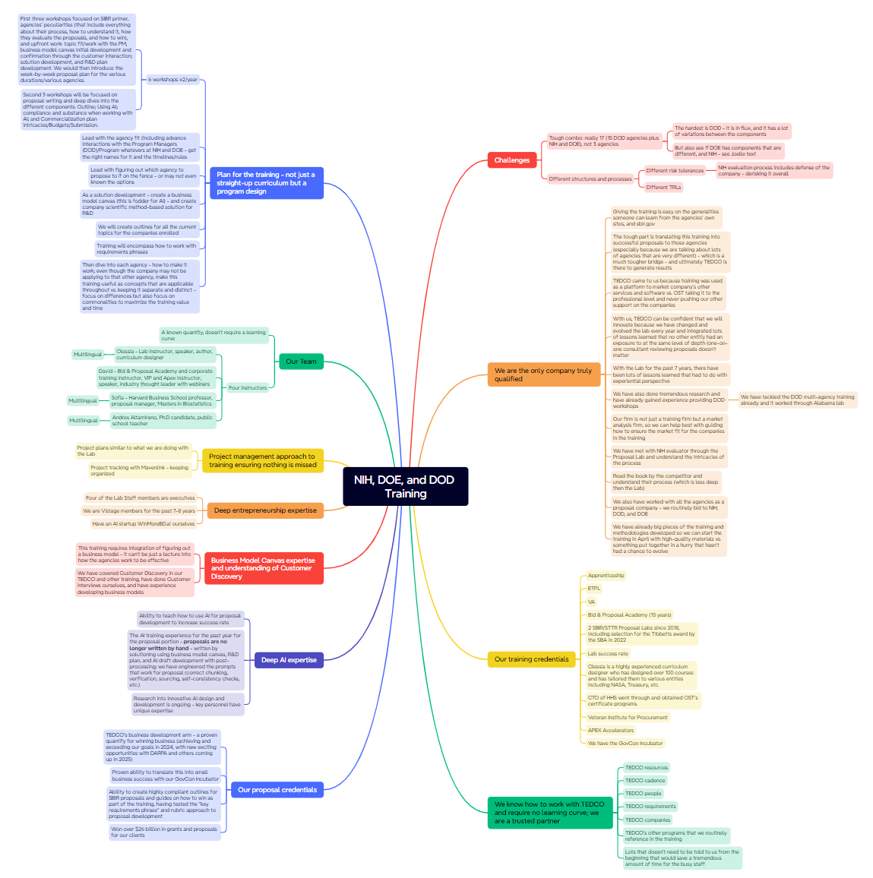
Proper Mind Mapping Techniques
Mind mapping captures the shortest-term memory in the front lobal parts of the brain – this is where the creativity resides; it’s like dreams you quickly forget
Place the paper in the “horizontal” format – it tricks the brain to feel there is more room
Don’t outline – draw a bubble, a line, or a rectangle to write your thought inside at random
Use the connectors to connect the thoughts – don’t write floating lists
Follow and capture thoughts naturally as they emerge – don’t outline
Relax and make random connections
Go quickly, don’t need to write everything out
Try different mind maps for same section – for example, the WHY and the HOW; try different settings and techniques
When ideas stop, ask: “what else?” Some of the most important ideas may emerge after you may think you are done!
Stop when ‘itching’ to write

Slide 64
Please, Complete Exercise 1 for Module 7 Prior to Proceeding to the Next Module

Slide 65
Module 7 Exercise 1: Mind Map Rekindling a Well-Forgotten Hobby (or a Picking Up a New One)
Try to have fun with this exercise even if it is hard to imagine that it could come true
Imagine you all of a sudden got one day a week freed up with a condition to dedicate it to a hobby you are not currently into
What hobby would you pick up?
Mind map what you would have to do to excel in this hobby?
Would you have to research anything?
Would you have to purchase anything?
Would you invite anyone to part-take in it?
What changes would you make in your life to fully embrace your hobby?
What resources would you require to fund your hobby?
Let your mind explore…
Take a photo and email your mind map to service@ostglobalsolutions.com
Notes:
Put your dogs in a kennel; pack…

Slide 66
UNiversal Organizer (UNO) – A Mind Mapping Alternative
Section
For those who just can’t get away from structuring – it’s how your brain works
Section
Support
Details
Subpoint
Key Point
Topic or Title

Slide 67
Examples of How UNO Can Be Used
Like any tool, make this tool work for you; here are a couple of ideas…

Slide 68
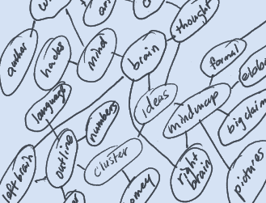
Another Alternative: Rico Clusters
Works when you don’t know what question to ask, or what exactly to address in the section
It is a web of related or interconnected ideas leading to one another, rather than ideas radiating out from a central concept that a mind map offers
Is intended to leverage the brain’s normal processes of communication between the right and left hemispheres
The idea is to work towards a kind of “critical mass,” where the language- and process-oriented left brain takes over from the visual- and pattern-oriented right
Once you start seeing the pattern, you can arrive at the question to ask
Think of the Hitchhiker’s Guide to the Galaxy:
What is the answer to Life, Universe, and Everything?
“42”
But what is the question?

Slide 69
Brainstorming with AI
Create a project where you can upload all the relevant documents for AI to reference
RFP instructions, evaluation criteria, statement of work, and other relevant documents
Capture documentation such as technical solution baselines
Capture intelligence on customer hot buttons
Win themes, etc.
Ask AI to be the solution architect.
Clarify the specific requirement to brainstorm on: Ex. “How to provide an on-site network-security test team that can surge to 95% staffing within 24 hrs?”
Continue your prompt—include goal, roles, technologies, success metrics: “Generate 5 distinct staffing-and-toolchain concepts for rapid network security testing that meet these objectives.”
Provide feedback, or explore ideas further: “How would we leverage automated ticket triage?”
Capture ideas that work in a separate document or a mind map; prune low-fit ideas
Deep-dive and detail by using the ideas you liked in a new prompt and ask AI for elaborations: “Drill into how we’d integrate a trouble-ticket API with our existing SOC dashboard” or “Outline training requirements to certify 10 network engineers in 2 weeks.”
Ask for pros and cons tables of different approaches
Validate and vet ideas by SMEs, and ask them to fact-check

Slide 70
Please, Complete Exercise 1 for Module 7 Prior to Proceeding to the Next Module

Slide 71
Module 7 Exercise 2: Mind Mapping a Proposal Section
This is an opportunity to try this approach on your brainstormed section – this is like brainstorming with yourself
Create the proposal section mind map using the case study to brainstorm on the solution
Read the Page 2 of the exercise handout to get details of the story
Make assumptions where you are missing information
Use your creativity, understanding that your brainstorming will help you write the section later
If you don’t know some facts, make documented assumptions or use AI to help you develop ideas
Alternatively, you can use UNO or Rico Clusters
AVOID looking at mind mapping as another way of outlining – let your thoughts fire at random and document
Take a photo and email your mind map to service@ostglobalsolutions.com

Slide 72
Module 8 Stage 2: Speed Writing

Slide 73
Stage 2: Writing
This is a “fast and furious” stage that should not take long; in fact, 20% of the time is overly generous and applies to really long pieces
If you are not ready to write, go back to research
Write as you would say it, say it out loud, say it simply
Do not write and edit
You cannot go back and correct until you finish the ENTIRE section
Type with your eyes closed or laptop screen bent back if tempted – just check periodically on your finger positioning because you could type a page of gibberish
It is important that you get raw ideas down on paper as fast as possible, without looking back

Slide 74
Where Stage 2 Fits in the Proposal Process
Predecessor: Capture Process
As you may notice, writing itself in the proposal lifecycle is limited to developing a complete first draft, that you can then rewrite, polish, edit, and perfect in other ways
Read RFP
Prepare for Kick-Off
Conduct Kick-Off to Reach 9 Goals
Develop Work Packages
Prepare Draft 1
Conduct Pink Team
Prepare Draft 2
Prepare Draft n
Conduct Red Team
Prepare Final Draft
Read-Out-Loud
Print, Check, Deliver
Implement Post-Delivery Win Strategy
Update Lessons Learned
Annotated Outline
Assignments
Work Packages
Compliance Checklist
Style Guide
Background Materials
Briefing
Pink Team Recovery
Outline Frozen
Red Team Recovery
Decision to proceed
Award
Make Bid-No-Bid Decision
Brainstorm & Research
In-Process Review(s)
In-Process Review(s)
DTP, Edit
DTP, Edit
Conduct Gold Team
Collect Lessons Learned
Attend Debrief
Integration Phase
Planning Phase
Writing Phase
Polishing Phase
Production
Phase
Post-Proposal
Phase
Successor: Project Delivery Process that Includes Capture of Additional Scope and Projects

Slide 75
MAIN SECRET: Allow Yourself to Be Imperfect
Don’t worry about the way your ugly cake of a section looks – you will have an opportunity to fix it later. The most important goal is to complete your section.
Allow yourself to enjoy the process of generating ugly writing like a toddler relishes getting wet and dirty in a muddy puddle!
Bake the cake all the way to the end. The uglier the cake, the better!

Slide 76
Remember the Simple Writing Rules
Most of these rules differ from what you may have learned at school; English language is alive and keeps changing
Write as you speak
Write in NOUNS and VERBS
Picture your evaluators reading
Use personal pronouns and short words
Contractions (don’t, can’t) are perfectly OK
Use simple transitions more often than long ones:
However -> but
As well as -> and
Additionally -> also
Nevertheless -> still
Consequently, therefore - > so
You can use transition words (And, But) to start sentences!
Just write your section without editing or looking back

Slide 77
Please, Complete an Assignment for Module 8 Prior to Proceeding to the Next Module

Slide 78
Module 8 Quiz
True of False? Stage 2 (“Writing”) should take at least 50 % of your proposal schedule. a. True b. False
If you catch yourself editing mid-draft, you should:
Delete everything and start fresh
Type with your eyes closed or screen bent back so you can’t see the words
Slow down and polish each sentence right away
Switch to another section and never return
True of False? You should take professional pride in making sure that every paragraph you produce as a first draft is perfect right away.
a. True b. False
True of False? When you’re not ready to write, it’s better to jump straight into editing existing text than to revisit your research or outline. a. True b. False
According to the Simple Writing Rules, which of these is not recommended?
Starting a sentence with “And” or “But”
Using short, conversational phrasing
Packing every sentence with large, fancy adjectives
Using personal pronouns when appropriate
Notes:
Q1: False Explanation: Stage 2 (“Writing”) is intended to be the “fast and furious” draft phase, not the bulk of your schedule. Best practice is to allocate about 20 % of your total proposal timeline to writing the first draft—and even that is generous for shorter sections. The bulk of time (at least 40 %) should go to Stage 1 (research, brainstorming, planning), with the remaining 40 % for polishing, reviews, and production.
Q2: B) Type with your eyes closed or screen bent back so you can’t see the words Explanation: The goal during Stage 2 is to get raw ideas down without self-editing. Physically hiding your own text—by closing your eyes or angling the screen—prevents the temptation to polish mid-draft. You’ll catch typos and refine language later in the dedicated editing phase. Just make sure that you check periodically that your fingers are on the right keyboard keys so that you don’t mis-key your text.
Q3: False Explanation: Your first-draft paragraphs do not need to be perfect. In fact, perfectionism during drafting causes unnecessary delays and writer’s block. Embracing imperfection—getting your thoughts on the page quickly—allows you to refine and polish later in dedicated editing phases using AI and human curation, which will significantly speed up your writing.
Q4: False Explanation: If you’re not ready to write, jumping into editing existing text often leads to aimless tweaks and stalls. Instead, revisit your research, outline, or brainstorming outputs so you can draft with confidence, ensuring your writing remains substantive and aligned with requirements.
Q5: c. Packing every sentence with large, fancy adjectives Explanation: The Simple Writing Rules advise clear, conversational prose built on strong nouns and verbs. Overloading your writing with elaborate adjectives and adverbs clouds clarity and dilutes impact. Instead, favor short words, contractions, personal tone, and simple transitions to keep your proposal direct and reader-friendly.

Slide 79
Module 9 Element 3 of the Speed Writing System: Tools

Slide 80
AI-Enabled Brainstorming
Try various AI platforms – from specialized proposal tools to general AI
Each AI has its own personality and voice – try all of them
AIs get “nerfed” to reroute compute to other tasks – don’t hesitate to switch models and platforms if you are not getting the smartest answers
Use AI to generate diagrams, graphics, and icons
Have AI troubleshoot AI-generated approaches
Ask questions as if you were asking a SME

Slide 81
Use Voice to Text Apps
Voice to text app in Windows – Windows Key + H
Use Dragon Anywhere app or Dragon Naturally Speaking desktop software for more accurate dictation
Use Otter.ai or Fireflies.ai (or similar app) for capturing full sentences without having to add punctuation
Interviews
Brainstorming
Provide the rough material to AI to turn it into section text

Slide 82
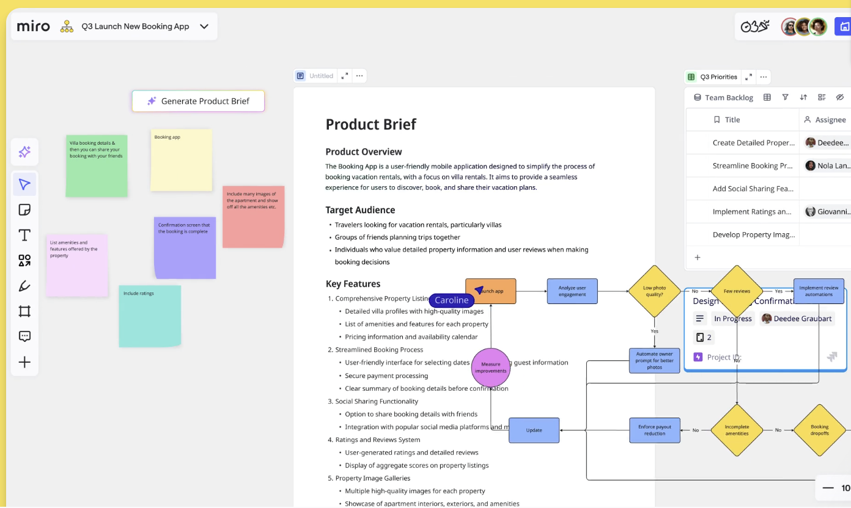
Virtual Brainstorming Tools
Use Miro Board, Microsoft White Board, Trello, Asana, Mural, Lucidspark, Stormboard, Google Jamboard, or similar tools for virtual brainstorming
Look for a tool that enables the team to have brainstorming capabilities on hand:
Sticky notes
Mind maps
Flowcharts
Kanban boards
Freehand drawing (whiteboarding)
AI-assisted idea clustering

Slide 83
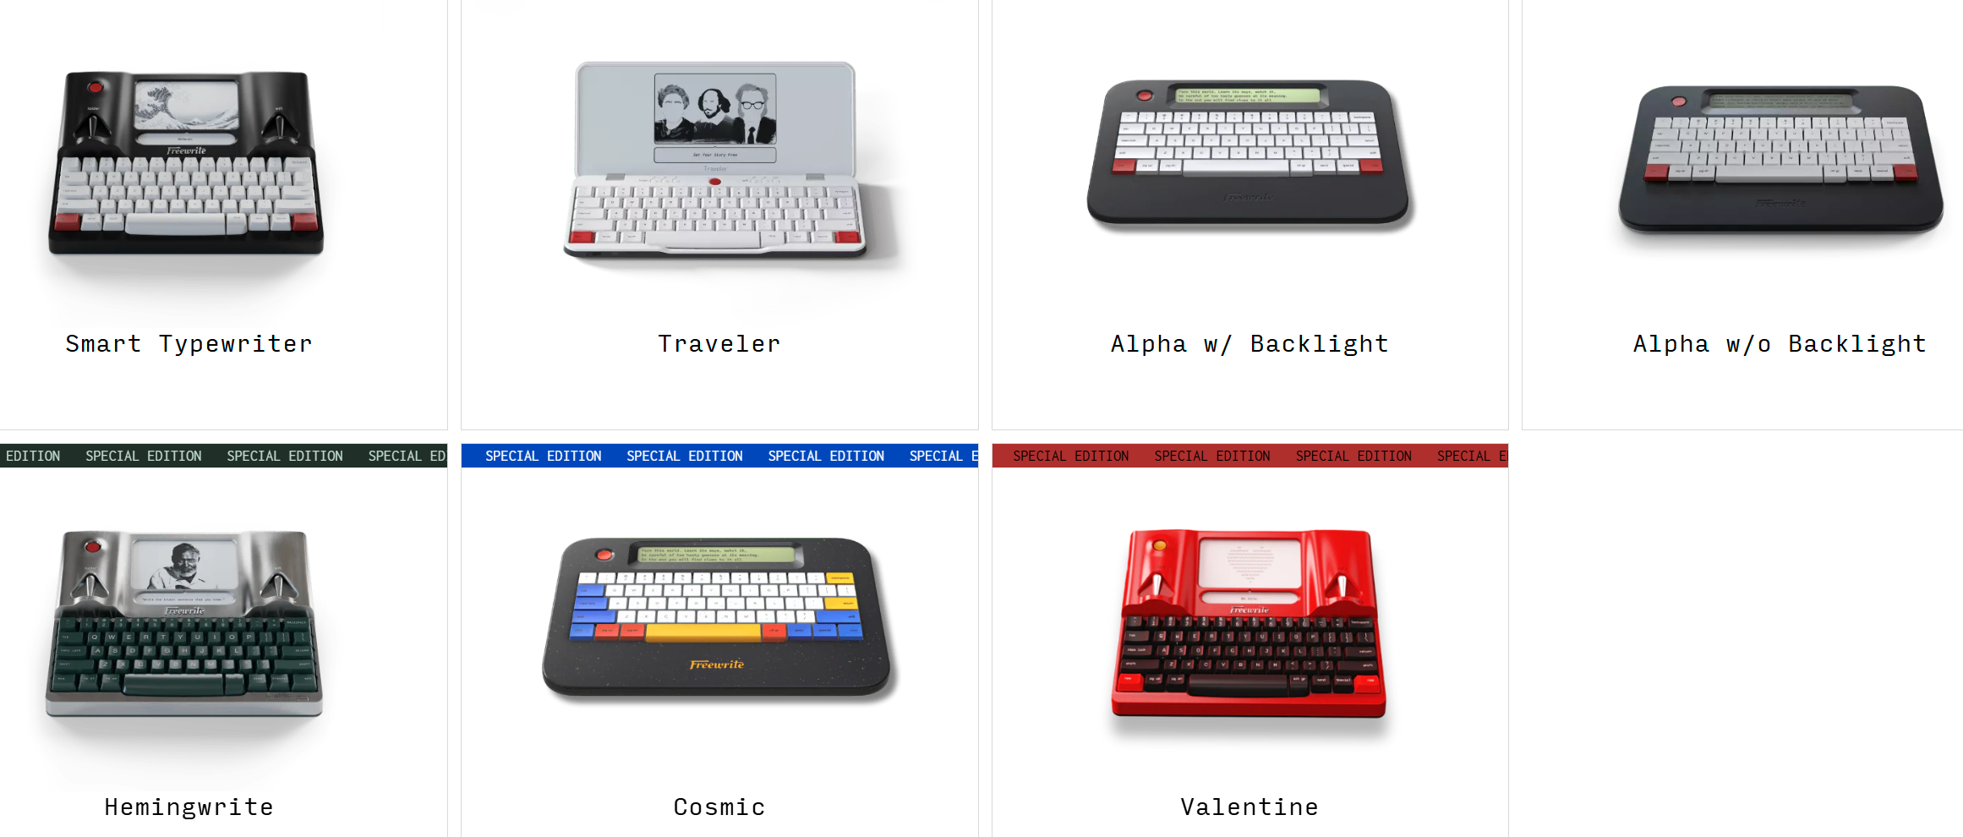
Writing Tools for Those Who Think Best While Typing
FreeWrite Devices
Write without looking and editing – but see enough to ensure you are not miskeying
No distraction
https://getfreewrite.com

Slide 84
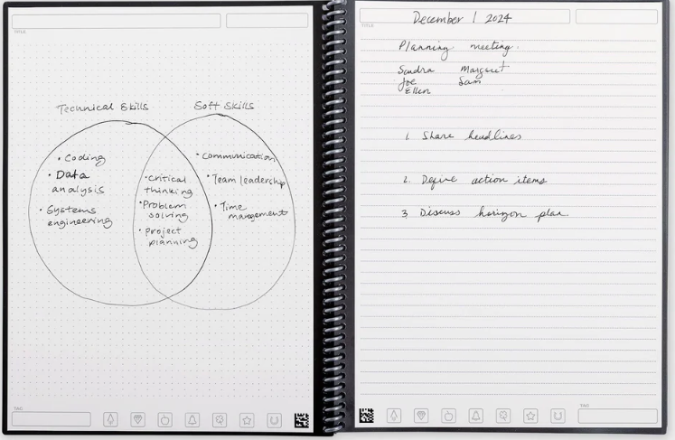
Writing Tools for Those Who Write Best by Hand
Handwrite your sections so that you are not distracted, you don’t rewrite, and don’t have a back button
The notebook provides a classic pen and paper experience, but is built for the digital age
The notebook feels traditional but is endlessly reusable and connected to your cloud services
Use any pen from the Pilot Frixion line for your writing to stick to pages like regular paper; add a drop of water to erase everything
Your writing is transcribed into text you can edit in Word
https://getrocketbook.com/

Slide 85
Please, Complete an Assignment for Module 9 Prior to Proceeding to the Next Module

Slide 86
Module 9 Exercise: Write the Mind Mapped Section
This is where everything you have done today comes together; feel free to use the tools provided
Start with prioritizing your mind map
Write the section that you have mind mapped using Word, voice to text plus editing or AI
Do not edit or wordsmith at all – promise you can do it later
You have to complete the entire section (bake the cake all the way)
Email your sections to the instructor at service@ostglobalsolutions.com

Slide 87
Recap
?
Let’s go over today’s material
Which technique for changing unhelpful beliefs about writing resonated with you the most?
What are the three key elements of the proposal speed writing system and why are they important?
Why are there three stages in the proper writing process, instead of just writing?
What brainstorming tips are you going to adopt?
Did you find the mind mapping process helpful in developing your first draft?
What is the biggest take-away from today’s class?

Slide 88
Thank You! Continue Taking More Courses to Advance Your Knowledge!
7361 Calhoun Place, Suite 560
Rockville, MD 20855
Phone: 301-384-3350
service@ostglobalsolutions.com
www.ostglobalsolutions.com

