Slide 1
Writing Persuasive Federal Proposals
Day 2
OST Bid & Proposal Academy Course
www.ostglobalsolutions.com

Slide 2
Agenda
09:00 – 10:30 AM Training
10:30 – 10:45 AM Break
10:45 AM – 12:00 PM Training
12:00 – 01:00 PM Lunch Break
01:00 PM – 02:45 PM Training
02:45 PM – 03:00 PM Break
03:00 PM – 04:00 PM Training
04:00 PM – 05:00 PM Flex
Please, give yourself the benefit of focus and limit email and use of cell phones to breaks

Slide 3
Module 10 Overcoming the Writer’s Block

Slide 4
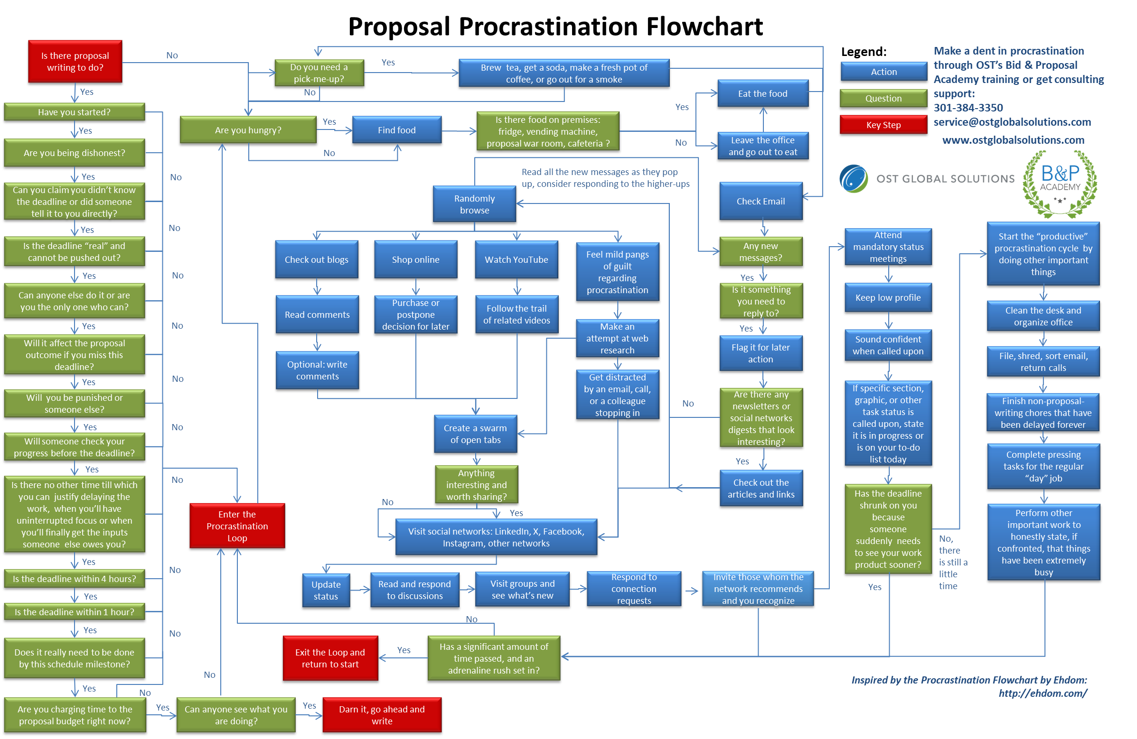

Slide 5
So, How Do You Break Free from the Writer’s Block and Even Help Your Proposal Team?

Slide 6
Take Advantage of the Mind-Body Connection
It is easy to get “glued” to your desk, but your mind is highly dependent on your physical state
Stimulate your physical state
OR
+
Give yourself a massage to improve circulation
Do stretching exercises or have a “movement snack”
Do breathing exercises (try box breathing 5 in - 5 hold – 5 out)
Go for a walk or run – repetitive motion and circulation work miracles
If all else fails…
Get a backrub

Slide 7
Do Not Succumb to Going Stir-Crazy
Changing the environment is your friend if you are stuck
Get away from the routine
Get away from working behind your desk
Work outside
Work at a coffee shop or cafeteria, keeping part of your mind busy with the ambient noise
Work from a library
Create a “zen” workspace and focus without any distractions
Just avoid the danger of falling asleep
Don’t kid yourself if you are not much of a self-motivated worker; get a “body double”

Slide 8
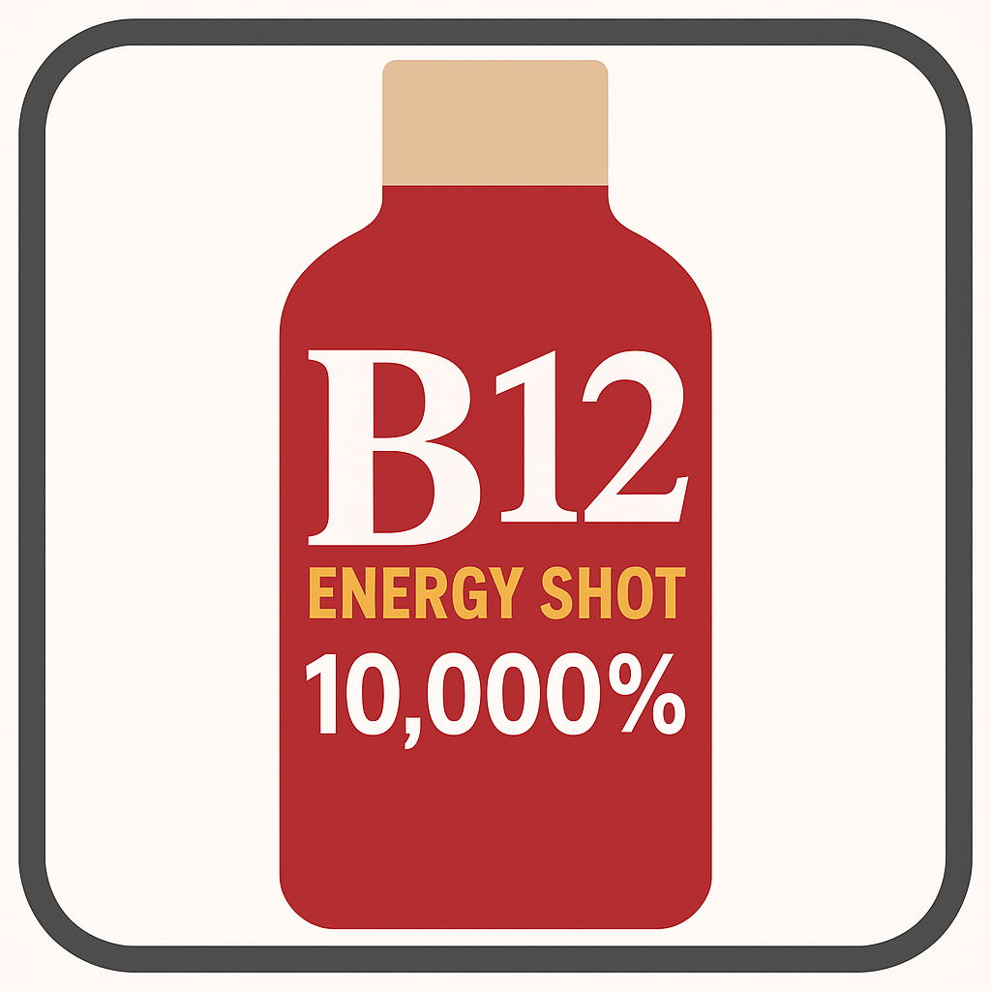
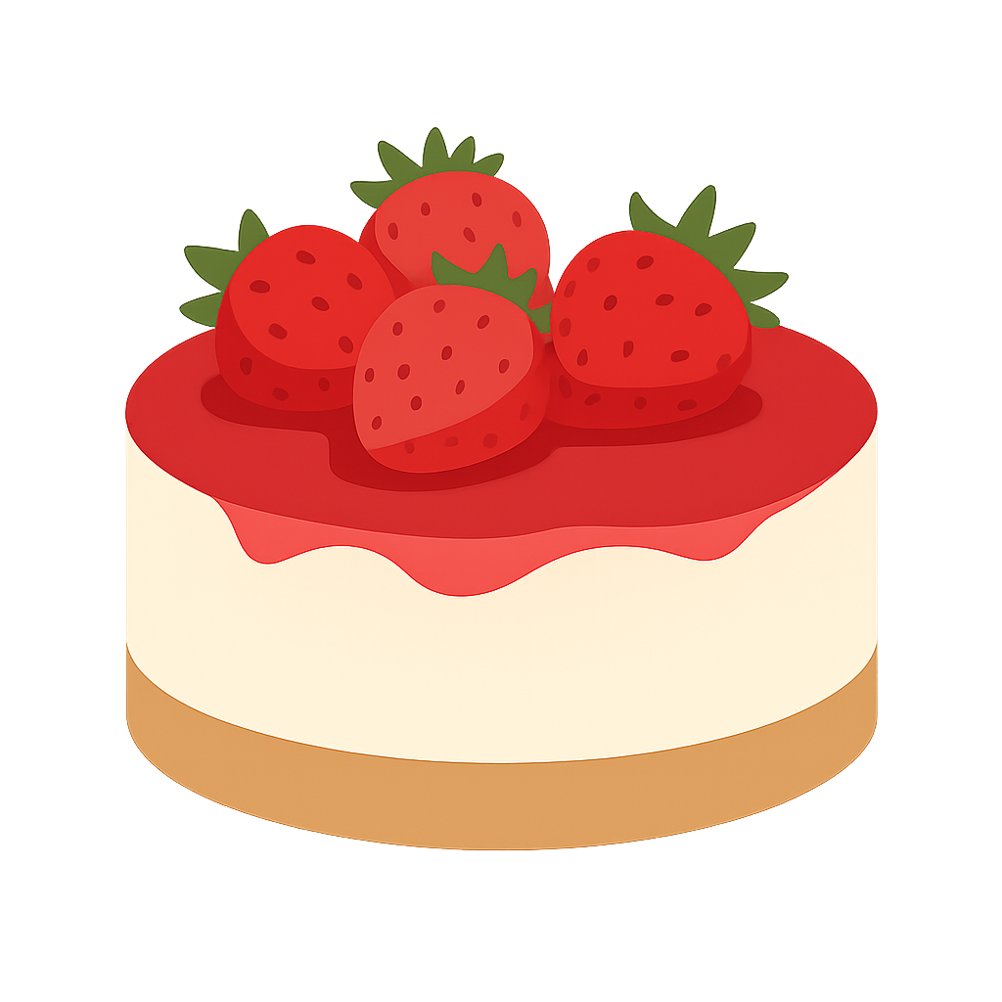
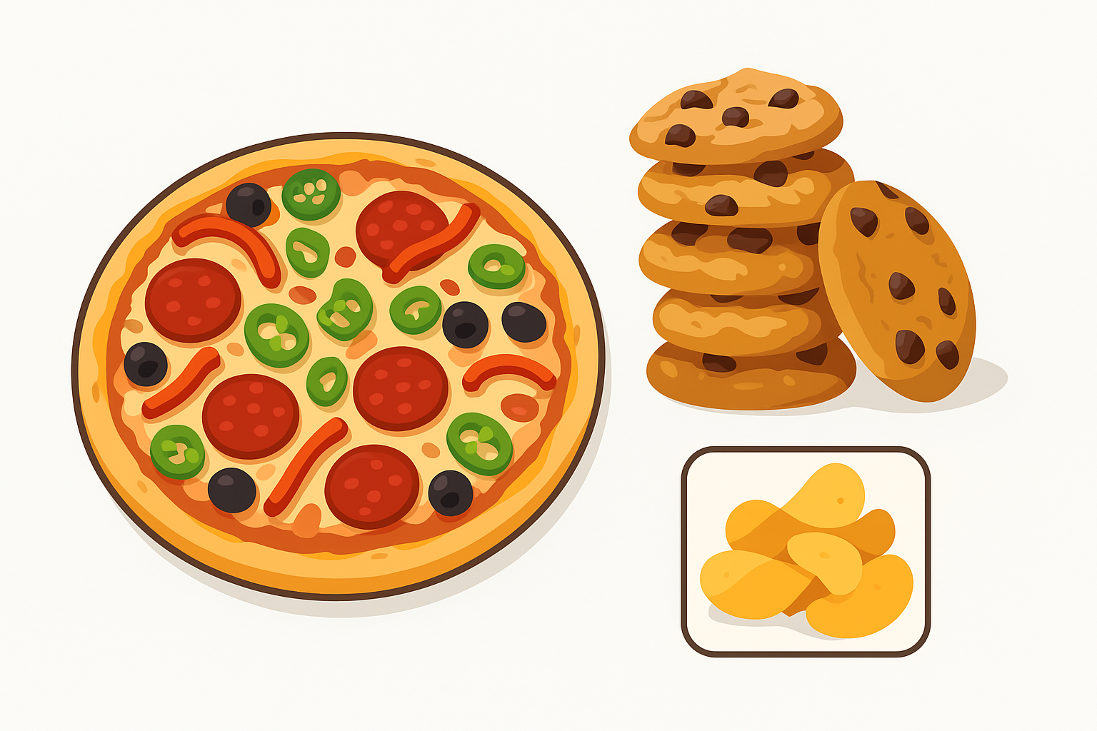
Alter Your Blood Chemistry the Healthy Way
(Or almost healthy, depending on whom you ask)
Get energy foods to alter your state
Pick a “healthier” energy boost if you need one
Eat a high-protein, low-sugar snack
Assign
rewards and
consequences
Avoid these proposal staples

Slide 9
Trick Your Mind that You Are Not Writing a Proposal
Believe it or not, playing tricks on your mind really works – especially for highly intelligent people like you!
Controlling your own mind is a serious strength
Write by hand
Dictate into a voice to text app
Pretend you are writing an email to a friend
Start writing in the middle or the end
Recruit a family member to interview you
Pretend you called your friend to report a juicy gossip

Slide 10
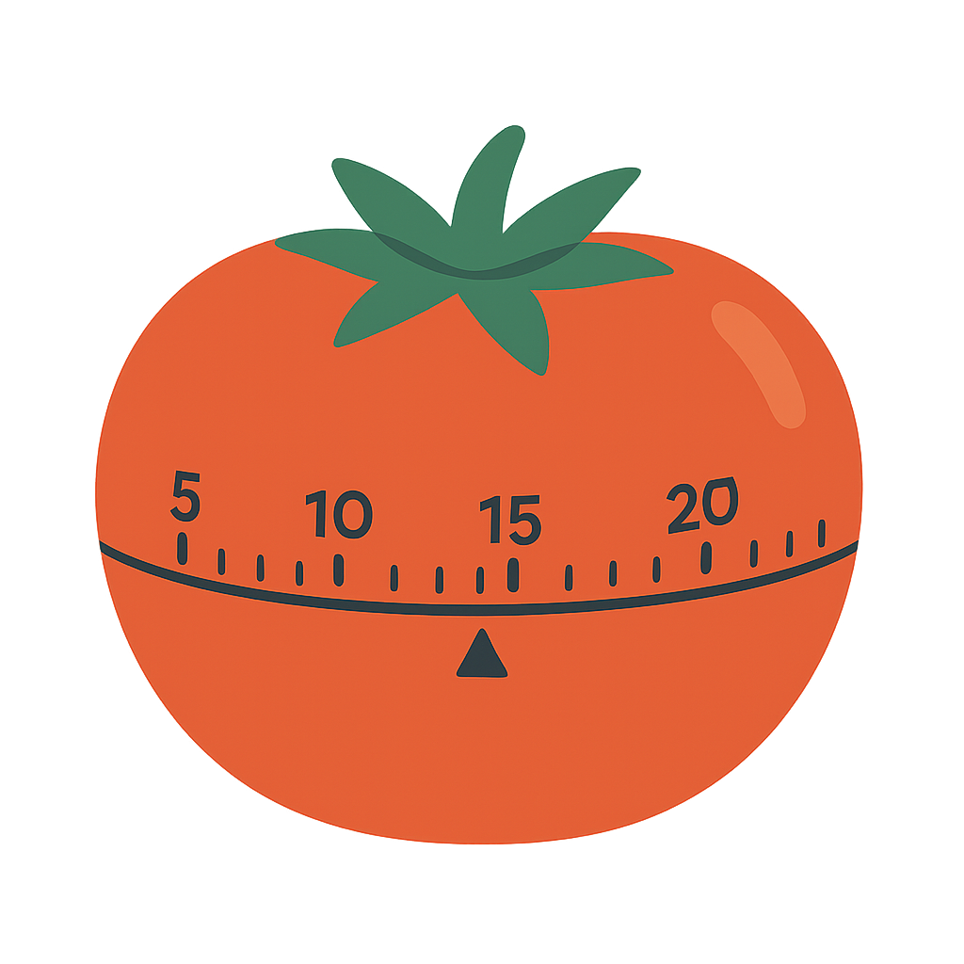
Manage Your Writing Time
Purchase a simple kitchen timer, or use a timer app on your laptop or smart phone; a kitchen timer ticks so it may be a helpful extra cue for you to hurry up and write
Stop dreading proposal writing because it should NOT take you hours
Productive writing is done in smaller chunks of time
15-20-minute intervals work best for intense writing without checking email or answering phone calls
It is another way to trick your mind
You will have an easier time starting since it’s no longer a daunting task
Sometimes you will not want to stop because you will be too into it

Slide 11
Please, Complete an Assignment for Module 10 Prior to Proceeding to the Next Module

Slide 12
Module 10 Quiz
True of False? The rhythm of the repetitive movement of walking helps us relax our mental state, which in turn helps us overcome the writer’s block.
a. True b. False
What is NOT helpful to combatting writer’s block?
Finding a place to work that’s different than one’s desk.
Eating a rich, calorie-packed meal followed by a sweet dessert.
Doing breathing exercises and stretches.
Working at a treadmill desk.
Postponing work until the inspiration hits.
b and e.

Slide 13
Module 11 Proposal Persuasion

Slide 14
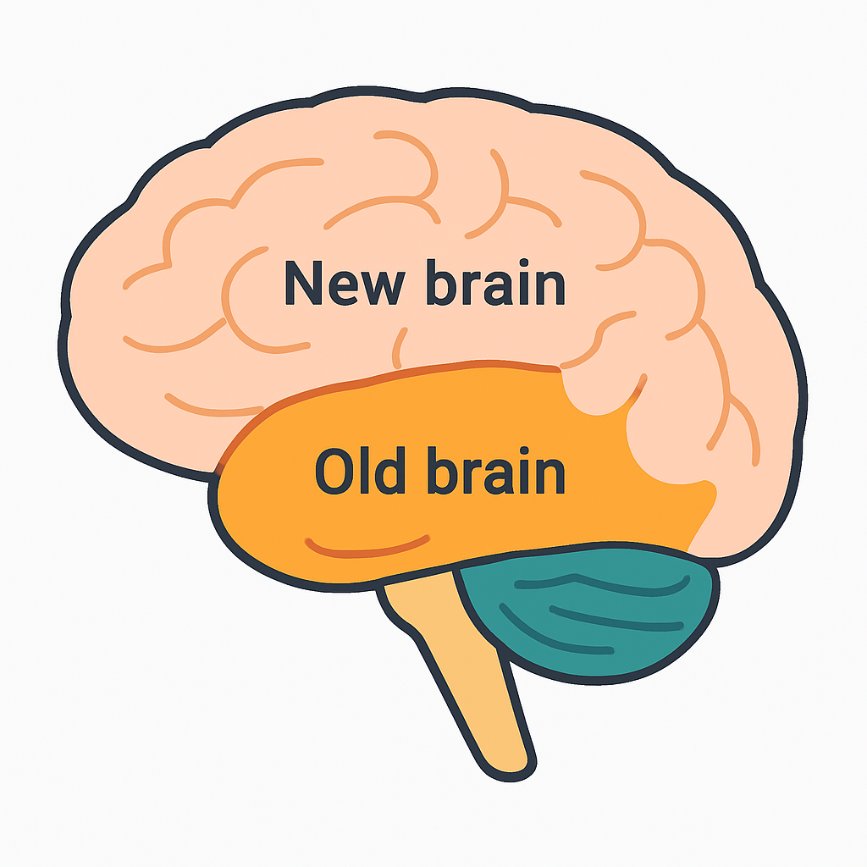
The Art of Persuasion is Based in Neuroscience
Most proposals bore to tears, annoy through excessive bragging, or insult with a tutorial on something the customer already knows – but fail to persuade
The “Old brain” (reptilian + limbic systems) controls survival-driven, fast decisions; the “New brain” (neocortex) handles analysis and logic
People are emotional buyers: the old brain makes the buying decision quickly
People with damage to the part of the frontal lobe that processes emotions (or “listens” to them) often struggle with making even routine decisions
That’s with IQ, memory, learning, language, and other capacities intact!
Logic is there to justify the emotional decision, to different degrees with different people and cultures
Much of the traffic between the old and modern parts of our brains is devoted to the conscious calculation of risks and rewards, relying on past experiences
Prestige, security, and career are at stake
Key drivers are the desire for gain and fear of consequence and failure; the fear is a much stronger driver

Slide 15
Let’s Dive into the Human Brain
Open with WHY, preferably focused on the threat of loss or missed opportunity to activate attention.
Repeat win themes, be consistent in text and graphics treatment, use consistent proof points, use the project team the customer knows and likes.
Back claims with data and logic but put this after emotional hook.
Amygdala (Limbic): Processes fear, threat, and emotional memory; evaluates threats and guides gut reactions before logic kicks in.
Prefrontal Cortex: Rationalizes emotional decisions. Manages emotional and social behavior, and controls thinking and decision-making. Solves problems creatively. Shortest-term memory resides in the frontal lobe.
Basal Ganglia: Loves consistency, repetition, familiarity, comfort in habit and routine.
Use compelling visuals including graphics, tables, focus boxes, and layout.
Guide evaluator focus: use layout, headers, and early priming to tell evaluators what to pay attention to. Make relevance unmistakable.
Occipital Lobe: Processes and makes sense of visuals - graphics.
Hypothalamus: Regulates hormones and emotions. Drives urgency and motivations—especially tied to reward, pleasure, status, safety, and risk avoidance. Filters sensory input and prioritizes what to focus on.
Use past performance stories, success case studies, lessons learned, and familiar customer-centric vocabulary and imagery.
Hippocampus: Bridges old brain and long-term memory. Influences decisions based on past experiences and success stories.
Strike the right tone through the “right proposal language.” Improve proposal readability. Tell stories and use metaphoric language.
Address risk reduction proactively. Don’t overwhelm—chunk your message and maintain visual clarity.
Temporal Lobe: Understands sounds, language, and stores memories. This is where language meets meaning. Involved in comprehending stories resulting in high persuasion.
Brainstem: Triggers the fight, flight, freeze, or fawn response in high-stress or life-threatening situations. Too much clutter fatigues evaluators.

Slide 16
Understanding Your Customer’s Motivating Factors
Neuroscience and neuromarketing are highly relevant to writing proposals
Drivers
Government evaluation board is composed of individual people with different drivers
Unconscious mind – not conscious mind – drives how evaluators respond to proposal content outside compliance
Underlying issues will drive people to emote on specific subjects they find particularly near and dear: we must understand everyone’s hot buttons:
Hopes
Fears
Biases
We must also understand the underlying emotional drivers
Satisfying people’s drivers, while not setting off “alarms” in their head is key to persuasion
Cost, risk, schedule
Compliance with regulations
Customer satisfaction
Quality
Public welfare
Leaving a legacy
Competitive positioning
Thoroughness
Formality
Innovation
Reputation
Politics
Career and personal goals
Organizational goals and
priorities, etc.

Slide 17
Proposal Language: What Sells
Customer knowledge comes first, but skillful writing will translate this knowledge into a winning proposal
Scientific writing approach
Matching the solution with the customer’s requirements and vision
Journalistic method of writing applied to proposals (grab the reader with the main point first)
Speaking customer’s language
Win themes with targeted features and benefits, and a clear value proposition
Use of graphics
Stories, with visual or written metaphors
Overwhelming proof and clear facts
Correct tone – sincere, confident, credible
DETAILS
MAIN POINT
MAIN POINT
DETAILS
Journalistic/Proposal writing approach

Slide 18
Proper Structure of the Argument (Recap)
Here is how the psychology of persuasion works and why the Ws are ordered the way they are
Higher level summary sections - X or X.X outline levels
Generates curiosity, scares, or shows deep understanding
Why: Customer problem, challenge, or key risk factor behind the requirement
Provides the answer rather than restating the requirement
What: What do we propose to do in response to the requirement?
Gives specifics rather than passive voice, your company’s name, or a generic “we”
Who: Who exactly is going to do this part of work, by name and title?
Builds confidence in that you know what you are doing
How: Step-by-step approach with benefits to the customer and risk mitigation
Provides more details or builds proof
When: In what sequence we are going to do it per schedule, or when have we done it before?
Provides more details or builds proof
Where: Indicate the location or facility, or say where we have done it before successfully
Brings your point home
Wow: Powerful section conclusion

Slide 19
Please, Complete an Assignment for Module 11 Prior to Proceeding to the Next Module

Slide 20
Module 11 Quiz
Evaluators will use pure logic and reasoning to score your proposals as there is no room for feelings and emotions in the field of proposal evaluation.
True b) False
Journalistic writing means:
Main point first, details last.
Details first, main point last.
Put the Ws in the order of a persuasive argument:
____ a. What
____ b. Why
____ c. How
____ d. Who
____ e. Where
____ f. Wow
____ g. When

Slide 21
Module 12 Telling Proposal Stories

Slide 22
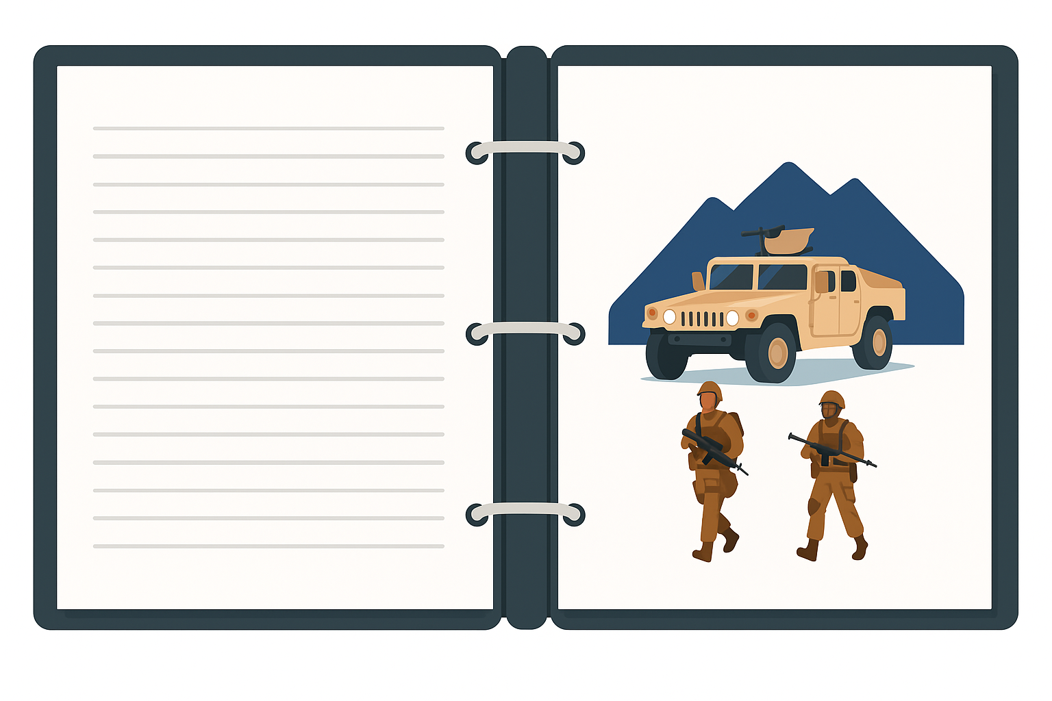
Story Makes Boring Proposal Writing Come Alive
Many can’t think of how to tell stories in proposals – yet a good story could become what differentiates your proposal from all the others an evaluator reads
It is all about a good story in modern marketing and sales
Every story must have 3 parts or it’s boring:
Beginning – where, when, who
In a kingdom far, far away, a long time ago, a beautiful princess…
Complication (challenge, problem, risk)
Was thrown in a tower by an old wizard and guarded by a dragon
Favorable resolution
A handsome prince slayed the dragon, rescued her, they fell in love, and lived happily ever after
Look for real life applicable anecdotes: interview project personnel
Mind map to develop a lead sentence to hook in the readers

Slide 23
Types of Stories You Can Tell in a Proposal
Proposal stories work best when all the stories and their elements reinforce and build on each other, and all lead to the same conclusion – to select you
If you are an incumbent, use “horror” stories scaring the customer into selecting you – show how things would break down if it weren’t for you
For types of proposal that have to do with health, safety, or security, try drama and tension – the story in the beginning with the outcome towards the end, using your solution
Tragedy could be why you are passionate about what you do or a lessons learned story and how it made you stronger and better fit for the project than any other competitor

Slide 24
More Proposal Stories
Be very careful not to insult customer’s own management and don’t claim all the credit if the customer helped
Anecdotes on past performance – what happened on a similar project in similar circumstances may be the inspiring story of overcoming challenges, and triumphing over the hardest of circumstances
In an executive summary or throughout the proposal when describing the solution, you may want to use one of the techniques that pertains to science fiction: describe a future result of your work that transforms the customer
Try the “before” and “after” story
In a research and development proposal, it may be a mystery – defining the challenging problem and showing how you could find the solution

Slide 25
And More…
Be as creative as you can and don’t hesitate to experiment
A case study with anecdotes and examples
A hypothetical example demonstrating the application of your solution
A story about what some of the steps in your process mean, why they are necessary in the first place, or how come you have added them – what problems are they meant to prevent?
A positioning story of you versus your competitors – where do you stack against them, and how you are better
A strong metaphor – a comparison with something similar to illustrate a point

Slide 26
Please, Complete an Assignment for Module 12 Prior to Proceeding to the Next Module

Slide 27
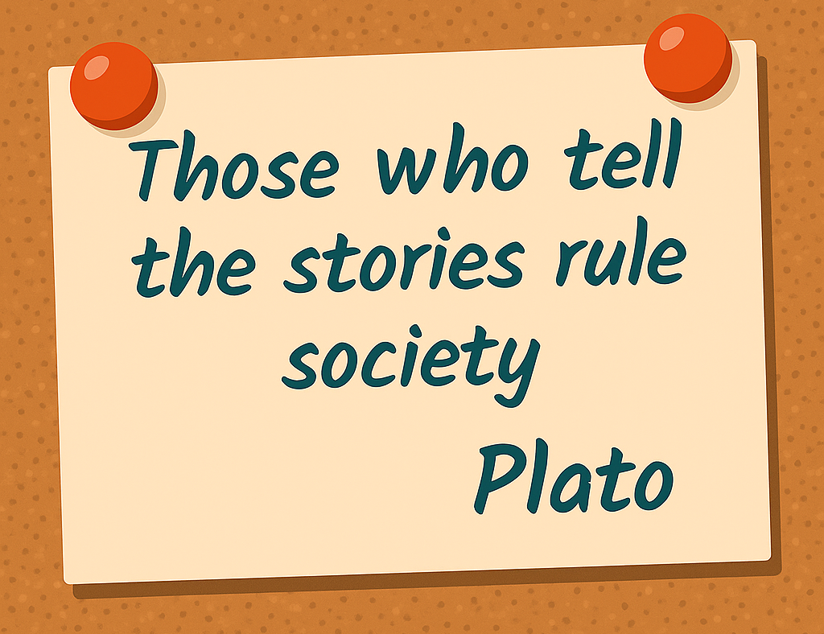
Module 12 Exercise: What Story Could You Tell?
This exercise has two parts: a warmup remembering the stories you told in proposals before (one per group is enough) and then getting creative and developing a story for your practice section.
Discussion:
What stories have you told before on proposals?
What story could you tell in your practice section?
Email your response to service@ostglobalsolutions.com

Slide 28
Module 13 Creating a Mental Picture Through Metaphor

Slide 29
Metaphor Creates Mental Picture
We use metaphors daily but most of them are so common-place we don’t notice them; many are cliché
A picture is worth a thousand words, but a mental picture is worth a thousand pictures
Say the word “circus” and experience it as a proof of this statement – it is loaded with images and feelings
We remember:
20% of what we hear
80% of what we hear and see
95% of whatever we hear or see when the images are vivid and tap into emotional memories
Information + Metaphor = “I see what you mean!”
Anne Miller, Metaphorically Selling

Slide 30
Types of Metaphors
There are technical names for different metaphors that are not that important for practical purposes; what’s important is how different metaphors work
Direct substitution – Our Capture Manager is the ‘Gary Kasparov’ of strategy
Substitution using “like” or “as” – Cyber terrorism is like toxic fungus or mold on steroids – if we don’t get protection and proactive measures in place to combat it, it will quickly destroy our house and undermine our health. This is why we have a two-prong approach to combating cyber terrorism – not only the security measures to defend us, but the proactive counter-terrorism group to run an offensive before an attack erupts.
Multi-level comparison –analogy that hints at multiple parallels:
Shooting an Elephant, an essay by George Orwell, uses the experience of hunting an aggressive elephant in Burma as a metaphor for British Imperialism. Starting each phrase with "some" creates a parallel structure that reinforces how easy it is for observers of the same event to have entirely different opinions.
"Some of the people said that the elephant had gone in one direction, some said that he had gone in another, some professed not even to have heard of any elephant."

Slide 31
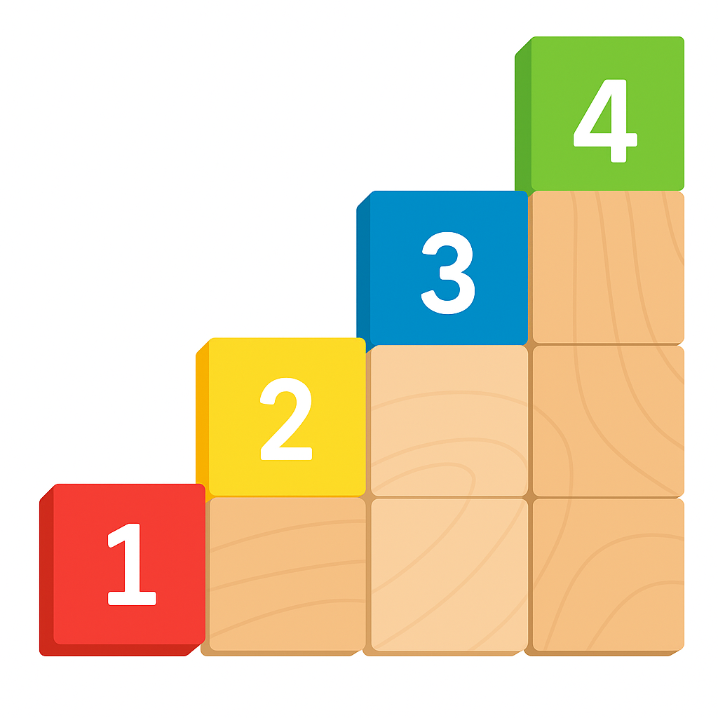
How to Build a Metaphor
Book recommendation: Anne Miller’s “Metaphorically Selling”
Anne Miller’s Four Steps:
Determine your customer’s potential blind spot
Identify some area where they could potentially underestimate or trivialize your understanding or approach, or not want to pay for something extra that’s much needed
Snapshot the customer
Which analogy would work well for them: sports, famous personalities, cars, kids, current events, etc.
Create Comparison
What analogy could you use from the snapshot to eliminate the blind spot?
Relate Back to Situation
Make sure you complete your metaphor with explicit explanation of why your analogy works to describe the situation – make it obvious to ensure your analogy is understood correctly

Slide 32
Some Important Metaphor Rules
Practice your “metaphor muscle” on a regular basis to develop it for proposal purposes
Relate objects to objects, verbs to verbs, events to events, etc. – mixing objects with actions is confusing
Make sure that the reference is not obscure or you are certain the person you address knows what you are talking about
For example, not everyone knows Gary Kasparov
Ensure your reference is not offensive or vulgar

Slide 33
Example of Mind Map to Build the Cyber Terrorism Metaphor

Slide 34
Please, Complete an Assignment for Module 13 Prior to Proceeding to the Next Module

Slide 35
Module 13 Exercise: Create Your Own Metaphor
It may seem like a tough exercise but try to have fun with it
Determine – what would your “customer” under-appreciate in your section?
Pick a “customer”; you will snapshot the “customer” by using a hobby picked for the mind mapping exercise in Module 7
Tip: You may pick the “customer” based on the hobby that’s easier to use for a metaphor
Create a comparison (metaphor) using a mind map
Relate it back to the situation – why does this metaphor work?
Write out the metaphor

Slide 36
Module 14 Stage 3 of the Proposal Writing Process: Rewriting, Restructuring, Editing, and Polishing

Slide 37
Stage 3 of the Correct Writing Process: Rewriting, Restructuring, Editing, Polishing
We are finally up to Stage 3 of the writing process – you are now getting ready to improve and polish your section
Huge relief to the left-brainers
Hardest type of editing: rewriting, restructuring, and adding compliance-related topics and language
Other editing can be automated: sentences, tenses, grammar, spelling
Can edit in any order
If editing your own section, walk away from it for a period of time (the longer you can afford, the better)

Slide 38
Where Stage 3 Fits in the Proposal Process
Stage 3 starts with the second draft, and ends when making the final tweaks to formatting while printing the final version
Predecessor: Capture Process
Read RFP
Prepare for Kick-Off
Conduct Kick-Off to Reach 9 Goals
Develop Work Packages
Prepare Draft 1
Conduct Pink Team
Prepare Draft 2
Prepare Draft n
Conduct Red Team
Prepare Final Draft
Read-Out-Loud
Print, Check, Deliver
Implement Post-Delivery Win Strategy
Update Lessons Learned
Annotated Outline
Assignments
Work Packages
Compliance Checklist
Style Guide
Background Materials
Briefing
Pink Team Recovery
Outline Frozen
Red Team Recovery
Decision to proceed
Award
Make Bid-No-Bid Decision
Brainstorm & Research
In-Process Review(s)
In-Process Review(s)
DTP, Edit
DTP, Edit
Conduct Gold Team
Collect Lessons Learned
Attend Debrief
Integration Phase
Planning Phase
Writing Phase
Polishing Phase
Production
Phase
Post-Proposal
Phase
Successor: Project Delivery Process that Includes Capture of Additional Scope and Projects

Slide 39
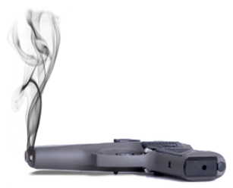
Language That Kills Persuasion
Unfortunately, all of these “killers” are common in proposals
Most adjectives and adverbs (superlatives)
“Premier”
“World class”
“Seasoned”
“Experienced”
Adjectives and adverbs make your proposal “salesy”, insincere, and suspect; the effect is just the opposite of engendering trust
They are overused and not believable
“We will leverage our experience…”
Explain exactly what you will do and how the past experience will be useful – don’t leave it as an empty claim like most proposals do or it will come across salesy
“We understand…”
Most proposals state that you understand something, and move on to the next topic – creating an unsubstantiated claim
If the understanding is demonstrated, you don’t need to say “we understand”
Best of breed or class
Industry leader, leading provider
Leading or cutting edge
State-of-the-art

Slide 40
More Words to Avoid Using in a Proposal
Rounding off or approximating quantities
Approximately $1 million in savings
Impersonal language
Too much technical jargon
Generalizations and statements not backed by facts and details
A number of, some, Multiple, Many, Several, Numerous, myriad, etc.
Philosophical ruminations
Our philosophy is to recognize every employee for their achievements…
We value…
Our mission is to…
We are dedicated to…
We believe, feel, think
It goes without saying that…
Persuasion is authenticity, authority, and passion that come from stating how your expertise will benefit the customer and citing the facts to prove it

Slide 41
Statements That Sound Fake
Industry best practices, industry standard (unless there really is one that you are citing)
We are customer-focused (who isn’t?)
We are quality-focused (good for us)
Top-quality (is there any other kind?)
We are committed to… (means nothing)
Full-service (are we a gas station in New Jersey?)
“Uniquely qualified” or “unique” (most aren’t)
“The right choice” (let the customer decide that)
“Trustworthy” or “You can trust our company to…”
Comprehensive support (is it really?)

Slide 42
Tentative Language
You have to be assertive and clear in your proposals to be persuasive; no one cares about your intentions – customers care about results
We will prioritize…
Our goal is to…
We intend to…
We will attempt to…
We will strive to…
We will try to…
We can provide…
We are devoted to…
We hope to achieve…
Our guess is…

Slide 43
More “Proposalese” and Outright Bad Language to Avoid
We are (or will be) pleased (or delighted, or honored, or excited) to…
“Very”
“We propose”
We are the fastest growing company…
We put our customers first
“Utilize” and its derivatives (the verb should be “use” unless it’s a technical term)

Slide 44
Passive Voice
Your proposals should contain as little of the passive voice as possible – even in introducing graphics and tables.
The Transition Plan will be developed by our Transition Manager.
Much more assertive and shorter:
Our Transition Manager will develop the Transition Plan.
Most (though not all) verbs have a property known as “voice,” which can be either active or passive
Voice shows the relation between the subject and the action expressed by the verb
In the active voice, the subject performs the action
In the passive voice, the subject is acted upon
Appropriate only when it is important to point out that the subject is not a “doer” but a “done-to”

Slide 45
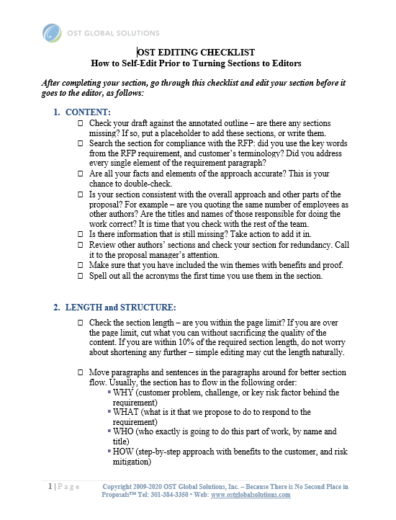
Editing Checklist
This checklist subdivides Stage 3 objectives into distinct tasks with their own goals
Content (compliance, accuracy, consistency, missing information, redundancy, win themes, and uncommon acronyms)
Length and Structure (proper paragraph order, flow, and paragraph and section length)
Sentences and Words (passive and active voice, word use, tone, style, and a variety of other issues)
Mechanics (spelling, typos, punctuation, capitalization, use of pronouns, subject-verb agreement, and verb tense throughout the document)

Slide 46
Please, Complete an Assignment for Module 14 Prior to Proceeding to the Next Module

Slide 47
Module 14 Exercise: Applying Checklist Parts 1 and 2 to Your Draft
Some parts of the checklist may warrant a quick glance to confirm everything is right, and others are there to remind you to perform a task
Tweak the content, length, and structure of your section
Apply parts 1 and 2 of the editing checklist to your section
Send your draft to service@ostglobalsolutions.com when done

Slide 48
Module 15 Proposal Readability

Slide 49
Simplify Your Writing
Simple
Complex
Simple
Stupid
Smart
Genius

Slide 50
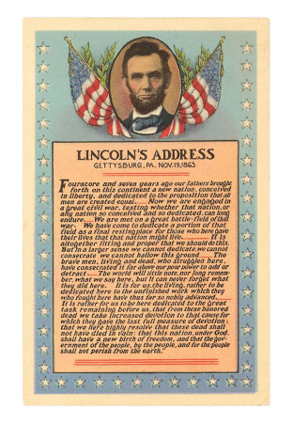
Readability
Remember: One of the most eloquent speeches ever written, the Gettysburg address, is at a 6th grade readability level
Proposal should be readable at:
9th–10th grade level for management
11th–12th grade level for technical
What this means is:
Average 4-5 sentences per paragraph
Average 20 words per sentence
Passive voice below 20%
Flesch Reading Ease score 40-50 or higher
Tools: Microsoft Word and Online Utility

Slide 51
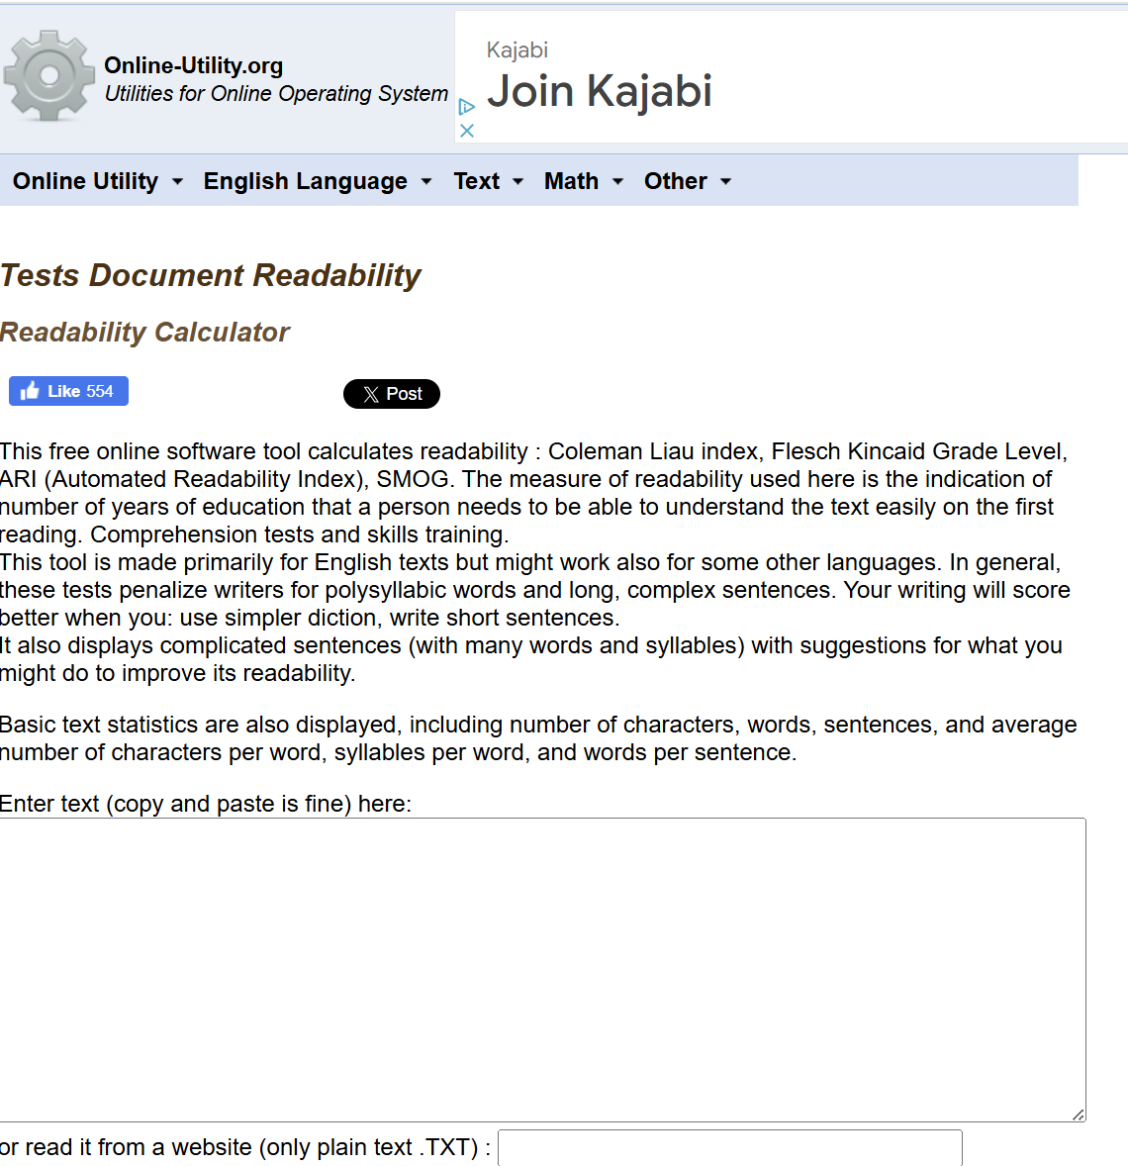
Use the Online Utility
http://www.online-utility.org/english/readability_test_and_improve.jsp
This readability calculator uses multiple algorythms for more accurate results

Slide 52
Eliminate Wordiness
With some training, it will be easy for you to spot wordy phrases; in the meantime, use AI to search for these elements and correct the sentences
All forms of “To Be”: It is, there are/is
It is necessary that we receive clearance in time -> We must receive clearance in time
There are two alternatives evaluated in the whitepaper -> The white paper evaluates two alternatives
-ION, -MENT, -IZE: Verbs disguised as nouns
We make the decision -> we decide
We recommend the advance development of the plan -> we recommend developing the plan in advance
We arrived at the conclusion -> we concluded
We came to an agreement -> we agreed

Slide 53
Make Your Writing Leaner (or Write Leaner)…
Some words may not matter as much, and others may be a bad habit you can shed like old clothes
Lists: methodology and approach can be just approach
Bloated, pompous words: herewith, therein, utilize
General verbs:
Offer
Provide
Deliver
Have
Give
Hold
Get
Make plus a noun to make it more specific
Two (2) examples
provided herein…
The team will hold meetings daily to provide integration support -> “The team will meet daily to support integration”
Avoid pompous pseudo-legalese

Slide 54
Other Enemies of Clear Writing
Wordy writing causes “ants on the page” syndrome – the evaluator can see the words but can’t focus enough to take in what they mean
That and which – drop them: a solution which is reliable -> a reliable solution
Sentence bloaters:
In order to or for the purpose of or as a means of -> to
In the near future -> soon
In the event that -> if
Stacks of nouns: our rapid design development methodology -> our methodology of rapid design development
Death by acronyms – spell them out an extra time if needed
Random bullets – keep them parallel: all verbs, nouns, gerunds; balance the bullet structure and content

Slide 55
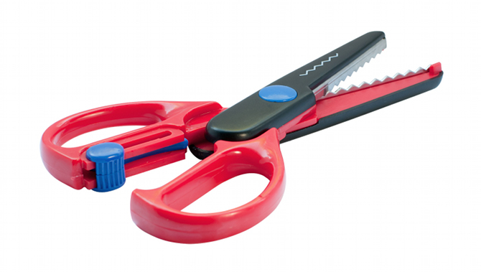
Shorten the Stacked Word Structures
A two-year period -> 2 years
Advance warning -> warning
Any and all -> any, all, or every
Capable of -> can, able to
Deteriorate in quality -> deteriorate
Close proximity -> proximity
End result -> result
Roughly estimated at -> estimated at
Exactly the same -> the same
Actual experience -> experience
Along the lines of -> similar to, like

Slide 56
Use Shorter Words
Longer words are OK once in a while, but used consistently, they make reading harder
Accomplish - > carry out, do
Accordingly -> so
Accurate, appropriate -> correct, right, exact, precise
Actual -> real
Approximately -> about, nearly, almost
Assist -> help
At the present time -> now
By means of -> by, with
Capability -> ability, can
Close proximity -> near
Component -> part
Comprise, constitute -> form, include, make up
Conclude -> close, stop, end, finish
Comply with -> follow
Consolidate -> combine, join, merge
Demonstrate -> prove, show
Determine -> decide
Discontinue -> stop
Disseminate -> send out, issue
Select -> choose, pick
Eliminate -> cut, drop, end, stop
Employ -> use
Encounter -> meet
Establish -> set up, prove, show
Evaluate, examine -> test, rate, check
Expertise -> ability, skill

Slide 57
Use Visual Thesaurus to Come Up with Shorter Words
VisualThesaurus.com

Slide 58
Eliminate Unnecessary Words
You are done with the sentence when there is absolutely nothing to cut out; please, pay attention to how AI writes as well.
Actually
Realistically speaking
Of course
Certainly
Quite
Rather
Definitely
Relatively
Respectively
Somewhat
Specific
A kind of

Slide 59
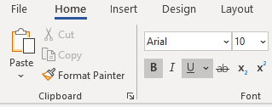
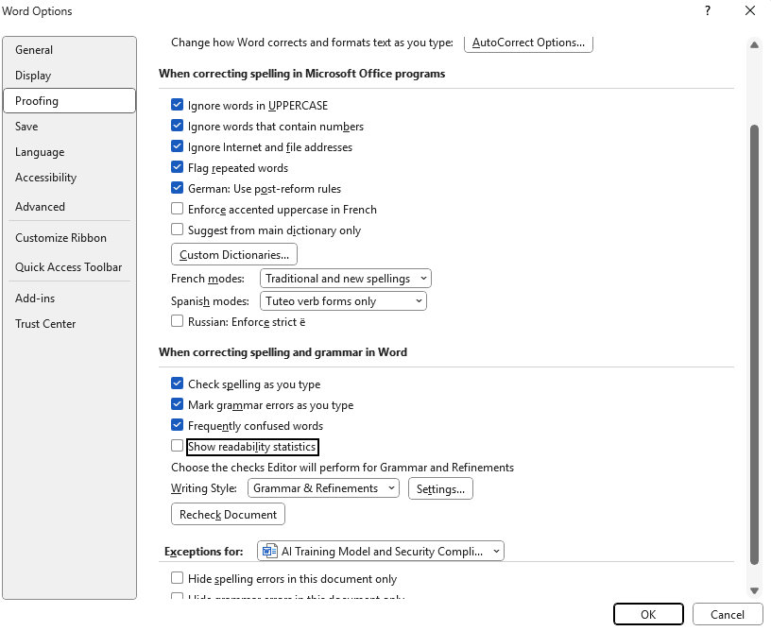
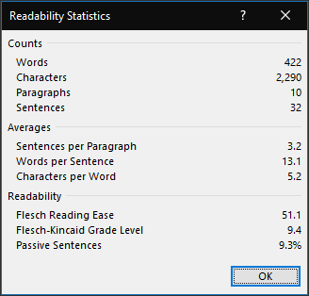
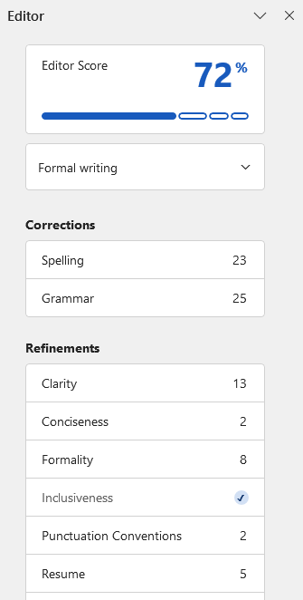
Configuring MS Word
Go to File, Options, Proofing
To turn on Editor: F7 or Review Tab, Editor

Slide 60
Please, Complete an Assignment for Module 15 Prior to Proceeding to the Next Module

Slide 61
Module 15 Exercise: Applying Checklist Parts 3 & 4 to Your Draft
This is the part where you can rely on tools to speed up your work and polish the section
Use parts 3 and 4 of your editing checklist
Configure MS Word or try using the Online Utility
Run readability statistics
Make fixes by identifying problem sentences and using the checklist and style guide
Do not forget to run the CTRL+F search
Rerun readability statistics and note any changes

Slide 62
Module 16 Editing Automation and the Big Picture

Slide 63
Other Recommended Tools for Editing Automation and Good Proposal Language
PerfectIt (performs consistency checks, creates acronym table)
WordRake (removes unnecessary words)
VisibleThread (shreds RFP to help check compliance; checks readability; helps identify unnecessary words)

Slide 64
How It All Maps to the Six-Phase Proposal Process
Predecessor: Capture Process
Addressing the psychology and beliefs about writing
Successor: Project Delivery Process that Includes Capture of Additional Scope and Projects
Read RFP
Prepare for Kick-Off
Conduct Kick-Off to Reach 9 Goals
Develop Work Packages
Prepare Draft 1
Conduct Pink Team
Prepare Draft 2
Prepare Draft n
Conduct Red Team
Prepare Final Draft
Read-Out-Loud
Print, Check, Deliver
Implement Post-Delivery Win Strategy
Update Lessons Learned
Annotated Outline
Assignments
Work Packages
Compliance Checklist
Style Guide
Background Materials
Briefing
Pink Team Recovery
Outline Frozen
Red Team Recovery
Decision to proceed
Award
Make Bid-No-Bid Decision
Brainstorm & Research
In-Process Review(s)
In-Process Review(s)
DTP, Edit
DTP, Edit
Conduct Gold Team
Collect Lessons Learned
Attend Debrief
Integration Phase
Planning Phase
Writing Phase
Polishing Phase
Production
Phase
Post-Proposal
Phase
Stage 1: Researching, Brainstorming, Planning
Stage 2: Writing
Stage 3: Rewriting, Revising, Editing, Polishing

Slide 65
Love the Proposal Writing and Get It to Love You Back
There are many great tools and techniques to help you write – don’t forget to use them
Yes – it is possible to enjoy proposal writing!
Hope that you take away many useful techniques from this class
Remember: most critical thinkers must overcome serious blocks to allow themselves write freely
No, you don’t have to have a special talent to be a great proposal writer
You CAN make your life easier by teaching your SMEs to:
Writer better and faster
Beat the writer’s block

Slide 66
Recap
?
Let’s go over today’s material
Can you list at least five attributes of a proposal that make it persuasive so that it sells?
What genres of stories can you incorporate in a proposal?
What are the steps for developing a metaphor?
Which parts of the editing checklist did you find most useful?
What are the readability metrics you should apply to the technical and management sections?
What is your biggest takeaway from the class?

Slide 67
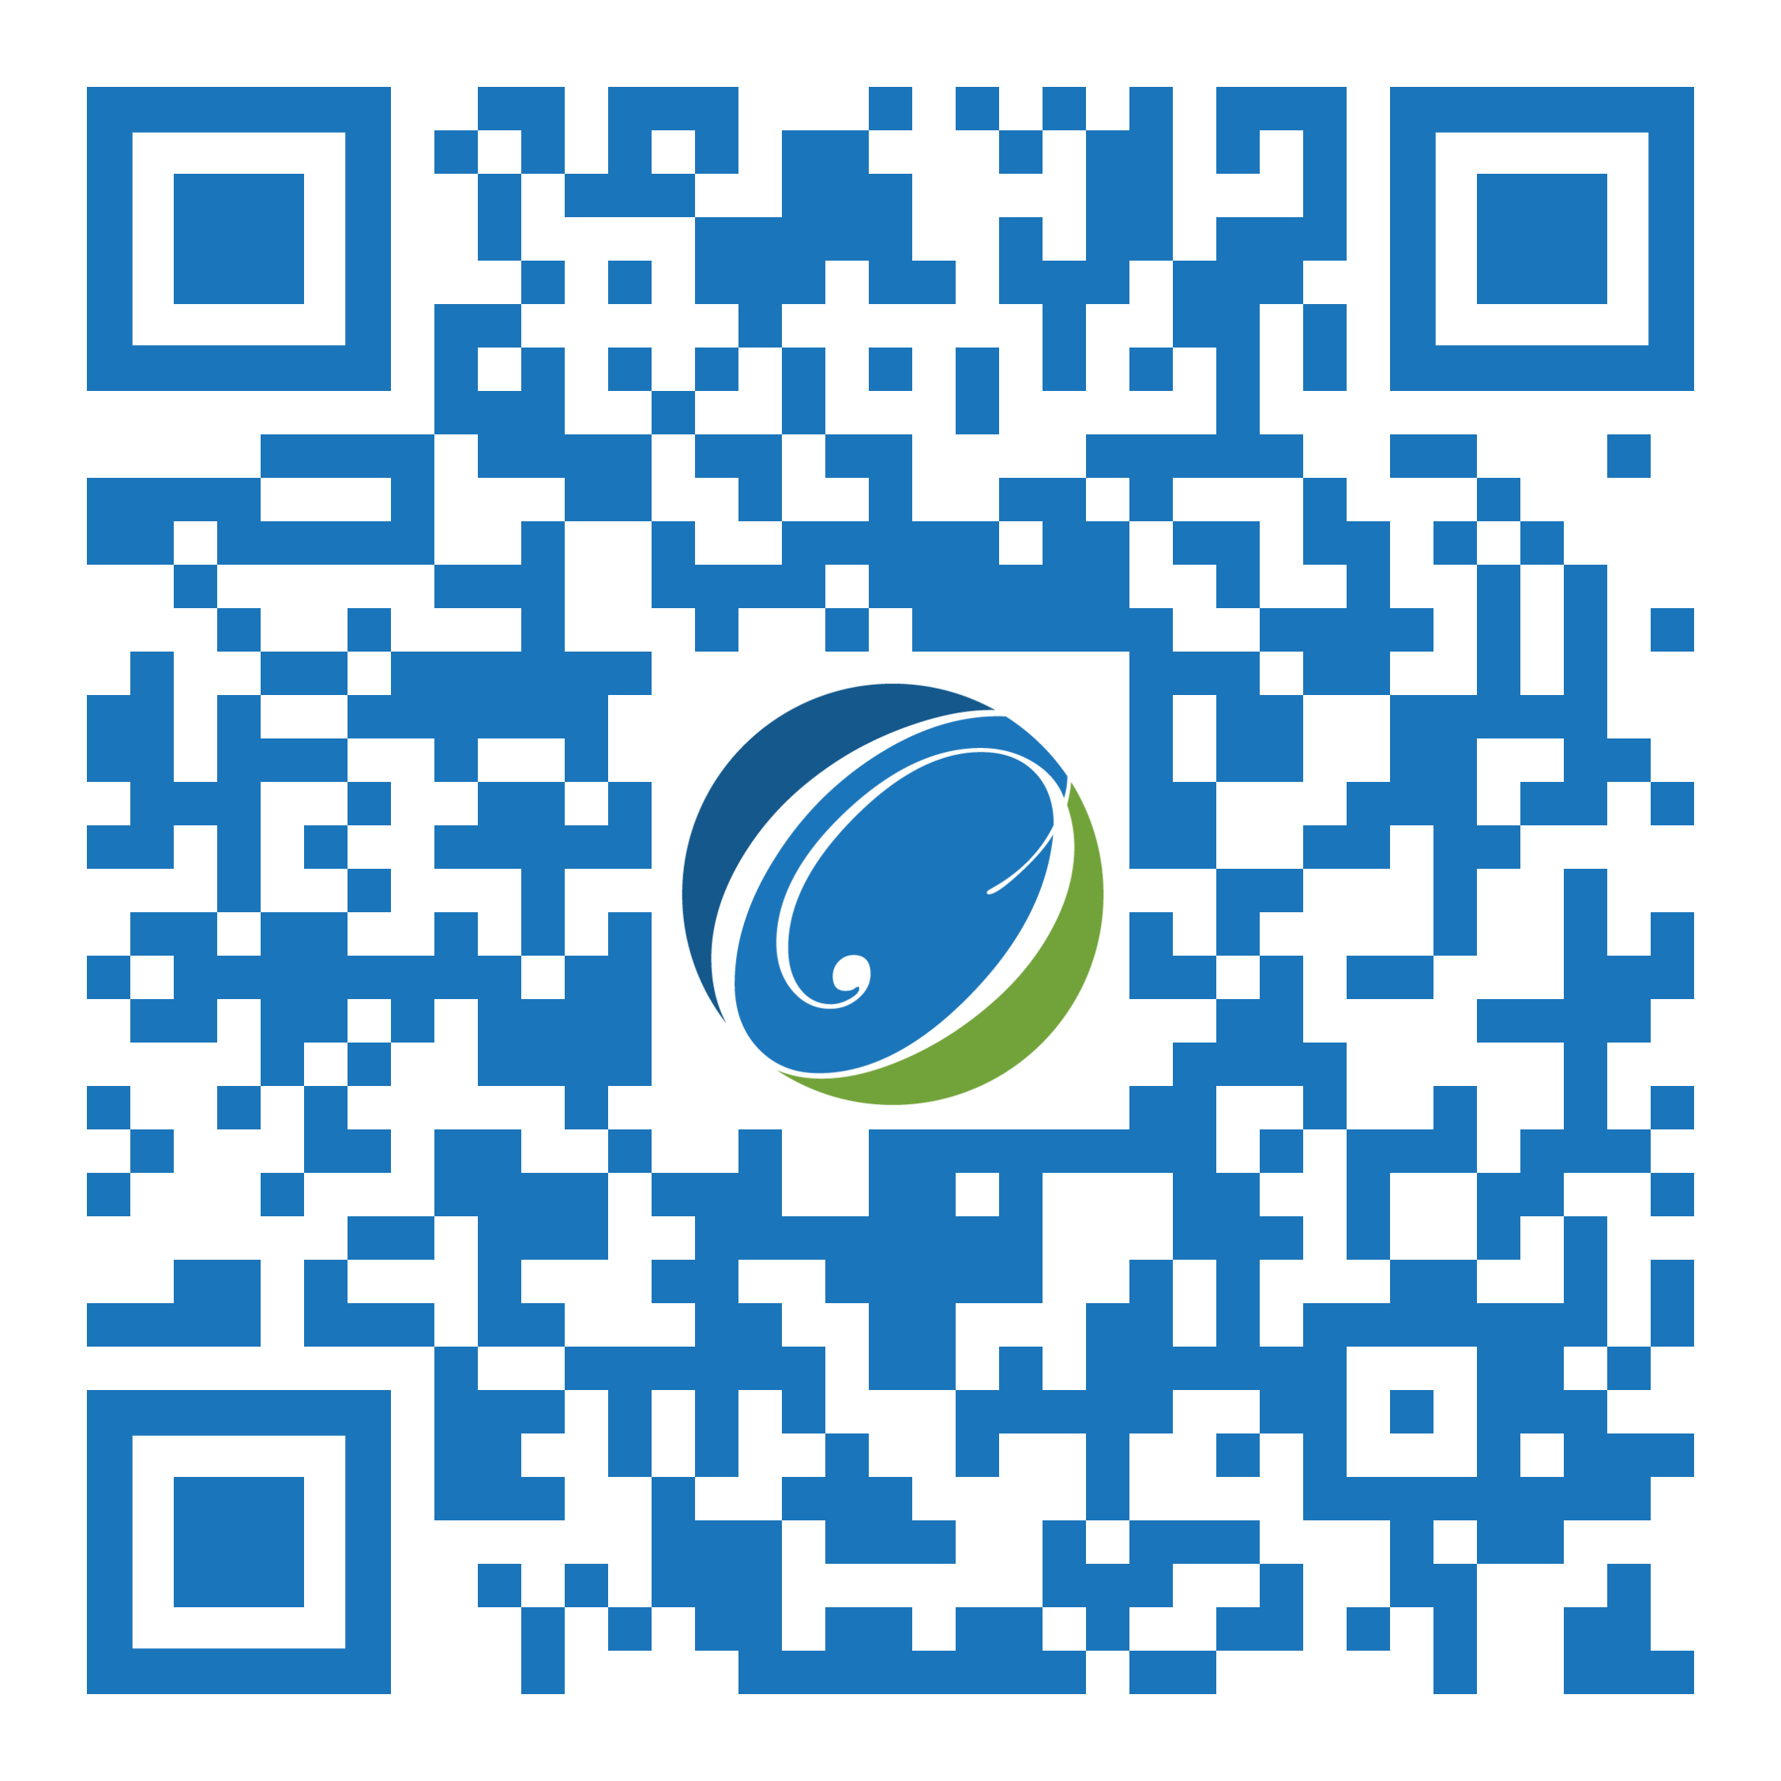
We’d Love It If You Left Us a Five-Star Review!
Did you find our training valuable and impactful?
You can leave a Google review HERE
and/or a Facebook review HERE
Notes:
Google: https://g.page/r/CeQcAmyWUhUZEAI/review
Facebook: https://www.facebook.com/OSTGlobalSolutions/reviews

Slide 68
Thank You! Continue Taking More Courses to Advance Your Knowledge!
7361 Calhoun Place, Suite 560
Rockville, MD 20855
Phone: 301-384-3350
service@ostglobalsolutions.com
www.ostglobalsolutions.com

